Slide 1

EMWAVE
FEM code to simulate EM wave propagation in magnetically confined plasma
PhD in Nuclear and Ionising Radiation Engineering
Hernán Domingo Ramos
Directors: Tutor:
Dani Gallart, Alejandro Soba Lluís Batet
27/10/2025
PhD Research Plan Defence

Slide 2


Outline
Motivation
State of the Art
Goals
Work plan
Work done so far
Journal and Conferences
References
Hernán Domingo | PhD Research Plan Defence

Slide 3
Motivation

Slide 4
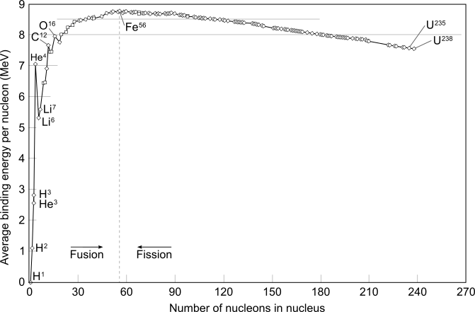
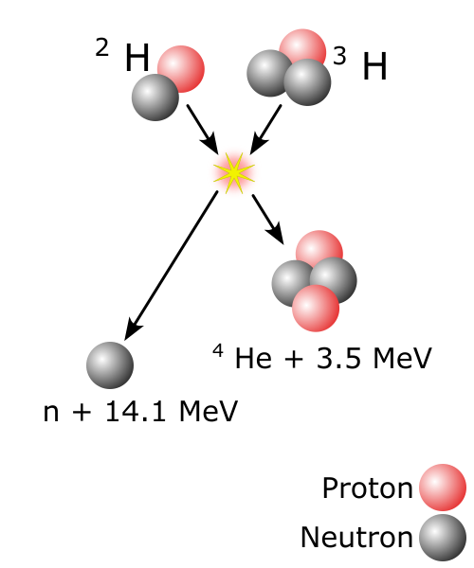
What is fusion?
Hernán Domingo | PhD Research Plan Defence
Notes:
Fusión nuclear: Método de obtención de energía. Fisión de uranio 235. Masa isótopos > masa producto. Comunidad de fusión objetivo D+T. ¿Por qué si hay más reacciones?

Slide 5
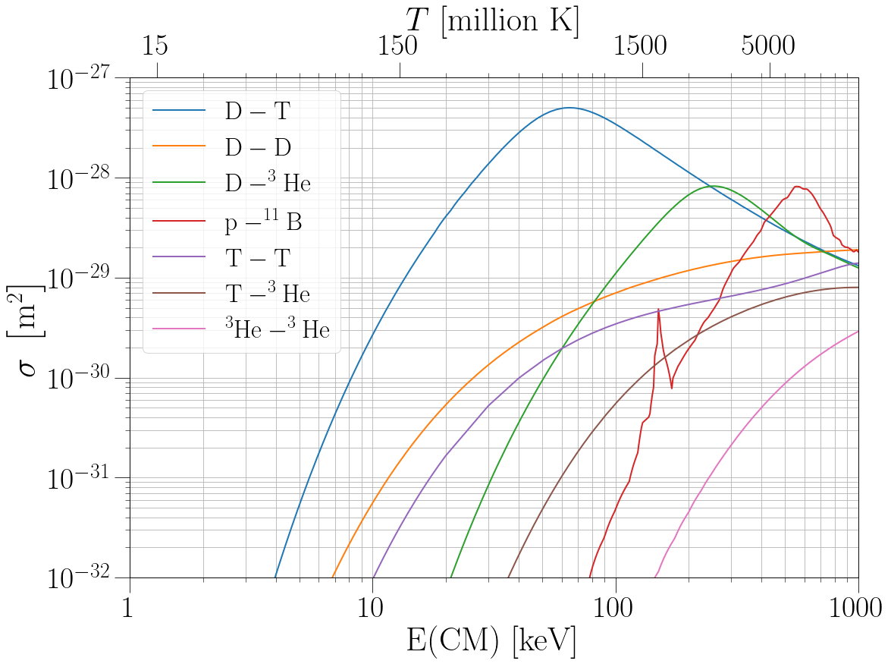
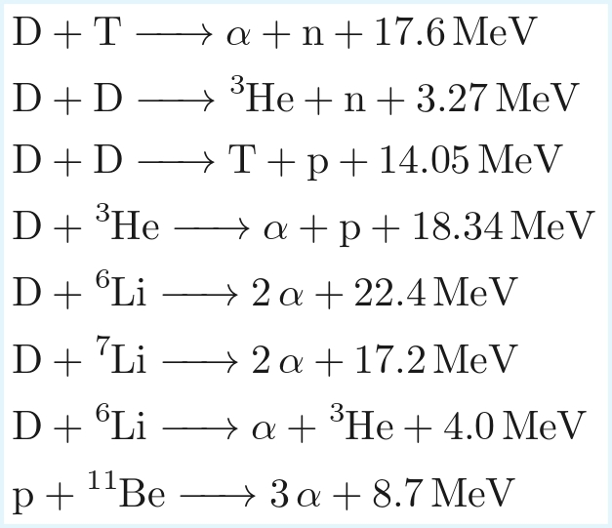
What is fusion?
Hernán Domingo | PhD Research Plan Defence
Notes:
Cada reaccion tiene ventajas e inconvenientes. Algunas son aneutrónicas (menor radioactividad y menor activación). Otras no requieren tritio, escaso.
El principal motivo es la tasa de reacción a temperaturas más bajas. Sin embargo, como llegamos a millones de Kelvin?

Slide 6
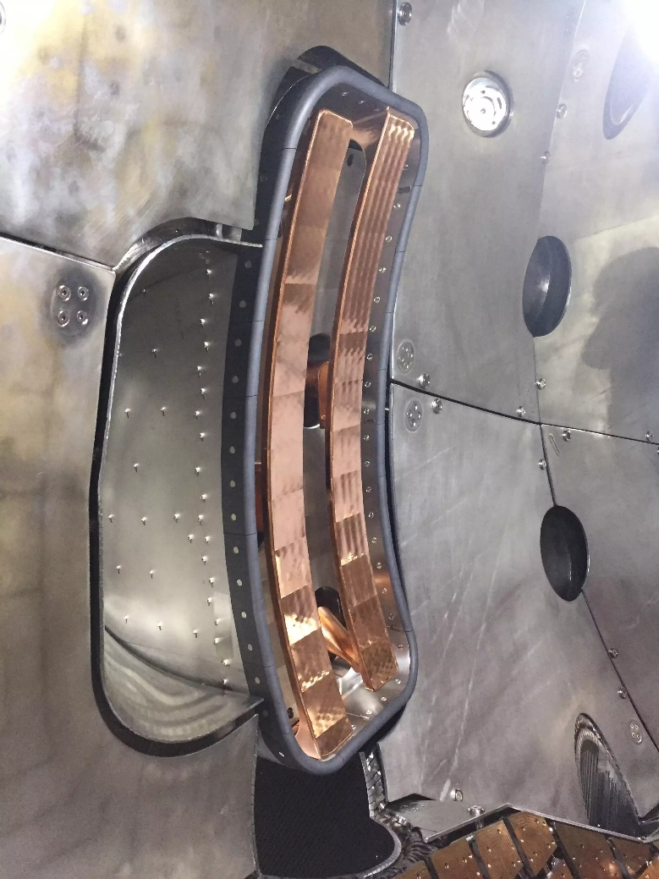
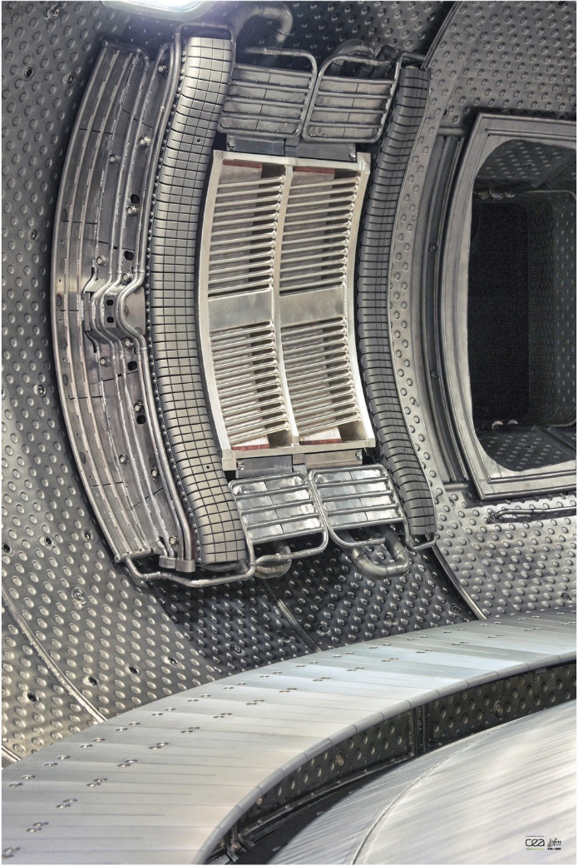
How do we heat the plasma?
Joule effect: Charges move due to induced current. Elastic (Coulomb) and stochastic collisions raise the temperature. Resistivity decreases, reducing the heating effect.
NBI: Neutral particle beam gets ionised and deposits energy and momentum at a desired location. It can be used to drive current.
ICRH and ECRH: Cyclotron resonance heating. Ions resonate in the range of MHz, while electrons resonate in the range of GHz.
ICRH antenna for Wendelstein 7-X
ICRH antenna for WEST
Hernán Domingo | PhD Research Plan Defence
Notes:
Hay tres métodos principales. Efecto Joule. La corriente transfiere la energía eléctrica a las partículas mediante colisiones elásticas. La resistividad decae y se llega a un umbral.
Haz de partículas neutras que transfieren momento y energía.
Cyclotron resonance heating. Inyección de Ondas EM mediante antenas. La frecuencia de la ona está en resonancia con el movimiento de ciclotrón, transfiriéndole energía.

Slide 7
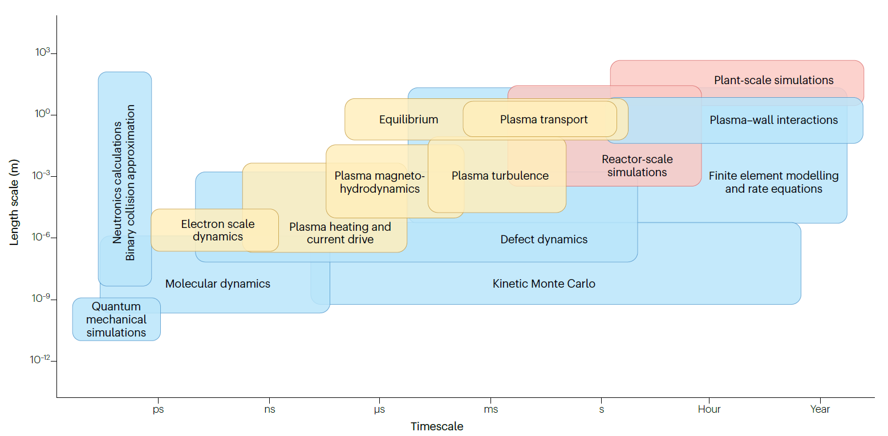
Fusion simulations
Nuclear Fusion Reactors are complex devices and present multi-physics coupled problems [1]:
Garcia-Gasulla, M., Mantsinen, M.J. Challenges and opportunities in exascale fusion simulations. Nat Rev Phys 7, 355–364 (2025).
Hernán Domingo | PhD Research Plan Defence
Notes:
Los reactores son dispositivos complejos. Con muchos subsistemas. Para simular un reactor necesitas tener en cuenta muchos eventos multifísicos. Ejemplos.
Esquema de escalas temporales. Bastante variabilidad. Si el objetivo es simular un reactor en su totalidad (rojo), hace falta un software capaz de ser ejecutado en HPC.

Slide 8
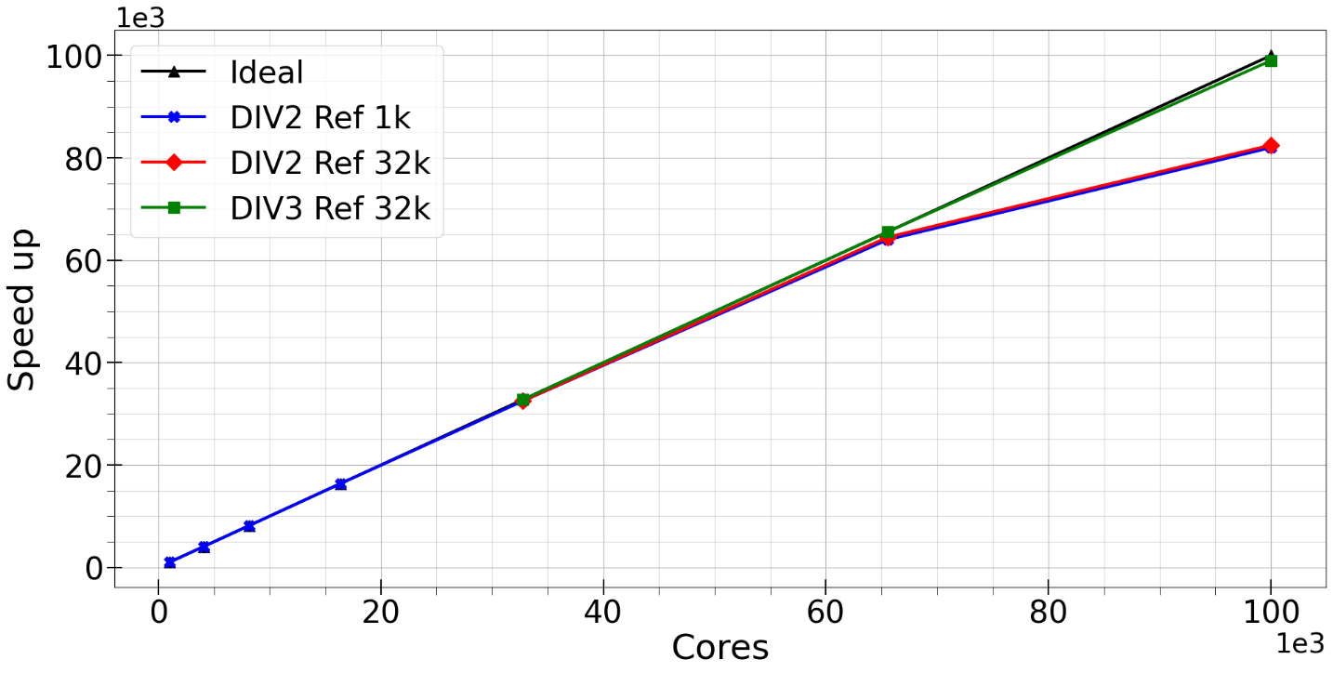
What is Alya?
Alya [2] is a high-performance computational multi-physics code to solve engineering-coupled problems.
Written in Fortran and uses the Finite Element Method
Parallelised code with excellent scalability
Early implementation on GPU multicore nodes
Vázquez, M. et al. Alya: Multiphysics engineering simulation toward exascale. Jour Comput Sci 14, 15-27 (2016).
Hernán Domingo | PhD Research Plan Defence
Notes:
Alya entra en juego. Código multi-física con módulos acoplados. Código altamente paralelizado. Usa Fortran y FEM. Intentos de ejecutarlo en GPU. EL grupo ha contribuido desarrollando módulos.

Slide 9
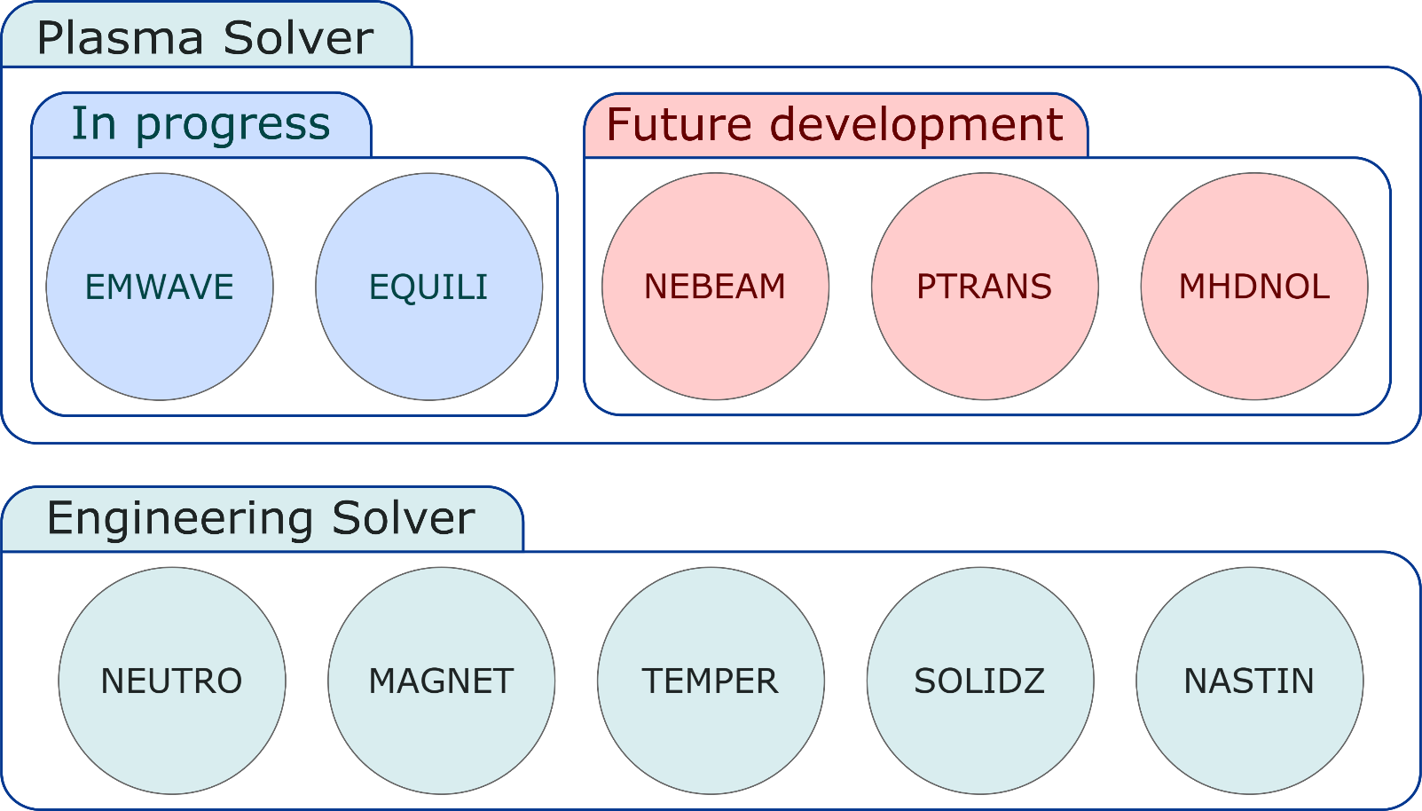
What is Alya4fusion?
Alya4fusion aims to use some of the physics modules developed in Alya to simulate relevant processes in nuclear fusion reactors.
Hernán Domingo | PhD Research Plan Defence
Notes:
Alya4fusion es el conjunto de módulos que se usarían para simular un reactor de fusión. Hay dos solvers, el de ingeniería y el de plasma. Describir módulos.

Slide 10
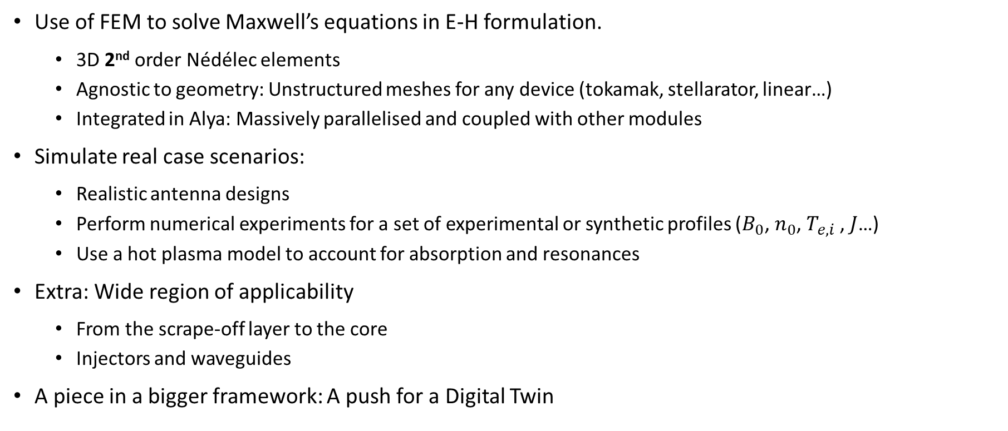
Goals
Use of FEM to solve Maxwell’s equations in E-H formulation.
3D 2nd order Nédélec elements
Agnostic to geometry: Unstructured meshes for any device (tokamak, stellarator, linear…)
Integrated in Alya: Massively parallelised and coupled with other modules
Simulate real case scenarios:
Realistic antenna designs
Perform numerical experiments for a set of experimental or synthetic profiles ($B_{0}$, $n_{0}$, $T_{e,i}$ , $J$…)
Use a hot plasma model to account for absorption and resonances
Extra: Wide region of applicability
From the scrape-off layer to the core
Injectors and waveguides
A piece in a bigger framework: A push for a Digital Twin
Hernán Domingo | PhD Research Plan Defence
Notes:
FEM con Nédélec 2º orden en 3D. Inherente al dispositivo y su geometría. Integrado en Alya y paralelizado.
Simulación de casos reales con diseños de antenas realistas, modelo de plasma caliente de alta fidelidad y análisis de variables físicas.
Aplicar el código en otros usos como inyectores y guías de onda, a la vez que comprobar el rango de funcionamiento, de la SOL al core.
Una pieza más en el digital twin.

Slide 11
State of the Art

Slide 12
State of the Art
Notable Codes
TORIC [3], TOPICA [4], SCENIC [6], PION [7], AORSA [8], ERMES [9], EVE [10], FEMIC [11] and FERMI [12]
Existing Modelling Approaches
Plasma-focused codes → detailed plasma, simplified SOL/antennas [3,6,7,8,10,11]
Antenna-focused codes → detailed antennas, simplified plasma core [4,9]
Hybrid/mode-matching approaches (e.g., FEM + TORIC) [5]
Current Limitations of Codes
Restricted to certain plasma regions
Simplified antenna or plasma models
Require coupling between multiple codes
Limited HPC integration
EMWAVE Contribution
First HPC-embedded FEM code for a full reactor-shaped domain
From SOL/antenna to plasma core
Modular design → integration with other physics modules in Alya
Toward a digital twin of fusion reactors
Strategic tool for design & optimisation of current/future devices
Similar initiative at Oak Ridge National Laboratory (USA) [12]
Hernán Domingo | PhD Research Plan Defence
Notes:
Hay varios códigos para ICRH que hacen cosas similares a EMWAVE.
Algunos están más focalizados en el core del plasma y la física que hay detrás. Otros están más focalizados en el SOL y la configuración de las antenas.
Tienen algunas limitaciones: región del plasma. Simplificaciones. Acoplamiento. Paralelización no optimizada.
Emwave está creado dentro de un entorno HPC, acoplamiento natural. From SOL to core: No toda la potencia de la antena va a estar directamente inyectada al plasma core. Funcionará como digital twin, lo que ayudará a optimizar el diseño de dispositivos.

Slide 13
Work Plan

Slide 14
Tasks
Implement a high-fidelity scheme to solve non-transient wave equations
Implement a high-order Nédélec FEM in 3D in Alya
Introduce a hot plasma model to account for resonances and wave absorption
Maxwell-Boltzmann
Fokker-Plank solver
Numerical experiments to analyse absorption and heating
Validate results with well-known codes
Write thesis and publish results
Hernán Domingo | PhD Research Plan Defence
Notes:
Algunas de las tareas es acabar el Nédélec en 3D.
Introducir un modelo hot plasma, ya sea Maxwell distribution o Fokker-Plank solver.
Analizar resultados.
Validar código.

Slide 15
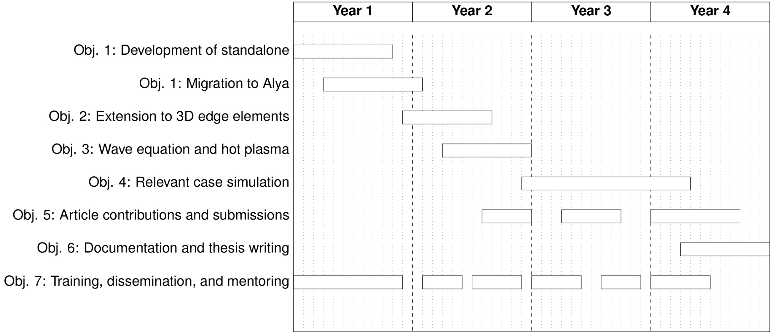
Gantt Chart
Aug 2024
We are here
Aug 2028
Hernán Domingo | PhD Research Plan Defence
Notes:
Estamos un poco avanzados en el calendario, pero estamos on track.
1- El desarrollo del código standalone lo he dejado atrás. En principio no habrá más mejoras.
2- El código ya se encuentra en alya, la versión 2D y una primera versión 3D. Faltaría incluir algunos detalles y 2º orden.
3- Estoy a las puertas de empezar pruebas con hot plasma. De momento será simplemente un tensor constante y totalmente poblado.
4- Espero que, a finales de este año, principios del tercero empiece a testear casos relevantes
5- A la vez que publicar un paper con la versión inicial de EMWAVE.

Slide 16
Work done so far

Slide 17
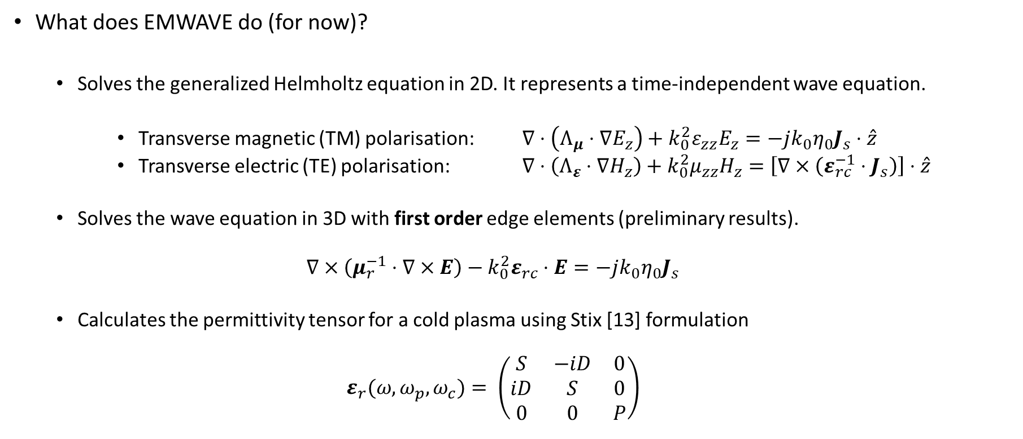
Work done so far: EMWAVE
What does EMWAVE do (for now)?
Solves the generalized Helmholtz equation in 2D. It represents a time-independent wave equation.
Transverse magnetic (TM) polarisation: $∇⋅\left(Λ_{μ}⋅∇E_{z}\right)+k_{0}^{2}ε_{zz}E_{z}=−jk_{0}η_{0}J_{s}⋅\hat{z}$
Transverse electric (TE) polarisation: $∇⋅\left(Λ_{ε}⋅∇H_{z}\right)+k_{0}^{2}μ_{zz}H_{z}=\left[∇×\left(ε_{rc}^{−1}⋅J_{s}\right)\right]⋅\hat{z}$
Solves the wave equation in 3D with first order edge elements (preliminary results).
$$∇×\left(μ_{r}^{−1}⋅∇×E\right)−k_{0}^{2}ε_{rc}⋅E=−jk_{0}η_{0}J_{s}$$
Calculates the permittivity tensor for a cold plasma using Stix [13] formulation
$$ε_{r}(ω,ω_{p},ω_{c})= \left(\begin{matrix}S & −iD & 0 \\ iD & S & 0 \\ 0 & 0 & P\end{matrix}\right)$$
Hernán Domingo | PhD Research Plan Defence
Notes:
Elementos nodales en 2D. Ecuación generalizada con fuentes finitas.
Elementos edge primer orden 3D. Primeros resultados.
Usamos un modelo de plasma frío.

Slide 18
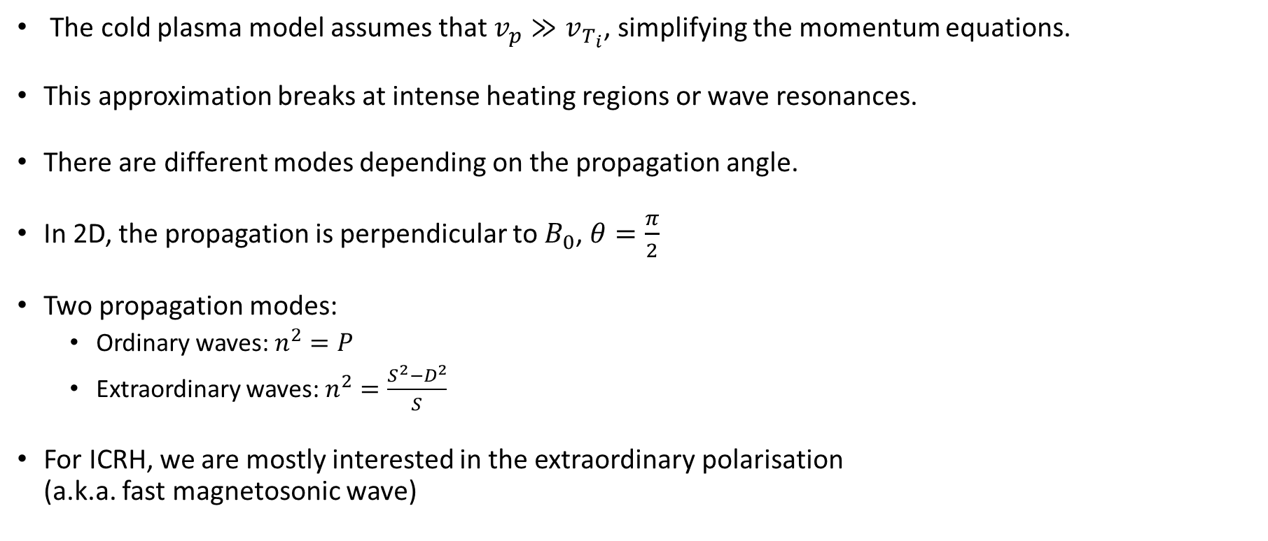
Cold Plasma
The cold plasma model assumes that $v_{p}≫v_{T_{i}}$, simplifying the momentum equations.
This approximation breaks at intense heating regions or wave resonances.
There are different modes depending on the propagation angle.
In 2D, the propagation is perpendicular to $B_{0}$, $θ=\frac{π}{2}$
Two propagation modes:
Ordinary waves: $n^{2}=P$
Extraordinary waves: $n^{2}=\frac{S^{2}−D^{2}}{S}$
For ICRH, we are mostly interested in the extraordinary polarisation (a.k.a. fast magnetosonic wave)
Hernán Domingo | PhD Research Plan Defence

Slide 19
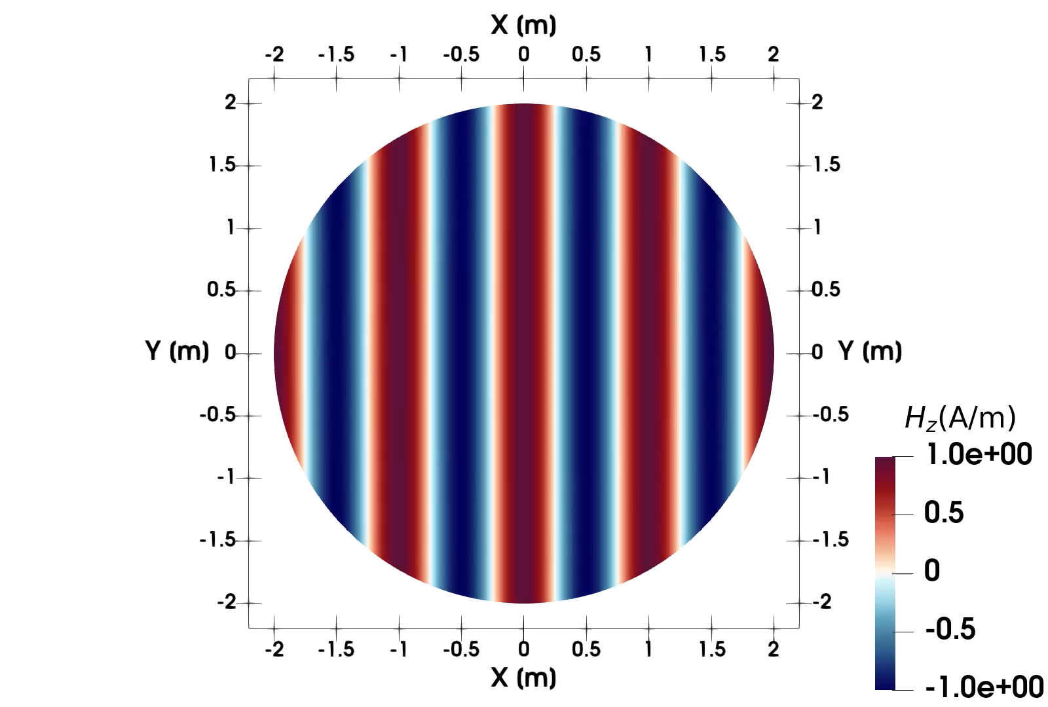
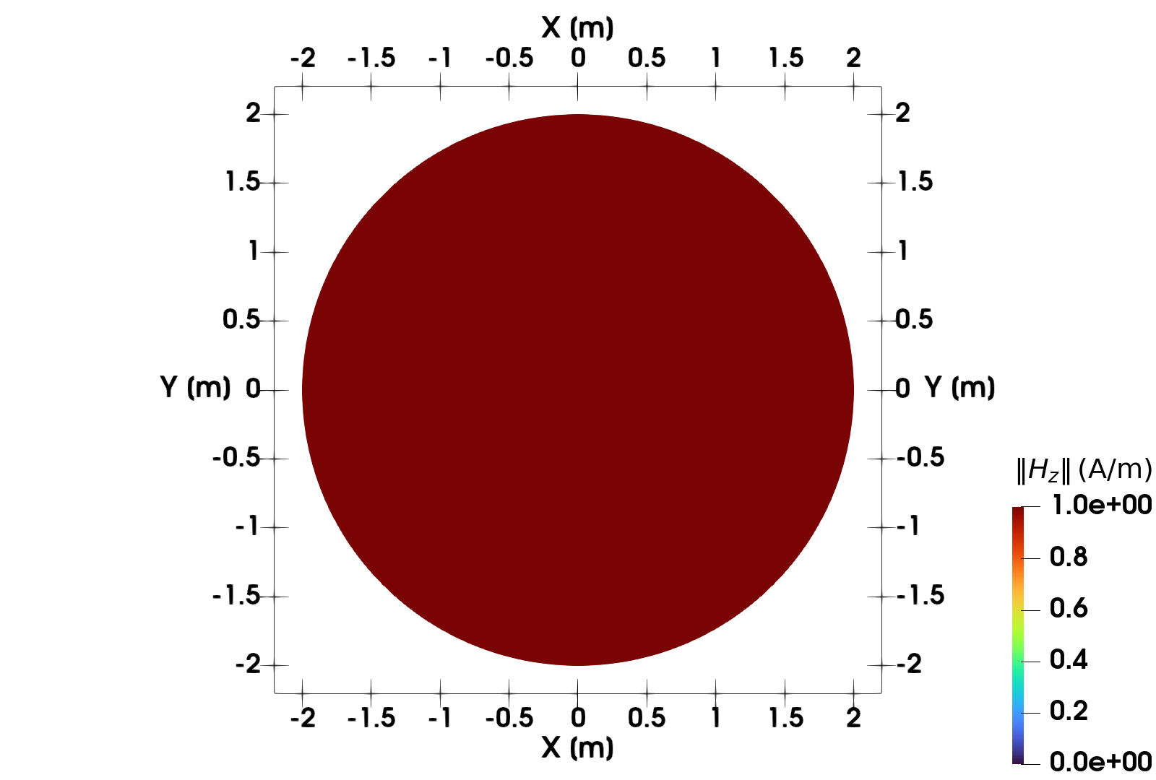
What do we plot?
Real Part
Magnitude
Hernán Domingo | PhD Research Plan Defence

Slide 20
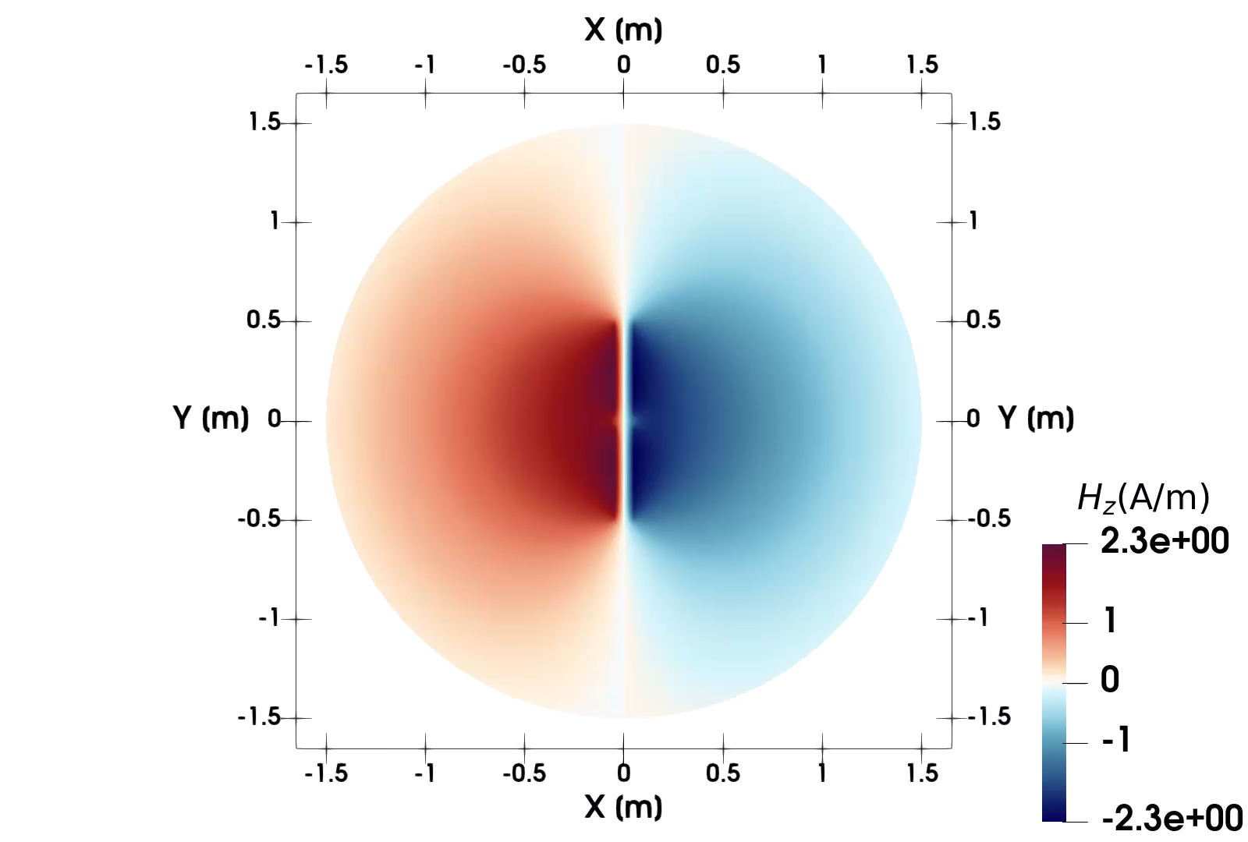
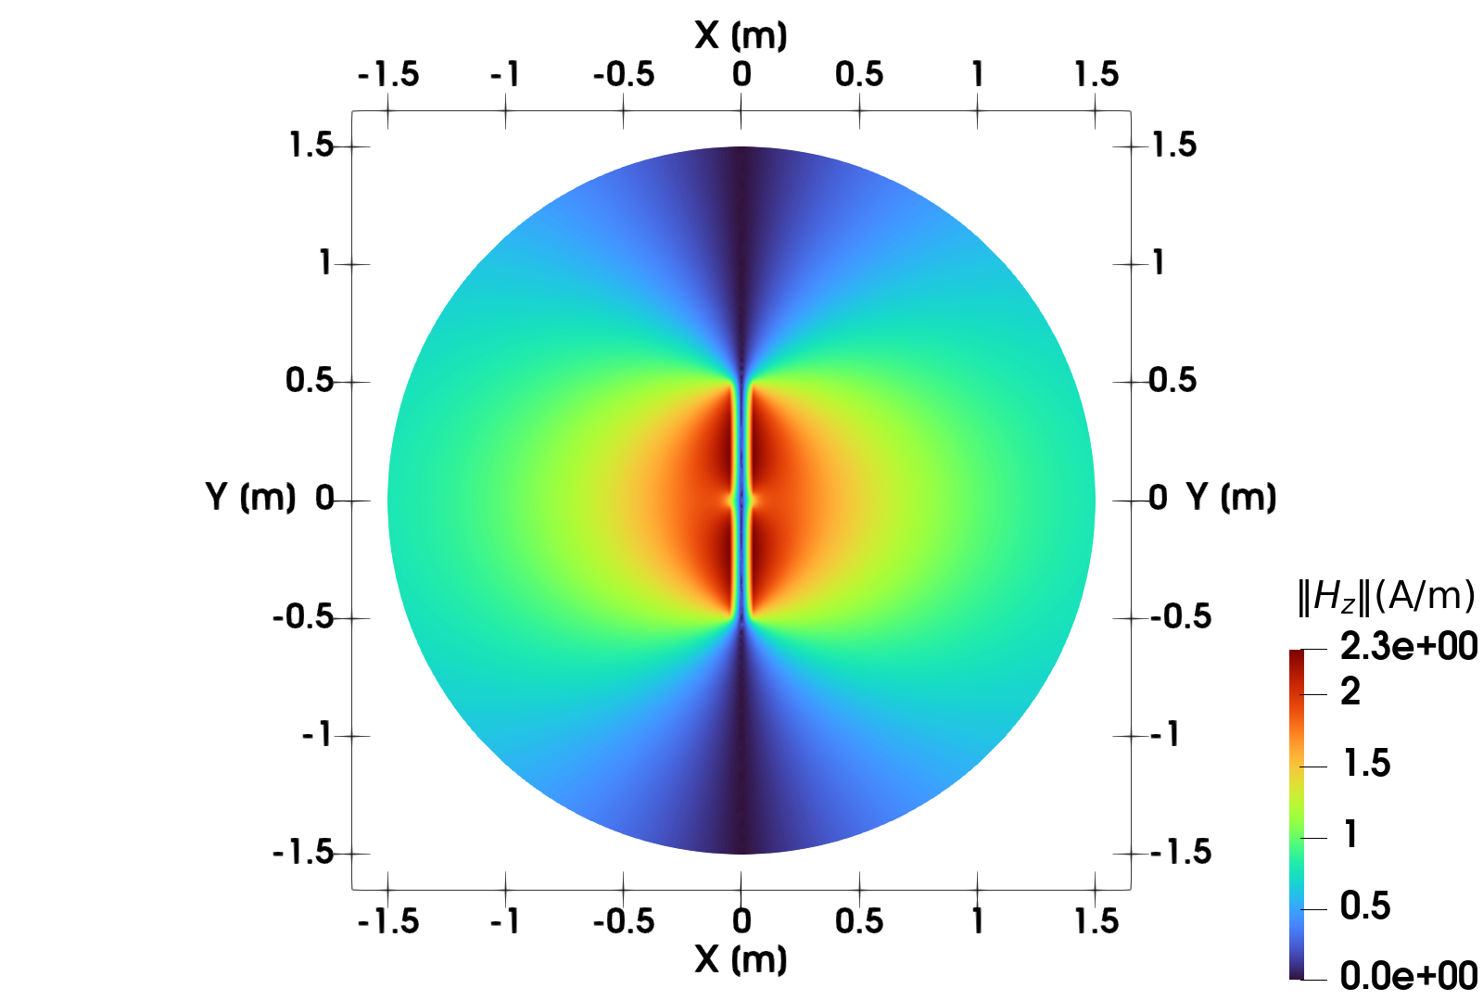
What do we plot?
Real Part
Magnitude
Hernán Domingo | PhD Research Plan Defence

Slide 21
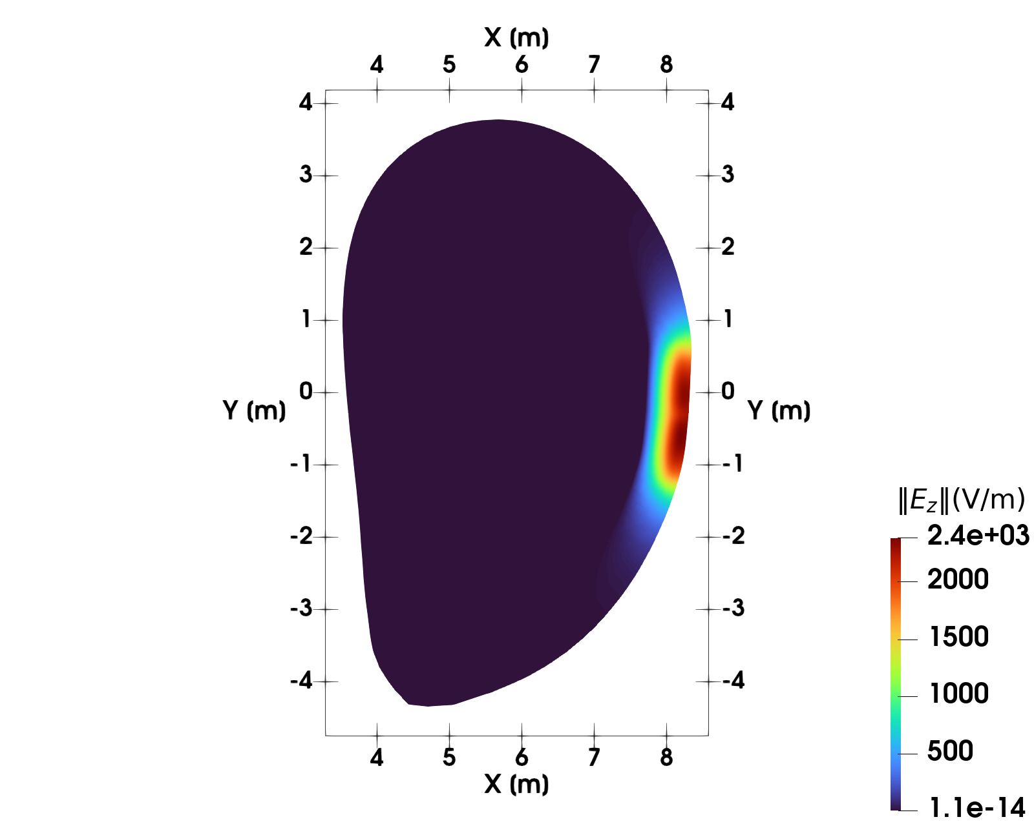
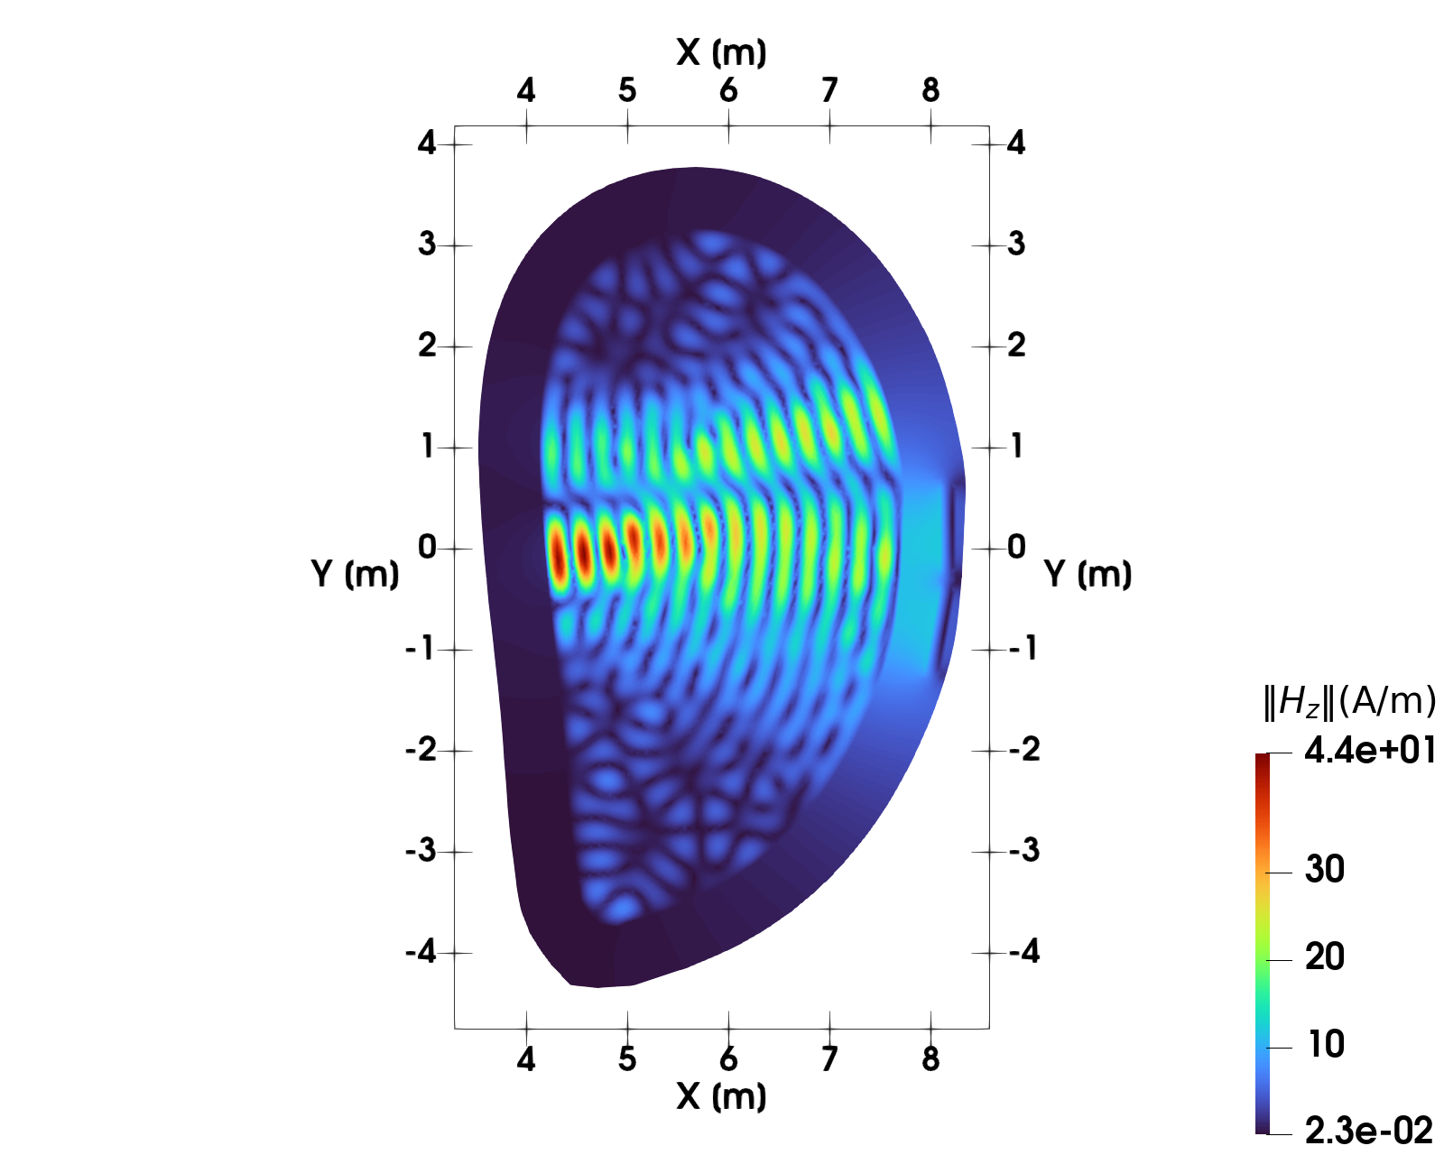


Propagation of O-Waves and X-Waves
For most of the cases:
O-Wave
X-Wave
$$n_{⊥}^{2}=\frac{RL}{S}$$
$$n_{⊥}^{2}=P$$
Hernán Domingo | PhD Research Plan Defence
Notes:
Con el modelo de plasma frío somos capaces de predecir la accesibilidad de la onda. Si se propaga o no.

Slide 22
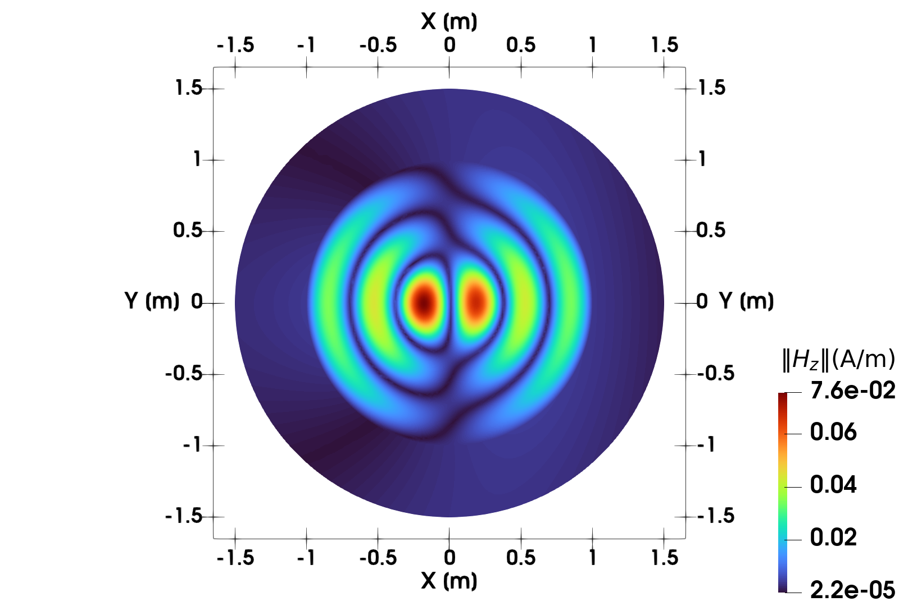
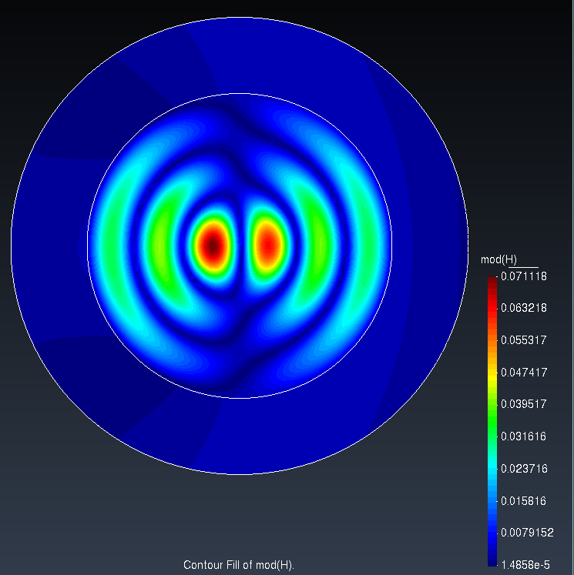
Cold Plasma: Benchmark
ERMES [9] is a code established within the community.
Among its various capabilities, it is used to evaluate wave propagation in regions close to the antenna.
The results are perfectly consistent with the cold plasma model.
Hernán Domingo | PhD Research Plan Defence

Slide 23
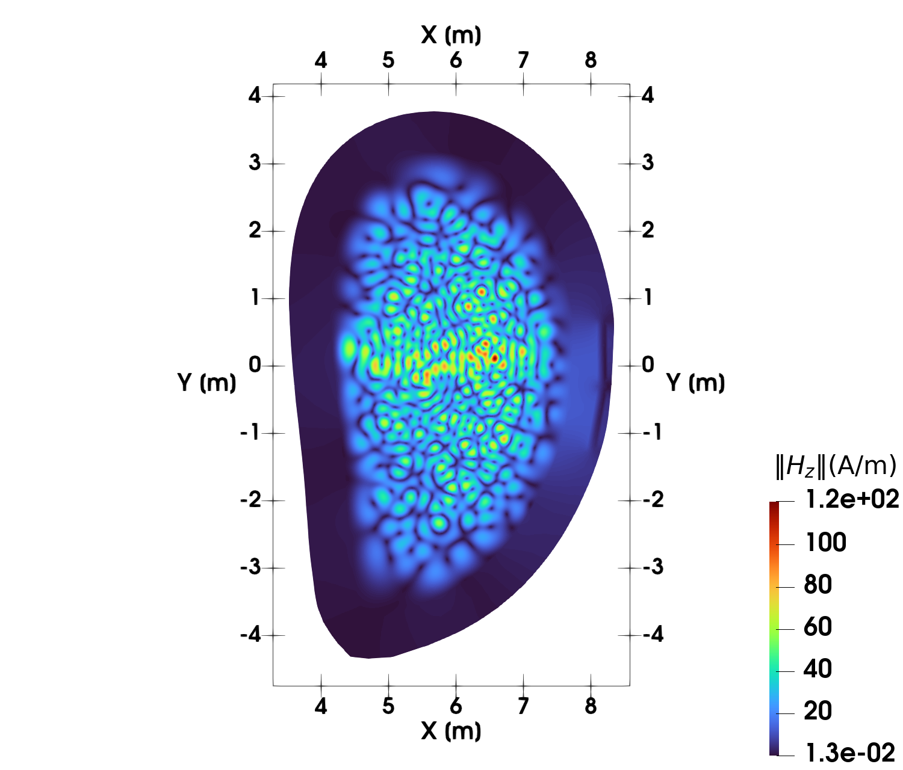
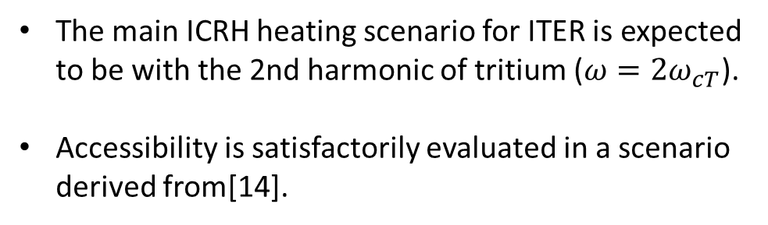
Cold Plasma: ITER Scenario
Parameter | Value
Plasma composition | 50:50 D-T
Wave frequency | 53 MHz
Toroidal magnetic field | 5.3 T
Central density | 3.5 x 10¹⁹ m⁻³
The main ICRH heating scenario for ITER is expected to be with the 2nd harmonic of tritium ($ω=2ω_{cT}$).
Accessibility is satisfactorily evaluated in a scenario derived from[14].
Hernán Domingo | PhD Research Plan Defence

Slide 24
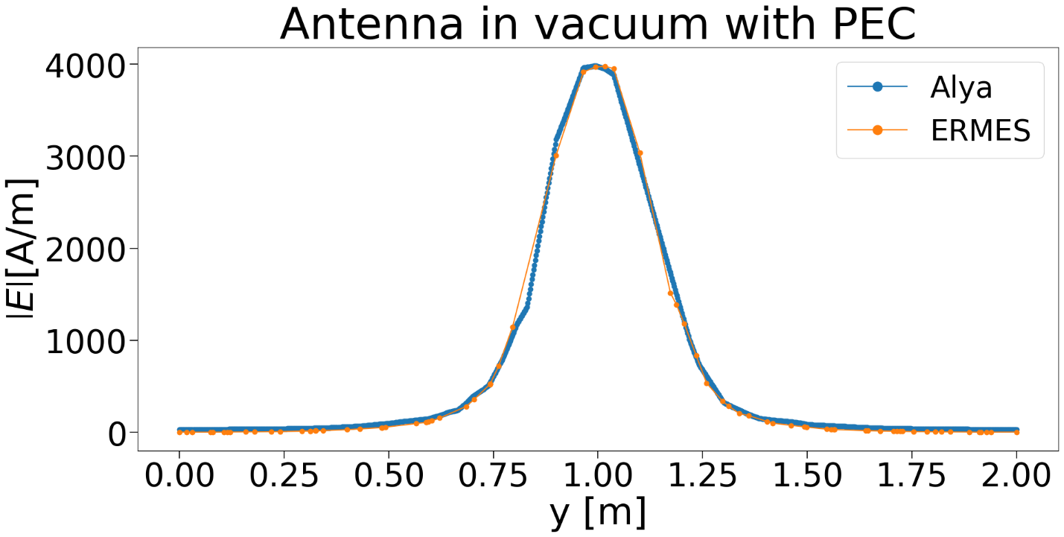

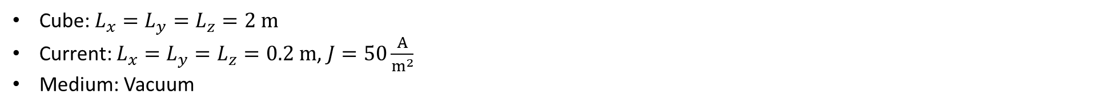
1st Order Edge Elements Results
Cube: $L_{x}=L_{y}=L_{z}=2 m$
Current: $L_{x}=L_{y}=L_{z}=0.2 m$, $J=50\frac{A}{m^{2}}$
Medium: Vacuum
Hernán Domingo | PhD Research Plan Defence
Notes:
Cubo de 2 m. “Antena” cúbica de 20 cm. Corriente de 50 A/m^2. En vacío.
Un gráfico para x=z=0 y el otro para y=z=0.

Slide 25
Potential journals and conferences
Already attended:
51st IOP Annual Plasma Physics Conference — Oral presentation
14th ITER International School — Poster presentation
XL Simposio Nacional de la Unión Científica Internacional de Radio (URSI) — Oral presentation and candidate to INDRA’s youth research prize
11th and 12th International BSC Severo Ochoa Doctoral Symposium — Poster presentation
5th HPC Fusion Workshop — Oral presentation
51st EPS Conference on Plasma Physics — Poster coauthor
Yet to be attended:
EPS Conference on Plasma Physics — Presenter
Topical Conference on Radio-Frequency Power in Plasmas
International Conference on Plasma Physics (ICPP)
Iberian Meeting on Computational Electromagnetics
Journals:
Plasma Physics and Controlled Fusion (PPCF)
Nuclear Fusion
Fusion Engineering and Design
IEEE Antennas & Propagation
IEEE Transactions on Plasma Science
Computer Physics Communications
Hernán Domingo | PhD Research Plan Defence
Notes:
Candidatos a revistas y conferencias.

Slide 26

These slides and their references can be found in the following repository:
Thank you!
27/10/2025
hernan.domingo@bsc.es

Slide 27
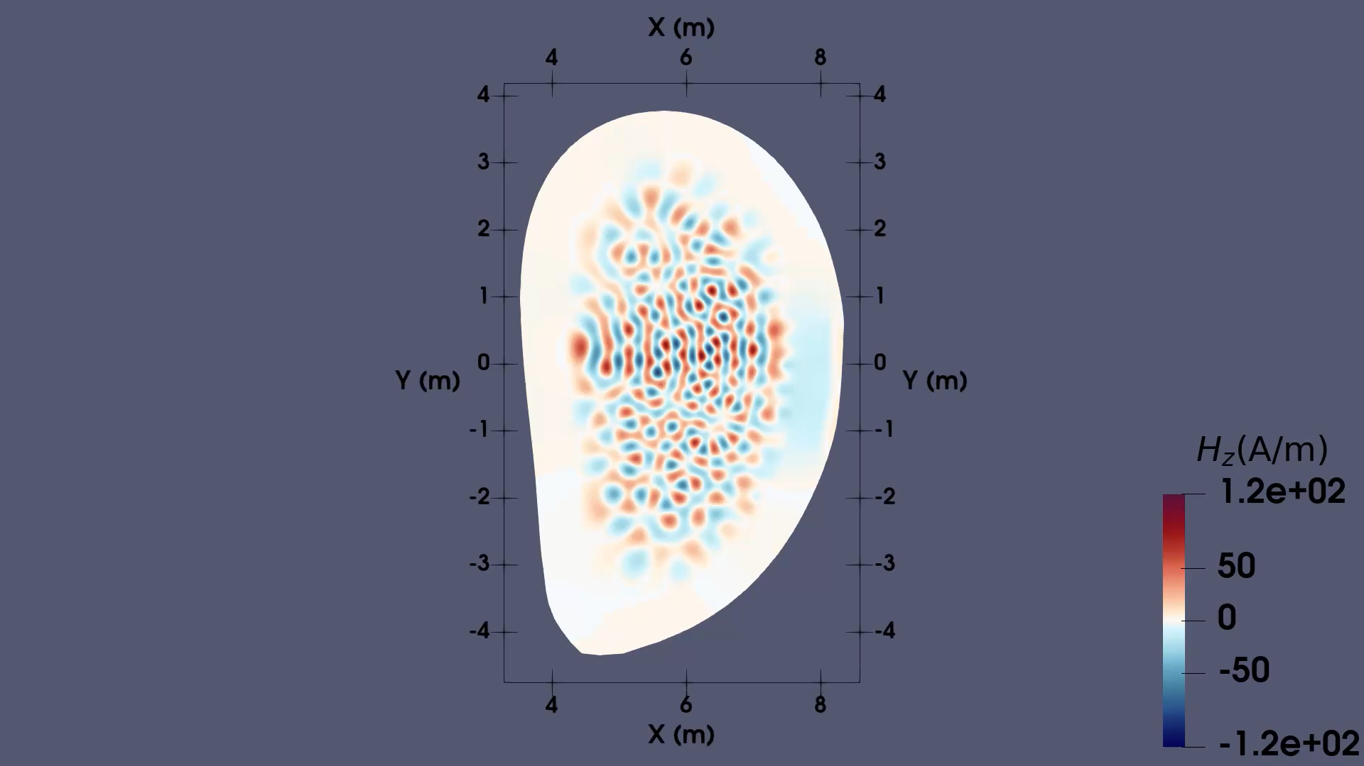
Hernán Domingo | PhD Research Plan Defence

Slide 28
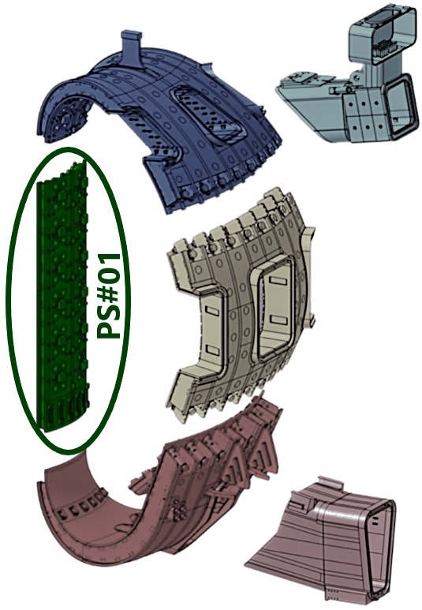
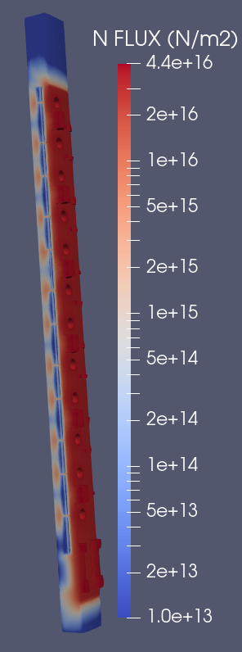
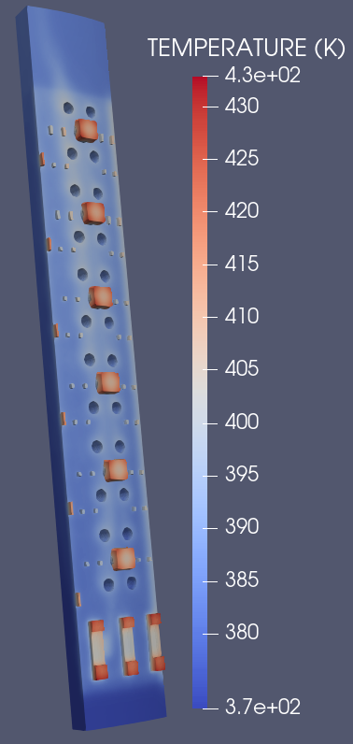
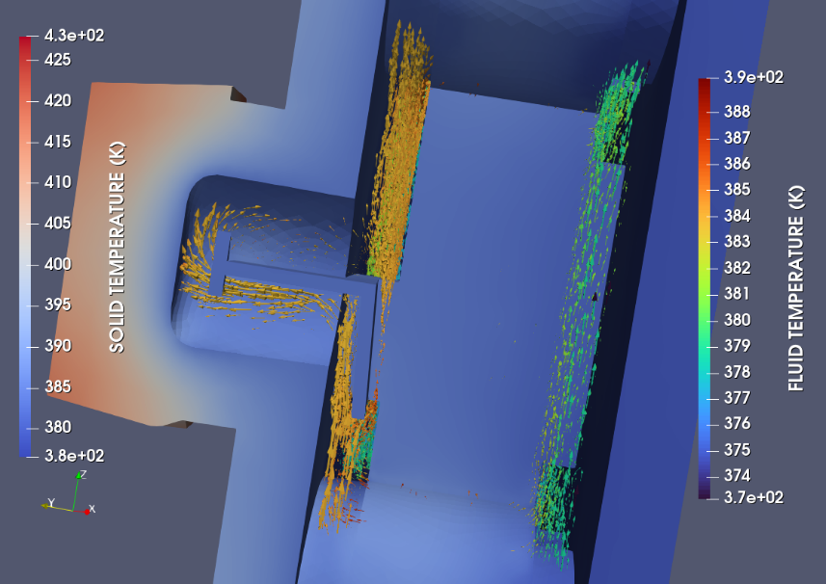
Coupling between modules
NEUTRO + TEMPER + NASTIN
Goldberg, E. et al. (2025), Fusion Science and Technology, pp. 1–15.
Hernán Domingo | PhD Research Plan Defence

Slide 29
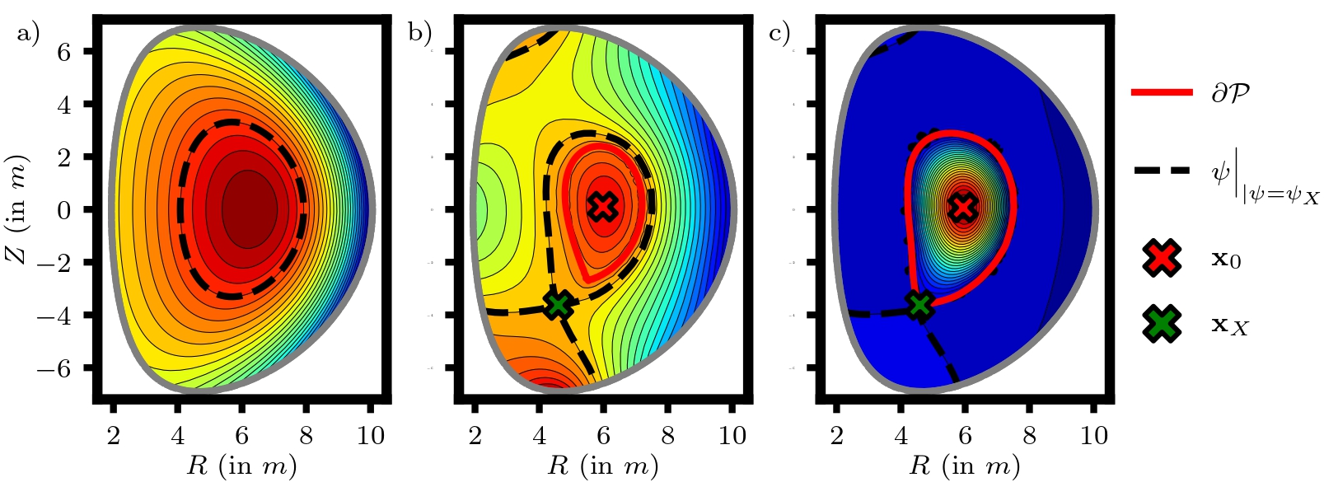
EQUILI
Solves the Grad-Shafranov equation
Uses embedded geometry discretization (CutFEM)
Manyer Fuertes, Pau. Universitat Politècnica de Catalunya, Oct. 2024
Hernán Domingo | PhD Research Plan Defence

Slide 30
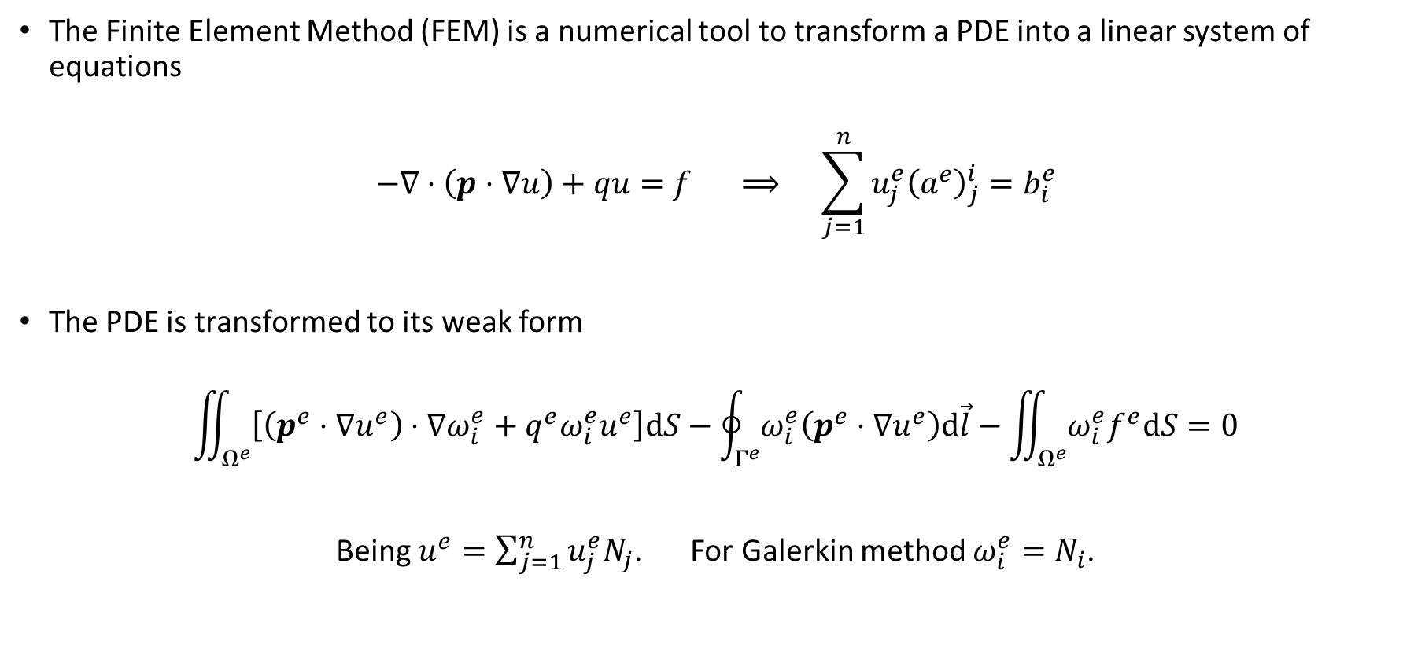
FEM in 2D Scalar Equations
The Finite Element Method (FEM) is a numerical tool to transform a PDE into a linear system of equations
$$−∇⋅\left.\left(p⋅∇u\right.\right)+qu=f ⟹ \sum_{j=1}^{n}{u_{j}^{e}{\left(a^{e}\right)}_{j}^{i}=b_{i}^{e}}$$
The PDE is transformed to its weak form
$$\iint_{Ω^{e}}{\left[\left(p^{e}⋅∇u^{e}\right)⋅∇ω_{i}^{e}+q^{e}ω_{i}^{e}u^{e}\right]dS}−\oint_{Γ^{e}}{ω_{i}^{e}\left(p^{e}⋅∇u^{e}\right)d\vec{l}}−\iint_{Ω^{e}}{ω_{i}^{e}f^{e}dS}=0$$
Being $u^{e}=\sum_{j=1}^{n}{u_{j}^{e}N_{j}}$. For Galerkin method $ω_{i}^{e}=N_{i}$.
Hernán Domingo | PhD Research Plan Defence

Slide 31
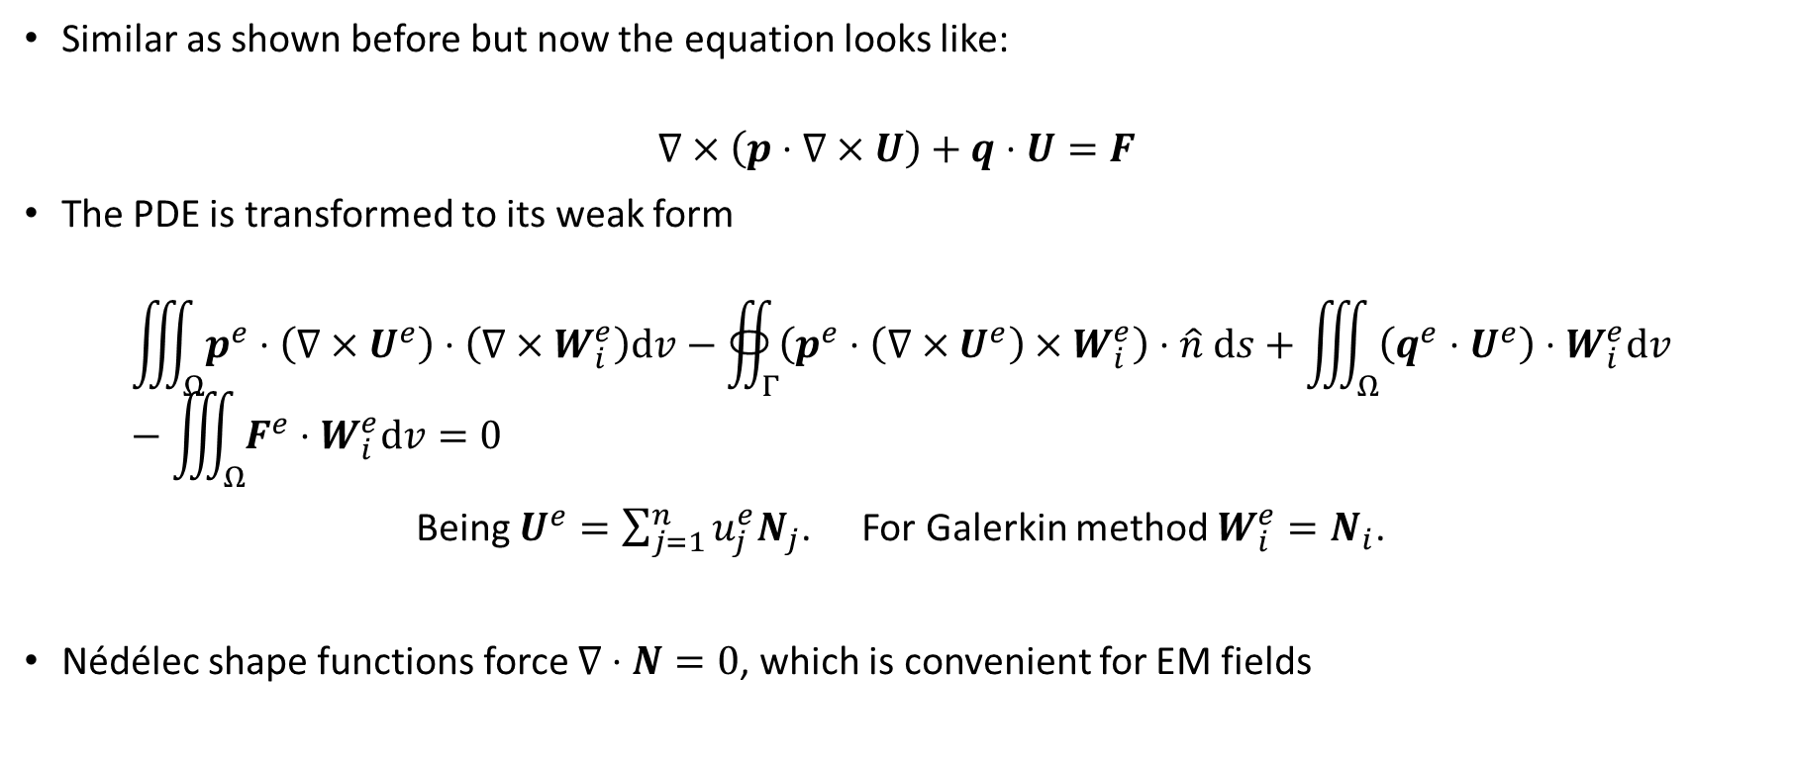
FEM in 3D Vector Equations
Similar as shown before but now the equation looks like:
$$∇×\left.\left(p⋅∇×U\right.\right)+q⋅U=F$$
The PDE is transformed to its weak form
$$\iiint_{Ω}{p^{e}⋅\left(∇×U^{e}\right)⋅\left(∇×W_{i}^{e}\right)dv}−∯_{Γ}{\left(p^{e}⋅\left(∇×U^{e}\right)×W_{i}^{e}\right)⋅\hat{n} ds}+\iiint_{Ω}{\left(q^{e}⋅U^{e}\right)⋅W_{i}^{e}dv}−\iiint_{Ω}{F^{e}⋅W_{i}^{e}dv}=0$$
Being $U^{e}=\sum_{j=1}^{n}{u_{j}^{e}N_{j}}$. For Galerkin method $W_{i}^{e}=N_{i}$.
Nédélec shape functions force $∇⋅N=0$, which is convenient for EM fields
Hernán Domingo | PhD Research Plan Defence

