Slide 1

Data Modeling
Power BI & Power Pivot\Query\View & Dax
Hernan Aronson
Tali Oberlander
05.08.2025

Slide 2
Project Objective
Implement the concepts taught in the course such as semantic modelling, dashboard creation, and business analysis using tools
Power BI
Power Pivot / Power Query / Power View
DAX

Slide 3
Data modeling Workflow
Data preparation
Data modeling
Power BI Report Building
Advance Dax Analisis

Slide 4

Data preparation
Imported SQL tables and CSV (regions) into Power Query
Renamed columns (e.g., SK, BK), removed or added fields as needed
Performed data cleansing: handled nulls, standardized formats
Defined Fact and Dimension tables
Created a custom Dim_Date table using start and end years
Generated continuous dates based on quarters, with random days and order
Created DateKey for relationships

Slide 5
Data modeling
Loaded cleaned data into Power Pivot using Manage Data Model
01
Built relationships in the diagram view: connected all dimension keys to Fact_Sales
02
Added calculated columns, measures, and KPIs
03
In Excel sheets: inserted PivotTables, PivotCharts, and Slicers for filtering
04

Slide 6

Power BI Report Building
Imported data model from Excel into Power BI
Reviewed and renamed tables and columns for clarity
Hid unnecessary fields and grouped measures in folders
Created new measure table to organize DAX calculations
Built dashboards focused on specific business topics (e.g., revenue, customers, growth)
Added meaningful visuals and interactive elements:
Slicers by year, region, and division
Drillthrough and custom tooltips
Dynamic KPIs using DAX time intelligence functions (SAMEPERIODLASTYEAR, etc.)

Slide 7
Advanced DAX Analysis
Developed custom DAX queries to extract insights not directly visible in the tables
Used DAX to compare yearly growth, evaluate performance against goals, and filter top customers

Slide 8
Problems and solutions
Since the dataset didn’t include order dates, we had to create a formula to randomly generate dates and associate them with each order. This allowed us to build a time-based structure and ensure continuity for working on the project.
In particular, we initially didn’t define the period column as a proper date format, which caused issues when trying to create time-intelligent DAX measures and visualizations.

Slide 9
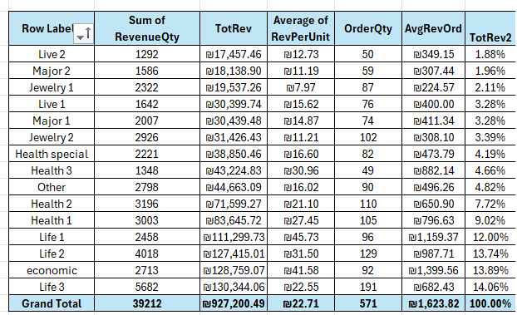
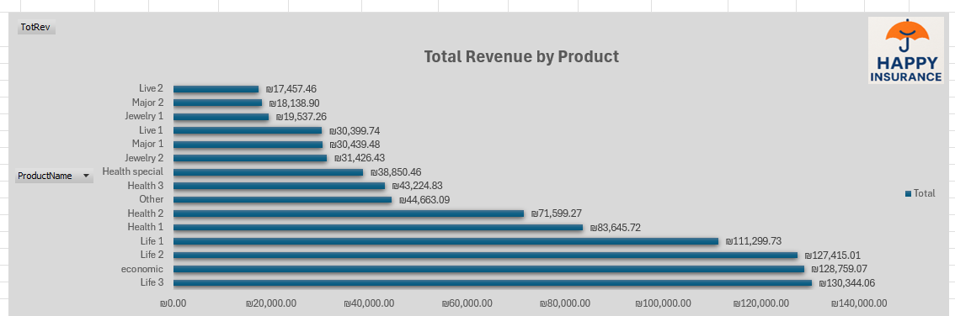
This chart shows the total revenue generated by each product. It allows us to easily compare which product categories are the most profitable.

Slide 10
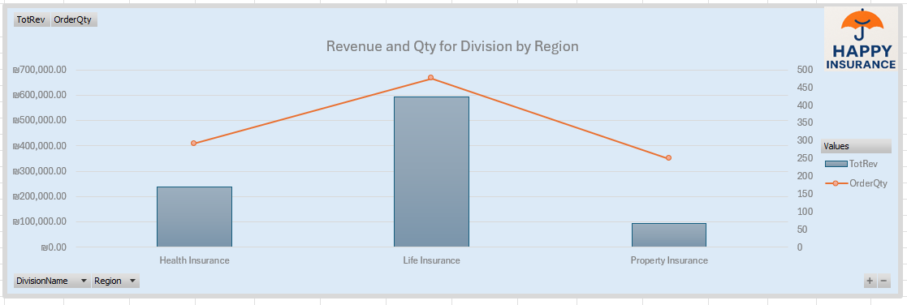
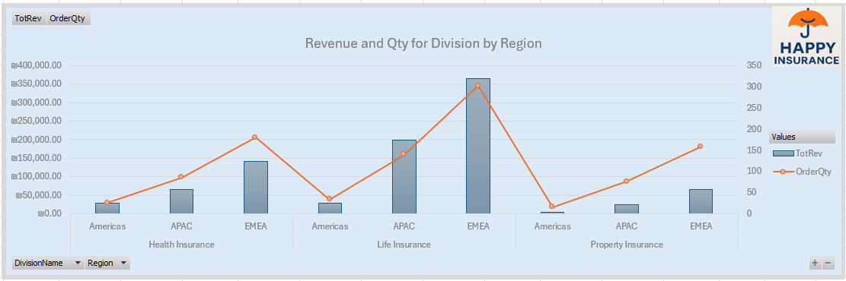
This These two charts display the same data but at different levels of hierarchy.
The first chart shows total revenue and quantity by division, while the second drills down into region-level details within each division.

Slide 11
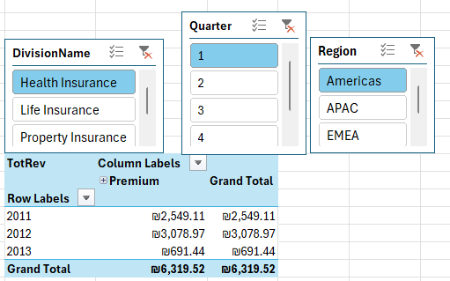
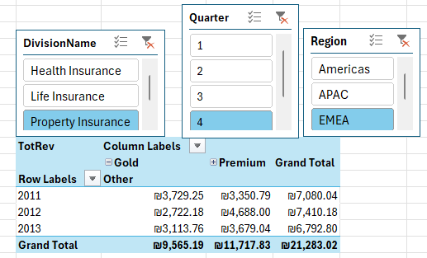
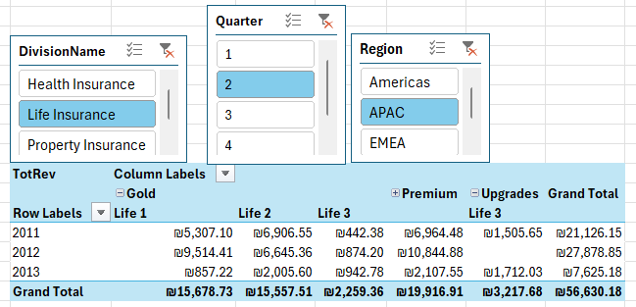
These three visuals demonstrate the use of slicers in Excel, which allow interactive filtering of the data based on Division, Quarter, and Region. Each slicer dynamically updates the pivot table to display only the relevant data selected.

Slide 12
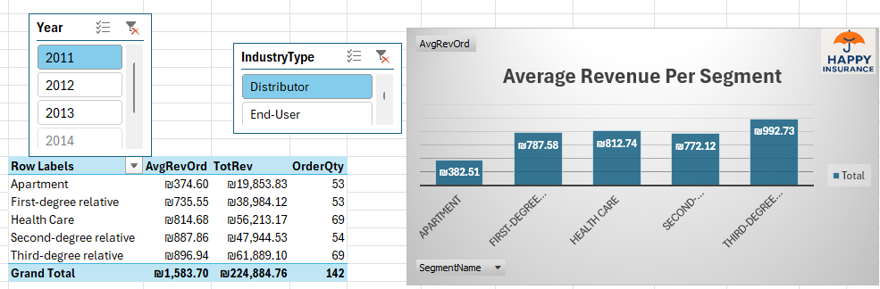
This visual shows the average revenue per order across different customer segments for the year 2011, filtered by the Distributor industry type using slicers.

Slide 13
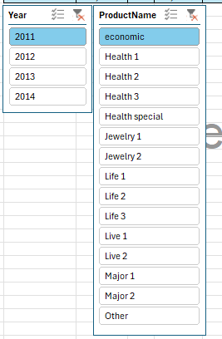
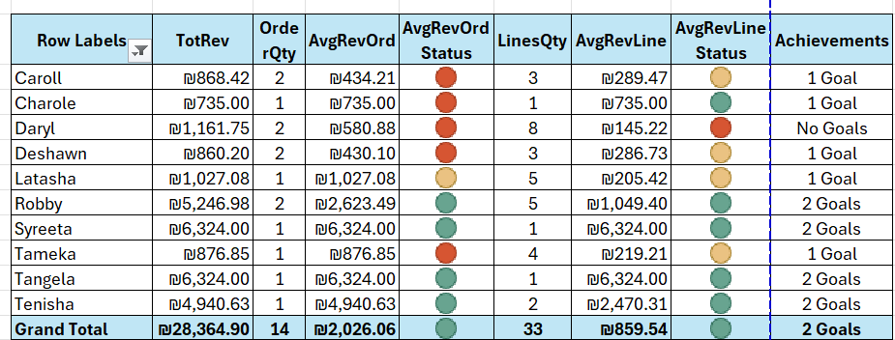
This table uses conditional formatting and status indicators to visually highlight customer performance. It includes dynamic slicers for selecting year and product, allowing interactive filtering and exploration of the data. This setup enables users to easily focus on specific segments or time periods and analyze performance at a glance.

Slide 14
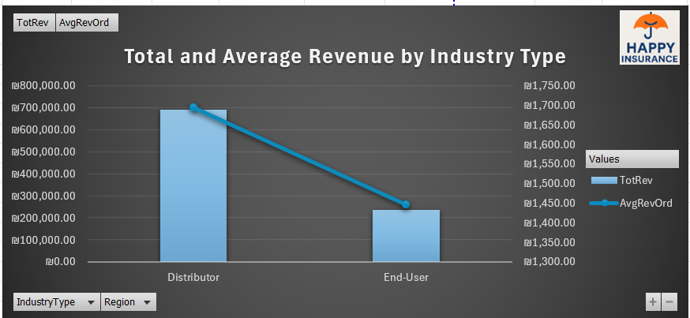
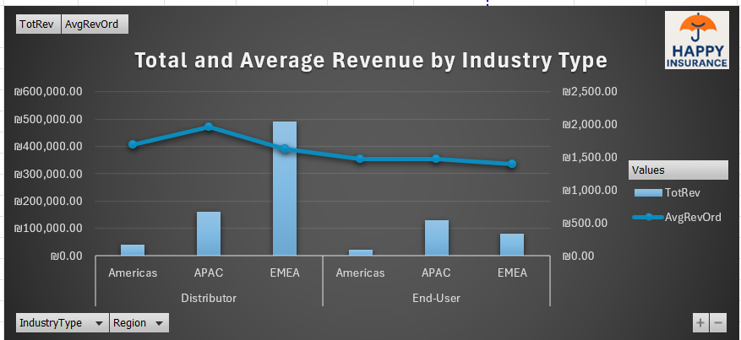
The slicers allow interactive filtering by industry type and region.
The first chart compares both total and average revenue overall, while the second dynamically updates the same metrics by region.

Slide 15
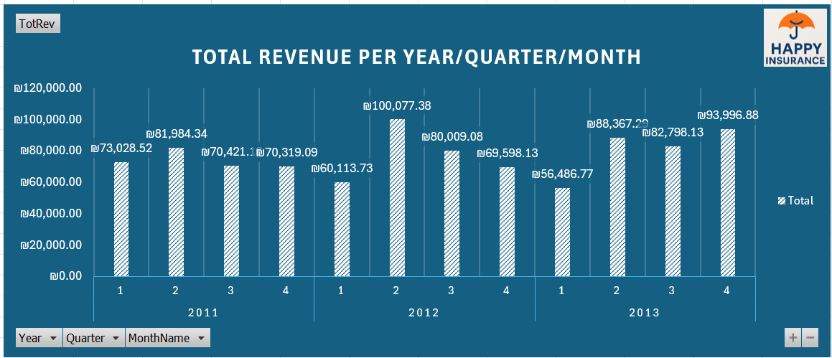
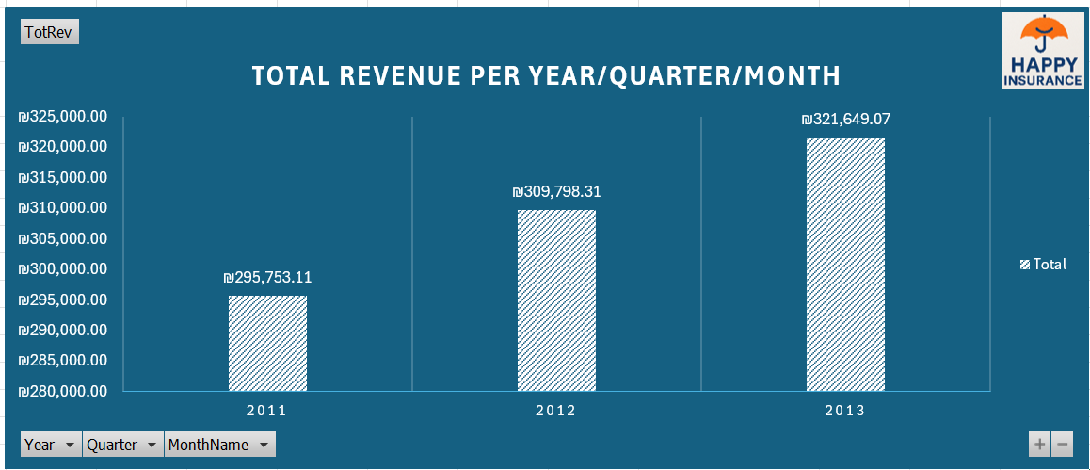
These two charts show the evolution of total revenue over time.
The slicers at the bottom (Year, Quarter, and Month) allow dynamic filtering, enabling users to drill down from annual to monthly data.
The first chart displays all periods, while the second chart shows only yearly totals after filtering by "MonthName" or "Quarter".
This setup provides a flexible way to analyze performance trends by different time levels.

Slide 16
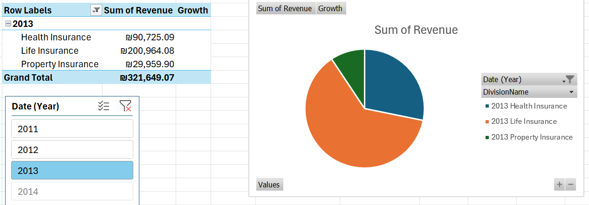
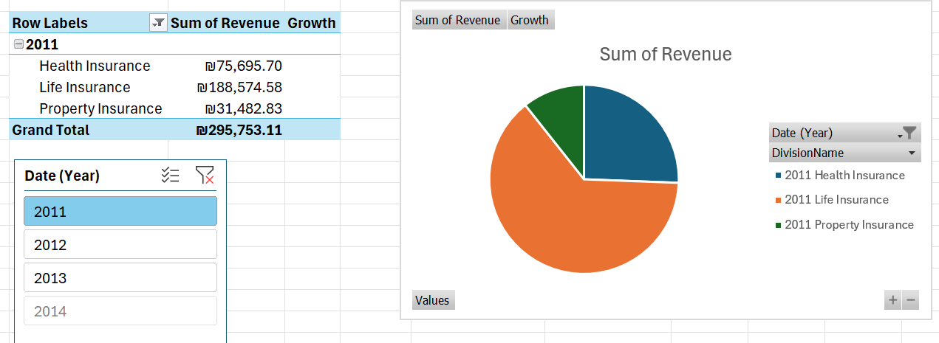
This visualization displays how total revenue is divided across the three main divisions—Health, Life, and Property Insurance—for a selected year.
Using the Year and DivisionName slicers, we can switch between different time periods and observe changes in the distribution. The chart updates dynamically, offering a quick comparison of the proportion each division contributes to the overall revenue.

Slide 17
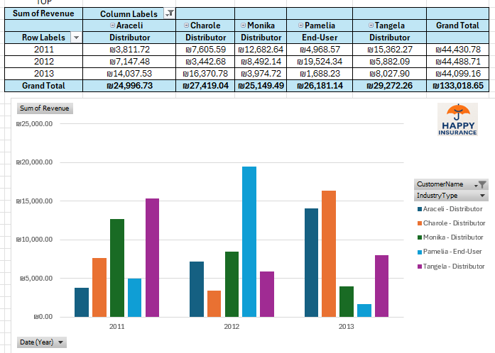
This dashboard highlights the top five customers by total revenue across three years. Each column represents a customer, with colors differentiating both the individual and their industry type (Distributor or End-User).

Slide 18
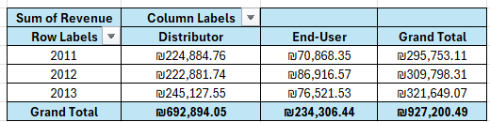
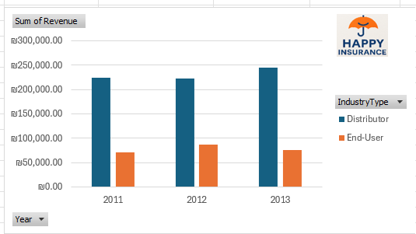
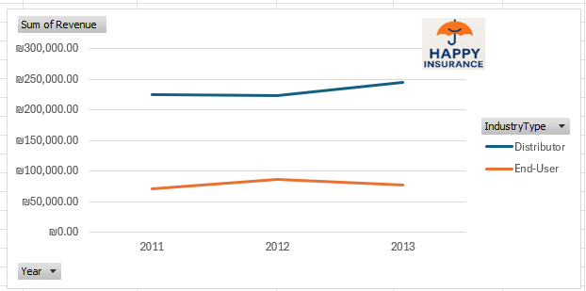
This page displays total revenue by Industry Type (Distributor vs End-User) across the years 2011–2013.
The pivot table shows detailed revenue per year and segment.
The column chart allows for a quick comparison between the two industry types over time.
The line chart highlights the revenue trends for each group across the years.

Slide 19
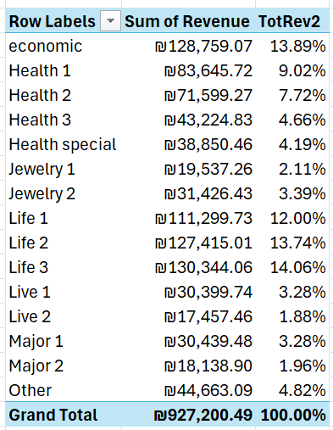
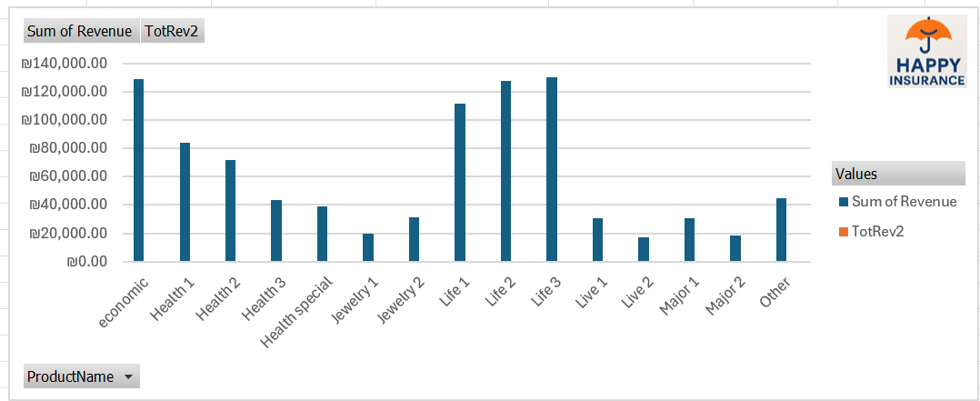
This table shows the total revenue per product along with each product’s percentage of the overall revenue.
The bar chart offers a visual comparison, while the slicer lets us filter by product name to explore specific data more easily.

Slide 20
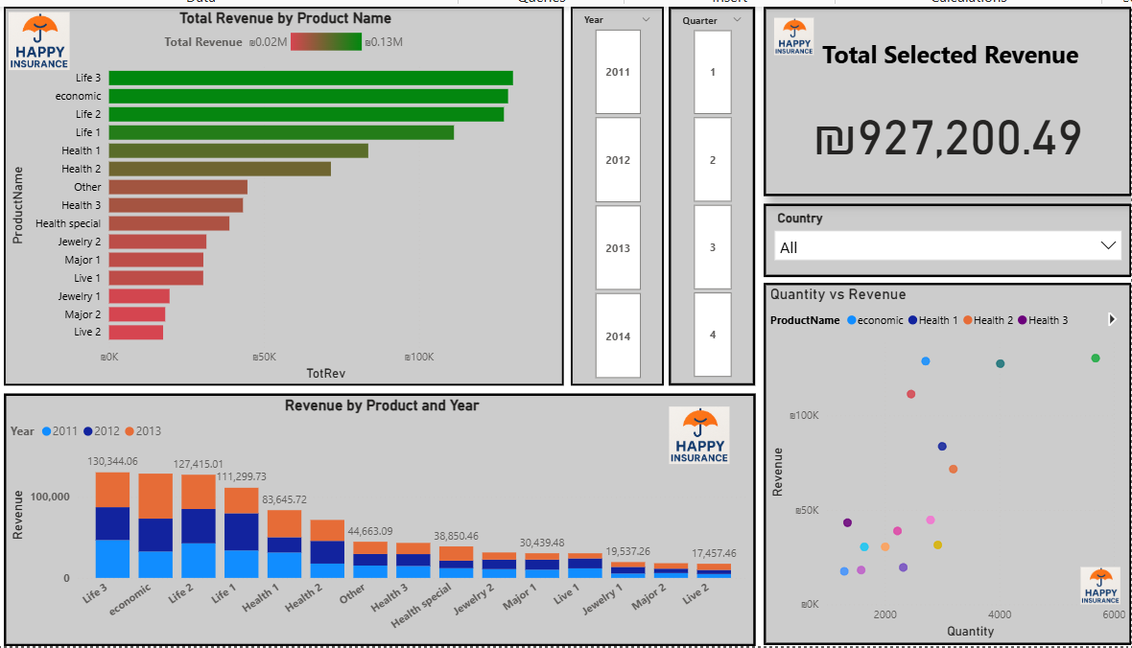
This dashboard shows total revenue per product, with the bar colors reflecting performance.
The stacked chart breaks revenue down by year, and the scatter plot compares revenue and quantity for selected products.
The slicers on the right let you filter the data by year, quarter, and country.

Slide 21
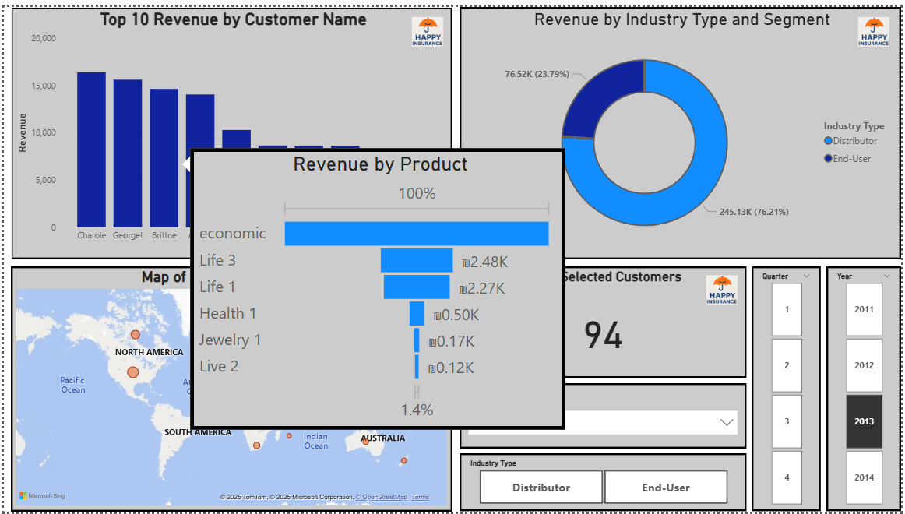
This dashboard shows the top 10 customers and revenue by industry.
If you hover over a customer, a detailed chart will appear showing the revenue breakdown by product for that specific customer.
You can also filter by year, quarter, country, or industry type to explore different segments.

Slide 22
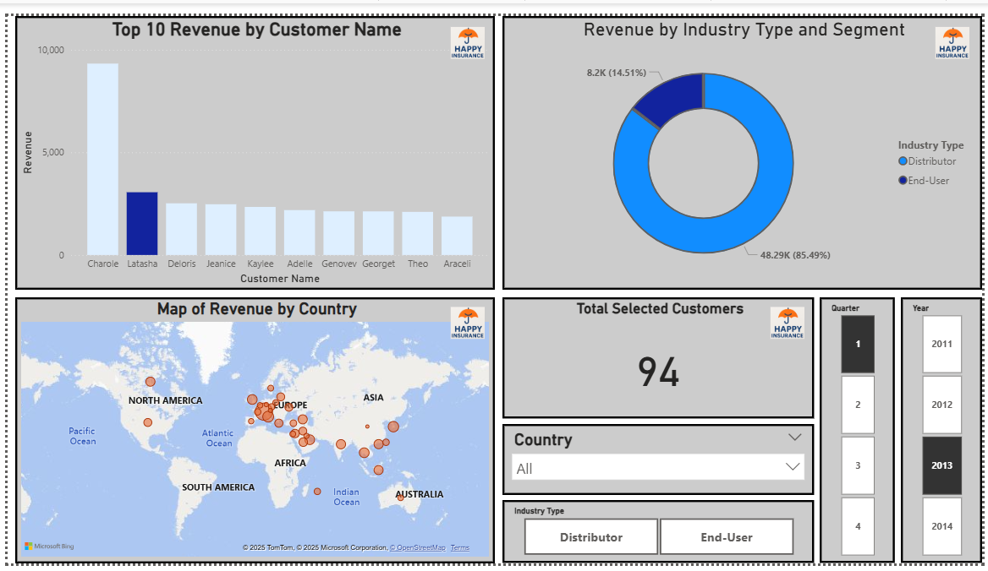

Slide 23
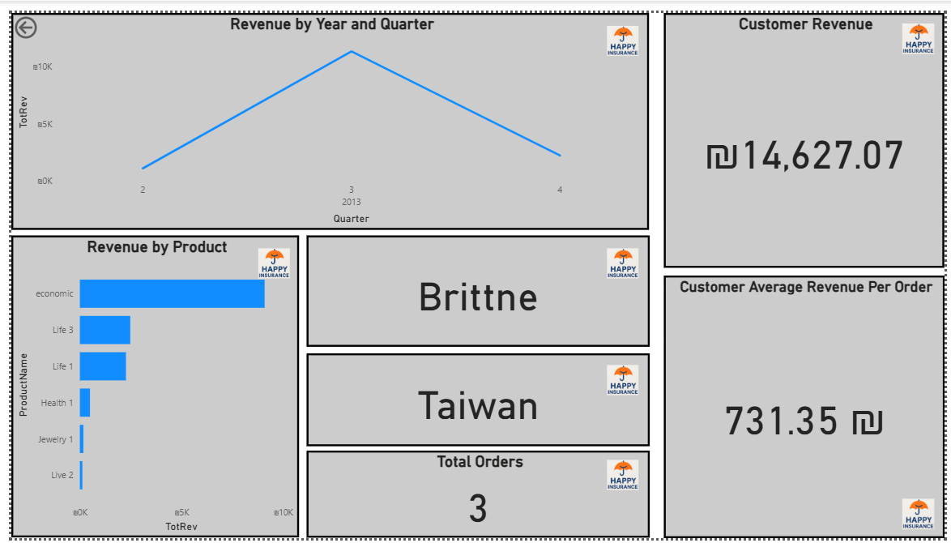
In the "Top 10 Revenue by Customer Name" visual, users can select a specific customer to explore further.
By using the Drillthrough feature, clicking on a customer automatically navigates to a detailed dashboard that provides comprehensive insights.

Slide 24
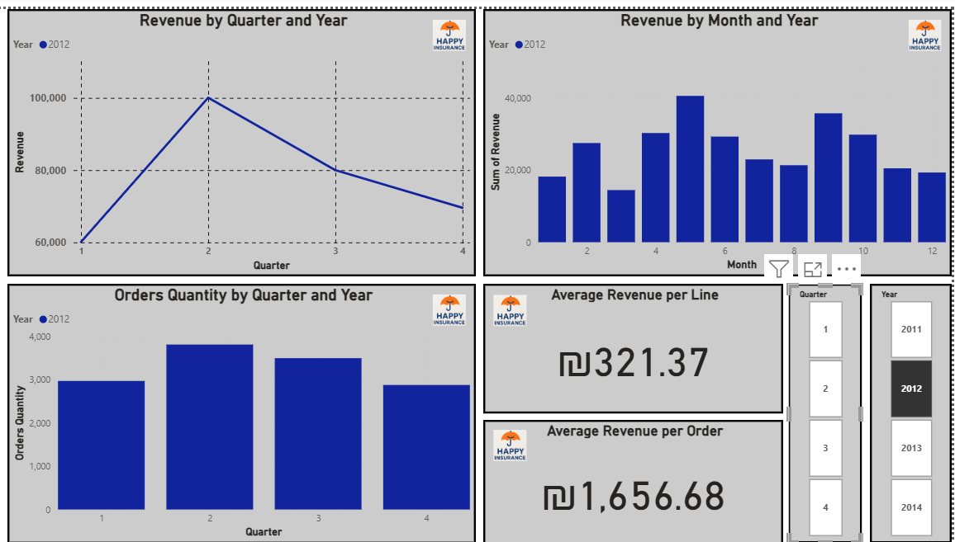
This dashboard provides a clear view of revenue trends and order quantities over time. Users can filter by year and quarter to analyze quarterly and monthly performance, view the number of orders, and monitor average revenue per line and per order.

Slide 25
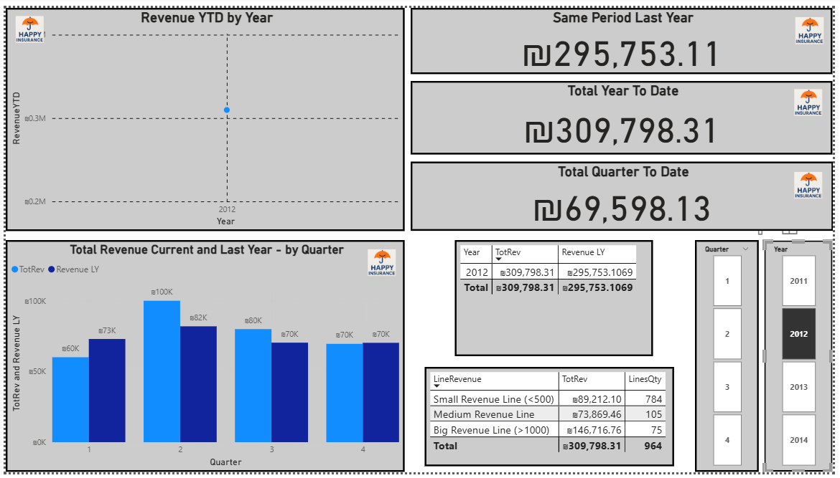
This dashboard displays interactive visualizations, using the slicers on the right, we can filter the data by year and quarter — and all charts update automatically.
The visuals are all connected, allowing for quick insights into seasonal patterns and business performance over time.

Slide 26
Conclusion
Power BI is a tool that requires hands-on practice to master its configuration options and learn how to effectively present data.
Throughout the process, we learned a lot through trial and error — especially about how to properly assign fields to the axes, values, and legend areas in each visual to get the desired result.
However, when used properly, its interactivity becomes a great advantage — making it incredibly intuitive even for users without technical backgrounds

