Slide 1
Food Center
Technion
Networked Software System Lab
Winter 2012/2013
Final Presentation
Submitted by: Dror Baum | Under supervision of: Genady Paikin

Slide 2
Agenda
1. What it is all about
1.1 Project Objective
1.2 Live Presentation
2. Methodology
2.1 System Overview
3. Server Logic
4. Client Logic
5. Issues

Slide 3
1. What it is all about?
Most of the employers use food order services such as CIBUS or 10BIS in order to give food services for their employees, but these services are lack of:
Mobile application
Employees can order food in the worst scenario only with a special card, on the best scenario on a non mobile compatible web page
The focus of this project:
Generating client-server application which will give all the required services to restaurants, companies and employees.
Learning and using Google services when they are available.

Slide 4
1.1 Project Objective
To design and develop prototype system that allows its users the following:
Manage restaurant and companies from the web
Employees can make food orders or table reservations from their mobile
Simplify the process of money handling for both the companies and the restaurants
Free of charge services for this client-server application

Slide 5
1.2 Live Presentation
…

Slide 6
2. Methodology
Client/ Sever architecture
Backend
Java server (JDK 1.7)
GAE 1.8.5 (developed on 1.8.4)
Google datastore and blobstore
Google services: Users API, Channel API, Image API, GCM
Frontend
Android application (Android SDK API level 15; JDK 1.6)
GWT web client
GUI to dispatch requests and display results

Slide 7
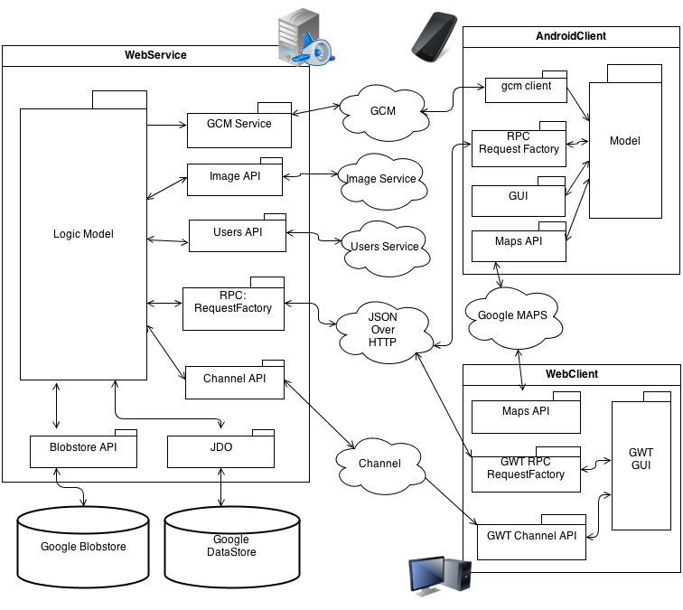
2.1. System Overview

Slide 8
2.1. System Overview
Database
Datastore + JDO for ORM objects
Blobstore for images
Transactional writes
Non-transaction reads
Services
Separated into classes based on authority
Users Service to identify clients
Communication
RequestFactory for delivering datastore objects (and image paths)
Form + Servlet to upload images
GCM to push Android messages
Channel API + AutoBean to push web-client messages
Locations
Google Maps services
On Android

Slide 9
3.0 Server Logic (How it works?)
Services are exposed to the world using RequestFactory as RPC and BlobServlet as image servlet for uploading and downloading images
All services are encapsulated in GAE authentication
All services are checking for current user’s permission before executing
Each Object has image key for the Blobstore – each object can have its own image

Slide 10
4.0 Client Logic (How it works?)
Client use RequestFactory to make a server requests
Web Client use GWT
Client receives Proxy response from the server
Client parse the response
Client show the parsed response options to the user
Web client use GWT
Each object which can be edited in the client has “isEditable()” function, when object is editable, client gives the option to edit this object

Slide 11
5. Issues
Service
Integration between RF and JDO was not trivial, there is lack of documents about this kind of integration where JDO object has child objects
Difficulty making complex persistence capable classes
Difficulty to figure how to JUNIT the services
Android
GAE Authentication on Android using cookie is lack of documentation (but many examples were helpful)
Android orientation handling for open Dialogs (Activity.onDestroy() is called)
Web Client
Figure how to compile GWT in the non-default project structure

Slide 12
The End (Questions?)
EOF

