Slide 1


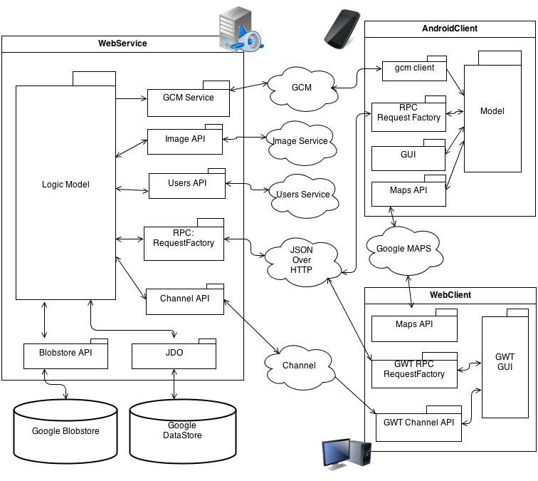
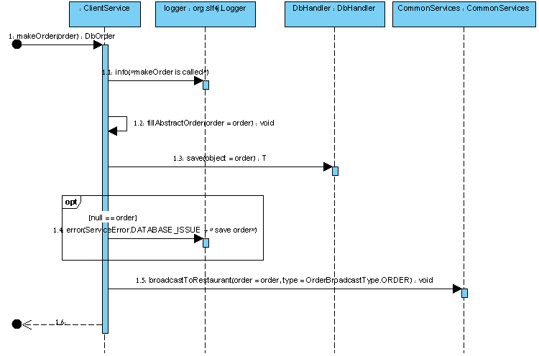
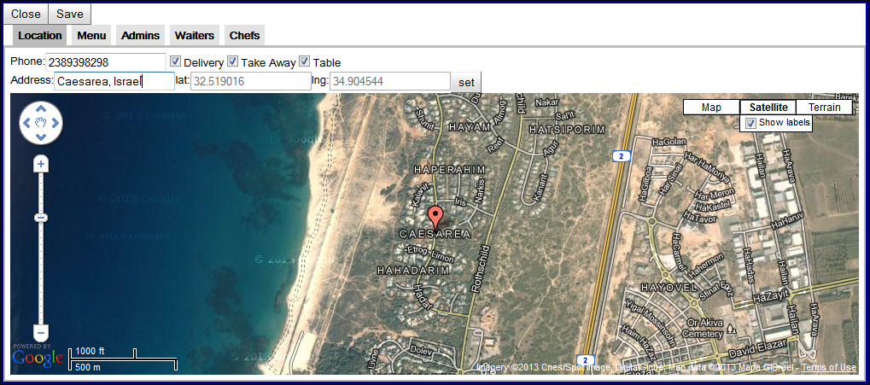
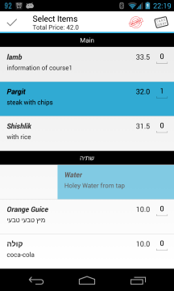
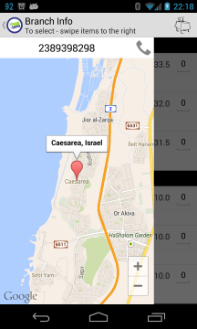
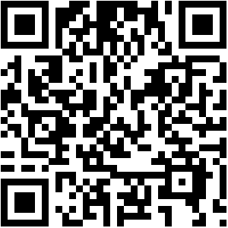
Food Center
Dror Baum
Supervised by: Genady Paikin
https://food-center.appspot.com
Introduction
System Overview
Now days most of the employers use food order services such as CIBUS or 10BIS in order to give food services for their employees. Using such a service simplified the money handling: employees don't need to keep receipts and deliver them at the end of the day/week/month in order to get their money; also restaurant and companies can have a report at the end of the month of all the orders involved and which user payment check this money needs to be taken from.
On the other hand, most of these services don't utilize the fact that most of the people today are using smartphones. The services that they provide are web-services such as http web client which at the worst scenario only shows you the available restaurants (CIBUS), or on the best scenario allow clients to make take-away/delivery orders (10BIS) which don't fit the mobiles screen properly, using a web page on the smartphone won't give the best user experience, and defiantly can't utilize all smartphone features. When employees want to make an order they must do it from their office where they have a computer.
Look and Feel
Check us on the web

