Slide 1
Intro to R
(FallR) – October 4, 2016
John Little and Joel Herndon
askdata@duke.edu
Notes:
Conventions- courier font means code

Slide 2
Background
Notes:
1. How many people have used a statistics package before? Which packages?
2. How many people have coded using a programming language before? Which languages?
3. How many of you have to use R for class? your own research? just interested?

Slide 3


R and R Studio
I’m the open source statistical programming language.
I’m a development environment for using the R programming language.
Notes:
After this slide, we do a bit of housekeeping.
get everyone in the same directory
access to files

Slide 4
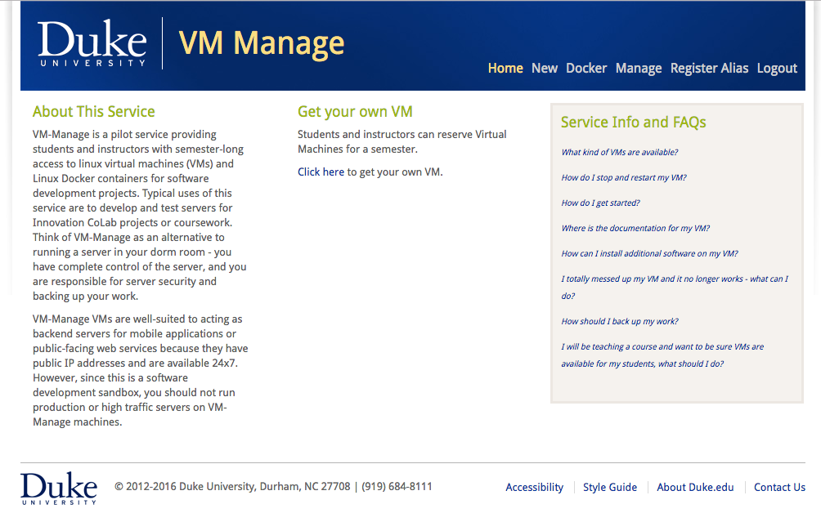
vm-manage.oit.duke.edu

Slide 5
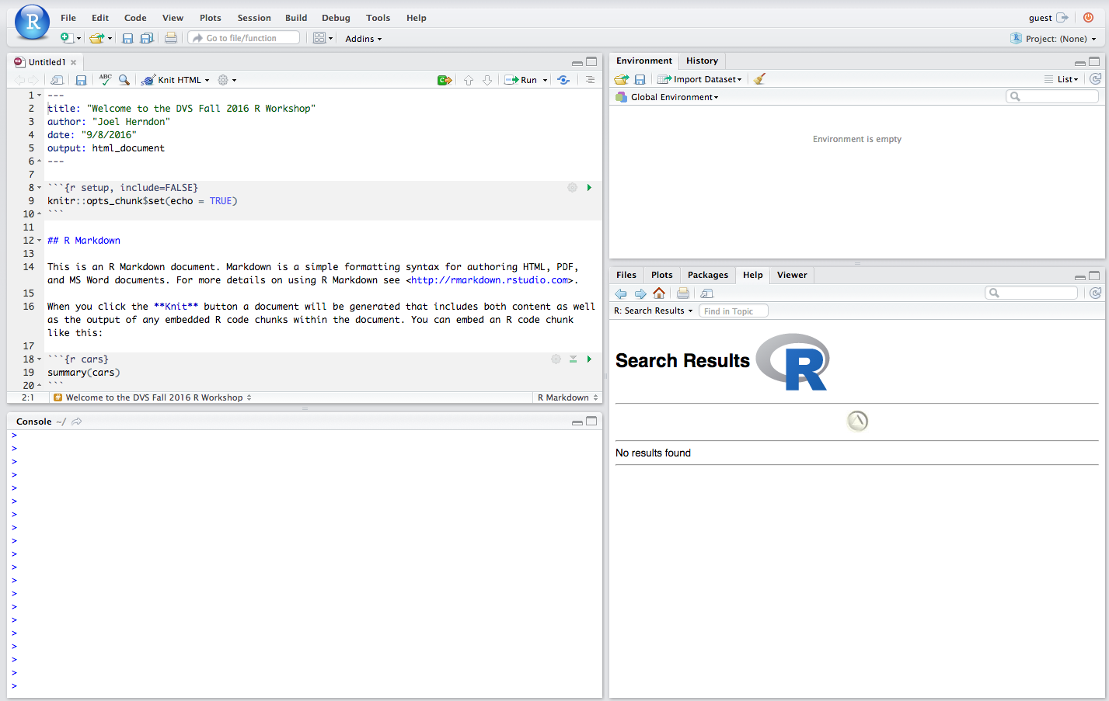

Slide 6
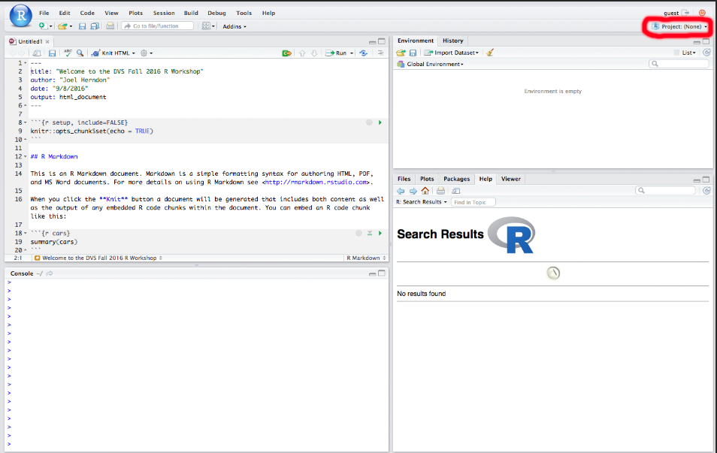

Slide 7
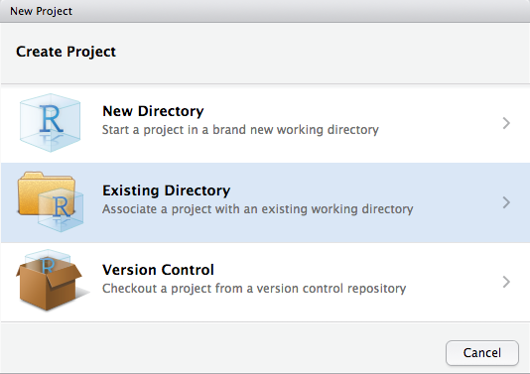

Slide 8
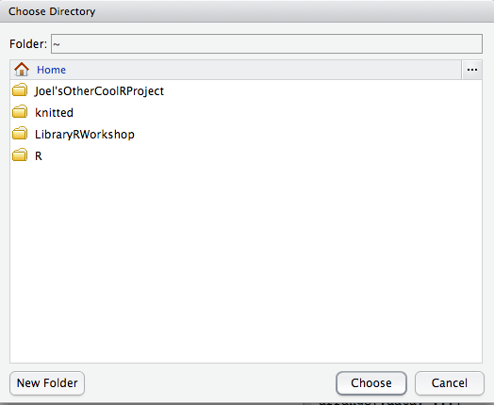

Slide 9
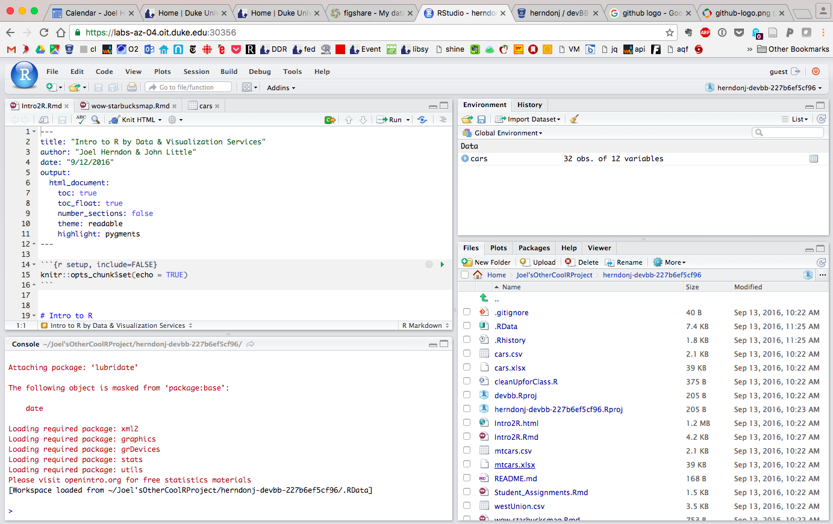

Slide 10
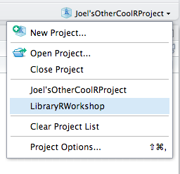
Notes:
Class should download zip file at this point.

Slide 11
(A few) Benefits of R
1. Open source/free
2. Extensible
3. Integrated tools for reproducible research
4. Integrated tools for data sharing/publication
5. A full suite of data structures
6. Ability to chain commands to build complex workflows

Slide 12
HELP!

Slide 13


http://r4ds.had.co.nz/
http://www.statmethods.net/

Slide 14




Getting Help Online
Google – add“r” or “rstats” to your search
Stack Overflow – add “[r]” to your search
rseek.org (Google, but focused on R)
Quick R – statmethods.net

Slide 15
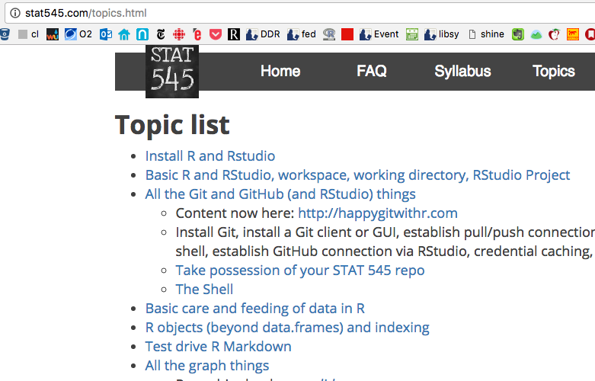
Stat545 – Jenny Bryan’s UBC Course on Stats in R
Notes:
And a personal favorite....

Slide 16
Getting Help At the Command Line
help(functionName) or ?functionName
??topic #search the help system
appropos(“topic”)
vignette(“topic”)

Slide 17








Extending R
...And many more....

Slide 18
Today’s goals
Notes:
1.) The R Interface
2.) Loading Data
3.) Data Management in five commands
4.) Want to do more? Let’s talk.

