Slide 1


FINSPARK HACKATHON 2026
AI-Driven Correlation of
Cybersecurity Telemetry & Transactional Behaviour
Connecting the dots between suspicious logins and suspicious money movement — before the money leaves the bank.
TEAM BLITZ
1st-year B.Tech CSE students using Machine Learning to bridge cybersecurity and financial fraud detection.
Kartik • Prerit • Harsh • Bedabrata
Date: July 13, 2026

Slide 2



PROBLEM STATEMENT
Two systems watch the same criminal
and never talk to each other
PROBLEM SELECTED
AI-Driven Correlation of Cybersecurity Telemetry & Transactional Behaviour.
➕
Cybersecurity
monitoring
Transaction
monitoring
Banks monitor suspicious logins and suspicious transfers in separate systems. Our unified AI connects the dots — catching a stolen-credential login that immediately moves money, or a silent data hoard staged for future decryption.
Unified correlation AI
catches what isolated systems miss
FINSPARK HACKATHON 2026 | TEAM BLITZ
2

Slide 3



PRE-REQUISITES
What we assume, use, and build on
Assumptions
Standard banking logs are available, combining user session data with transaction amounts.
Datasets
Real banking data is confidential, so we generate a synthetic dataset: thousands of normal actions with a few dozen injected malicious attacks.
Environment
A local Python environment — Jupyter Notebooks for testing, VS Code for development.
FINSPARK HACKATHON 2026 | TEAM BLITZ
3

Slide 4

TOOLS & RESOURCES
A lean, proven Python stack
LANGUAGE
LIBRARIES
FRAMEWORK
Python
Pandas • NumPy • Scikit-Learn
Streamlit
Core logic & data handling
Data manipulation & anomaly-detection AI
Fast, interactive dashboard for bank admins
FINSPARK HACKATHON 2026 | TEAM BLITZ
4

Slide 5


SUPPORTING FUNCTIONAL DOCUMENTS
How a threat is caught, step by step
1
2
3
4
→
→
→
Data Ingestion
AI Processing
Correlation
Explainable Output
System reads combined CSV logs: IP address, device, transfer amount, data downloaded.
Isolation Forest ML model scans the combined logs for outliers.
Rules engine flags when a suspicious login also triggers an unusually large transfer.
AI generates a plain-English alert on the dashboard for the admin.
FINSPARK HACKATHON 2026 | TEAM BLITZ
5

Slide 6

KEY DIFFERENTIATORS & ADOPTION PLAN
Not another red X — an explanation
KEY DIFFERENTIATOR
ADOPTION PLAN
Most solutions just block a transaction with an error code. We provide Explainable AI — telling the admin exactly why a transaction was flagged.
Deployed as a lightweight API alongside existing banking dashboards — no need to replace legacy systems.
Plug into existing bank IT stack
"User logged in from new IP and transferred 500% of their usual average."
No legacy system replacement needed
Fast pilot-to-production path
FINSPARK HACKATHON 2026 | TEAM BLITZ
6

Slide 7

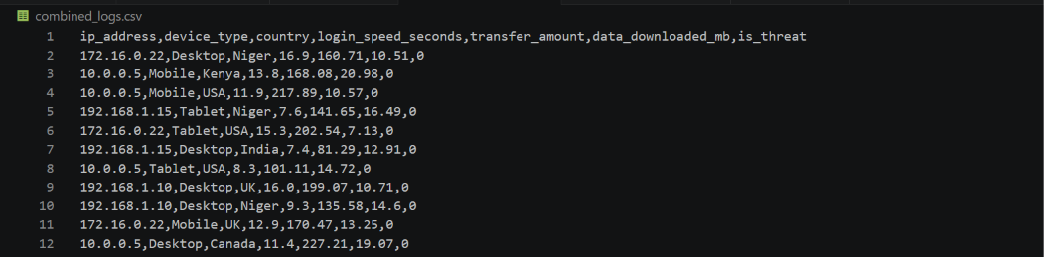
GITHUB REPOSITORY & SUPPORTING MATERIAL
Where the code lives
github.com/herobhai69/SnoopLog
A lightweight, ML-powered threat intelligence prototype built with Python and Streamlit that correlates network security logs with financial ledger anomalies to detect complex fraud.
Sample Dataset
FINSPARK HACKATHON 2026 | TEAM BLITZ
7

Slide 8


BUSINESS POTENTIAL & RELEVANCE
Why banks would pay for this
REAL-WORLD USE CASE
FUTURE EXPANSION
Prevents account-takeover (ATO) fraud and defends proactively against "harvest-now-decrypt-later" quantum attacks, by flagging massive, unusual data downloads.
Integrate with live banking APIs to automatically pause suspicious transactions before the money ever leaves the bank.
FINSPARK HACKATHON 2026 | TEAM BLITZ
8

Slide 9

UNIQUENESS OF APPROACH AND SOLUTION
Lightweight by design, not by accident
We aren’t building a massive, resource-heavy neural network. Isolation Forest anomaly detection paired with simple rule-based correlation runs incredibly fast on basic hardware.
Heavy neural net
Slow, GPU-hungry, hard to explain
CyberSync approach
60-70%
lighter compute footprint vs. a comparable deep-learning pipeline, by relying on classical ML instead of neural networks
Isolation Forest + rules — fast, explainable, runs on basic hardware
FINSPARK HACKATHON 2026 | TEAM BLITZ
9

Slide 10

USER EXPERIENCE
Built for the bank security admin
A clean, dark-mode Streamlit dashboard that never overwhelms with raw data — alerts are separated by risk, written in plain sentences, with quick action buttons.
RISK LEGEND
High Risk
Immediate review — credential + transaction anomaly together
THREAT INTELLIGENCE FEED
Medium Risk
Single-signal anomaly — worth a quick look
HIGH RISK
New-IP login + 500% transfer spike
Unusual device, normal amount
No raw data dumps — every alert is a plain-English sentence an admin can act on in seconds.
MEDIUM RISK
Investigate
Dismiss
FINSPARK HACKATHON 2026 | TEAM BLITZ
10

Slide 11

SCALABILITY
From a static CSV to millions of transactions a second
→
→
→
Prototype
Pipeline
Apache Kafka
Multi-branch scale
Static CSV logs processed in a local Python environment
Python architecture connects to a real-time data pipeline
Streams live telemetry across the bank
Millions of transactions/sec across every branch
FINSPARK HACKATHON 2026 | TEAM BLITZ
11

Slide 12


EASE OF DEPLOYMENT AND MAINTENANCE
Ship it, run it, forget it
Practicality
Maintenance
Minimal Dependencies
Streamlit + Python means the entire solution can be containerized using Docker.
IT teams spin up or restart the service on any standard cloud server (AWS/Azure) in minutes.
A lean stack keeps setup and updates fast, with little ongoing overhead.
FINSPARK HACKATHON 2026 | TEAM BLITZ
12

Slide 13
SECURITY CONSIDERATIONS
Trust is the product
Data Protection
Access Control
The ML model processes data locally / on-premise — sensitive financial telemetry never leaves the bank’s secure network.
The dashboard features mock role-based access, so only authorized security personnel view the threat intelligence feed.
FINSPARK HACKATHON 2026 | TEAM BLITZ
13

Slide 14
ARCHITECTURE DIAGRAM
System architecture, end to end
→
→
→
User Login +
Transfer
Data Processor
(Pandas)
AI Anomaly Engine
(Scikit-Learn)
Threat Intel
Dashboard (Streamlit)
Data flows left to right: every login and transfer is captured, cleaned, scored for anomalies, and surfaced as a plain-English alert.
FINSPARK HACKATHON 2026 | TEAM BLITZ
14

Slide 15
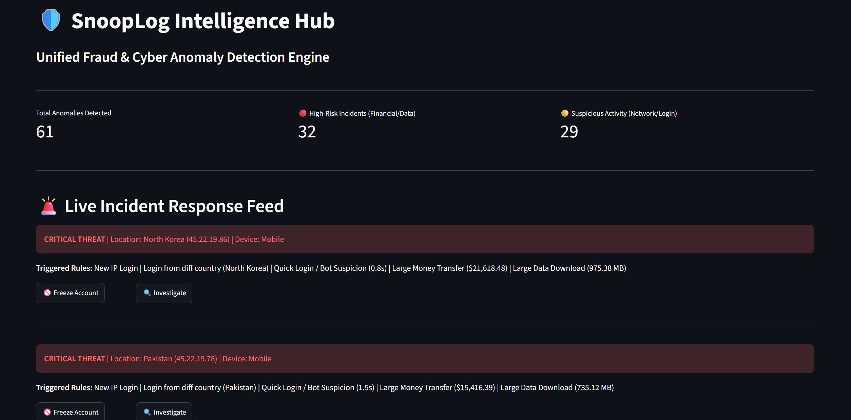
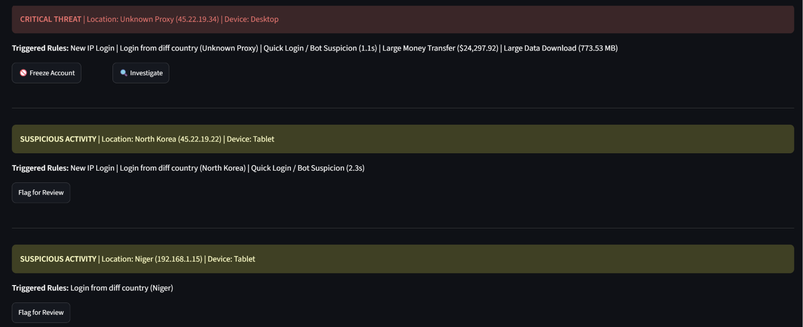
SOLUTION SCREENSHOTS, VIDEO & GITHUB LINK
See it in action
DEMO VIDEO
1.5-minute screen recording —
https://youtu.be/1yIgfY40piQ (YouTube)
GITHUB REPOSITORY
github.com/herobhai69/SnoopLog
Full source code, README, and setup instructions
Placeholder — add 1–2 screenshots of the Streamlit web UI here
FINSPARK HACKATHON 2026 | TEAM BLITZ
15

Slide 16




THANK YOU
Team Blitz
Building the future of secure banking — thank you to the Finspark mentors for the opportunity.
Kartik
Prerit
Harsh
Bedabrata
Machine Learning Logic
Data Generation
Streamlit UI Integration
Research & Presentation
Contact: TheFraudFather@hotmail.com
FINSPARK HACKATHON 2026 | TEAM BLITZ
16

