Slide 1

Cross-platform Real-time Chat
USING WEBSOCKET WITH SOCKET.IO
Chuan Pham
Dai Hoang Tran
Kyithar

Slide 2


WebSocket and Socket.io
A full-duplex single socket connection over which messages can be sent between client and server
Next evolutionary step in web communication compared to Ajax
Socket.IO is a JavaScript library for real-time web applications.

Slide 3
To demonstrate the power for WebSocket with real-time chat, and runs on multiple platforms (Browser, Android native app)
Four components:
Chat server
Brower chat client
Android chat client
Bug tracking system for android app.

Slide 4
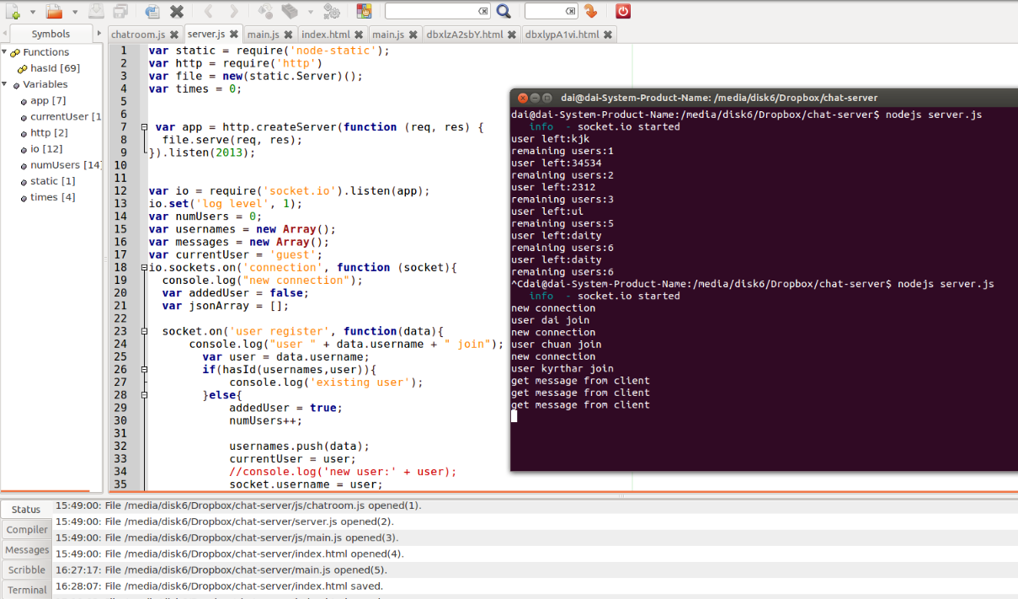
The Chat Server
Using NodeJS
Receives and forwards messages to all clients
Can extends to support binary data forwarding, and video/audio

Slide 5
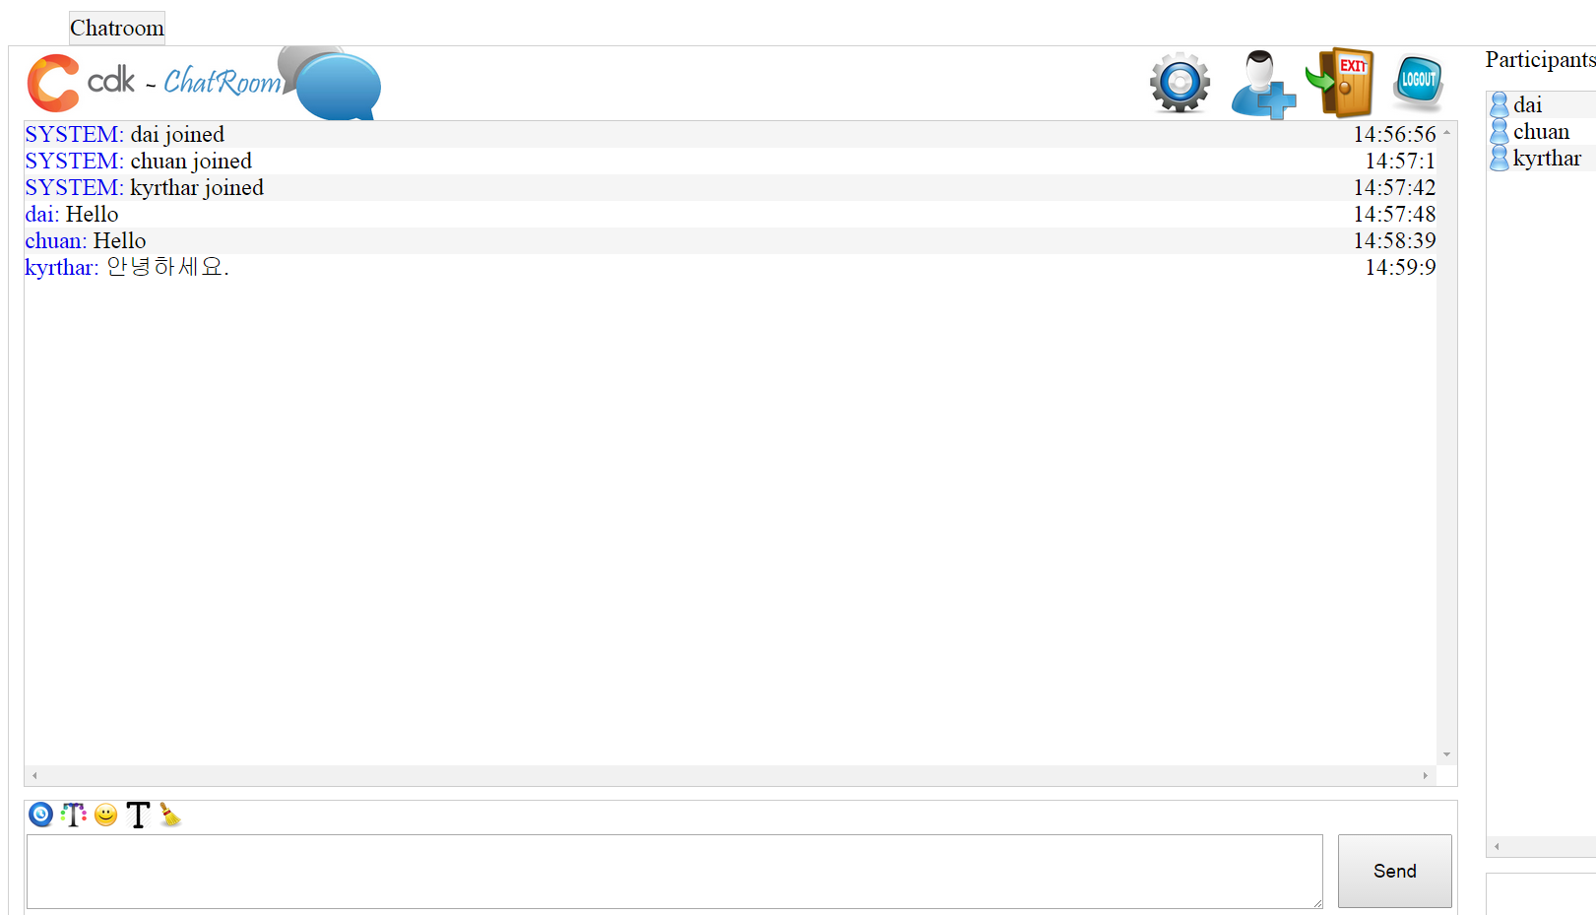
The Clients - Browser
Standard HTML5
Socket.IO API
Cross-platform

Slide 6
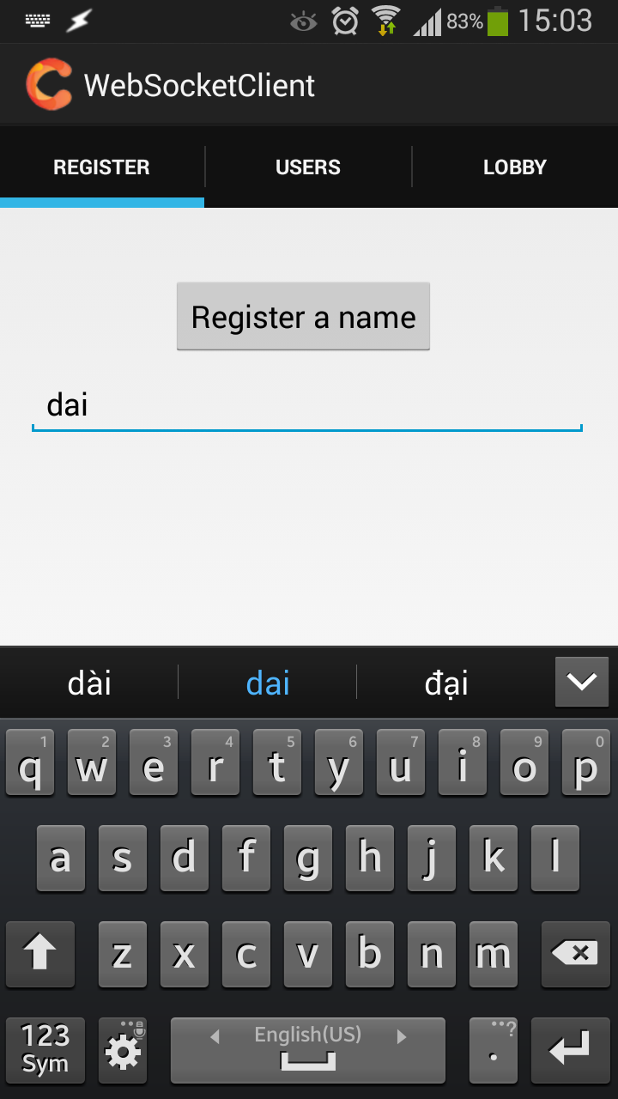
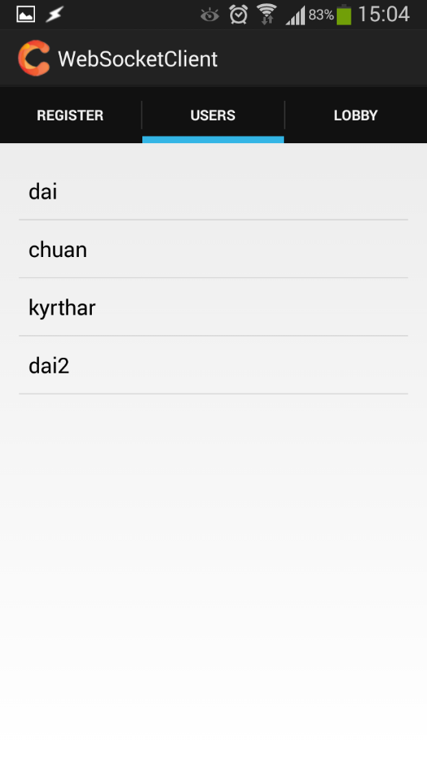
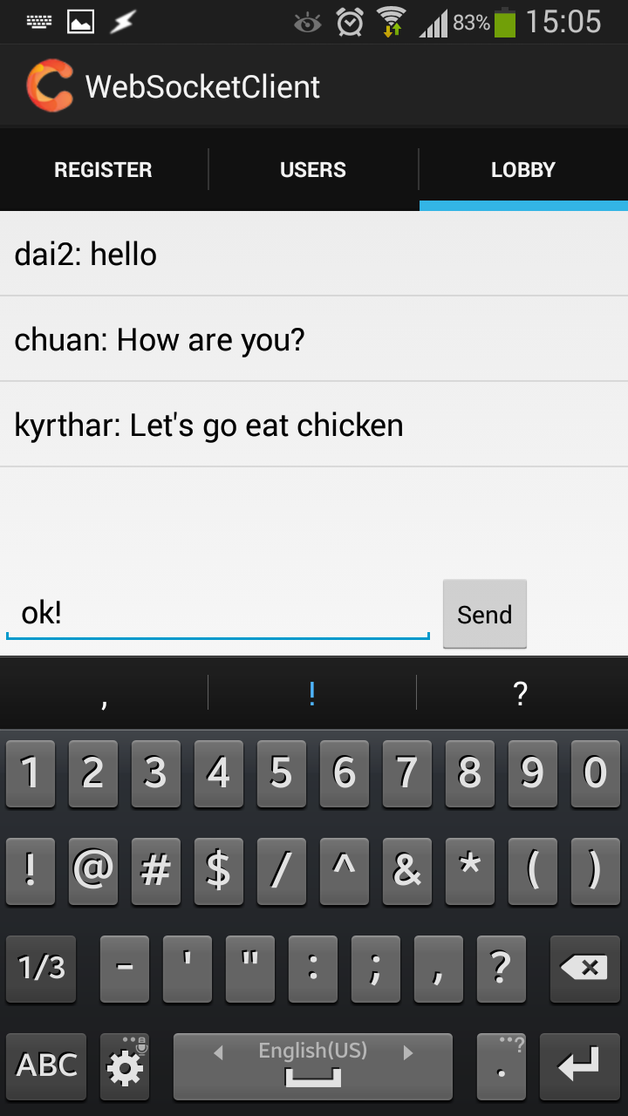
The Clients - Android

Slide 7
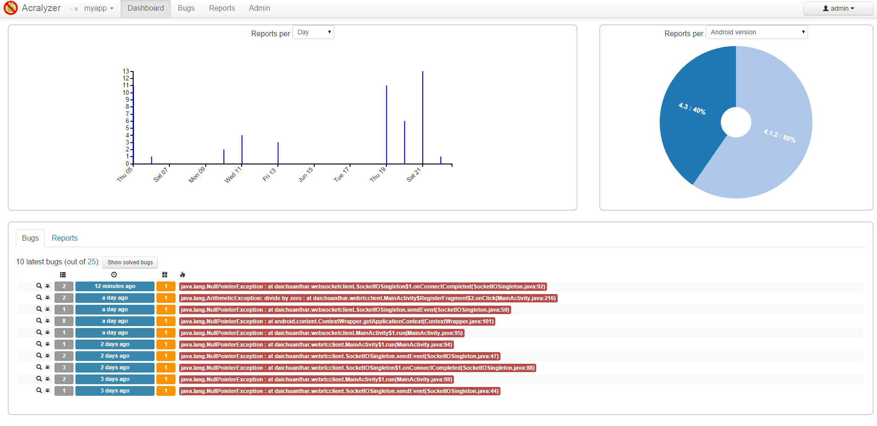
Bug-tracking system

Slide 8
DEMO
Address: http://163.180.116.93:2013/
Android app: http://163.180.116.93:2013/client.apk
Bug-tracking:
http://163.180.116.93:5984/acralyzer/_design/acralyzer/index.html#/dashboard

