Slide 1
Virtual Teacher/Mentor Deliverables 1 & 2
Group 14:
Stephen Caskey, Anthony Delprete, Kevin Krutek, Jason Shih,
Jason Shipman, Marlon Smith

Slide 2
Overview
Educational game meant for students from first to fourth grade
Subjects such as Mathematics, Language Arts, Sciences, and History
Students are quizzed at the end of each lecture
Each student will progress through “years”

Slide 3
Some final quick points
Coded in Java
Light resource use
Internet connection not required

Slide 4
Concept of Operations
Stephen Caskey

Slide 5
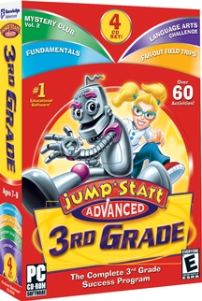

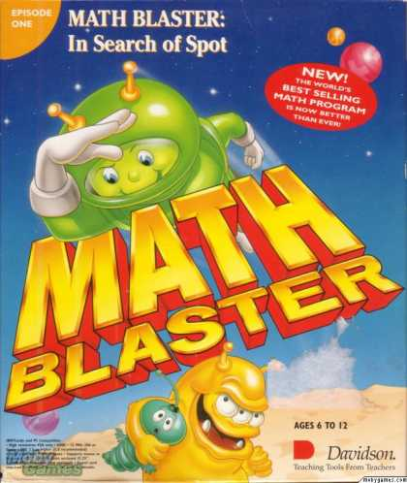
Current System

Slide 6
Proposed System: Needs
Unique User Profiles
Content changes based on grade level
Users have the ability to change difficulty level
Displays user progress
Various subjects taught
Teaches, doesn’t just review

Slide 7
Proposed System: Users
One type of user: Students
First through Fifth Grade
New or Continued
Teaching
Testing
Review (if needed)
Next section

Slide 8
Proposed System: Modes of Operation
Login mode
Map mode
Lesson mode
Tutor mode
Options mode

Slide 9
Proposed System: Operational Scenarios
Standard
Bugs:
Insecure login
Progress prevention
Save data glitch

Slide 10
Proposed System: Operational Features
Profile system
Modular content
Progress Assessment
Basic graphics
Basic sound
Possible:
An online component
More advanced A/V
Mini-games

Slide 11
Proposed System: Expected Impacts
Students should be able to use our application either as a supplement to their existing education or as a stand-alone. We would love for teachers to be able to implement the program into their existing teaching plans (perhaps for homework) and that they would be able to do so easily.
We expect it to provide a more comprehensive educational platform for students than other software out there.

Slide 12
Proposed System: Analysis
Expected Improvements:
The new system will cover a wider range of topics more comprehensively than existing topics.
Disadvantages:
Learning content might prove to not be expansive enough to fully engage and educate students.
Limitations:
The content required to create the game is not readily available and must be compiled slowly.
Risks:
The program might not engage students enough to encourage further play
Alternatives and Tradeoffs:
Change the focus of the game from a primary teaching aid to a game that “tricks” students into learning

Slide 13
Project Management Plan
Marlon Smith

Slide 14
Project Team Organization
Jason Shipman – Project Manager
Alternating Roles
Weekly Meetings

Slide 15
Software Life Cycle Process
Phased Incremental Development Process
Small functional subsystem
Constant addition of functionality

Slide 16
Applicable Standards
Coding Standard
White spacing
Comments
Class names
Document Standard
Font size
Spacing
Spelling and Grammar
Artifact Size Metrics

Slide 17
Technical Project Metrics
Requirements
Total number of requirements
Completed requirements
Number of "To-Do's"
Design
Number of the following:
Packages
Classes
Methods
Memory usage
Big-O scores
Code
Number of the following:
Lines
Functions
Class Variables

Slide 18
Tools
Operating Systems: Windows 7
Programming Language: Java (JDK 7)
IDE: Eclipse
Compiler: The JDK's compiler (javac)
Libraries: Slick

Slide 19
Config. Management
Add/modify/delete source file(s).
Include these changes for the next commit.
Commit these changes.
Update copy of repository to Jason Shipman's stable repository's latest version.
Ensure changes made do not conflict with the stable repository. (If conflicts occur, fix them)
Repeat steps 1-5 if multiple issues are addressed across multiple commits.
Issue a pull request on Github for Jason Shipman to consider merging team member’s changes into the stable repository.

Slide 20
Quality Assurance
Code – inspections via test plan
Design – update respective design plans
Test Plan – few changes as possible

Slide 21
Risk Management
Loss of a Member: Reassign responsibilities efficiently through the remaining group members.
Missing Deadlines: We will check in with everyone’s progress via email every two days to make sure that we as a group are on track.
Data Loss We plan to use an online repository and maintain offline backups for our documents and code

Slide 22
Software Requirement Specifications and Test Plan
Jason Shih and Kevin Krutek

Slide 23
Introduction
This program is designed to serve as an educational facility for a user between the ages of 6 and 11. It will teach the user as a student a variety of subjects in math, history, language arts, and science using a simulated school environment.
The user will have a standard computer in this era.
User may need upwards of 2 gigs of RAM, at least a duo core processor, a dedicated graphics card (low-end), Windows XP, Vista or 7 operating system.
The program should stand alone and not require other systems or external processes.
Children that want extra help with school

Slide 24
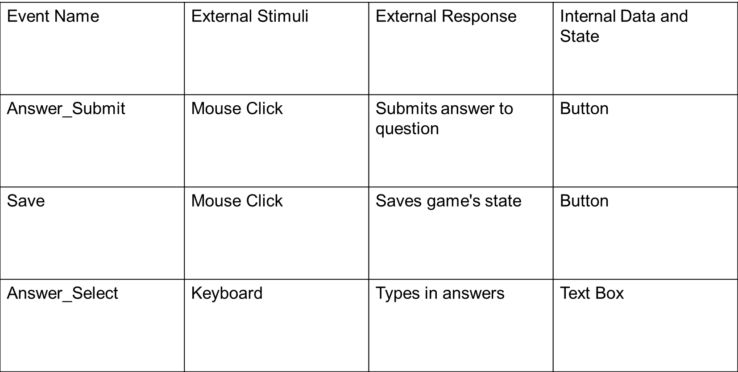
Event Table

Slide 25
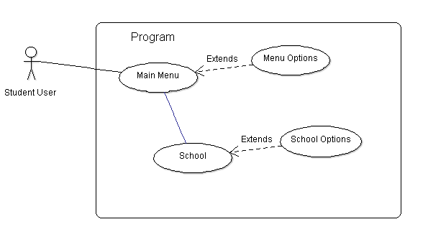
Use Case Diagram

Slide 26
Functional Requirements
The program shall validate inputs to be numeric or alphanumeric where needed.
The program shall catch invalid inputs and recover gracefully.
The program shall accurately grade inputs to determine their accuracy, display corresponding messages and modify grade values accordingly.
The program shall follow the sequence of events outlined in our diagram.
The program shall have familiar account management actions. A user must be able to create, save, and delete their account.
The program must teach subjects in the form of a school simulation every day for a set of weeks. Subjects include Math, Science, History, and Language Arts.

Slide 27
Input Requirements
Data received by the user must be completely accurate
Accuracy needed on inputs shall vary depending on the question. Unique accuracy domains are necessary for different types of questions.

Slide 28
Physical Environment Requirements
Users should be using a desktop or laptop computer with specifications noted.
Users will primarily be students
All users should require no training outside of a basic tutorial. All user functionality must be simple and explicit to accommodate this. The assumed skill level for users in fairly low.

Slide 29
Documentation Requirements
The program shall record grades and print them out. The program must retain grades for users indefinitely.
The assumed audience level is relatively low and untrained for all users.

Slide 30
Security Requirements
One account’s user data should be isolated from others
The program should be of fair quality and should not encounter faults that require outside maintenance. In the worst case, a reinstall should fix any problems. Thus, no special care needs to be taken.

Slide 31
Test Plan
The program will be written in Java and on Windows based machines. The testers will be our peers.
Test
Program responsiveness
User account management
Test all questions/answers accuracy
Test grading results

Slide 32
High Level Design
Anthony Delprete

Slide 33
Component Diagram

Slide 34
Architectural Design Choice
Layering and Repositories
Our program will be a mix of a Repository and Layering design structure.
These aspects should be clear from the component diagram. We have three layers of information flow that goes from top to bottom and back up again. We also have repositories of data that will provide our lessons and quizzes with the data that they both need.

Slide 35
Design Issues
Performance:
Our team is new to using Java slick which is a 2D game development software. We are a little concerned about how smooth every transition will be from event to event. We are implementing a drop down menu that allows a user to jump back to a specific week and day in the school year and these changes will happen in real time. We aren’t exactly sure how well this’ll work or how well the program will perform doing this action.
Portability:
The user should be able to put the entire game onto a flash drive and play it wherever they please. The problem with this is that with each new PC the PC will need to be Windows based and be able to run a JAVA program.

Slide 36
Design Issues
Testability:
An issue with testing is that we literally have to test each problem with a correct answer and a wrong answer to fully test our system of any bugs in question answering. This may take quite a bit of time.
Technical Difficulties:
We really want to implement two different lecture formats: Video based lecture and Text and Image based lecture. Using Java Slick we are unsure if we can put videos into our program, which may force us to scrap video lectures all together and have to come up with a new way to teach concepts such as math.

Slide 37
Detailed Design
Jason Shipman

Slide 38
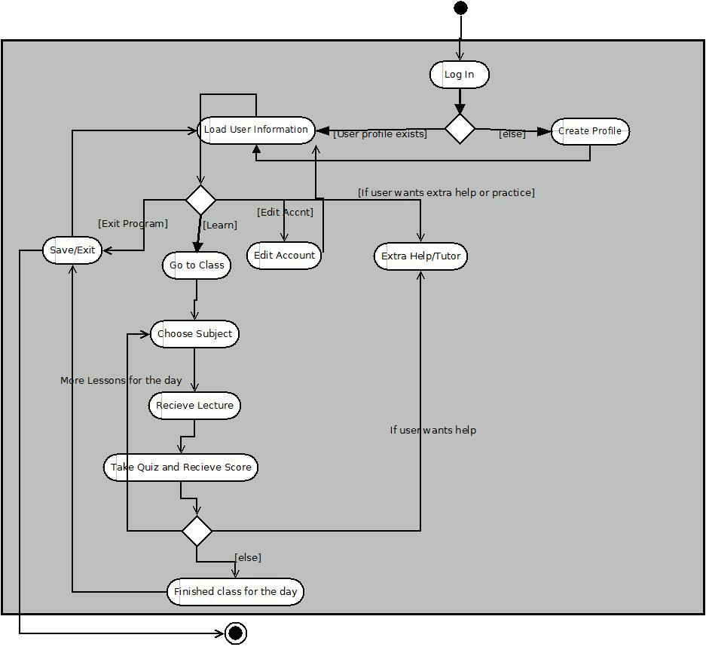
Activity Diagram

Slide 39
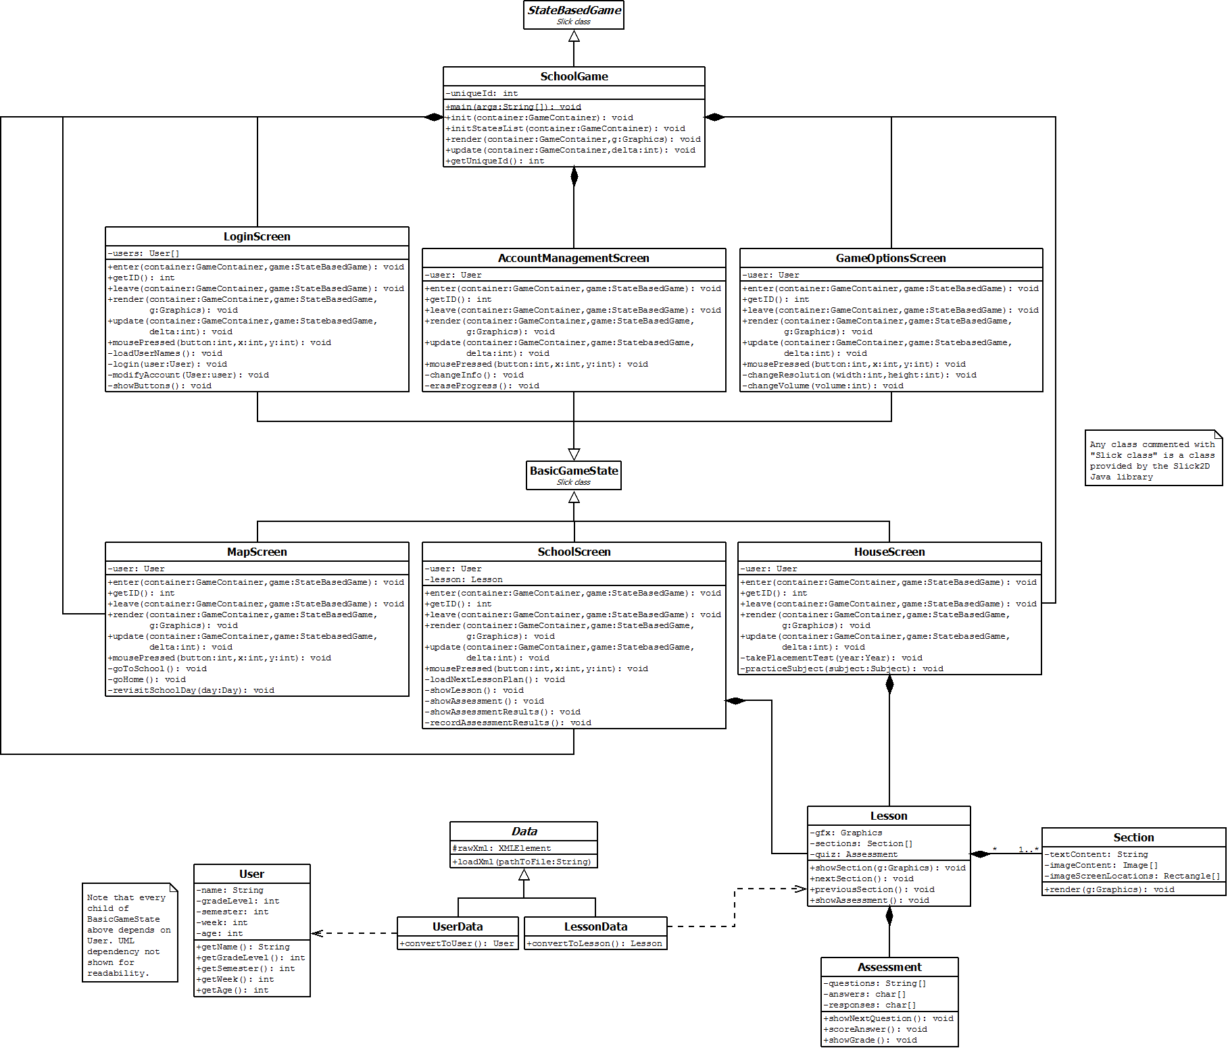
Class Diagram

Slide 40
Design Decisions
Interactive home screen (2 views)
Map view
Calendar view

Slide 41
Design Decisions
Map view
Select school
Select subject
Select house
Placement and options
Navigate with mouse

Slide 42
Design Decisions
Calendar view
Revisit a previous lesson
Take an old quiz
Complete visual history of progress

Slide 43
Design Decisions
1 “day” at school = 1 subject lesson
1 “week” at school = All 4 subject lessons

Slide 44
Design Decisions
Completing a lesson involves:
Viewing the material
Taking a quiz/assessment
Must pass to advance
Fail? View material again and/or retake

Slide 45
Design Decisions
Too easy?
Skip a grade
Must take final exam though

Slide 46
Design Decisions
Too hard?
Tutor is available
Tutor provides more questions
This involves creating many more questions though

Slide 47
Design Decisions
A Big Goal
Nice Appearance
Should look colorful and inviting
Kid-friendly
A Bigger Obstacle
We can’t draw

