Slide 1
Gemmy english
Student management

Slide 2
agenda
Server
Domain
Fee

Slide 3
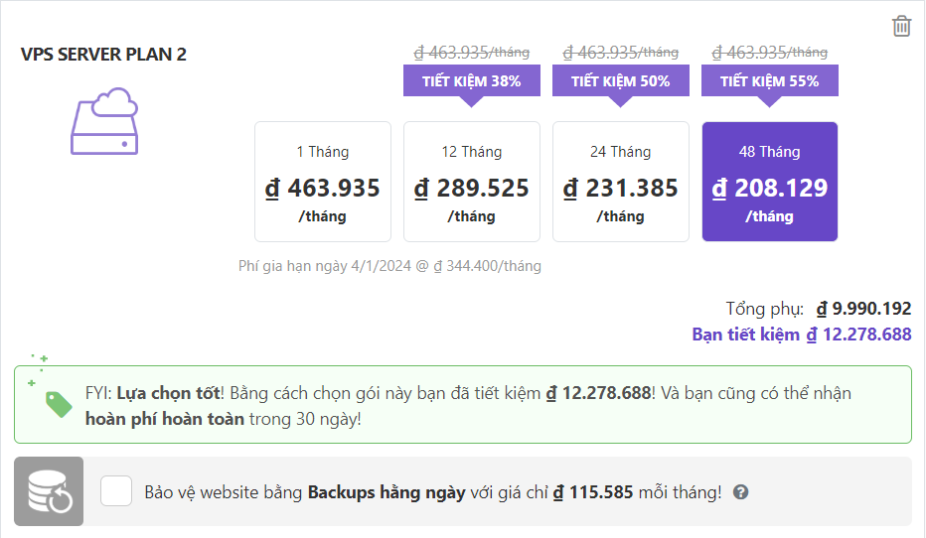
VPS – Virtual Private Server
Hostinger.vn
Price can be changed but it is about 460.000/mon

Slide 4
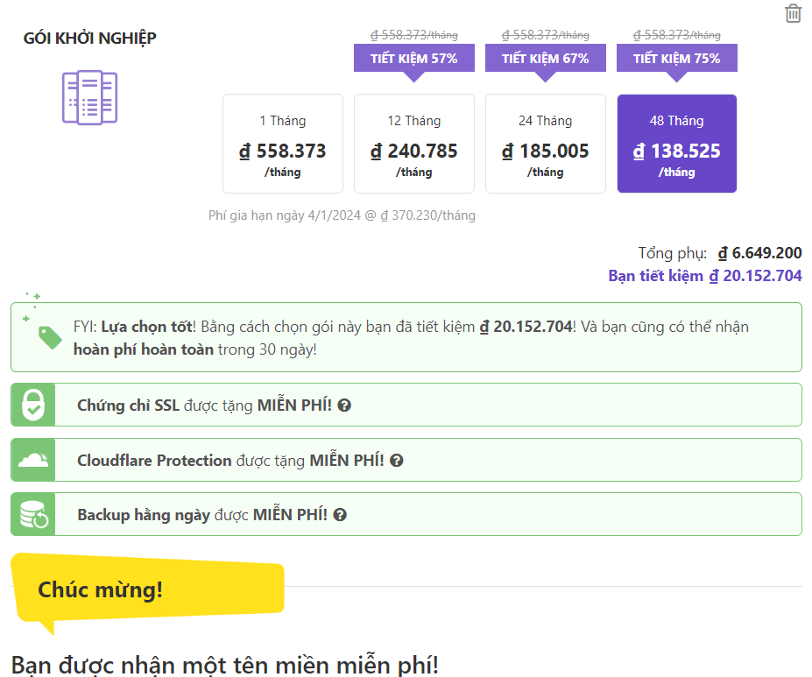
Cloud server
1 domain for free
Better than vps

Slide 5
Domain
https://www.matbao.net/ten-mien/bang-gia-ten-mien.html
https://inet.vn/domain/bang-gia-ten-mien
Common domain:
Domain | First year | Next years
.vn | 770.000/y | 460.000/y
.com | 185.000/y – 240.000/y
.com.vn | 670.000/y | 360.000/y
.edu.vn | 490.000/y | 260.000/y

Slide 6
Fee
10$/h
Main feature: (1d = 8h working)
Database: 3d
Login: 2d
Student list: 1d
Class management: 3d
Report: 1d
Fee Management: 1D
Salary Management: 1d
Score management: 1d
Landing page: 8m

Slide 7
Release plan
Divide into 4 phase
First release: 13 March 2020 – 30%
- Requirement:
- Database
- student management
- class management
- staff management
2. Second Release: 5 April 2020 – 30%
- report file
- Fee management
- salary management
- Score management
3 last release: 3 May 2020 – 30%
- login
- landing page
4. Fix issue - – 10%

