Slide 1

Predicting the number of movie torrents to appear online
Bryant Biggs
15th June 2016

Slide 2
Data
www.the-numbers.com => Title & Production Budget
www.omdbapi.com => Genre, Release Date, Runtime, Rating, Actors, Runtime, etc.
torrentz.eu => Torrent Count
kat.cr => Torrent Count
thepiratebay.org => Torrent Count
 | Title | Budget | Released | Year | Month | Rated | Runtime | Genre | Director | Actors | Torrents
0 | The Siege | 70000000.0 | 1998-11-06 | 1998 | 11 | R | 116 | Action, Thriller | Edward Zwick | Denzel Washington, Annette Bening, Bruce Willi... | 113

Slide 3
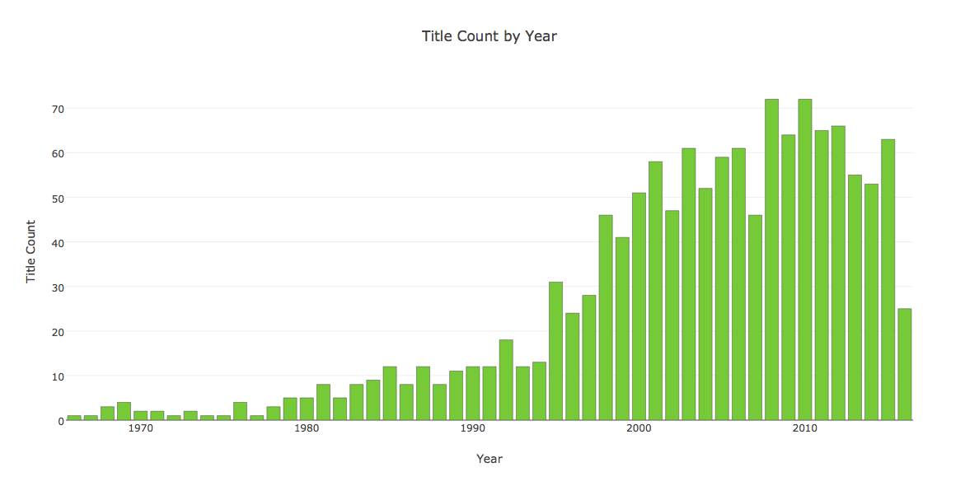
Cutoffs
Years: 1998 – 2015
Genres: - Action, Adventure, Comedy, Drama

Slide 4
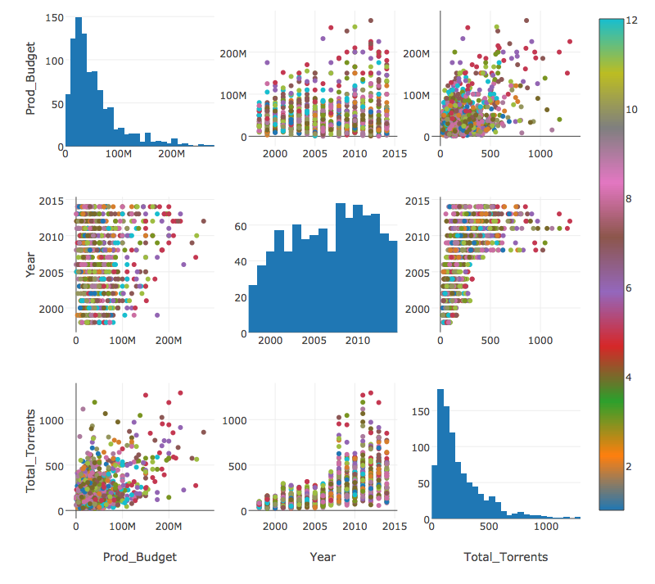
standard

Slide 5
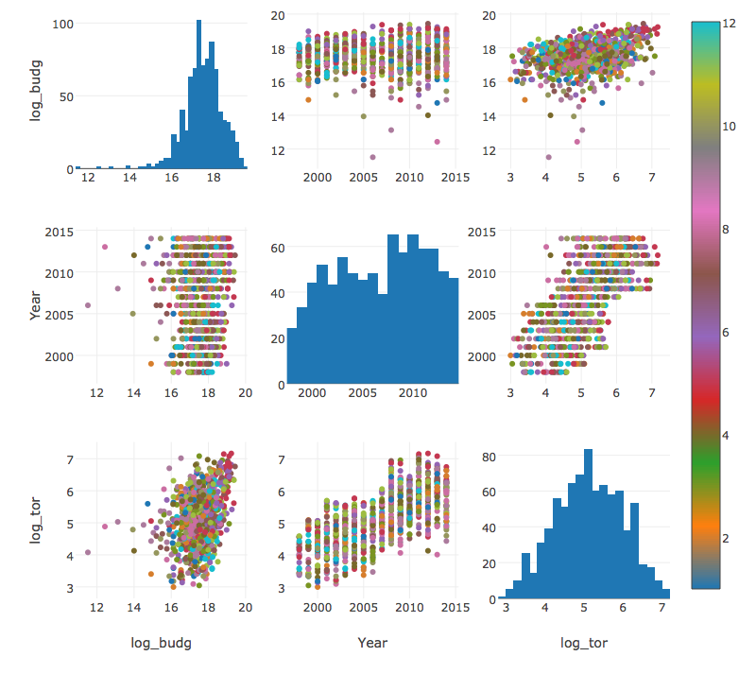
Log Transform

Slide 6
Results
R-squared: | 0.638
Adj. R-squared: | 0.635
F-statistic: | 181.3
No. Observations: | 831
Df Residuals: | 822
Features | coef
Genre[T.Adventure] | -0.2901
Genre[T.Comedy] | -0.5138
Genre[T.Crime] | -0.6252
Genre[T.Drama] | -0.3233
log_budget | 0.2505
Year | 0.1249
Train Model Score = 0.64
Train Mean Square Error = 0.26
Test Model Score = 0.69
Test Mean Square Error = 0.25

Slide 7
future
- Reduce data fallout
- Explore other analysis models & regularization
- Collect data on torrent quality
- Time series analysis with in inflation
- Better classification for genre (varies by website)
Thank you.

