Slide 1
Swift
CSCI 6221 Advanced Software Paradigms
Oğuzhan Yangöz, Yuang Zhang, Kusch Qin
4/11/2022

Slide 2
Criteria for programming language
Readability
Writability
Reliability
Cost

Slide 3
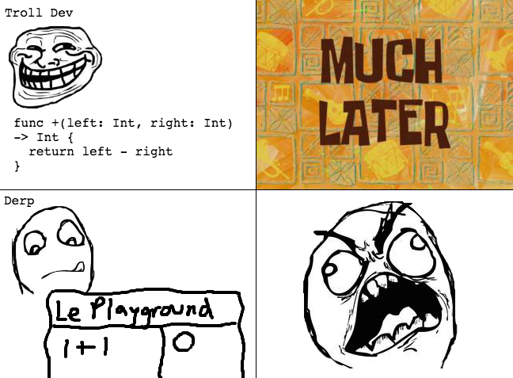
Readability
Overall Simplicity
number of basic construct
feature multiplicity
let b = 10 let a = 5 equivalent to let (a, b) = (5,10)
operator overloading
Graph from:Operator Overloading in Swift Tutorial | raywenderlich.com

Slide 4
Readability
Orthogonality
e.g. = vs ==
Data type
Int/Uint, Float, Double, Bool, String, Character, Optional, and Tuple
Syntax Design
Ruby

Slide 5
Writability
Expressivity
prefix expressions
infix expressions
primary expressions
postfix expressions.

Slide 6
Reliability
Type Checking
The is operator The is op
The is operator checks at runtime whether the expression can be cast to the specified type. It returns true if the expression can be cast to the specified type; otherwise, it returns false
Using type(of:)
Unlike the is operator, this can be used to check the exact type, without consideration for subclasses.
Swift is Type-Safe – i.e. Can’t pass a String when an Int is expected
Swift has Type Inference – Compiler can infer type at compile time

Slide 7
Reliability
Exception handling
Aliasing
Allows Type Aliasing using typealias
Ex: typealias Inches = Int

Slide 8
Cost
training programmers to use the language
writing programs in the language
compiling programs in the language
executing programs
cost of the language implementation system
cost of poor reliability
cost of maintaining programs

Slide 9
definition of 3 measurable criteria
Number of application fields
Number of problem-solving source
Average Annual Developer Salary
Learning Resources

Slide 10
Number of application fields
The core of Swift's grammar design is still OOP, but this does not prevent Swift's grammar from being strengthened in supporting POP and functional programming and even DSL. Furthermore, because of SDL features, Swift has gradually adapted to the development of declarative programming.
SWIFT is suitable for macOS, iOS, watchOS and Apple tvOS, etc.

Slide 11
Number of problem-solving source
Swift has 232,474 available github repository results
Swift has 311,709 available stack overflow question results
Swift has 39,556 available SAP sources
Popularity – Swift vs Python, C, Java, C++

Slide 12
 | Swift | Objective-C | Fluter | C#
github | 232,474 | 17,751 | 467 | 193,276
Stack overflow | 311,709 | 292,329 | 333 | 1,531,799
SAP | 39,556 | 828,275 | 99,561 | 247,432

Slide 13
Average Annual Developer Salary
Swift vs Common Languages
(Python, Java, C/C++, Javascript, C)
Swift vs Specialized Languages
(Clojure, Rust, R, Kotlin, Go)

Slide 14
Learning Resources
Swift has a lot of learning resources, but most of them are online courses, and most of the textual information comes from its official documents.
Over 2000 Swift books can be found on Amazon.

Slide 15
 | Swift | Objective-C | Fluter | C#
Number of books | 182 | 34 | 0 | 408

