Slide 1

NDF-GAN-WSL(Neural Distance Field）
Generative Models for 3D Shapes
Presenter: WANG MENG
Date:19th JAN 2026

Slide 2

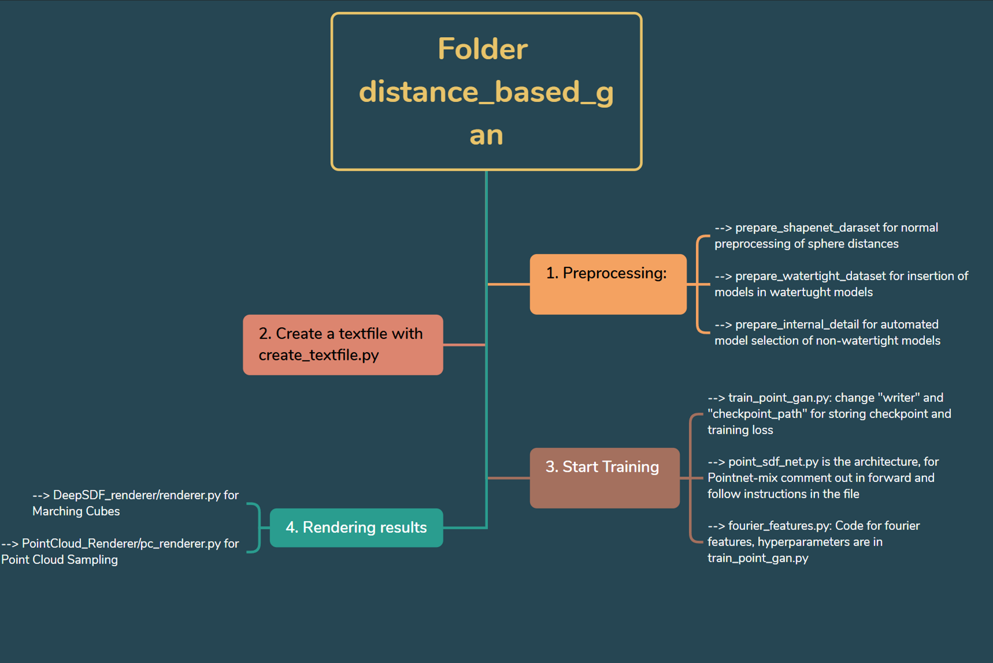
OVERVIEW
RESEARCH EXPERIENCE
WHY PHD
RESEARCH PROPOSAL
FLOW
CHART

Slide 3

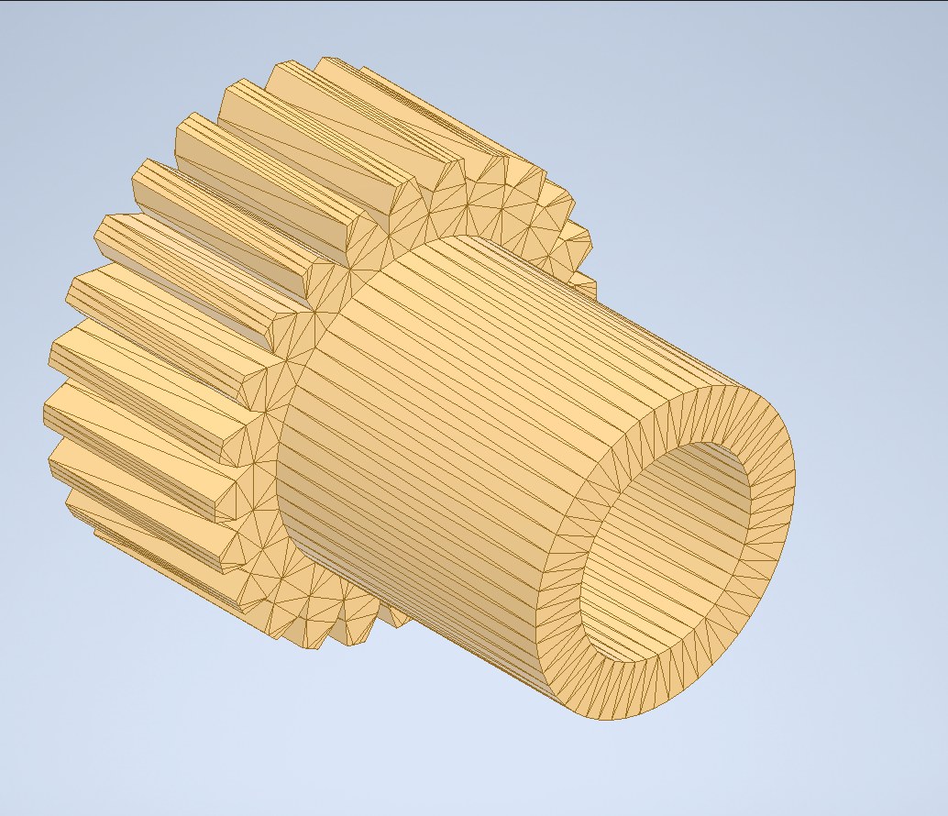
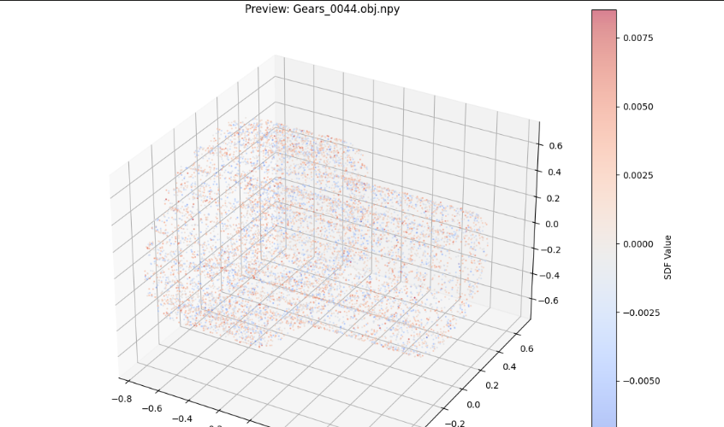

Overview: prepare_shapenet_dataset.py
Its primary mission is Data Transformation :
1. Input : Raw .obj files (Mesh polygons).。
2. Process :
○ Normalization: Scales the car to fit inside a unit sphereSampling: Picks thousands of points around the model.
○ Distance Calculation: Measures how far each point is from the model's surface.
Output : .npy files containing (x, y, z, distance) data.

Slide 4
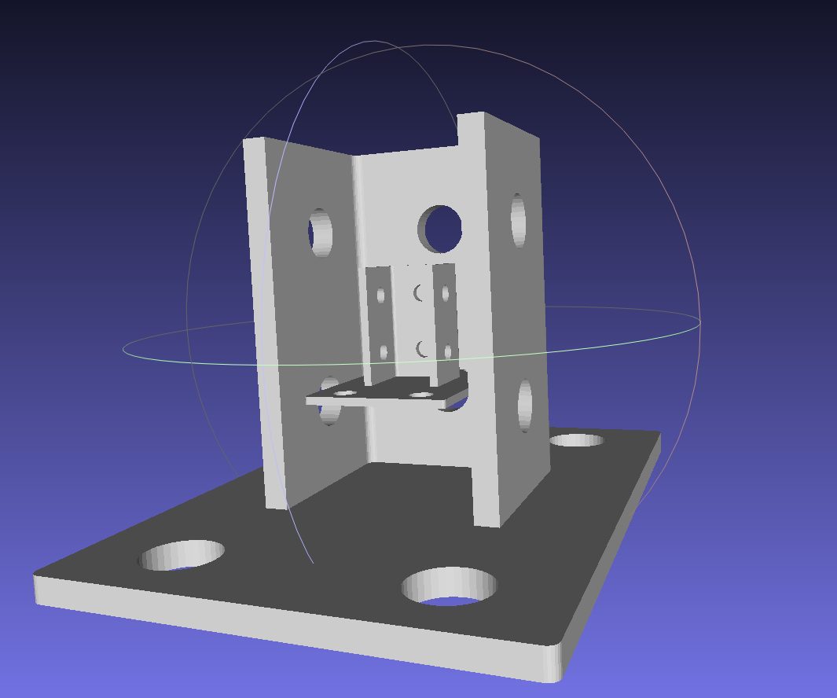
Overview: repare_watertight_internal_dataset.py
This script is designed to generate an "Internal Kernel" for the original 3D mesh model (usually a surface shell, such as a car shell) and merge it with the original shell.
Input: The original.obj model (for example, the car in the 00 good folder). Output: Enhanced.ply model (save to 00 good watertight folder), including shell + reduced interior copy.

Slide 5
Overview: prepare_internal_detail.py
Function: Automated model selection.
Workflow:
Calculate the Convex Hull of the 3D model.
Compute the Chamfer Distance (or average distance) between the surface point cloud of the original model and the surface point cloud of its convex hull.
A threshold (set to 0.029 in the code) is predefined; models with a calculated distance lower than the threshold are classified as "simple models" and discarded.

