Slide 1
Bootstrap Basic
Herpiko Dwi Aguno
<herpiko@gmail.com>
CC-BY-SA

Slide 2
Brief intro of CSS
Inline styling
<div style=”color:red”>apadah</div>
Inside <style> tag
<style>
.class-name {
property : value
}
</style>
External CSS file(s)
<link type="text/css" href="style.css?v=2" rel="stylesheet"/>

Slide 3
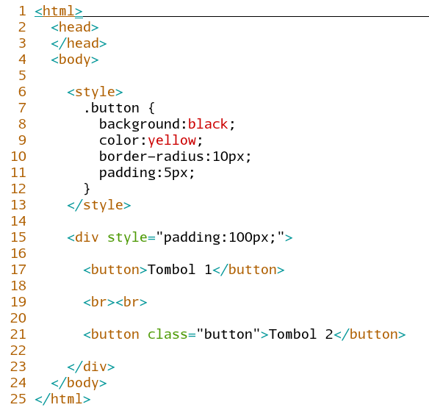

Slide 4
WTH is Bootstrap?
CSS Framework for faster and easier development
Create responsive layout design with less effort
Some UX feature like menu dropdown, etc
Consistent design
Open source

Slide 5
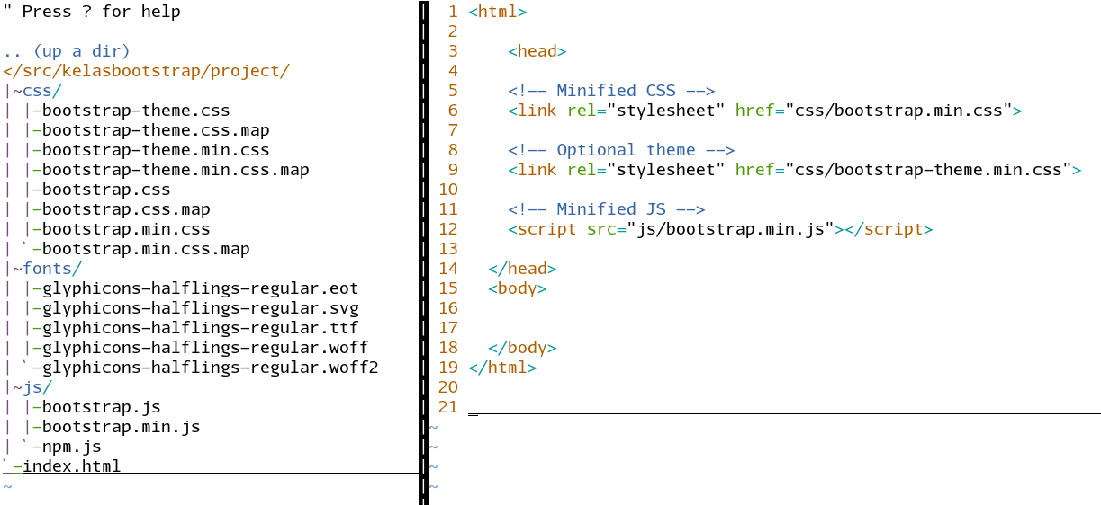
Basic Usage

Slide 6
Grid System
12 column
container
row
col-xs-, col-sm-, col-md-, col-lg-

Slide 8
Container
Row 1
Row 2
Row 3

Slide 9
Table table-striped table-bordered table-hover table-condensed
Notes:
Use thead and tbody
Table-stripped
Table-bordered
Table-hover
Table-condensed

Slide 10
List list-inline list-unstyled
Notes:
List-inline
List-unstyled

Slide 11
Form & Input form-group form-control input-group input-group-addon
Notes:
<form
Form-group
Label
form-control
Input-group
Input-group-addon
Form-control
Using col

Slide 12
Button btn btn-group btn-default btn-primary btn-info btn-success btn-warning btn-danger
Notes:
Btn
Btn-group
Default primary info success warning danger

Slide 13
Images img-circle img-thumbnail img-rounded
Notes:
Img-rounded circle thumbnail

Slide 14
Icon glyphicon glyphicon-keyword
Notes:
Glyphicon glyphicon-

Slide 15
Navigation navbar navbar-inverse navbar-fixed-top navbar-fixed-bottom
Notes:
<nav navbar navbar-fixed-top

Slide 16
Any question?

Slide 17
Thank you

