Slide 1

Portscanner
Applied Information Security 12.01.2016
Simon Targa Mirko Bez

Slide 2
Aim of the project
Understand the theory under Port Scanners and Detectors
Implement a C port scanner
  Various scan methods e.g. TCP connect scan, TCP SYN scan …
  Console program like nmap
Implement a C port scan detector
  Console program

Slide 3
Motivation
Which ports are open?
Admins scan system/network:
  Chek security of a network/system
  Check intrusion attempts
Attackers scan victims:
  Identify services that are running on a system
  Check vulnerabilities of systems
  Exploit vulnerabilities in services running on open ports

Slide 4
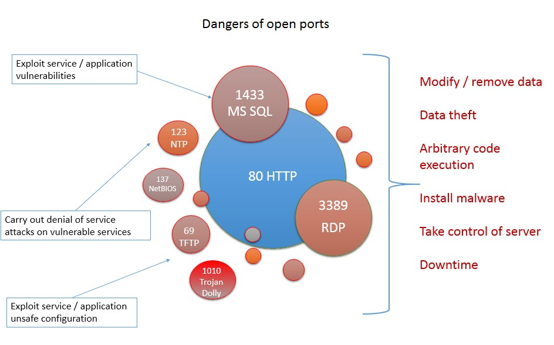
Danger of open ports

Slide 5
Implemented Scan Methods
TCP connect scan
TCP SYN scan
NULL scan
XMAS scan
FIN scan
Maimon scan

Slide 6
TCP connect scan
Simple approach
Use system call connect() to try to establish a connection
SOCK_STREAM socket (TCP socket)
Check the return value of connect()
  0 → connection successful → port is open
  Otherwise port is closed

Slide 7
Advantages/Disadvantages
Advantages:
+ Accurate
+ Fast
+ No root privileges required
+ Easy implementation
Disadvantages
- Easy detectable/logged

Slide 8
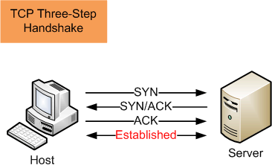
TCP Handshake

Slide 9
SYN scan
Half-open scanning →
doesn't open full TCP connection
Send SYN packet
SYN/ACK response = port is listening
RST = port is close
TIMEOUT(no answer) = port is filtered
Standard scan method of nmap

Slide 10
Advantages/Disadvantages
Advantages:
+ Reliable
+ Fast
+ No TCP three-way handshake → No logs
Disadvantages
- Requires root privileges

Slide 11
Raw socket
Allows direct sending and receiving of Internet Protocol packets without any protocol-specific transport layer formatting
Programmer builds packet to send
Full control over headers (IP and TCP)
Allows sophisticated scan techniques

Slide 12
Implementation
Use RAW socket and set IP and TCP header
Only set SYN Flag in TCP Header
Send the packet to target machine
Receive packets from target machine and check flags:
  SYN/ACK flag set = port is open
  RST flag = port is closed
  TIMEOUT (no response) = port is filtered

Slide 13
XMAS, FIN, NULL scan
Exploits a subtle loophole in the TCP RFC to differentiate between open and closed port
RFC 793 says:
  “if the [destination] port state is CLOSED .... an incoming segment not containing a RST causes a RST to be sent in response”
  If packets are sent to open ports without the SYN, RST, or ACK bits set it states: “you are unlikely to get here, but if you do, drop the segment, and return.”

Slide 14
Advantages/Disadvantages
Advantages:
+ More stealthy than SYN scan
+ No TCP three-way handshake → No logs
Disadvantages
- Requires root privileges
- Slow false positives

Slide 15
Flags
NULL scan: Does not set any bits (TCP flag header is 0)
FIN scan: Sets just the TCP FIN bit
XMAS scan: Sets the FIN, PSH, and URG flags, lighting the packet up like a Christmas tree
Maimon scan: Sets FIN and ACK flags

Slide 16
Implementation
Use RAW socket and set IP and TCP header
Set Flags depending on method in TCP Header
Send the packet to target machine
Try to get a response:
  RST packet received = port is closed
  No response = Port is open/filtered

Slide 17
Port Scan Detector
Aim: detect port scan of the different types
Main Idea:
You are (potentially) port scanned if in a short interval you receive a lot of UDP or TCP requests from the same IP-Address

Slide 18
Port Scan Detector Functionality
Scanlogd Approach
  At least 7 different privileged or 21 non-privileged ports […] have to be accessed with no longer than 3 seconds between the accesses to be treated as a scan.
Source http://www.openwall.com/scanlogd/scanlogd.8.shtml
Sophos Approach (Implemented)
  “A port scan is detected when a detection score of 21 points in a time range of 300ms for one individual source IP-Address is exceeded”
Source https://www.sophos.com/it-it/support/knowledgebase/115153.aspx

Slide 19
Sophos Aproach: Point Score
Detection Score can be calculated as follows:
Packet with TCP destination port < 1024: 3 points
Packet with TCP destination port >= 1024: 1 point
Packet with TCP destination port = 11, 12, 13 or 2000: 10 points
Source https://www.sophos.com/en-us/support/knowledgebase/115153.aspx

Slide 20
Implementation Notes
PCAP library used
  Used by Wireshark and TCPdump to get packets!
  Easy API
  Possibility to choose which packets to get:
  e.g. “dst host 192.168.0.1 && dst portrange 1-1024”
For each potential attacker (i.e. different IP-Source) a thread is started
This thread checks each 300 ms if a port scan is detected

Slide 21
Little Demonstration

Slide 22
Summary
Port Scan are used to determine which ports are open
  Open ports can be used for different attacks
  To defend from port scans → use a Port Scan Detector and close as many ports as possible!
We implemented
  A TCP Port Scanner with 6 scan methods available
  A TCP/UDP Port Scan Detector

Slide 23
Thank you
Thank you for your attention
Are there Questions?

