Slide 1






Disease Course Maps
allow the monitoring of disease progression
Igor Koval, PhD
Post-doctoral fellow @ ARAMIS Lab

Slide 2
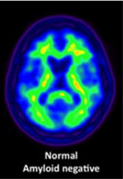
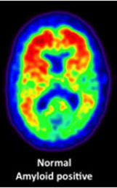
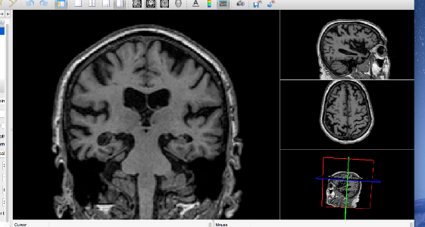

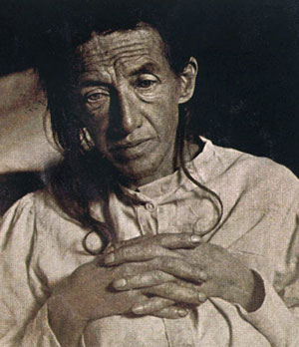

Alzheimer’s Disease
> 10 y
6 – 8 y
~65 years
diagnosis
care
Build computational model of disease progression
from clinical and imaging data
Sumarize the variability of disease progression profiles
Position individual subject on his own trajectory
Predict the future progression
Determine who and when to treat or intervene

Slide 3
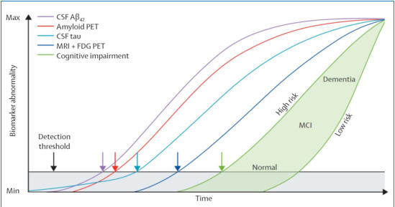
Neurodegenerative disease timeline
Motor
Prodromal signs
Cognitive
Neuropsychologic
diagnosis
Neurodegenerative disease timeline
Schematic example
AD progression [ Jack et al, 2013 ]
Objective: Build computational model of disease progression from clinical & imaging data
Summarize the disease progression profile & its variability in the population
Position individual subject on this disease timeline
Determine how cofactors (education, genetic mutations, environmental factors, …) modulate this progression
Predict the future progression
Determine who and when to intervene & treat

Slide 4
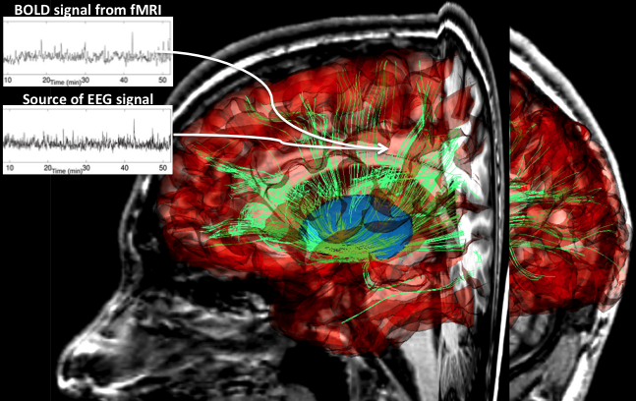
Longitudinal Data Analysis
Time (age)
subject #1
subject #2
subject #3
Temporal marker of progression
(e.g. time since drug injection, seeding, birth, etc..)
Regression
(e.g. compare measurements at same time-point)
Linear mixed-effects models
[Laird&Ware’82, Diggle et al., Fitzmaurice et al.]
Learning spatiotemporal distribution of trajectories
Find temporal correspondences
Compare data at corresponding stages of progression
Needs to disentangle differences in:
Measurements
Dynamics of measurement changes
No temporal marker of progression
(e.g. in aging, neurodegenerative diseases, etc..)
Notes:
Key message : Need time re-alignement and data normalization → difficult

Slide 5



Longitudinal Data Analysis
Realign temporally the individual data to reconstruct long-term scenario of disease progression from short sequences of individual data
Disentangle the individual characteristics from the average progression to compare them
Disentangle the measurement values from the measurement dynamics to predict future disease stages
Notes:
Key message : Need time re-alignement and data normalization → difficult
Key message:
1/ We combine short sequence of individual data to build a long-term scenario of disease progression
2/ We learn how the individual sequence differ one from each others
3/ We personalize the model to subjects’ data to determine the disease stage and predict his or her future progression

Slide 6

?
Notes:
Key message:
1/ We combine short sequence of individual data to build a long-term scenario of disease progression
2/ We learn how the individual sequence differ one from each others
3/ We personalize the model to subjects’ data to determine the disease stage and predict his or her future progression

Slide 7
Disease Course Map:
an atlas of disease progression

Slide 8
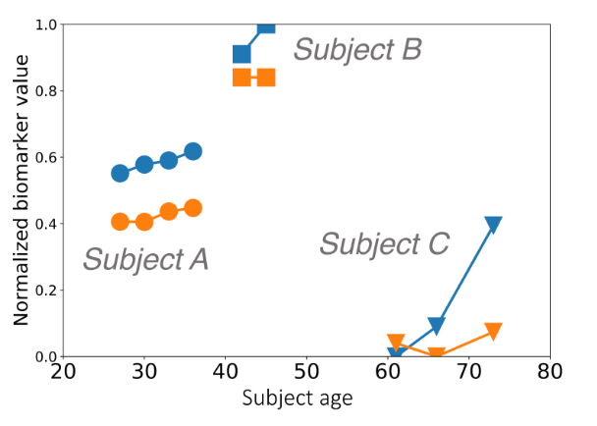
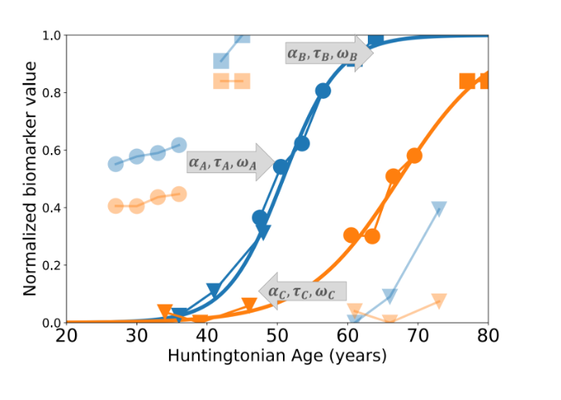

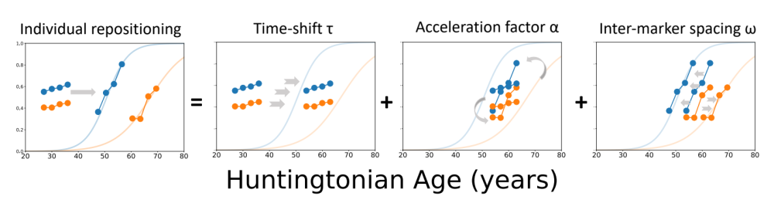
Model intuition
Average progression of the biomarkers:
Long temporal description
Without individual variability
Longitudinal progression of two biomarkers for three patients
NB: All biomarkers are normalized between 0 and 1 (increasing progression)

Slide 9
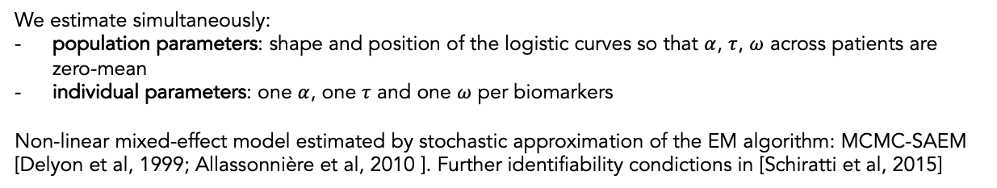
Model estimation
Longitudinal progression of two biomarkers for three patients
Average progression of the biomarkers
We estimate simultaneously:
population parameters: shape and position of the logistic curves so that $α$, $τ$, $ω$ across patients are zero-mean
individual parameters: one $α$, one $τ$ and one $ω$ per biomarkers
Non-linear mixed-effect model estimated by stochastic approximation of the EM algorithm: MCMC-SAEM [Delyon et al, 1999; Allassonnière et al, 2010 ]. Further identifiability condictions in [Schiratti et al, 2015]

Slide 10
Huntington Disease Course Map
Selected subjects:
TRACK-HD:
117 pre-symptomatic HD mutation carriers
116 subjects with early-stage HD
TRACK-ON:
239 roller participants + new pre-symptomatic mutation carriers
NB: Controls: 186 relatives without pathogenic HD-mutation
Selected biomarkers:
15 biomarkers:
3 clinical biomarkers: Total Motor Score, Total Functional Capacity, Apathy
4 cognitive biomarkers: Stroop reading test, Symbol Digit Modality Test, Direct and indirect Circle Tracing
8 imaging biomarkers: striatum, globus pallidus, putamen, ventricles, caudate, white matter, grey matter and total brain volume - all normalized to total intracranial volume
Notes:
Il manque la durée de suivi et le nombre moyen de time-point par sujets

Slide 11
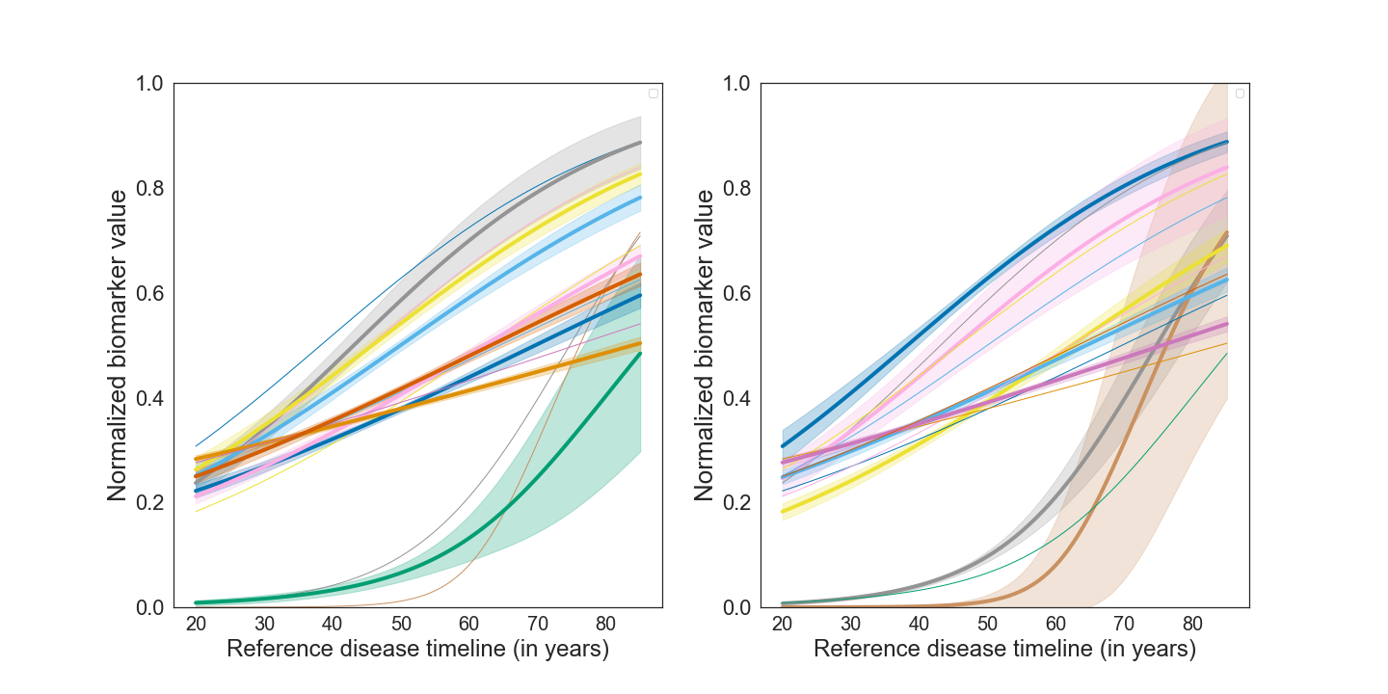
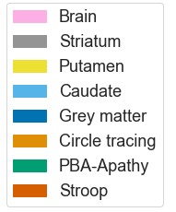
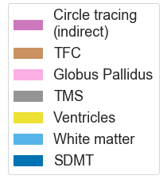
Huntingtonian Age

Slide 12
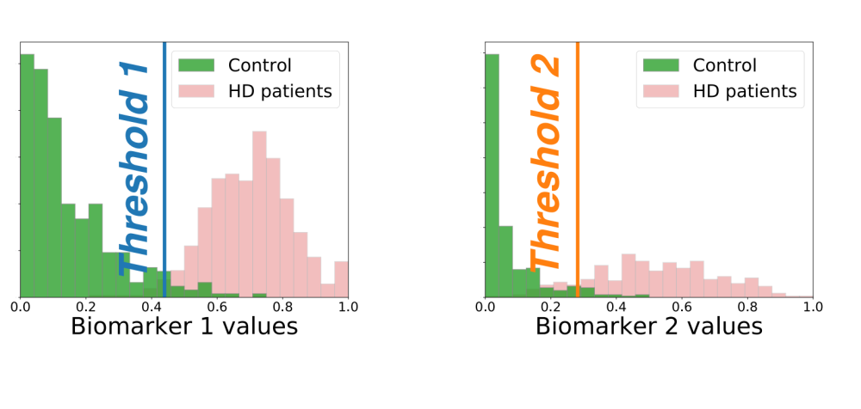
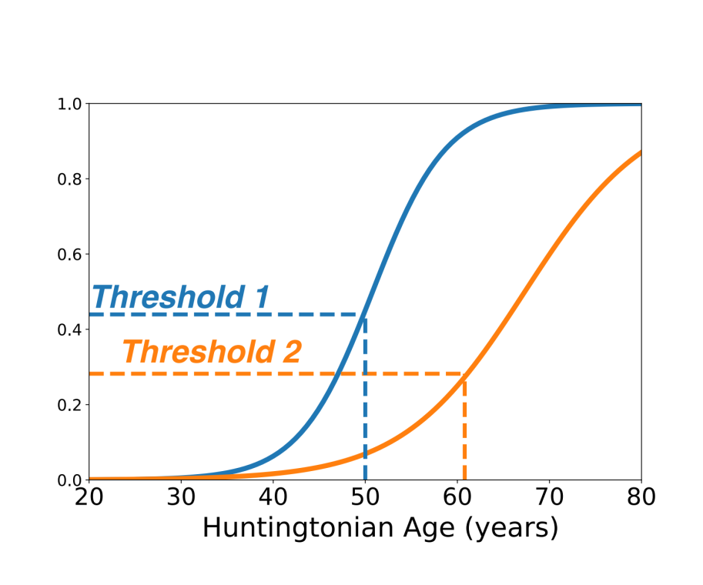
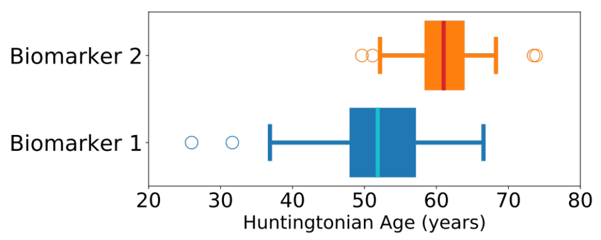

Slide 13
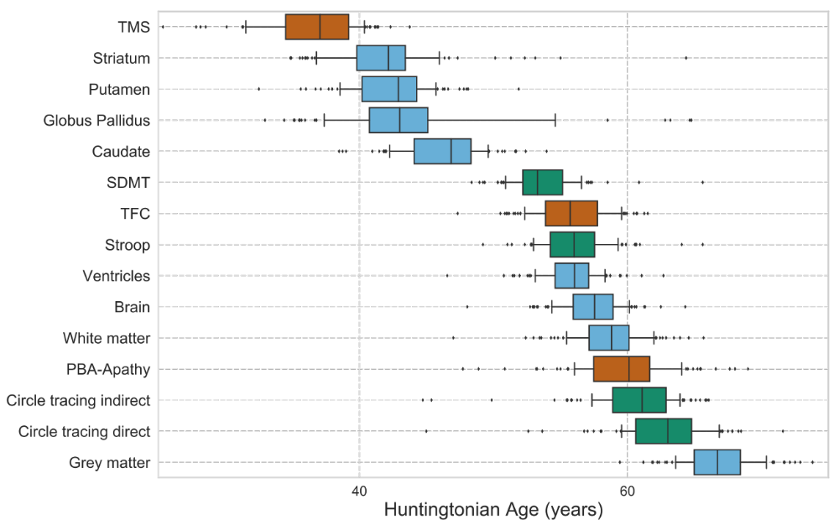
Notes:
Message: such a abnormality sequence allows selection of candidate biomarkers for testing drug at different disease stage

Slide 14
Parkinson’s Disease Course Map
Selected subjects:
PPMI:
362 patients with idiopathic PD
65 patients with idiopathic REM sleep behavior disorder (iRBD)
192 controls
Dig-PD:
411 patients with PD
Average follow-up 3.3 years
Controls
Selected biomarkers:
10 biomarkers:
6 clinical biomarkers
  Motor score (MDS-UPDRS III)
  Self-reported daily living (MDS-UPDRS II)
  Behavior and mood (MDS-UPDRS I)
  Dysautonomy (SCOPA-AUT)
  Cognition (MoCA or MMSE)
  Sleep disorders
4 imaging biomarkers: DAT-scan binding ratio in
  Putamen (L/R)
  Caudate (L/R)
Notes:
Il manque la durée de suivi et le nombre moyen de time-point par sujets

Slide 15
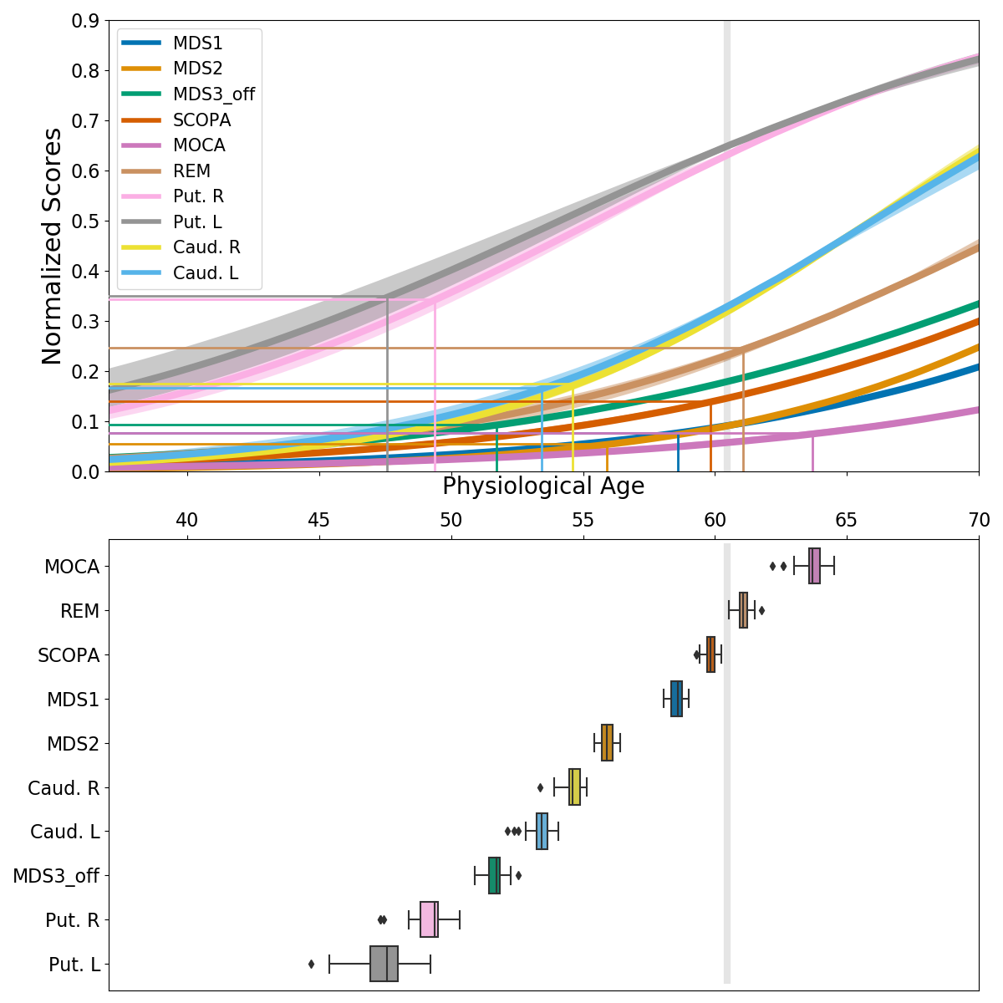

Slide 16
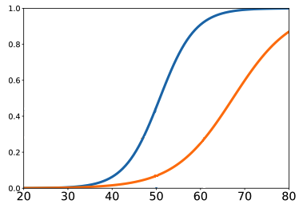
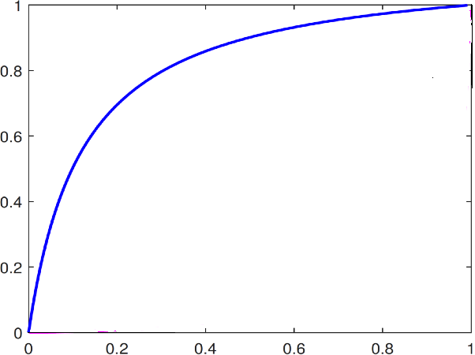
Generalization of other data types such as images
t=80y
t=70y
t=60y
Biomarker value
biomarker 1
t=50y
45 yo
40 yo
t=40y
38 yo
t=30y
Age (years)
biomarker 2
biomarker 1
biomarker 2
Notes:
Il faut refaire la figure de droite car les valeurs ne correspondent pas avec le graphe de droite…

Slide 17
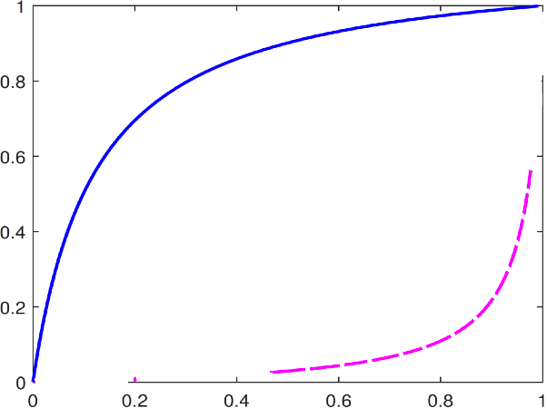
Time-shift + acceleration
Inter-marker spacing
t=80y
t=80y
t=70y
t=80y
t=70y
t=70y
t=60y
t=60y
t=60y
50y
70y
70y
t=50y
t=50y
t=50y
45y
65y
65y
40y
60y
60y
t=40y
30y
38y
t=40y
50y
55y
t=40y
50y
55y
Notes:
Il faut refaire la figure de droite car les valeurs ne correspondent pas avec le graphe de droite…

Slide 18
This construction generalizes to any data that can be represented on a Riemannian manifold, e.g.:
Image whose intensity varies with disease progression
Surface or volume whose shape varies with disease progression
Time-reparametrization
(applies to any curves)
Exp-parallelization
(with orthogonality condition to ensure identifiability)
a Riemanian manifold
a geodesic
t=80y
t=80y
t=70y
t=80y
t=70y
t=70y
t=60y
t=60y
t=60y
50y
70y
70y
t=50y
t=50y
t=50y
45y
65y
65y
40y
60y
60y
t=40y
30y
38y
t=40y
50y
55y
t=40y
50y
55y
Notes:
Il faut refaire la figure de droite car les valeurs ne correspondent pas avec le graphe de droite…

Slide 19
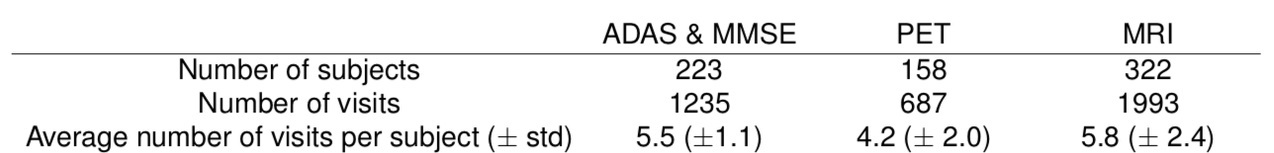
Alzheimer Disease Course Map
Neuropsychological assessments:
  ADAS-Cog (break down in 4 cognitive categories)
  MMSE
Flurodesoxyglucose (FDG) PET:
  Regional brain metabolism
MRI data:
  Cortical thickness maps
  Hippocampal atrophy
www.digital-brain.org

Slide 20
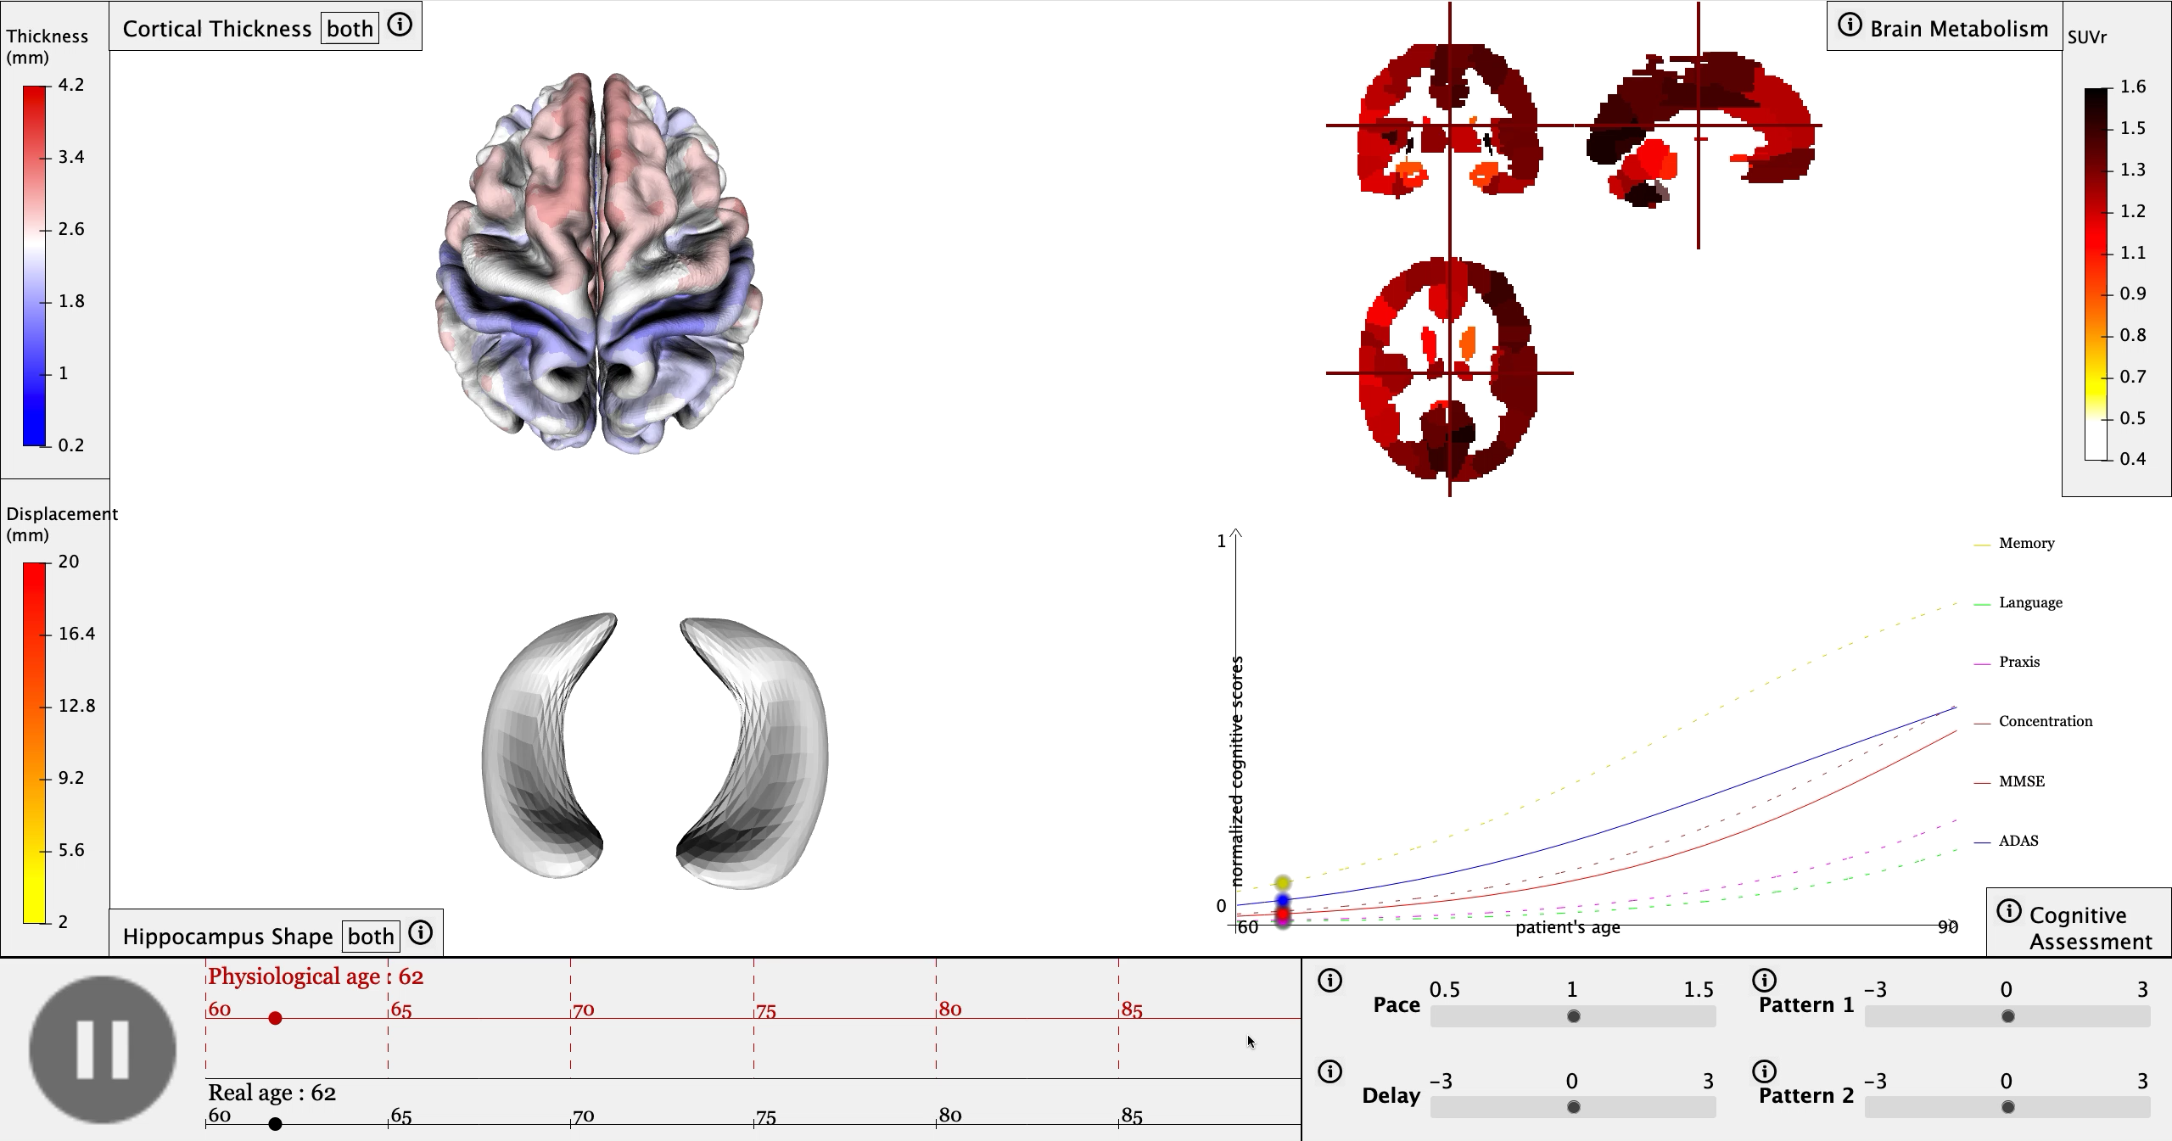
www.digital-brain.org

Slide 21
Disease Course Map
positions the subject’s progression on a personalized trajectory

Slide 22
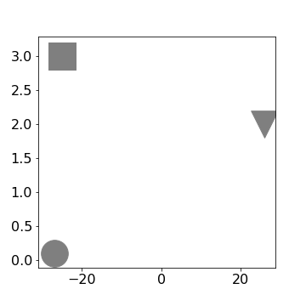
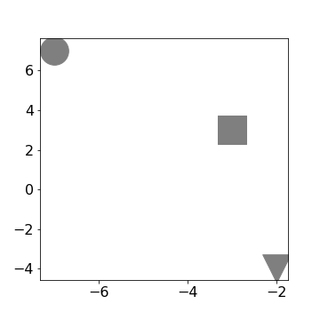




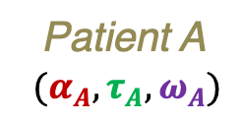

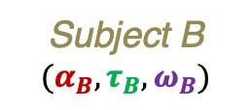


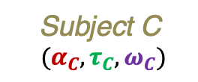


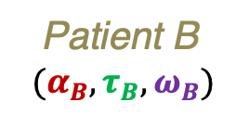



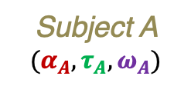
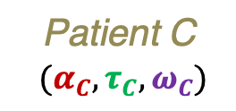



Represent subjects by their individual parameters
$$(α_{B}, τ_{B})$$
$$(α_{C}, τ_{C})$$
Acceleration factor $α$
Inter-marker spacing $ω_{2}$
$$(α_{A}, τ_{A})$$
Subject A $(α_{A}, τ_{A}, ω_{A})$
Subject B $(α_{B}, τ_{B}, ω_{B})$
Subject C
$(α_{C}, τ_{C}, ω_{C})$
Time shift $τ$
Inter-marker spacing $ω_{1}$
Personalization to individual data
Patient A
$(α_{A}, τ_{A}, ω_{A})$
$$(α_{B}, τ_{B})$$
$$(α_{C}, τ_{C})$$
Acceleration factor $α$
Inter-marker spacing $ω_{1}$
Patient B
$(α_{B}, τ_{B}, ω_{B})$
Patient C
$(α_{C}, τ_{C}, ω_{C})$
$$(α_{A}, τ_{A})$$
Time shift $τ$
Inter-marker spacing $ω_{0}$

Slide 23
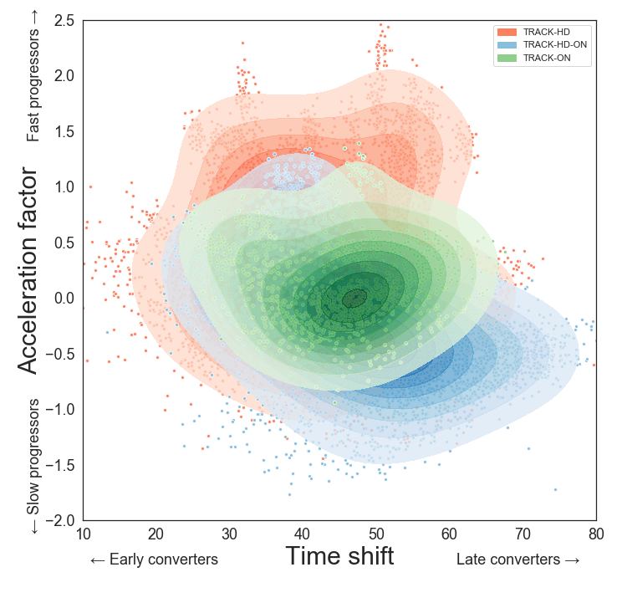
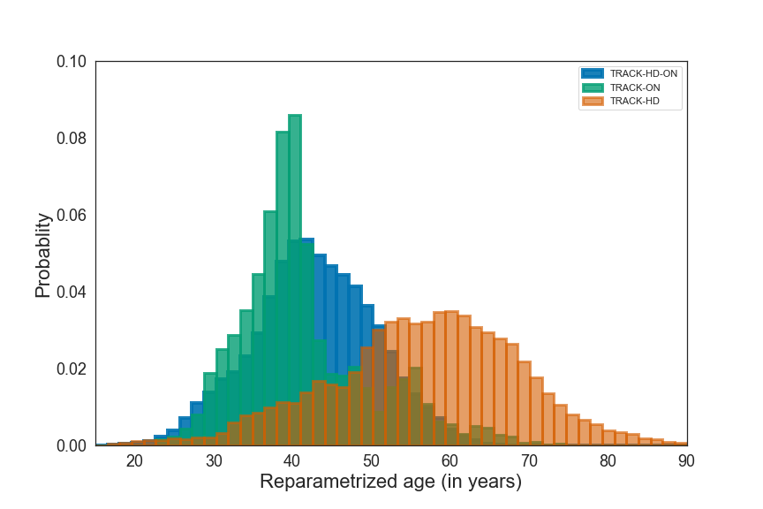
Huntington Disease Course Map
Fast progressors
Track-HD
Track-ON
Late disease stages
Late converters
Huntingtonian age

Slide 24
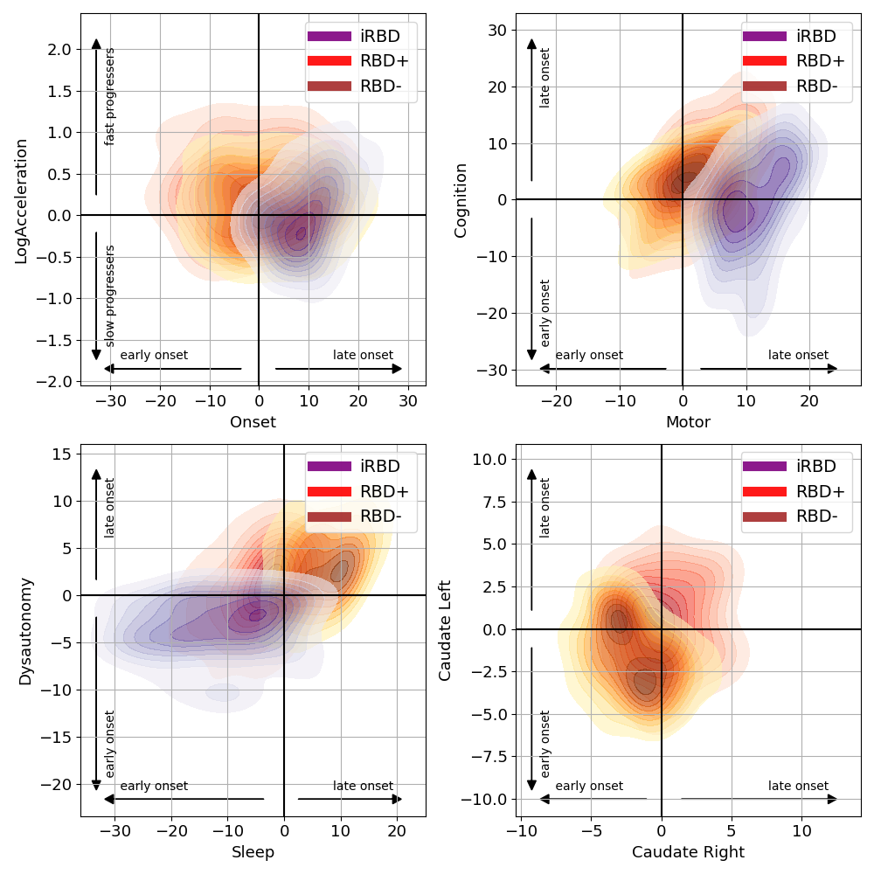
Parkinson’s Disease Course Map

Slide 25
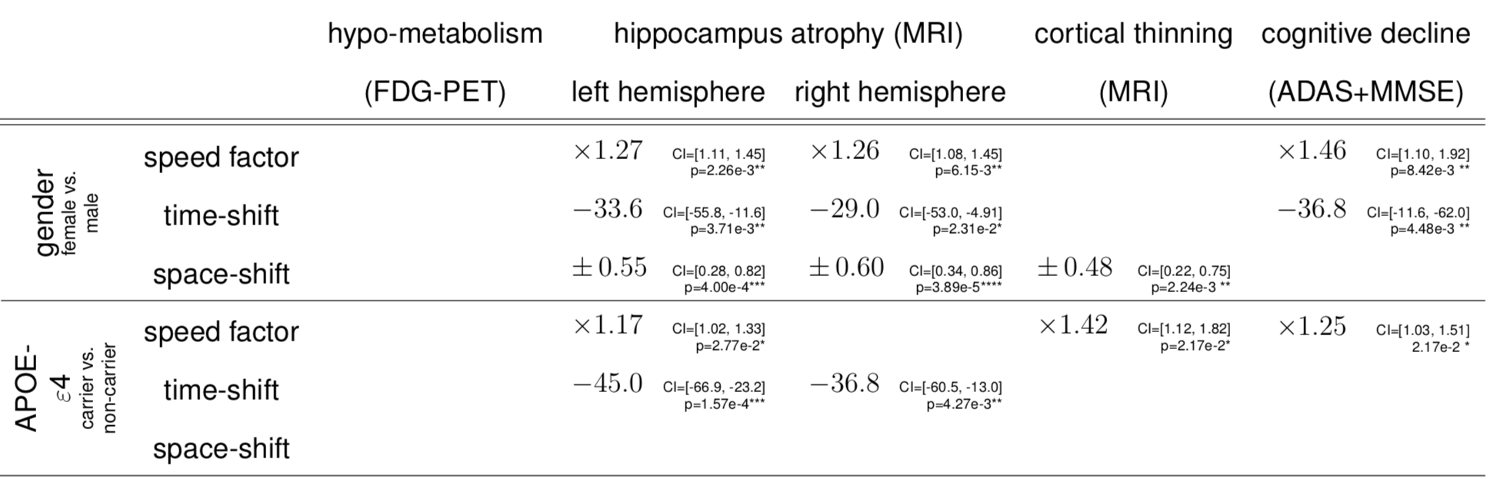
Alzheimer’s Disease Course Map

Slide 26
Disease Course Map
predicts the future subject’s progression

Slide 27
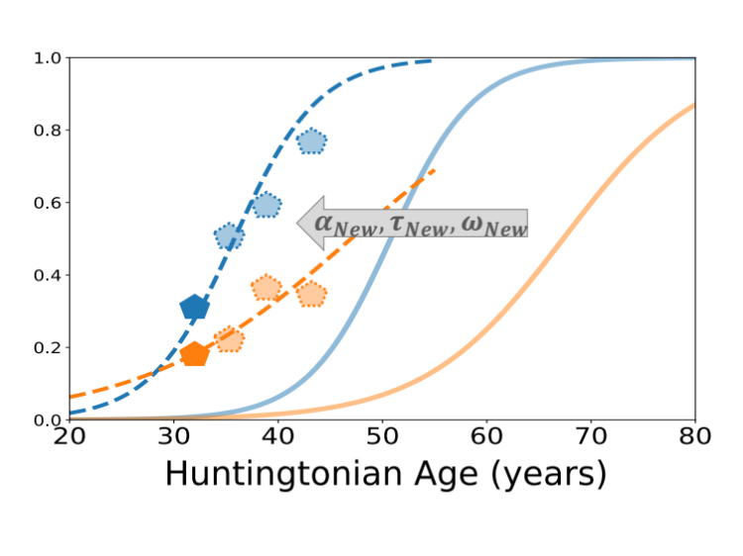
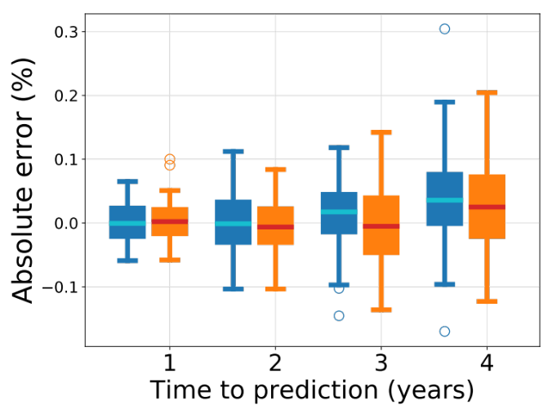
Individual prediction of feature progression
We use past individual data to position a subject on the Disease Course Map.
Then predict how the subject’s biomarkers will change in the next few years

Slide 28
Huntington Disease Course Map
Variable to predict | Time 1 year | Time : 2 years | Time : 3 years | Time : 4 years
SDMT | 1⋅29 (± 5⋅02) | 1⋅31 (± 5⋅70) | 1⋅81 (± 6⋅98) | 4⋅10 (± 7⋅25)
Stroop | 0⋅09 (± 3⋅57) | 0⋅18 (± 3⋅67) | 0⋅69 (± 4⋅62) | 1⋅48 (± 5⋅54)
TMS | -1⋅86 (± 5⋅30) | -1⋅42 (± 5⋅00) | -1⋅92 (± 5⋅53) | -3⋅63 (± 5⋅20)
Mean error (± standard deviation) (in %)
Variable to predict | Time 1 year | Time : 2 years | Time : 3 years | Time : 4 years
SDMT | 3⋅94 (± 3⋅36) | 4⋅42 (± 3⋅83) | 5⋅58 (± 4⋅57) | 6⋅30 (± 5⋅45)
Stroop | 2⋅74 (± 2⋅30) | 2⋅93 (± 2⋅22) | 3⋅47 (± 3⋅13) | 4⋅56 (± 3⋅48)
TMS | 4⋅05 (± 3⋅90) | 3⋅68 (± 3⋅67) | 4⋅02 (± 4⋅25) | 4⋅58 (± 4⋅39)
Mean Absolute error (± standard deviation) (in %)

Slide 29
Alzheimer’s Disease Course Map
ADNI:
1800 subjects
7600 visits
Calibration of the model & prediction
(Cross-validation setting)
COMPARISON:
Constant prediction
Linear Mixed-Effect
International challenge: Tadpole
Pharmacog:
130 subjects
600 visits
Time
AIBL:
800 subjects
1600 visits
Replication: Prediction only
Individual
Predicted timepoint
Subset of
known visits
MEMENTO:
2100 subjects
13000 visits
Results: Talk by Etienne Maheux, tomorrow (Wednesday, 2nd of September), from 10:30 to 11:00
Forecast of the MMSE & ADAS13 scores up to 6 years ahead, with cross-cohort replication
J-ADNI:
500 subjects
3000 visits

Slide 30
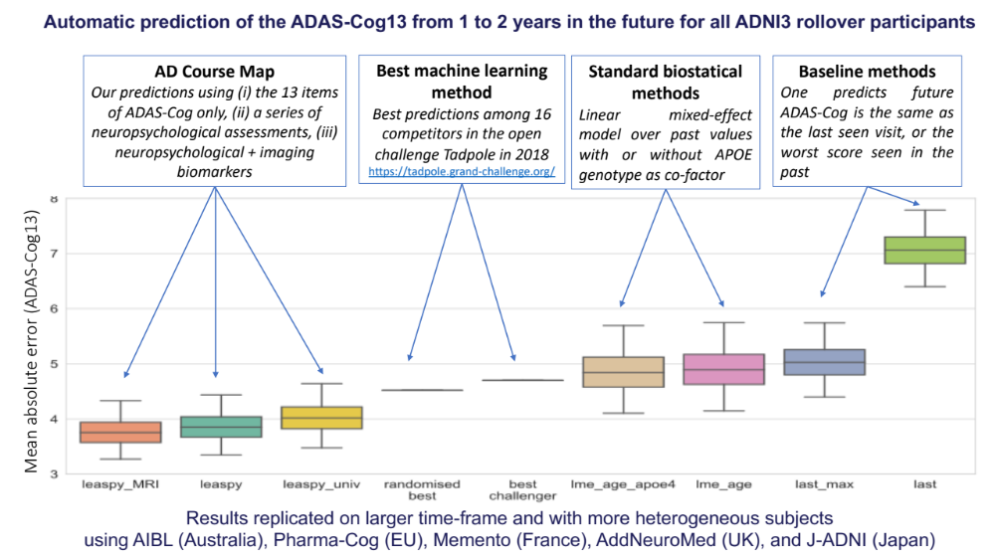

Slide 31
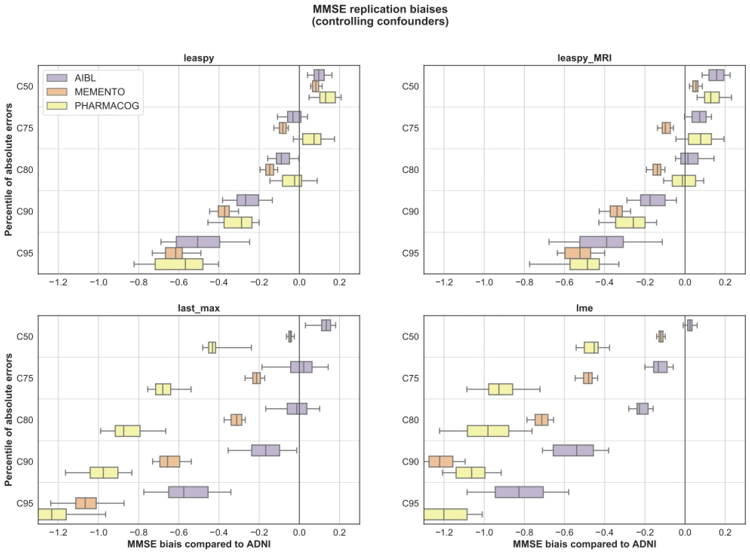
With AD Course Map, distributions of errors are stable across studies
Standard methods exhibit more variability

Slide 32
Disease Course Map
identifies the right patients at the right time

Slide 33
Huntington Disease Course Map
Patients of interest: Target
Initial cohort
Proposed method
Classic inclusion criteria
Patient selection:
Target population: motor score & caudate volume => pathological during the trial
Standard design: burden < 250 & TMS > 5 at inclusion
Proposed design: idem + predicted TMS > 10 in 3 years
Result: Less patients (50% selected) & more accurate selection (26% to 40%)

Slide 34
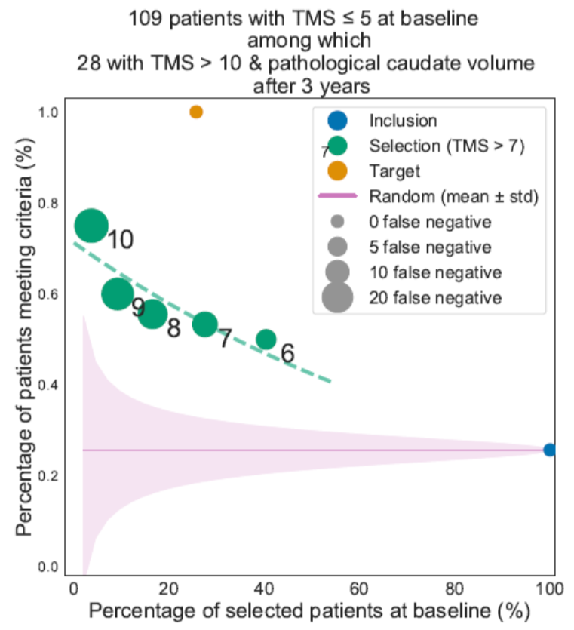
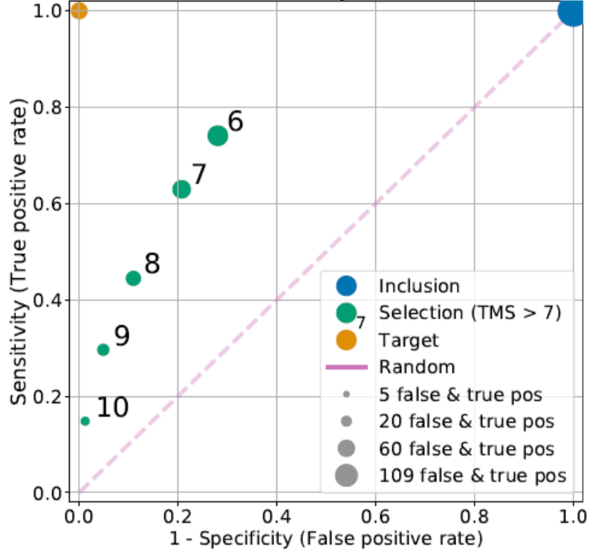
Huntington Disease Course Map
Detect subjects with sharp increase in TMS

Slide 35
Huntington Disease Course Map
Trial simulation for a drug improving TMS by 15% in 2 years:
256 (CI=[204,331]) subjects needed with standard criteria
138 (CI=[191,233]) subjects needed with our selection method → 46% fewer subjects!
at 5% significance level and 80% power
Trial simulation for a drug improving TMS by 10% in 2 years:
606 (CI=[483,784]) subjects needed with standard criteria
327 (CI=[216,552]) subjects needed with our selection method → 46% fewer subjects!

Slide 36
In short, disease course mapping is
A novel statistical learning technique which allows one to:
summarize the range of possible disease progression profile
explain how (e.g. genetic) factors modulate disease progression
position new subjects onto the map and predict the future evolution of their biomarkers
select the right patient at the right disease stage, thus improving statistical power of clinical trials

Slide 37










Thank you
ARAMIS Lab: S. Durrleman (head), A. Bône, R. Couronné (docs), E. Maheux, A. Valladier (engineers)
Clinical collaborators: Profs A. Dürr (Huntington), B. Dubois, S. Epelbaum (Alzheimer), J.-C. Corvol, M. Vidhailet, S. Lehéricy (Parkinson)
Academic collaborators: S. Allassonnière (U. of Paris), B. Charlier (U. of Montpellier)
Funders: ERC, Paris AI Research Institute PR[AI]RIE, H2020 projects EuroPOND and TVB-Cloud

Slide 38

Thank you
Open-source software Leaspy on GitLab: https://gitlab.com/icm-institute/aramislab/leaspy/
Patent: A method for determining the temporal progression of a biological phenomenon (PCT/IB2016/052699)
On-going collaboration with pharmaceutical industries to develop precision medicine trials
Selection of publications:
Simulating Alzheimer's disease progression with personalised digital brain models, I Koval et al., preprint https://hal.inria.fr/hal-01964821
Learning the spatiotemporal variability in longitudinal shape data sets, Bone et al. IJCV 2020
Learning Disease Progression Models With Longitudinal Data and Missing Values, R. Couronné et al. ISBI 2019
Spatiotemporal propagation of the cortical atrophy during the course of Alzheimer’s Disease: Population and individual patterns, I. Koval et al. Frontiers in Neurology, Vol 9, p 235, 2018
A Bayesian mixed-effects model to learn trajectories of changes from repeated manifold-valued observations, J.-B. Schiratti et al. Journal of Machine Learning Research, 18(133):1−33, 2017

