Slide 1
Leaspy : a non-linear mixed-effect model for disease course mapping
7-8 janvier 2021
Winter AI School
Disease course mapping with longitudinal data

Slide 2
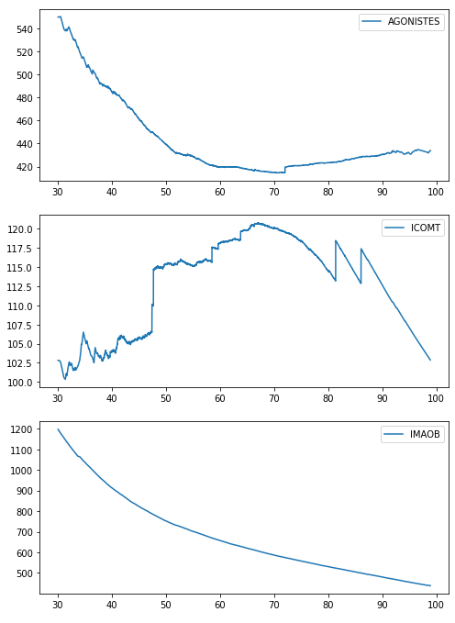
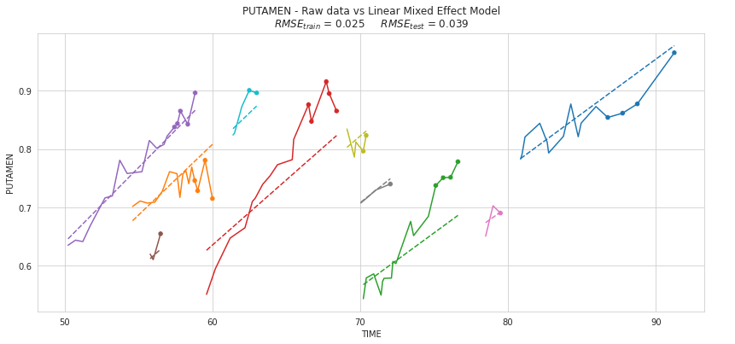
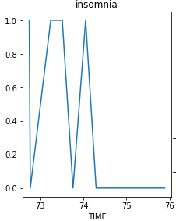
Linear models versus medical data
Linear models (from previous practical session)
Medical data
Accurate on short periods of time
Adequate for close to linear growth
Non-linear in most cases
Sometimes non-monotonous, or not continuous
?

Slide 3
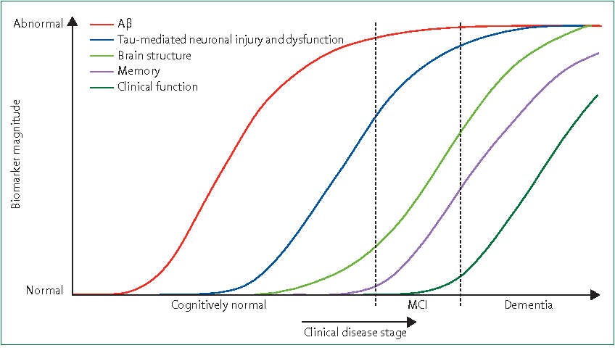
Jack et al., 2010 : the sigmoïd hypothesis
Biomarker/scores hypothesis
Monotonous progression
Logistic curves

Slide 4
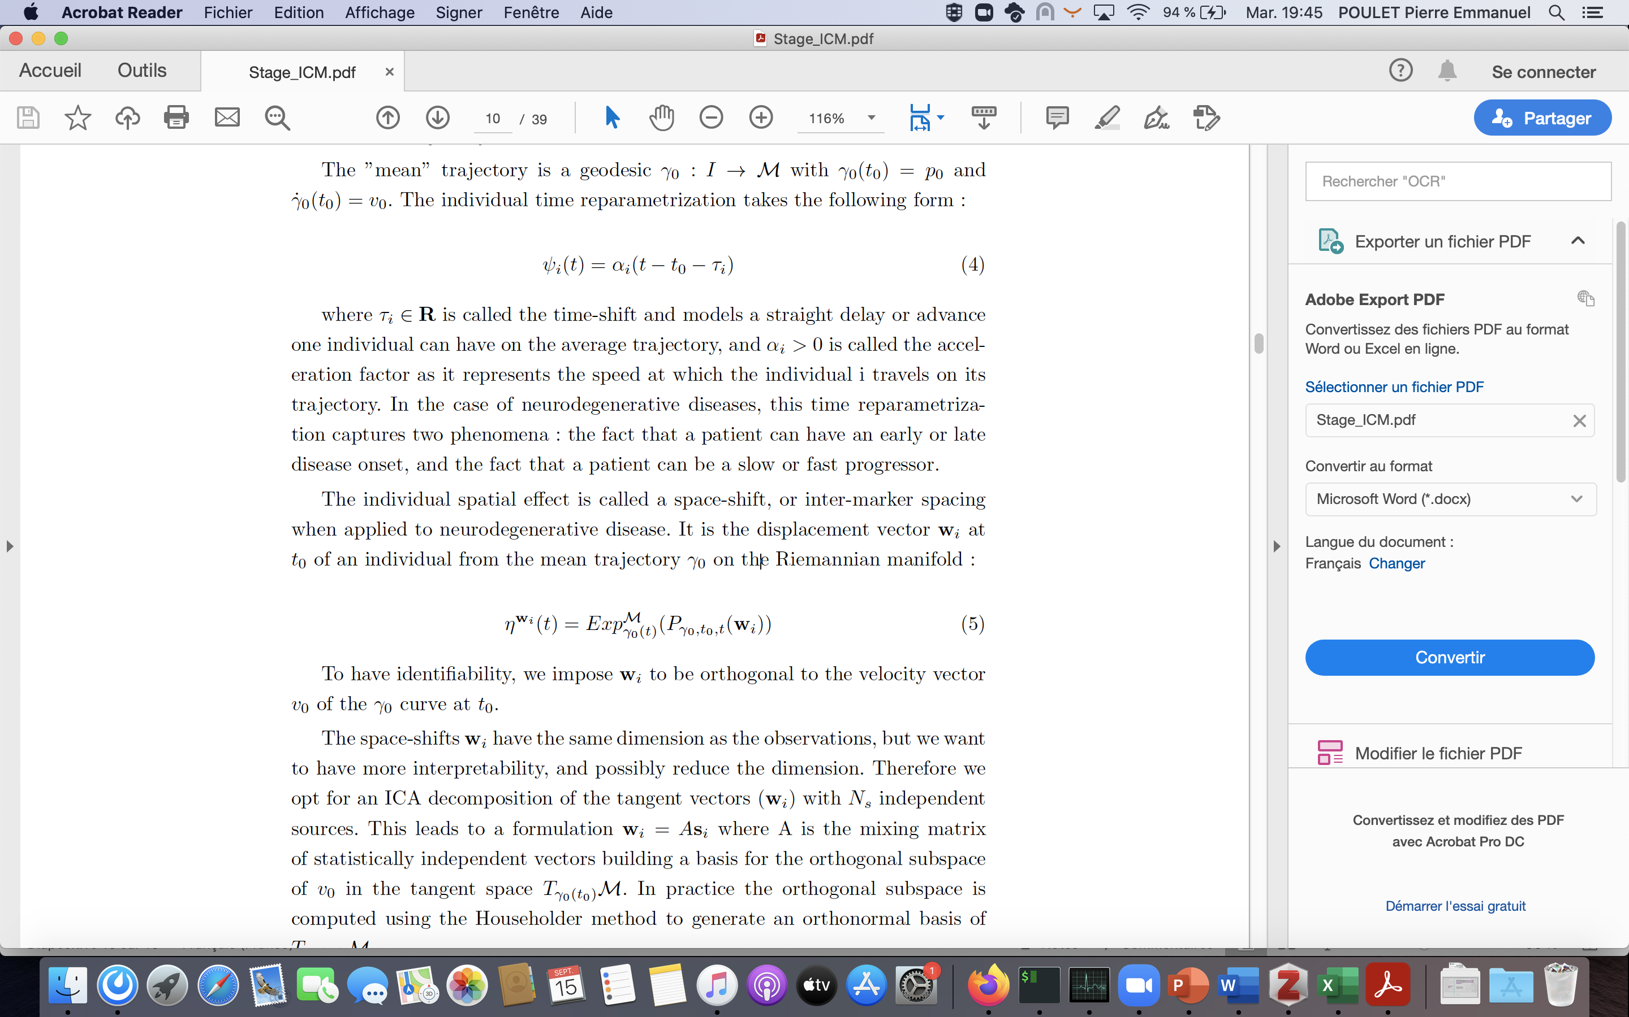


Non-linear mixed-effect model : how ?
Push forward transformation
Riemannian manifold
Simple to understand
Harder to compute
However a more proper mathematical framework
f
$$γ_{i}$$
w_{i}
$$γ_{0}$$

Slide 5
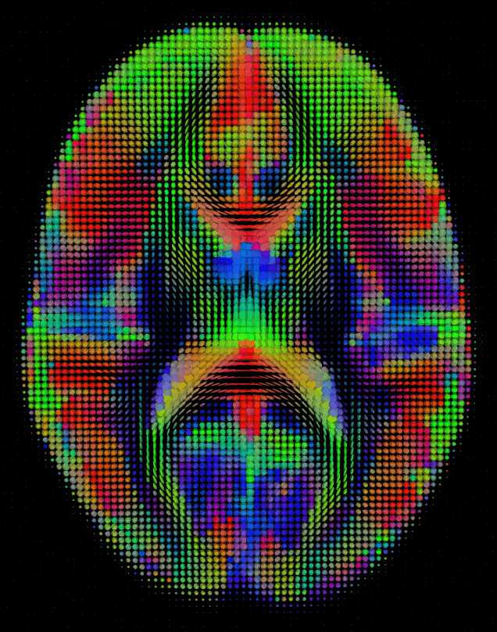
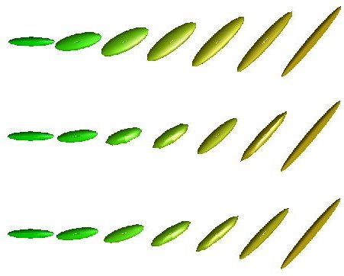
A taste of Riemannian manifolds in medical imaging

Slide 6
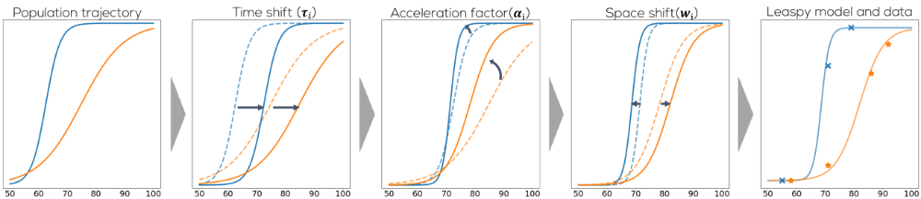

The disease course mapping model
Population parameters (fixed effects parameters) describe the average population trajectory of observations
Observations can be multidimensional (here 2)
$$γ_{0}(t)$$

Slide 7
The disease course mapping model : time reparametrization
Individual effects are divided in two types :
  Time effects : patients can have a late/early onset of the disease

Slide 8
The disease course mapping model : time reparametrization
Individual effects are divided in two types :
  Time effects : patients can experience faster/slower disease progression

Slide 9
The disease course mapping model : spatial variations
Individual effects are divided in two types :
  Spatial effects : positions of markers relative to each other can be shifted

Slide 10
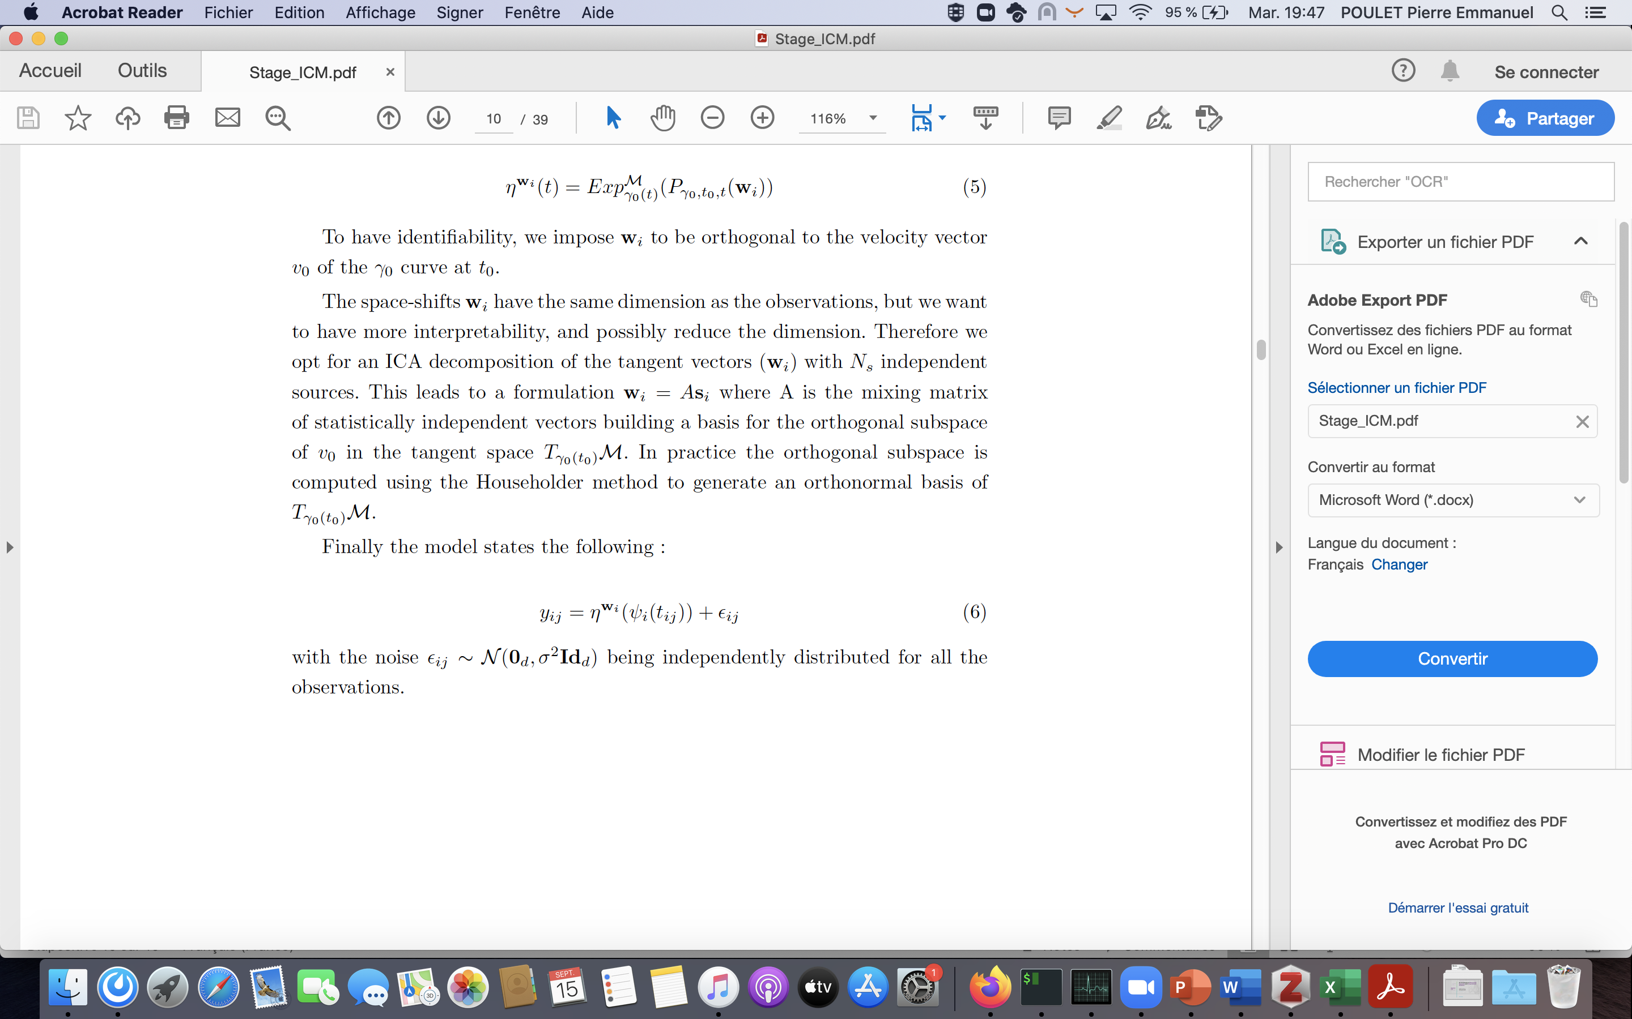
The disease course mapping model : individual data
Individual model aims at being as close as possible to the observations, i.e. mean squared error should be as low as possible
Estimation uses the expectation maximisation (EM) algorithm

Slide 11
References
Leaspy :
-Schiratti, J.B., Allassonniere, S., Colliot, O., Durrleman, S.: A Bayesian Mixed-Effects Model to Learn Trajectories of Changes from Repeated Manifold-Valued Observations. The Journal of Machine Learning Research 18 (Jan 2017)
-Koval, I., Schiratti, J.B., Routier, A., Bacci, M., Colliot, O., Allassonniere, S.,Durrleman, S.: Statistical Learning of Spatiotemporal Patterns from Longitudinal Manifold-Valued Networks. In: Descoteaux, M., Maier-Hein, L., Franz, A., Jannin, P., Collins, D.L., Duchesne, S. (eds.) Medical Image Computing and Computer Assisted Intervention MICCAI 2017, vol. 10433, pp. 451{459. Cham (2017)
Estimation algorithm :
-Delyon, B., Lavielle, M., Moulines, E.: Convergence of a Stochastic Approximation Version of the EM Algorithm. The Annals of Statistics 27(1), 94{128 (1999)
-Kuhn, E., Lavielle, M.: Coupling a stochastic approximation version of EM with an MCMC procedure. ESAIM: Probability and Statistics 8, 115{131 (2004)

