Slide 1
Modeling and predicting disease progression
AI4Health Winter School

Slide 2
Overview
Introduction
The aim of the session is to apply the theory present in the course «Modeling and predicting disease progression with longitudinal data» by S. Durrleman.
Introduction (10 min)
Overview of medical longitudinal data
& models associated
14h – 15h
TP1
15 min
Introduction (10 min)
A disease course mapping model:
How to use leaspy ?
TP2
15h15 – 16h15
15 min
Introduction (10 min)
TP3
Going deeper into leaspy model tuning
16h30 – 18h
2

Slide 3
Overview of medical longitudinal
data & models associated
TP 1

Slide 4
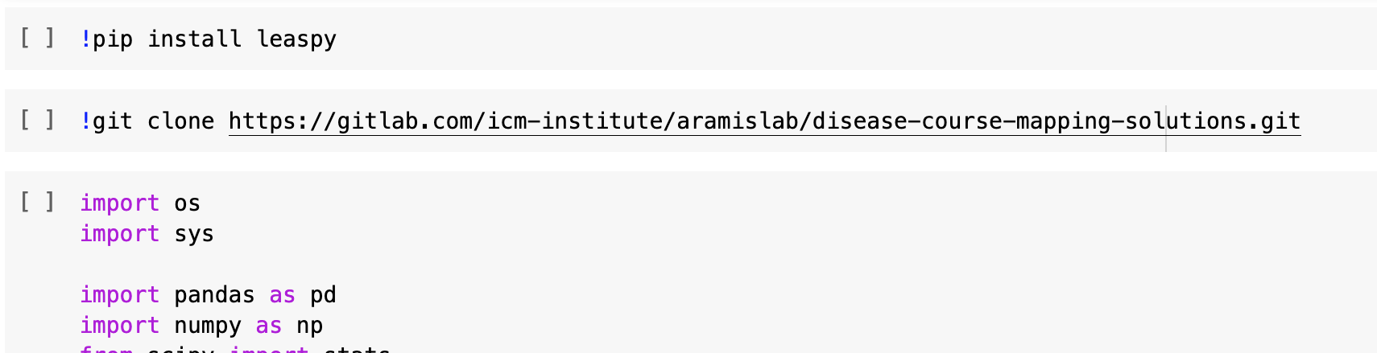
TP1
To start
Please follow the link below :
https://colab.research.google.com/drive/1uZDC4LYE8tmBG83UGcZZPfWr-UUBRxgH?usp=sharing#scrollTo=U_vNmA7gBFd4
And run the 3 first cells :
4

Slide 5

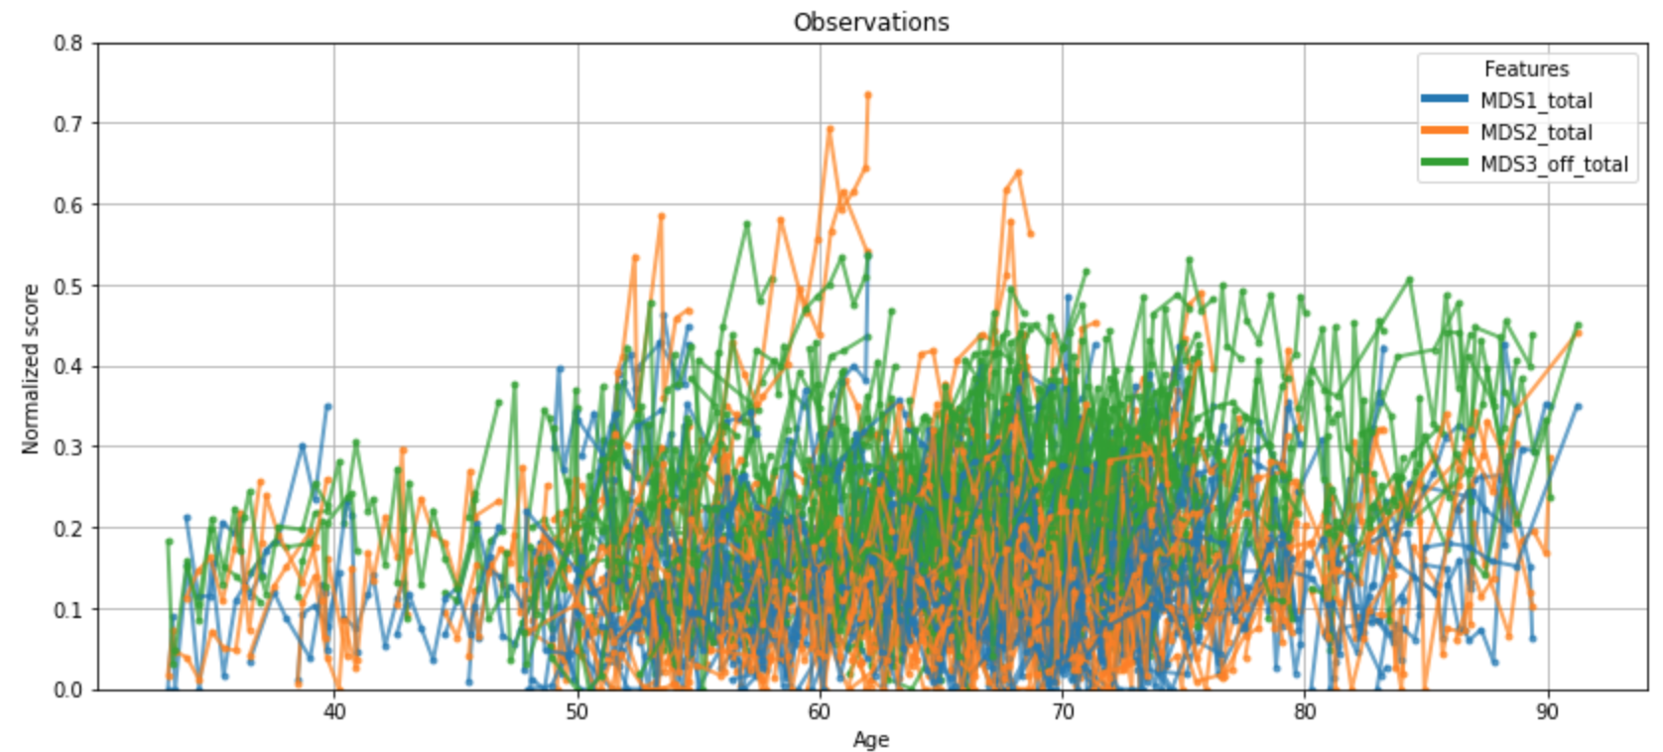
TP1
Introduction
Objectives
Get familiar with medical longitudinal data
Get a taste of state-of-the-art models
Understand mixed-effects models
5

Slide 6
Go, it’s your turn !
And don’t hesitate if you have any question !

Slide 7
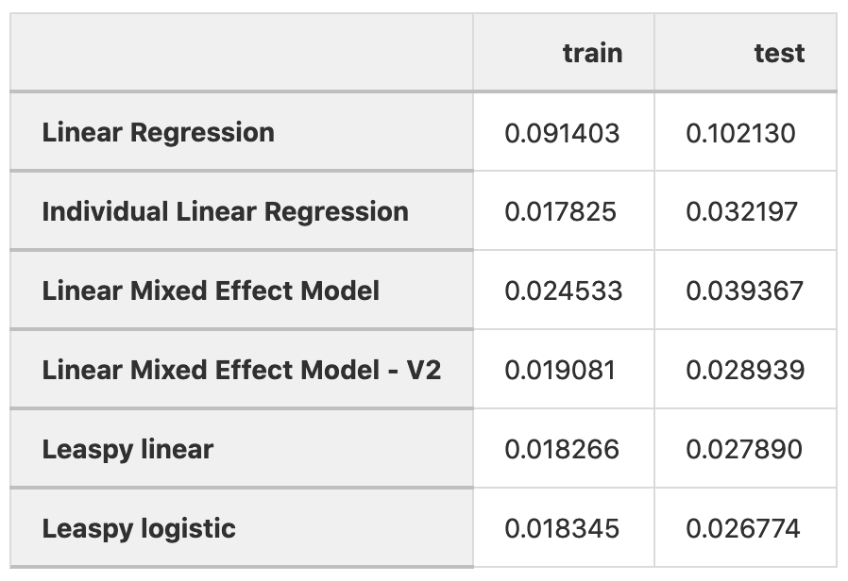
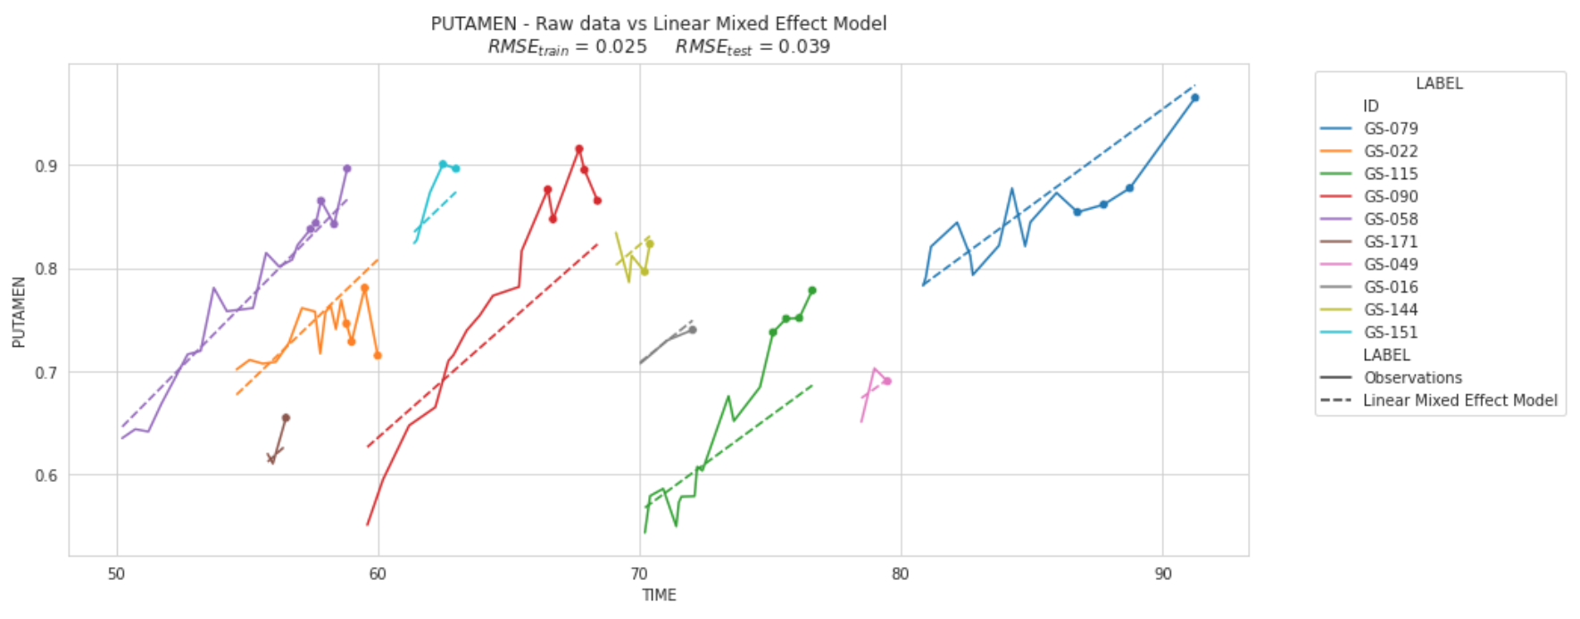
TP1
Take home messages
There exist few models to analyse longitudinal data and RMSE can vary a lot between train and test.
Linear Mixed Effect Model
Root Mean Squared Error
7

Slide 8
A disease course mapping model:
How to use leaspy ?
TP 2

Slide 9
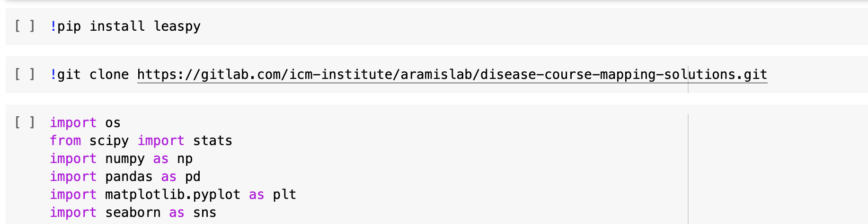
TP2
To start
Please follow the link below :
https://colab.research.google.com/drive/1dCMa9In1ef9_Y3HKt8SeSzKf0-3CcxNt?usp=sharing
And run the 3 first cells :
9

Slide 10




TP2
Introduction
Objectives : Learn to use Leaspy methods
II. Personalize
III. Impute & predict
Predicted data
Test data
Individual
parameters
IV. Application: cofactor analysis
V. Data Simulation
I. Fit
Leaspy model
Train data
Simulated data
10

Slide 11
Go, it’s your turn !
And don’t hesitate if you have any question !

Slide 12
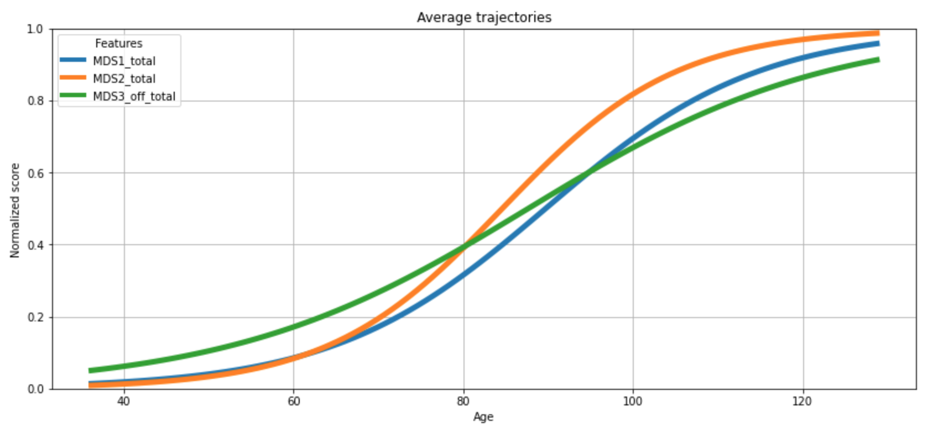
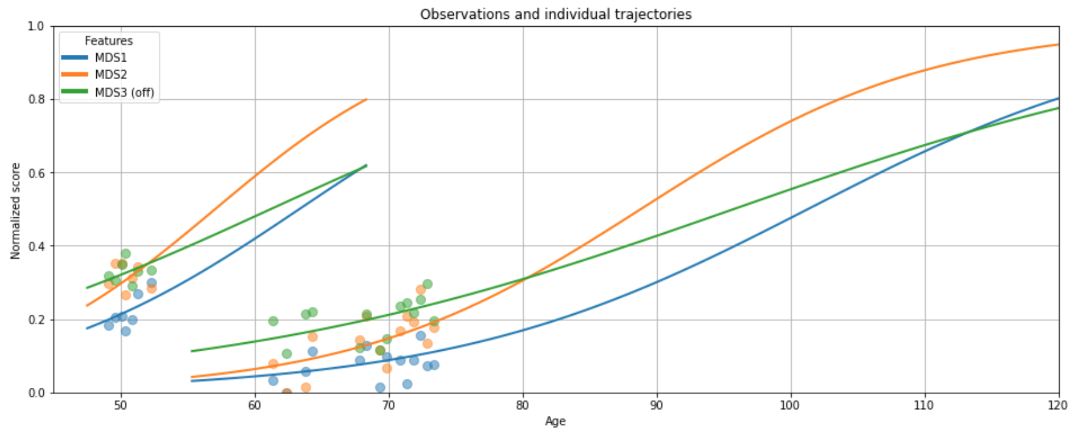
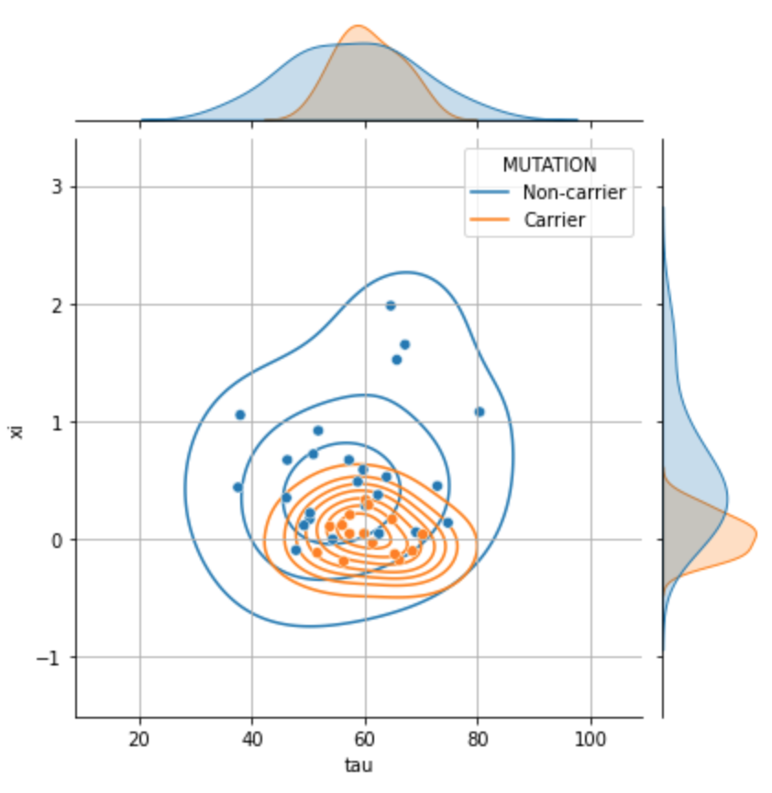
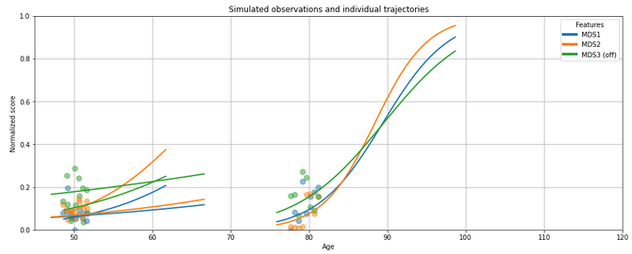
TP2
Take home messages
Leaspy model can be an helpful tool to
Get disease timeline with population disease progression
Predict individual disease progression
Extract interpretable information
Simulate data
12

Slide 13
Going deeper into leaspy model tuning
TP 3

Slide 14
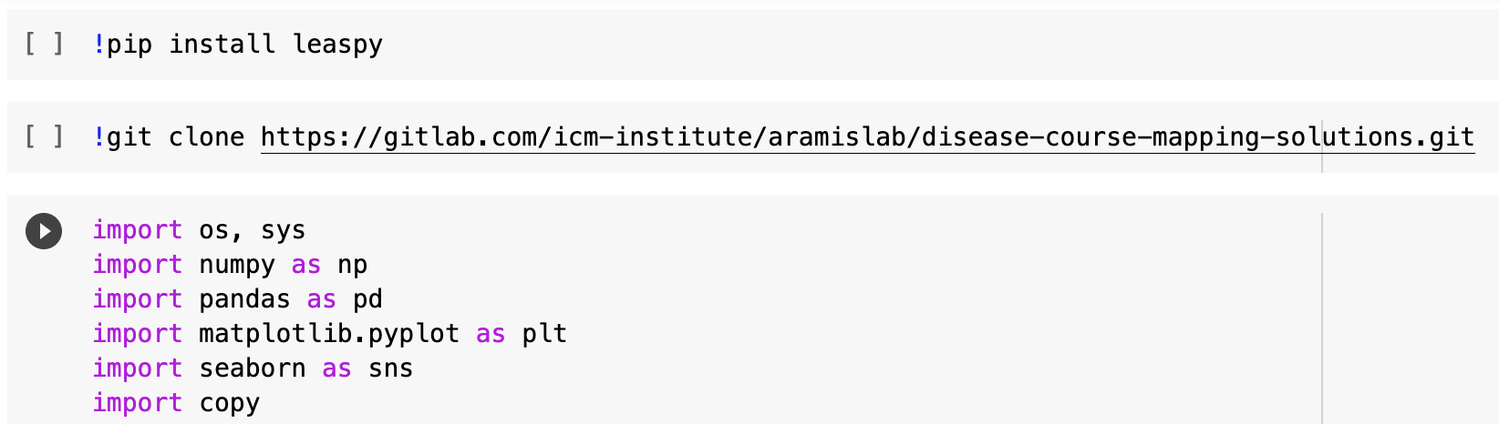
TP3
To start
Please follow the link below :
https://colab.research.google.com/drive/1UmzmerIjMCn2yfJZ-5tE8__QEYKIeeeq?usp=sharing
And run the 3 first cells :
14

Slide 15


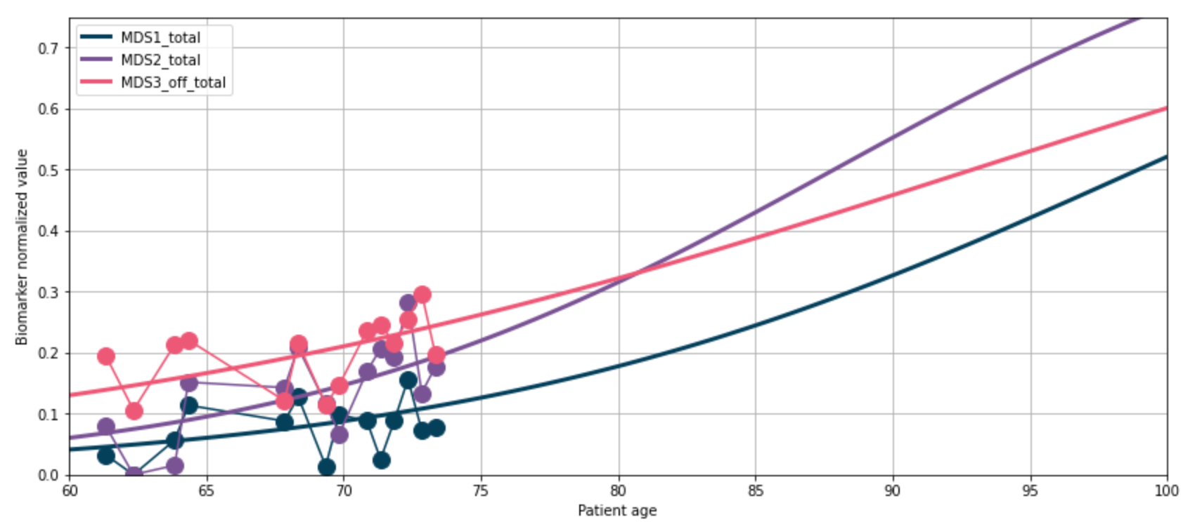

TP3
Introduction
How to use leaspy in daily situation ?
What are the constraints on inputs ?
How to get the best model ?
What kind of data ?
How to evaluate performances ?
What about binary observations ?
Univariate or multivariate models ?
15

Slide 16
Go, it’s your turn !
And don’t hesitate if you have any question !

Slide 17
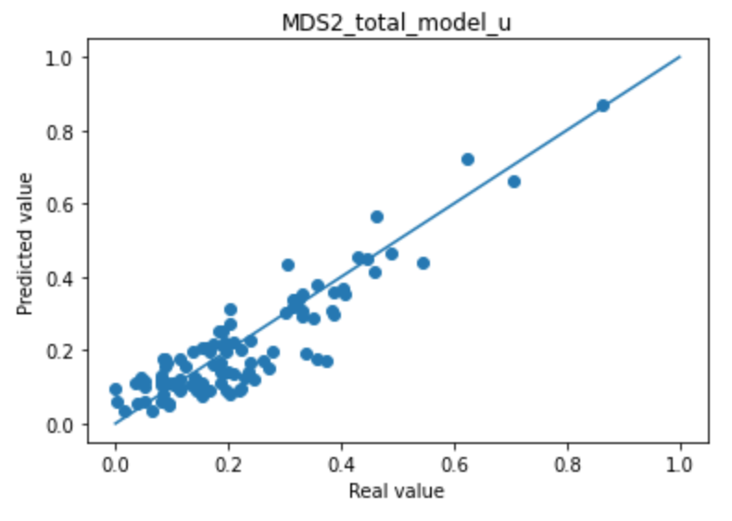
TP3
Take home messages
How to use leaspy in day life situation ?
What are constraints on inputs ?
How to get the best model ?
Data :
Should be between 0 and 1
Should increase with time
Should be continuous or binary (adding noise_model="bernoulli")
Can contain missing data
Can contain one or several features
There is no general rule for multivariate or univariate model, you should try different options and monitor the following (among other things) :
17

Slide 18
Conclusion

Slide 19

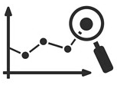


Conclusion
Take home messages
Leaspy is a good tool to handle medical longitudinal data, it allows you to :
Get disease timeline with population disease progression
Predict disease progression,
Extract interpretable information,
Simulate data.
19

Slide 20




Thank you for your attention, and don’t forget to fill the survey !
gitlab.com/icm-institute/aramislab/leaspy
www.aramislab.fr
20

