Slide 1






AI 4 Health Winter School
Modelling and predicting disease progression with longitudinal data
Juliette Ortholand
Sofia Kaisaridi
Pierre-Emmanuel Poulet
Stanley Durrleman

Slide 2
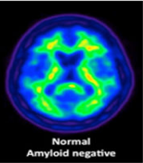
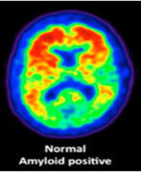
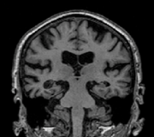

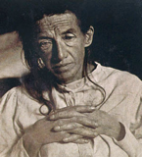

Alzheimer’s Disease
> 10 y
6 – 8 y
~65 years
diagnosis
care
Build computational model of disease progression
from clinical and imaging data
Summarize the variability of disease progression profiles
Predict the future progression
Position individual subject on his own trajectory
Determine who and when to treat or intervene

Slide 3
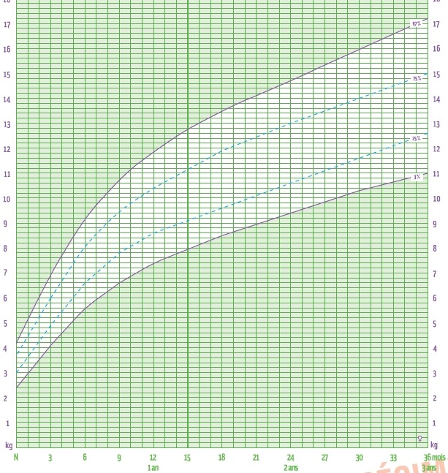
Weight (kg)
How to extend to multiple biomarkers to study to joint distribution?
How to extend to structured data such as images?
Could the model predict future progression?
Age is not a good marker of disease progression

Slide 4
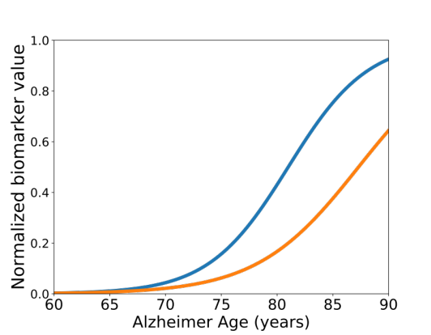
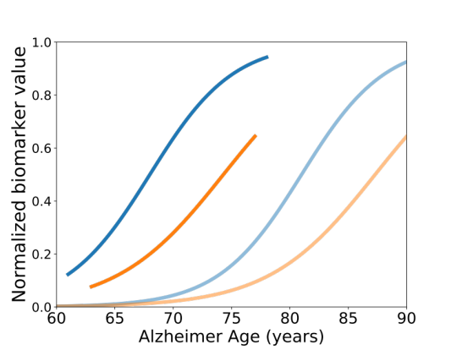
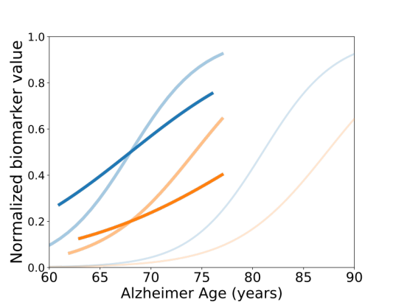
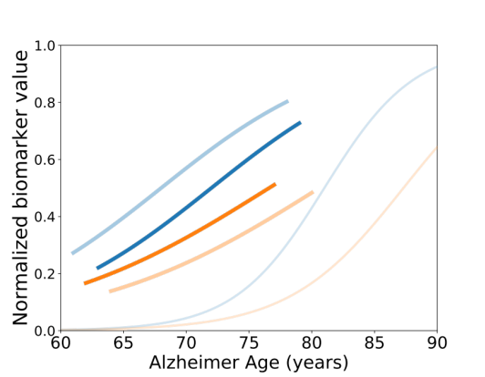
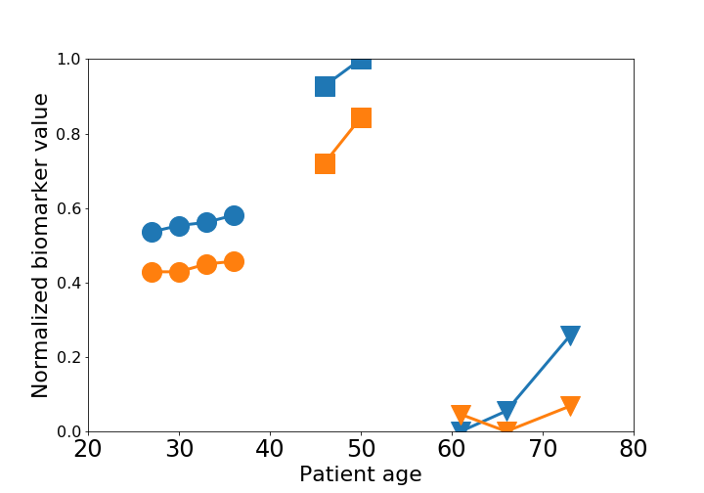
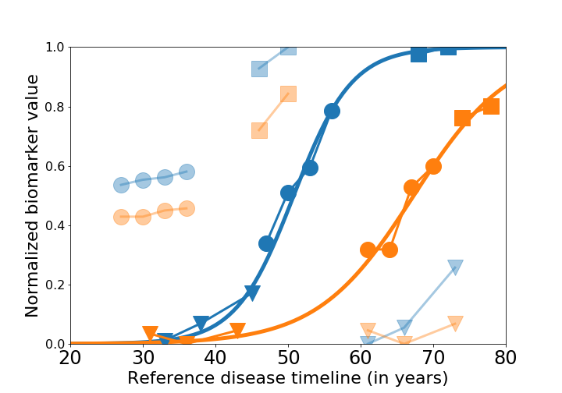







Individual data
& model
Time-shift
Acceleration factor
Inter-marker spacings
$$+ τ$$
$$× α$$
$$+ w_{0}$$
Normalized biomarker
$$+ w_{1}$$
Age (years)
Patient B
$$α_{B}, τ_{B}, ω_{B}$$
$$α_{A}, τ_{A}, ω_{A}$$
Patient C
Patient A
$$α_{C}, τ_{C}, ω_{C}$$
4

Slide 5
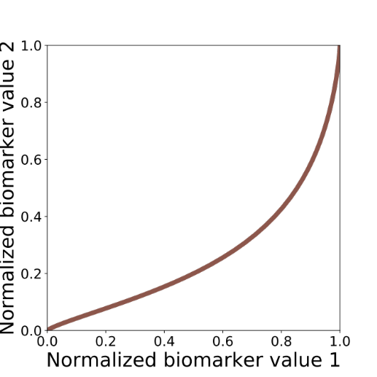
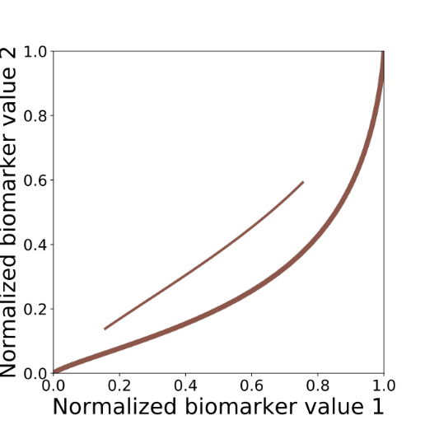
Individual data
& model
Time-shift
Acceleration factor
Inter-marker spacings
$$+ τ$$
$$× α$$
$$+ w_{0}$$
Normalized biomarker
$$+ w_{1}$$
Age (années)
Biomarker 1
70
72
72
68
70
72
68
66
70
72
66
72
70
68
68
66
70
66
66
68
Biomarker 2

Slide 6
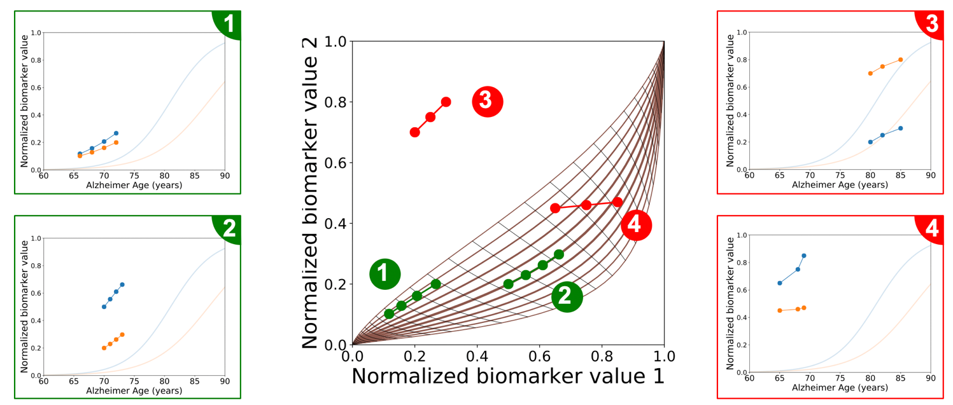
likely
Disease course map charts the range of likely trajectories
unlikely

Slide 7
Part I: Disease course mapping
Non-linear mixed-effect model for longitudinal data
Part II: An example of application & Validation
Alzheimer disease course map
Part III: Practical Session
Modelling and predicting disease progression

Slide 8
Part I: Disease course mapping
Non-linear mixed-effect model for longitudinal data

Slide 9
Part I: Disease course mapping
Non-linear mixed-effect model for longitudinal data
Mathematical concepts
Univariate case
Multivariate case
Shape data
Learning the metric
Going Further

Slide 10
Part I: Disease course mapping
Non-linear mixed-effect model for longitudinal data
1. Mathematical concepts

Slide 11
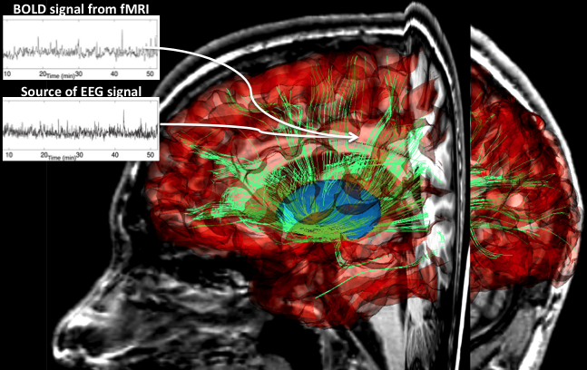
Longitudinal Data Analysis
Time (age)
subject #1
subject #2
subject #3
How to learn typical trajectories of data changes from longitudinal data?
Temporal marker of progression
(e.g. time since drug injection, seeding, birth, etc..)
Regression
(e.g. compare measurements at same time-point)
Linear mixed-effects models
[Laird&Ware’82, Diggle et al., Fitzmaurice et al.]
Learning spatiotemporal distribution of trajectories
Find temporal correspondences
Compare data at corresponding stages of progression
Needs to disentangle differences in:
Measurements
Dynamics of measurement changes
No temporal marker of progression
(e.g. in aging, neurodegenerative diseases, etc..)

Slide 12
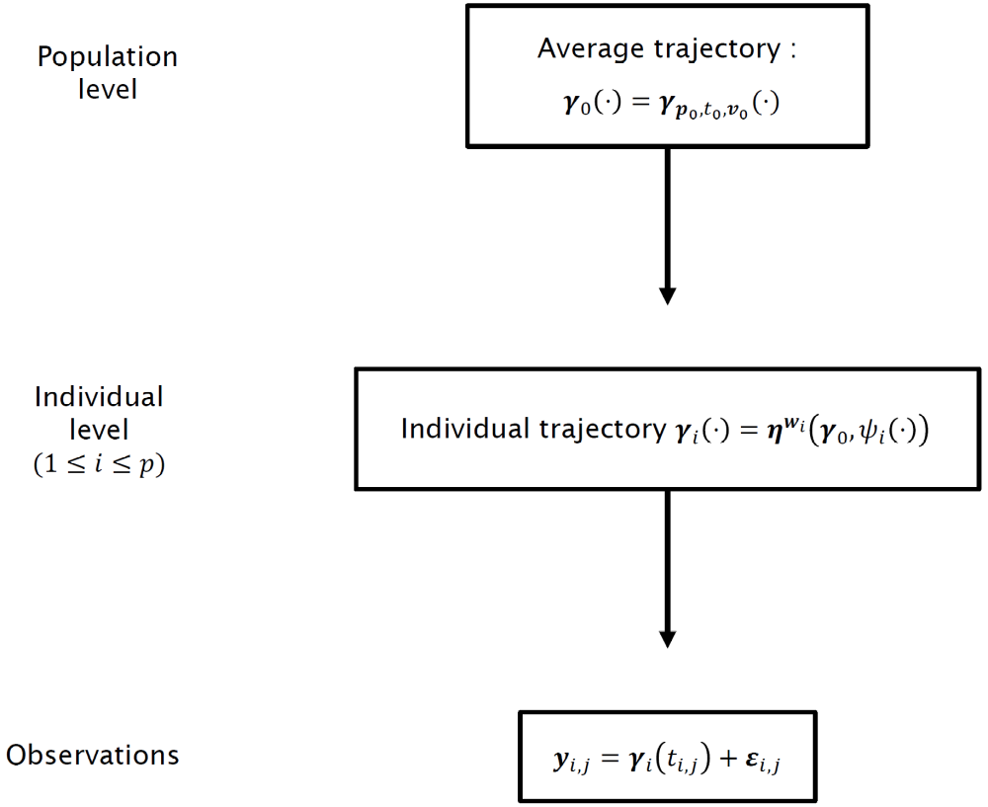

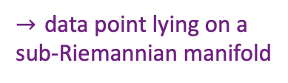

Hierarchical model
$→$ Geodesic on a Riemannian manifold $𝕄$
$→$ Spatiotemporal transform of trajectory
$→$ data point lying on a sub-Riemannian manifold

Slide 13


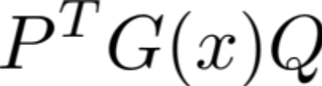
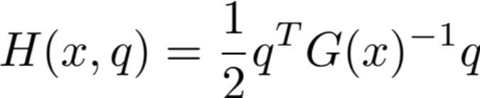
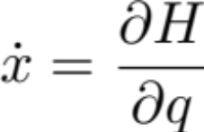
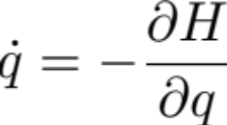
The metric: a positive-definite matrix at each point x
The inner-product between two vectors P and Q on the tangent plane at point x
source: extermeTech
Kinetic energy (Hamiltonian) of a particule at position x with momentum q
Equations of motion (geodesics) for a particle starting at some initial position x₀ with initial momentum q₀

Slide 14




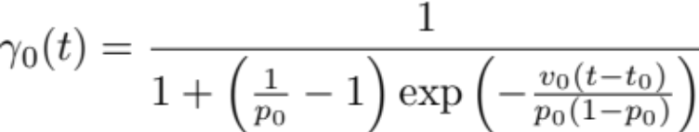
canonical metric
Product manifold with the product metric

Slide 15
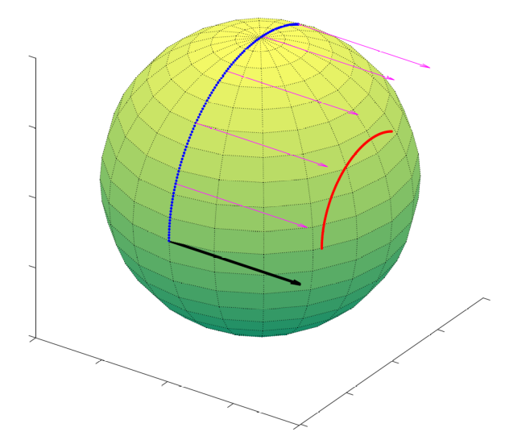











Exp-parallelization on manifold
$$η^{w_{i}}(γ_{0},s)$$
$$T_{γ_{0}(t_{0})}𝕄$$
$$P_{γ_{0},t_{0},s}(w_{i})$$
$$w_{i}$$
$$γ_{0}^{′}\left(t_{0}\right)=v_{0}$$
$$𝕄$$
$$η^{w_{i}}(γ_{0},∙)$$
$$γ_{0}(s)$$
$$γ_{0}\left(t_{0}\right)=p_{0}$$
$γ_{0}$
[Schiratti et al. IPMI’15, NIPS’15, PhD’17, JMLR’17]

Slide 16











Spatiotemporal hierarchical model
Invariance w.r.t. reference point on geodesic
Orthogonality ensures unique space/time decomposition
Time is random variable
Random effects:
Acceleration factor
Time-shift
Space-shift
Fixed effects:
[Schiratti et al. IPMI’15, NIPS’15, PhD’17, JMLR’17]

Slide 17



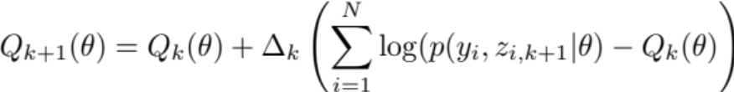



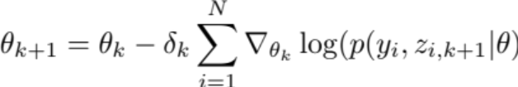
Parameter estimation using MCMC-SAEM
Simulation:
Approximation:
Maximisation:
Metropolis Hastings (within Gibbs sampler)
Distribution from the curved exponential family
Gradient descent step
[Lavielle, Delyon, Moulines]
[Allassonnière et al.’10]

Slide 18
A generic mixed effect model
A generic inference algorithm
Simulation:
Approximation:
Maximisation:

Slide 19
Part I: Disease course mapping
Non-linear mixed-effect model for longitudinal data
2. Univariate case

Slide 20












Univariate case:
$$α_{i}v_{0}$$
$$v_{0}$$
canonical metric
$$t=t_{0}$$
$$p_{0}$$
$$t=t_{0}+τ_{i}$$
$$p_{0}$$
$$Exp_{p_{0},t_{0}}(v_{0})(⋅)$$
$$Exp_{p_{0},t_{0}+τ_{i}}(α_{i}v_{0})(⋅)$$
$$𝕄$$
$$Exp_{p_{0},t_{0}}(v_{0})(⋅)$$
$$𝕄$$

Slide 21


Univariate: straight-line model
y
t₀
time
t₀
time
Time at which measurement of the i^{th} subject reaches b
Measurement of the i^{th} subject at time t₀
Schiratti et al. (2015)
Laird & Ware (1982)

Slide 22
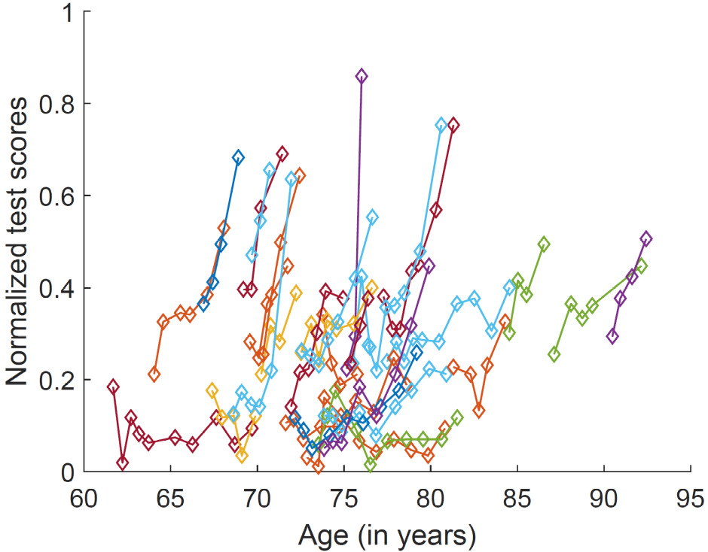
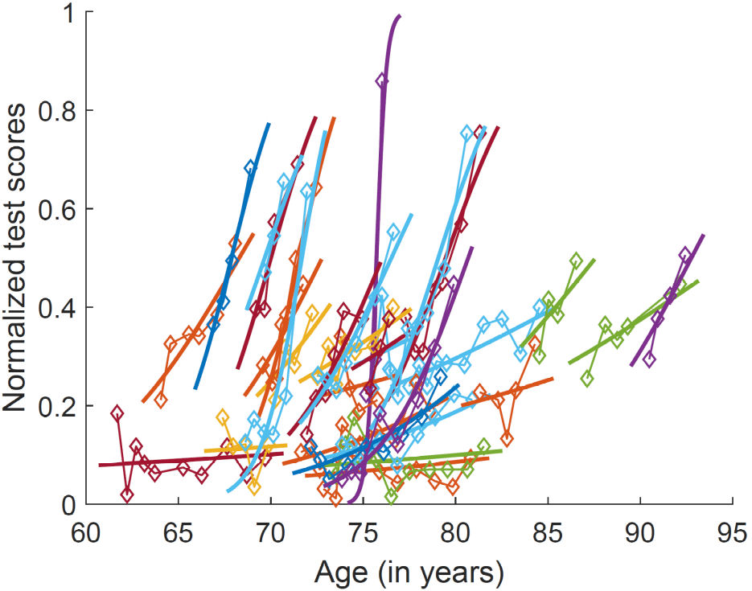
Univariate logistic model
1393 individuals, 5 time-points on average, ADAS-Cog13
Notes:
All curves are pieces of the same logistic curve, which has been translated and dilated/shrinked along the time-axis

Slide 23
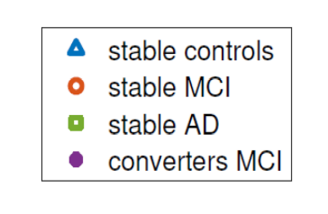
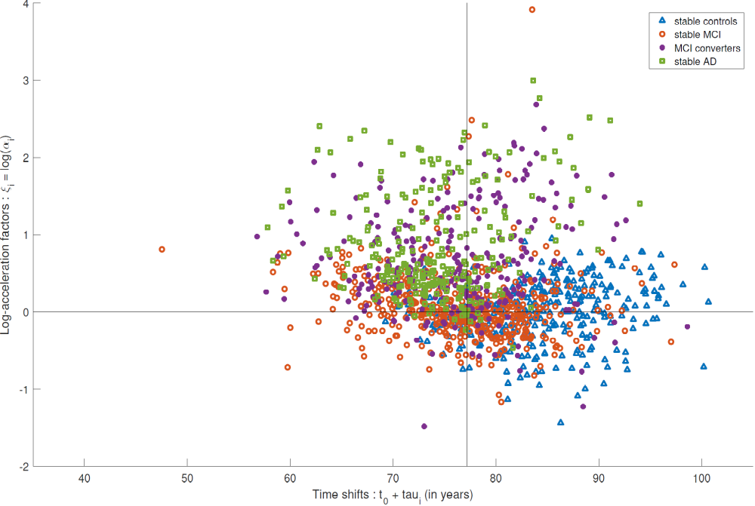
Fast progressers
Slow progressers
Early onset
Late onset

Slide 24
Part I: Disease course mapping
Non-linear mixed-effect model for longitudinal data
3. Multi-variate case

Slide 25

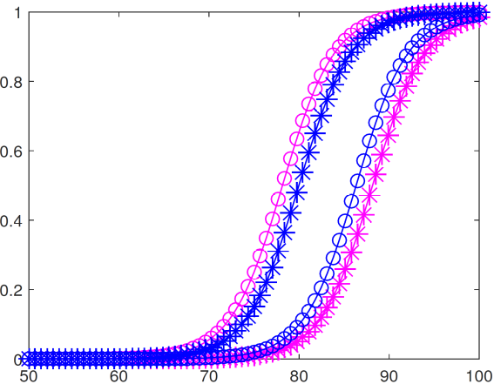
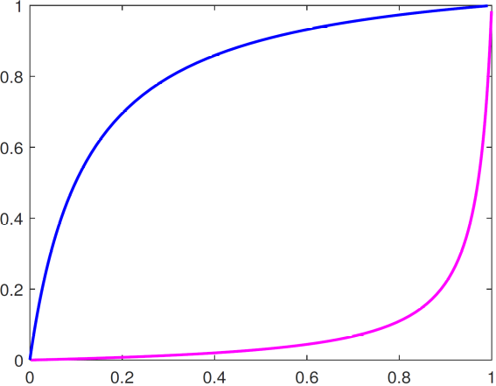
Multivariate data: the propagation model
Product manifold with product metric:
Exp-parallelization in the direction w:
Adding orthogonality in the exp-parallelization ensures unique decomposition between time-reparameterization and appearance change
y
x or y
t
x
[Schiratti et al. IPMI’15, NIPS’15, PhD’17, JMLR’17]

Slide 26
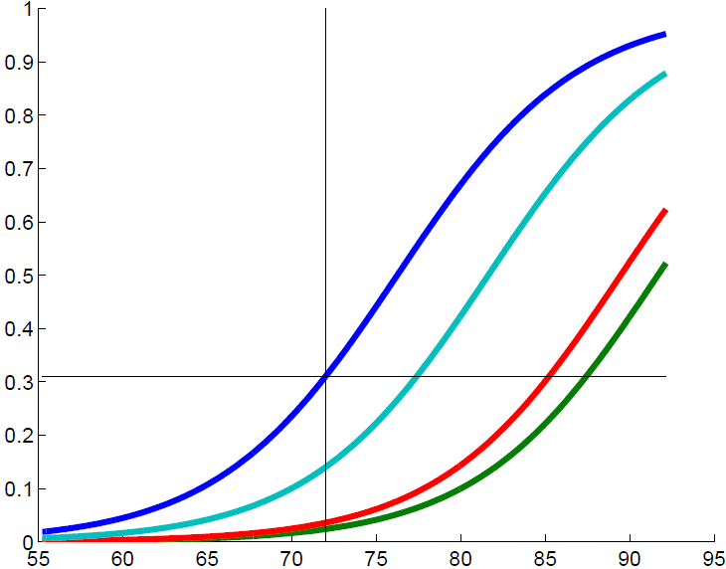

Model of cognitive decline in Alzheimer’s Disease
The average trajectory of data changes
Neuropsychological tests ADAS-Gog from ADNI
248 subjects who converted from MCI to AD
6 time-points per subjects on average (min 3, max 11)
Data points
with propagation logistic model
[Schiratti et al. IPMI’15, NIPS’15, PhD’17, JMLR’17]

Slide 27
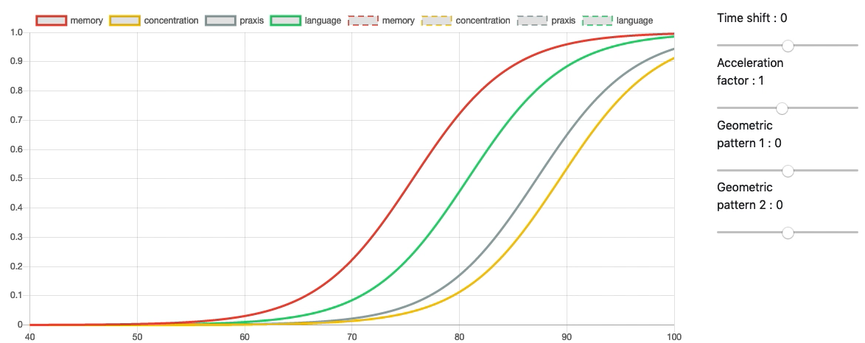
adjusting for:
age at onset
pace of progression
disease presentation, i.e.
timing of symptom onset
appearance of image data
We learn the distribution of parameters generating disease trajectories

Slide 28
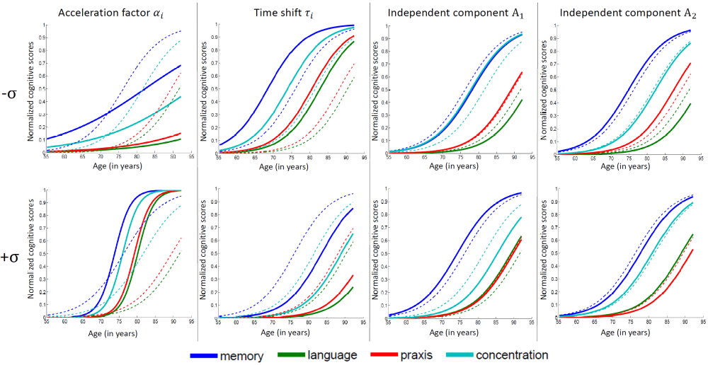
Distinguish fast vs. slow progressers
Distinguish early vs. late onset individuals
Variability in the relative timing and ordering of the events

Slide 29
Part I: Disease course mapping
Non-linear mixed-effect model for longitudinal data
4. Shape data

Slide 30
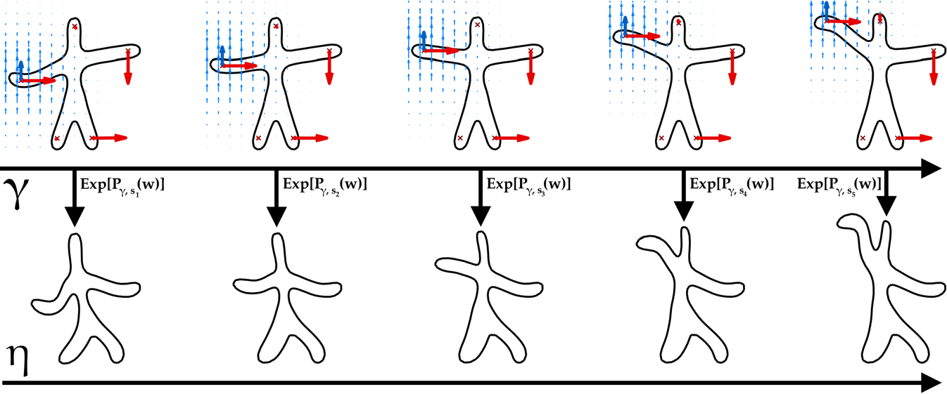
Exp-parallelization in deformable shape spaces
[Bône et al. MFCA’17, CVPR’18]

Slide 31
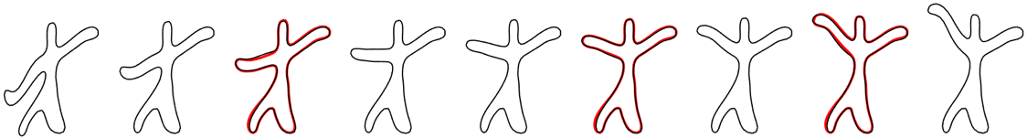
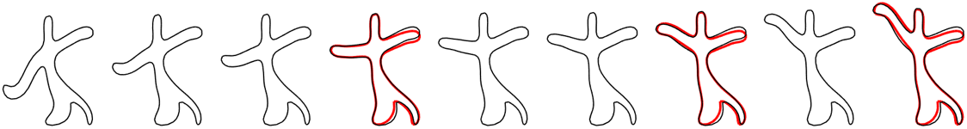
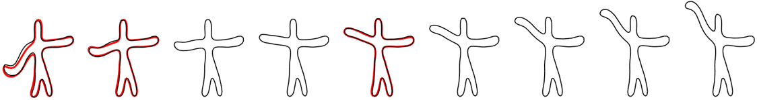

[Bône et al. MFCA’17, CVPR’18]

Slide 32
Part I: Disease course mapping
Non-linear mixed-effect model for longitudinal data
5. Learning the metric

Slide 33
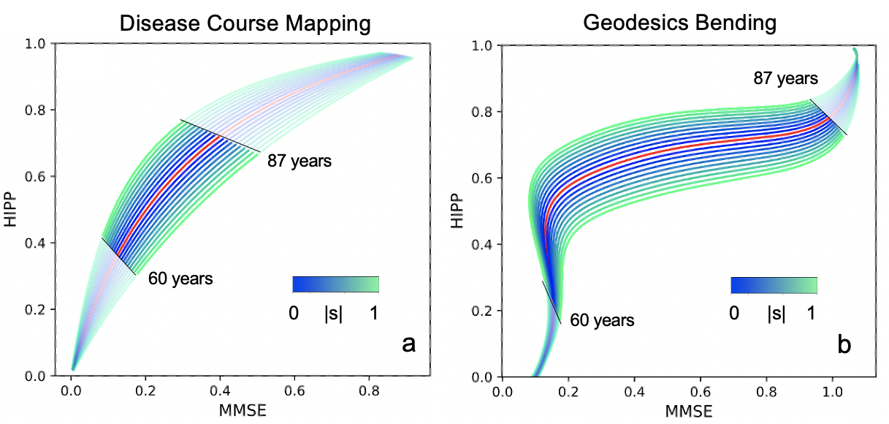
Geodesic bending vs. Disease Course Map
Hippocampus volume
Hippocampus volume
Mini Mental State Examination
Mini Mental State Examination
(a, b) The estimated bundle of trajectories is shown for the hippocampus volume and Mini Mental State Examination (MMSE) scores, showing the distribution of the spatial variability around the average geodesics in red by changing the space-shifts $w_{i}$ on a principal direction. 60 and 87 years are the 0.05 and 0.95 quantiles for the ages $(t_{ij}$).
Gruffaz et al. NeurIPS 2021

Slide 34
Part II: An example of application & Validation
Alzheimer disease course map

Slide 35
Part II: An example of application & Validation
Alzheimer disease course map
Model computation steps
Data description
Summarizes the range of likely disease trajectories
Forecast disease progression up to 5 years in advance
Generates virtual cohorts of patients
Selects participants at entry of a trial

Slide 36
Part II: An example of application & Validation
Alzheimer disease course map
1. Model computation steps

Slide 37




Calibration: given a longitudinal data set {y_{ij},t_{ij}}, find the parameters maximizing
Personalisation: for the optimal parameter value , find z maximizing the conditional likelihood for a new subject data {y_{testj} t_{j}}
Prediction / forecast: personalize the model to the first visits of the test subject, and predict values at future time-points.
Simulation: for the optimal parameter, simulate random effects z and generate synthetic data at user-defined time-point t:

Slide 38
Part II: An example of application & Validation
Alzheimer disease course map
2. Data description

Slide 39
 | ADNI USA | AIBL Australia | PHARMACOG Europe | J-ADNI Japan | MEMENTO France
Number of subjects | 1,599 | 460 | 111 | 469 | 1,995
Number of visits | 6.1 ± 2.8 [2, 17] | 3.7 ± 0.7 [2, 4] | 5.1 ± 0.6 [3, 7] | 5.1 ± 0.8 [4, 6] | 6.8 ± 1.8 [2, 9]
Follow-up duration (y) | 4.7 ± 3.0 [1.4, 15.2] | 4.1 ± 1.0 [1.5, 4.5] | 2.0 ± 0.3 [1.5, 3.0] | 2.7 ± 0.5 [1.5, 3.0] | 3.7 ± 0.7 [1.4, 5.2]
Delay between visits (m) | 11.1 ± 6.3 [1.8, 62.8] | 18.2 ± 2.0 [18.0, 54.0] | 6.0 ± 0.6 [ 6.0, 18.0] | 7.8 ± 2.8 [6.0, 24.0] | 7.7 ± 3.4 [1.5, 53.7]
Age at baseline (y) | 73.4 ± 7.1 [55.1, 91.5] | 71.5 ± 7.1 [55.3, 92.1] | 69.8 ± 7.4 [50.5, 84.5] | 71.8 ± 6.7 [30.0, 85.0] | 70.6 ± 8.6 [32.5, 92.6]
Female | 744 (46.5 %) | 247 (53.7 %) | 63 (56.8 %) | 246 (52.5 %) | 1216 (61.0 %)

Slide 40
Part II: An example of application & Validation
Alzheimer disease course map
3. Summarize the range of likely disease trajectories

Slide 41
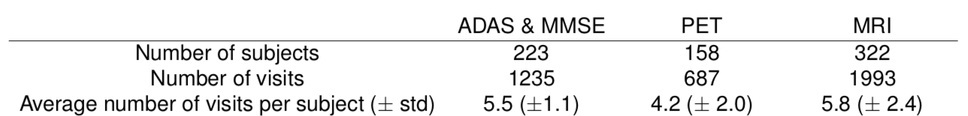
1st model: natural AD progression from prodromal to clinical stages
Neuropsychological assessments:
  ADAS-Cog (break down in 4 cognitive categories)
  MMSE
Flurodesoxyglucose (FDG) PET:
  Regional brain metabolism
MRI data:
  Cortical thickness maps
  Hippocampal atrophy
All ADNI-1, GO, 2 with at least one Dx of Alzheimer’s disease

Slide 42
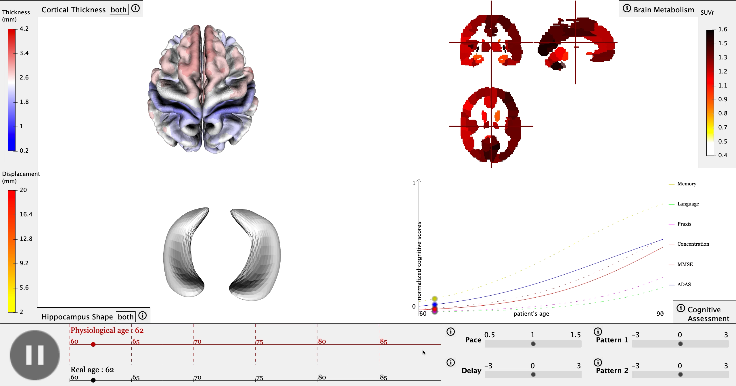
www.digital-brain.org

Slide 43
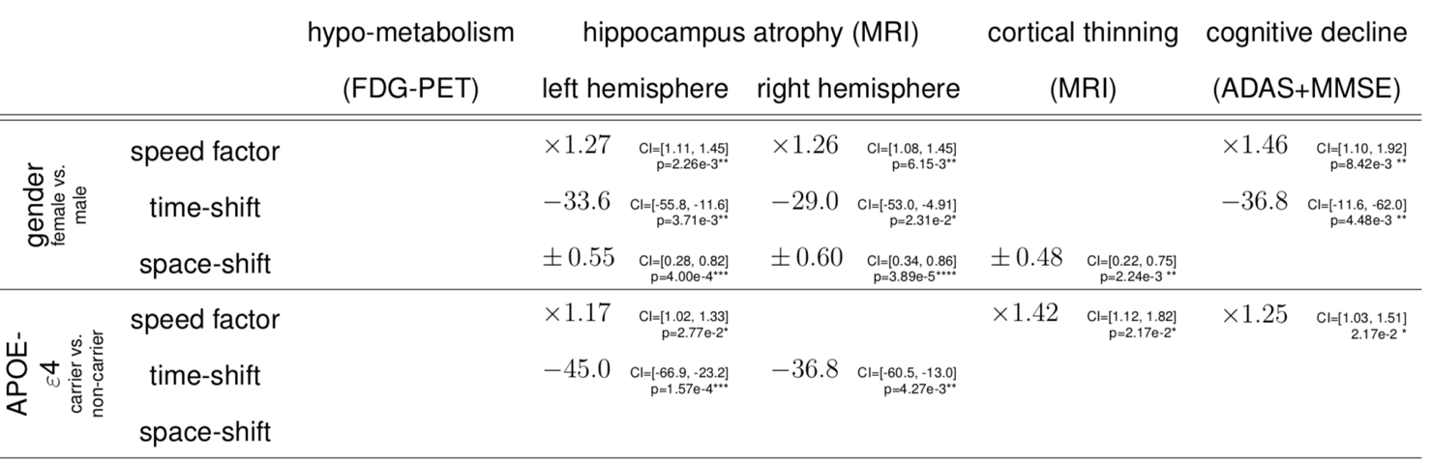
Explaining heterogeneity in disease progression profiles
43
We also show that biological and environmental factors also modulate disease progression
AD Course map charts Alzheimer’s disease progression, Koval et al. Scientific Reports, 2021
https://hal.inria.fr/hal-01964821

Slide 44
Part II: An example of application & Validation
Alzheimer disease course map
4. Forecast disease progression up to 5 years in advance

Slide 45
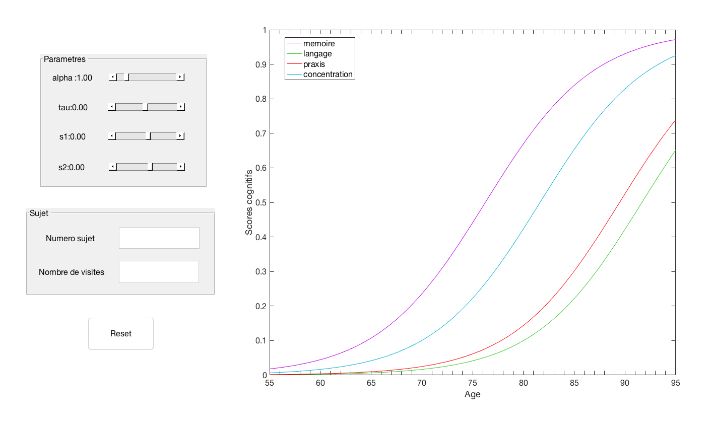
Step 0 (off-line):
The model was trained on observational longitudinal data set.
45

Slide 46
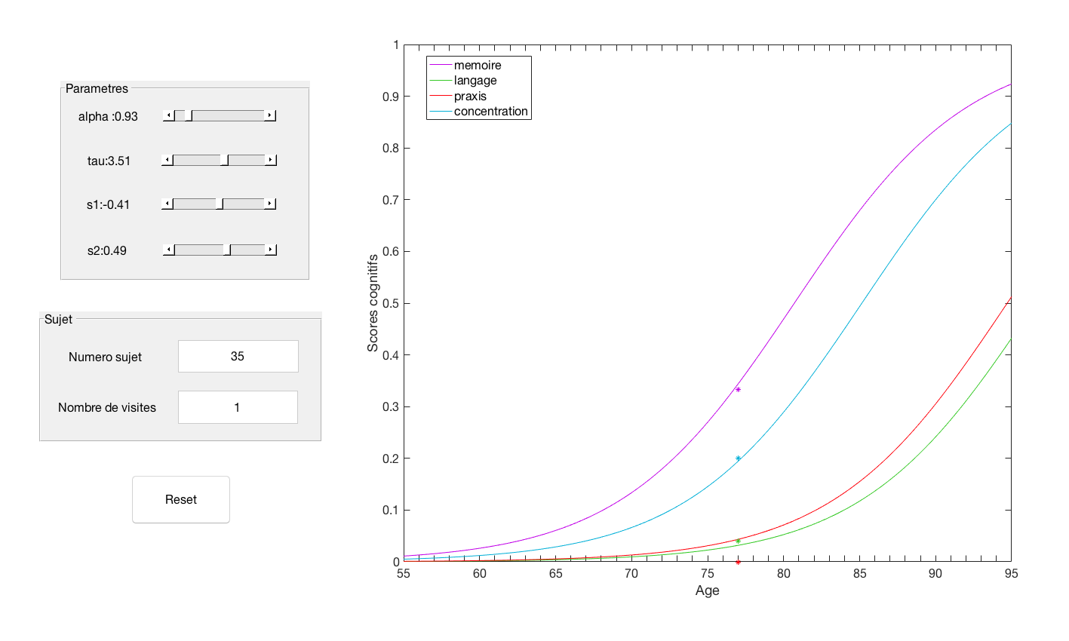
Step 1:
A new patient comes in.
We report the endpoints of the patient at his corresponding age.
We adjust the model parmeters to predict a progression curve of the patient.
46

Slide 47
Step 2:
We forecast the endpoint values at follow-up visits
We measure the discrepancy with the true hidden measurement
47

Slide 48
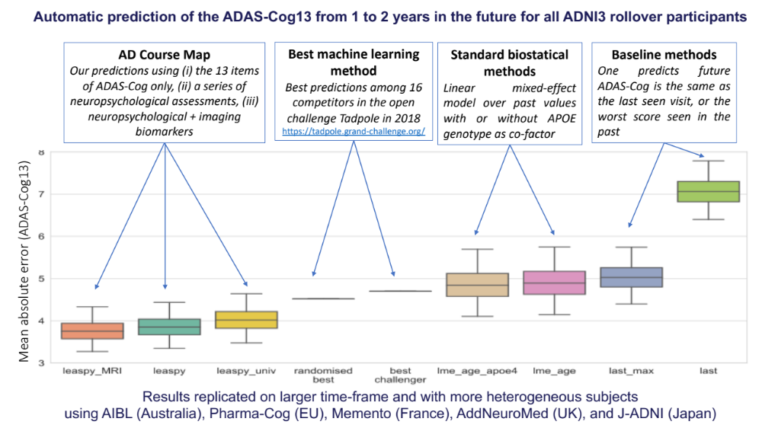
AD Course Map better predicts cognitive decline than 56 alternative methods from the TADPOLE Challenge

Slide 49
Part II: An example of application & Validation
Alzheimer disease course map
5. Generates virtual cohorts of patients

Slide 50
Input:
parameter distribution in AD Course Map
participants characteristics (taken as in ADNI in this experiment)
  number of participants
  sex ratio
  average and std of number of visits per participant
Output: a simulated longitudinal data set, e.g. a virtual replicate of ADNI.
Download data of 1 million of such patients at www.digital-brain.org !
Perspective: change sex ratio, disease stage at inclusion, genetic or other factors to create other populations of reference

Slide 51
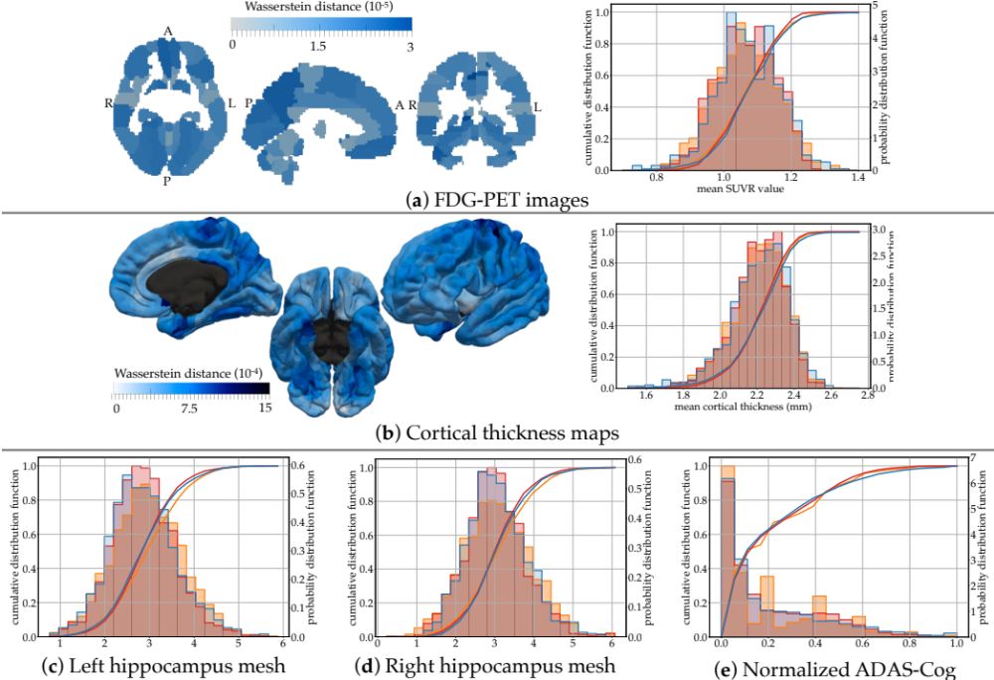
distributions of:
simulated data (blue)
reconstructed training data (red)
primary raw data (orange)

Slide 52
Part II: An example of application & Validation
Alzheimer disease course map
6. Selects participants at entry of a trial

Slide 53
Simulation of inclusion procedures for early stage Alzheimer’s disease subjects
Standard selection for early stage AD
age=50-85
CDR=0.5 or 1
Optimized cohort
only subjects for whom we predict a significant change of the MMSE during trial
Selection of progression profiles
using AD COURSE MAP
All available subjects
Forecast in 2 years
Prognosis score
CDR-SoB
Time

Slide 54
Simulation of inclusion procedures for early stage Alzheimer’s disease subjects
Standard selection for early stage AD
age=50-85
CDR=0.5 or 1
Selection of progression profiles
using AD COURSE MAP
(in comparison with no selection)
Trial simulation
(2 years trial)
Sample size for a range of hypothetical treatment effects
All available subjects
Optimized cohort
only subjects for whom we predict a significant change of the MMSE during trial

Slide 55
Part II: An example of application & Validation
Alzheimer disease course map
7. Going Further

Slide 56
Resources
Open-source software Leaspy on GitLab:
Source code: https://gitlab.com/icm-institute/aramislab/leaspy/
Hands-on sessions: https://gitlab.com/icm-institute/aramislab/disease-course-mapping-challenges
→ practical sessions !
3D Interactive view of AD Course Maps: www.digital-brain.org
Some shorter presentations:
https://www.youtube.com/watch?v=ixeRX8HpaU4
https://www.youtube.com/watch?v=8TvnMPfXuJE
21h course (in French):
- https://www.youtube.com/playlist?list=PLYXOv-91x4vZwUeNbinSkpr05Knc0ggRX

Slide 57
Selection of publications
AD Course Map charts Alzheimer’s disease progression, I Koval et al., Scientific Reports, 2021
Learning the spatiotemporal variability in longitudinal shape data sets, Bone et al. IJCV 2020
Learning Disease Progression Models With Longitudinal Data and Missing Values, R. Couronné et al. ISBI 2019
Spatiotemporal propagation of the cortical atrophy during the course of Alzheimer’s Disease: Population and individual patterns, I. Koval et al. Frontiers in Neurology, 2018
A Bayesian mixed-effects model to learn trajectories of changes from repeated manifold-valued observations, J.-B. Schiratti et al. Journal of Machine Learning Research, 2017

Slide 58
Part III: Practical Session
Modelling and predicting disease progression

Slide 59
Part III: Practical Session
Modelling and predicting disease progression
Introduction
Overview of medical longitudinal data & models associated
A disease course mapping model: How to use leaspy ?
Going deeper into leaspy model tuning
Conclusion

Slide 60
Part III: Practical Session
Modelling and predicting disease progression
1. Introduction

Slide 61
Overview
Introduction
The aim of the session is to apply the theory presented in the first course «Modeling and predicting disease progression with longitudinal data»
Introduction (10 min)
Overview of medical longitudinal data
& models associated
11h – 12h30
TP1
BREAK
Introduction (10 min)
A disease course mapping model:
How to use leaspy ?
TP2
14h30 – 16h
BREAK
Introduction (10 min)
TP3
Going deeper into leaspy model tuning
16h30 – 18h

Slide 62
Part III: Practical Session
Modelling and predicting disease progression
2. Overview of medical longitudinal data & models associated

Slide 63
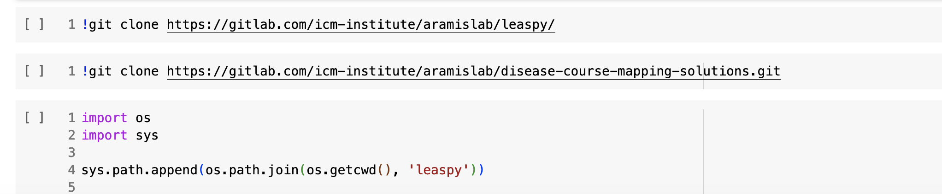
TP1
To start
Please follow the link below :
https://colab.research.google.com/drive/1uZDC4LYE8tmBG83UGcZZPfWr-UUBRxgH?usp=sharing#scrollTo=U_vNmA7gBFd4
And run the 3 first cells :

Slide 64

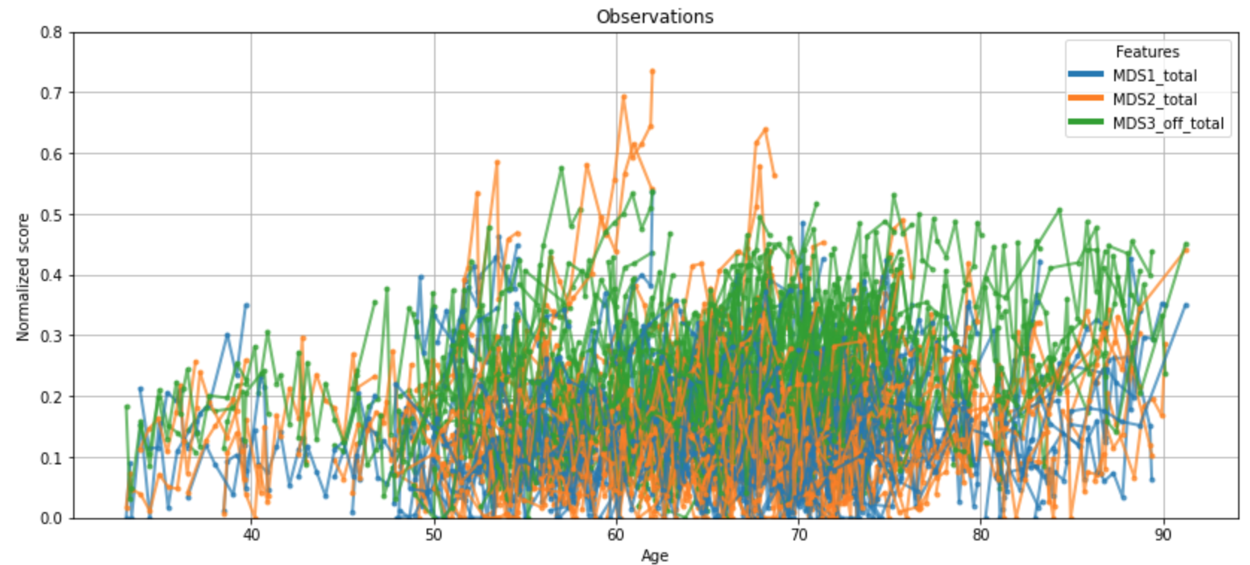
TP1
Introduction
Objectives
Get familiar with medical longitudinal data
Get a taste of state-of-the-art models
Understand mixed-effects models

Slide 65
Go, it’s your turn !
And don’t hesitate if you have any question !

Slide 66
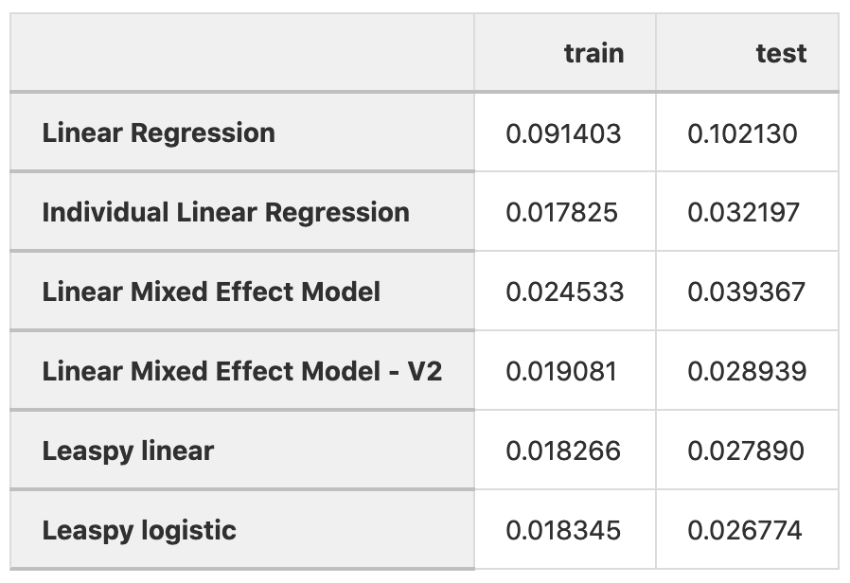
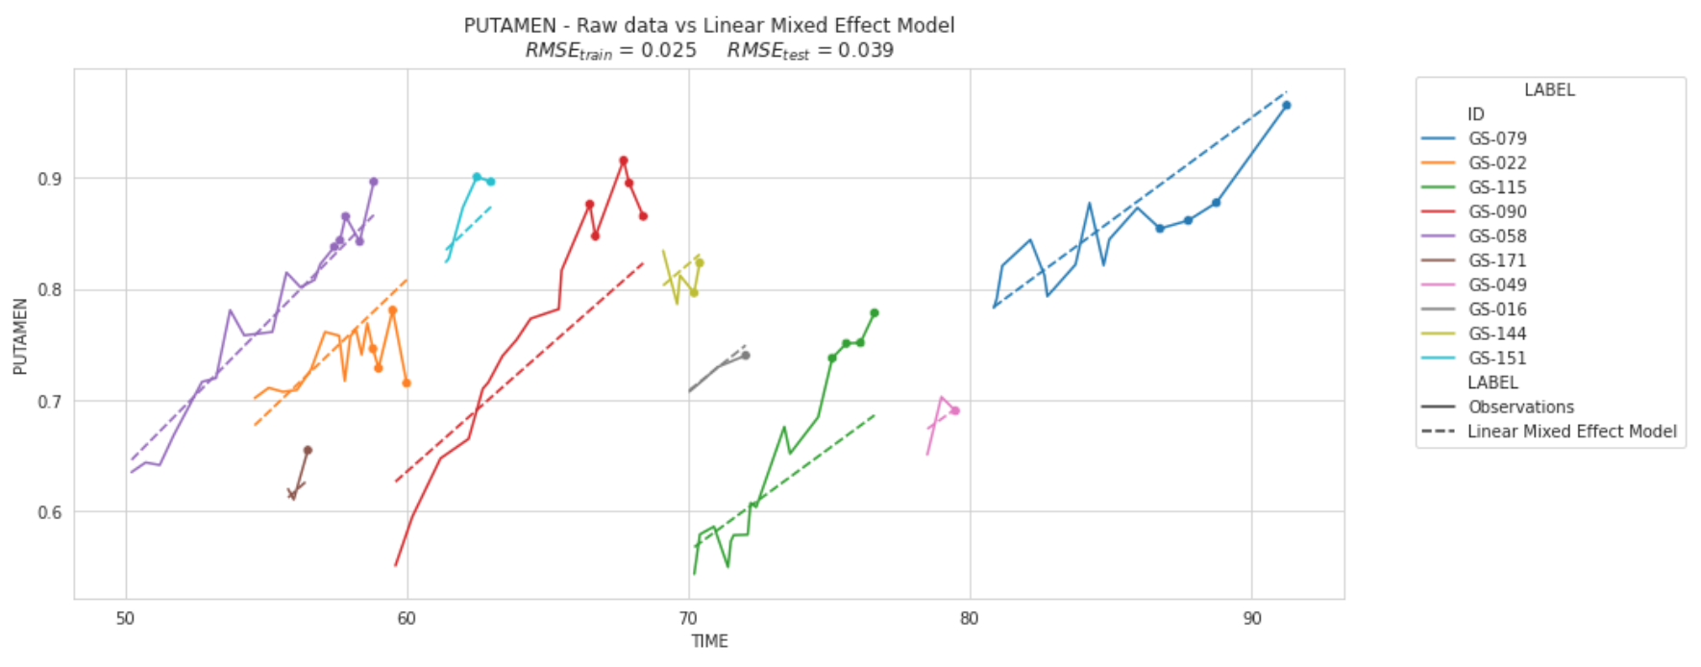
TP1
Take home messages
There exist few models to analyse longitudinal data and RMSE can vary a lot between train and test.
Linear Mixed Effect Model
Root Mean Squared Error

Slide 67
Part III: Practical Session
Modelling and predicting disease progression
3. A disease course mapping model: How to use leaspy ?

Slide 68
TP2
To start
Please follow the link below :
https://colab.research.google.com/drive/1dCMa9In1ef9_Y3HKt8SeSzKf0-3CcxNt?usp=sharing
And run the 3 first cells :

Slide 69




TP2
Introduction
Objectives : Learn to use Leaspy methods
II. Personalize
III. Impute & predict
Predicted data
Test data
Individual
parameters
IV. Application: cofactor analysis
V. Data Simulation
I. Fit
Leaspy model
Train data
Simulated data

Slide 70
Go, it’s your turn !
And don’t hesitate if you have any question !

Slide 71




TP2
Take home messages
Leaspy model can be an helpful tool to
Get disease timeline with population disease progression
Predict individual disease progression
Extract interpretable information
Simulate data

Slide 72
Part III: Practical Session
Modelling and predicting disease progression
4. Going deeper into leaspy model tuning

Slide 73
TP3
To start
Please follow the link below :
https://colab.research.google.com/drive/1UmzmerIjMCn2yfJZ-5tE8__QEYKIeeeq?usp=sharing
And run the 3 first cells :

Slide 74




TP3
Introduction
How to use leaspy in daily situation ?
What are the constraints on inputs ?
How to get the best model ?
What kind of data ?
How to evaluate performances ?
What about binary observations ?
Univariate or multivariate models ?

Slide 75
Go, it’s your turn !
And don’t hesitate if you have any question !

Slide 76

TP3
Take home messages
How to use leaspy in day life situation ?
What are constraints on inputs ?
How to get the best model ?
Data :
Should be between 0 and 1
Should increase with time
Should be continuous or binary (adding noise_model="bernoulli")
Can contain missing data
Can contain one or several features
There is no general rule for multivariate or univariate model, you should try different options and monitor the following (among other things) :

Slide 77
Part III: Practical Session
Modelling and predicting disease progression
5. Conclusion

Slide 78




Conclusion
Take home messages
Leaspy is a good tool to handle medical longitudinal data, it allows you to :
Get disease timeline with population disease progression
Predict disease progression,
Extract interpretable information,
Simulate data.

Slide 79




Thank you for your attention, and don’t forget to fill the survey !
gitlab.com/icm-institute/aramislab/leaspy
www.aramislab.fr

