Slide 1

Forbes List Analysis
2018

Slide 2
Data_1 Vs. Data_2
Data_1: Units_1
Data_2: Units_2
Period: 2018

Slide 3
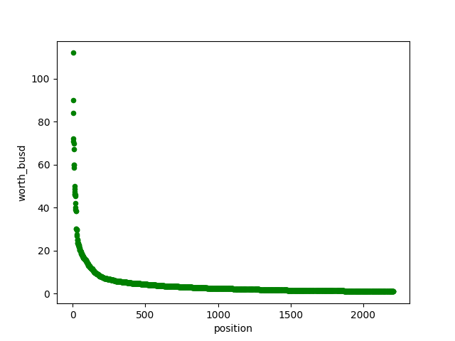
Data_1 Vs. Data_2

