Slide 1
Video Game Design
Summer 2015

Slide 2

Who We Are
Hannah Glazebrook
Eric Kidder
Matt Moldavan
Gina Nguyen
Team Fantastic

Slide 3

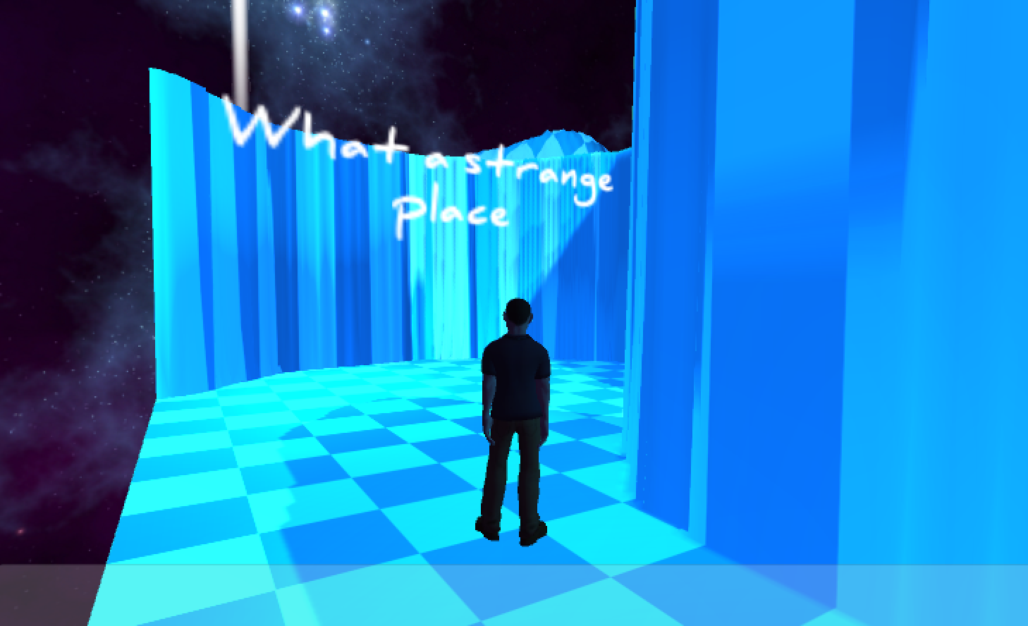
What Hath We Wrought
You may remember us from such classic game concepts as...
and then more of...
and then...

Slide 4

No Really, What Hath We Wrought
But this time we seriously nailed it!

Slide 5
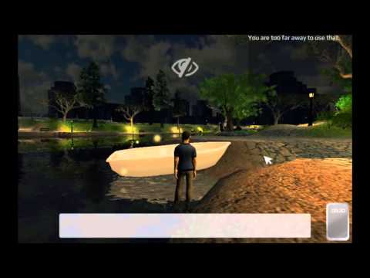

Slide 6
Game Concept:
Emotion, Mechanic, and Themes
The player must remove or destroy evidence in a crime scene within the time limit without arousing too much suspicion.

Slide 7
Environment
In a dark, mysterious park (modeled after Piedmont Park in Atlanta, GA)

Slide 8
NPCs are watching you!

Slide 9
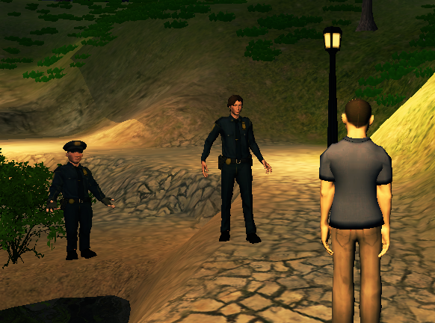
NPCs: Patrolling Cops

Slide 10
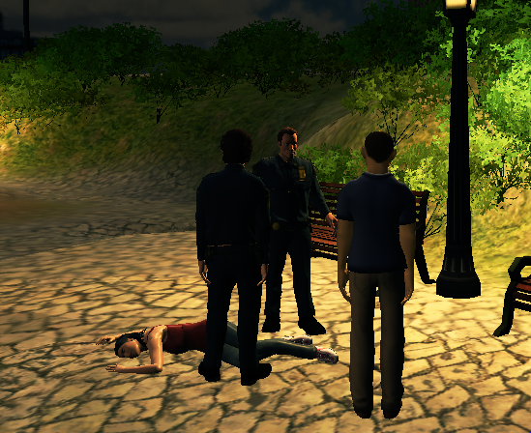
NPCs: Guards (watching the body)

Slide 11
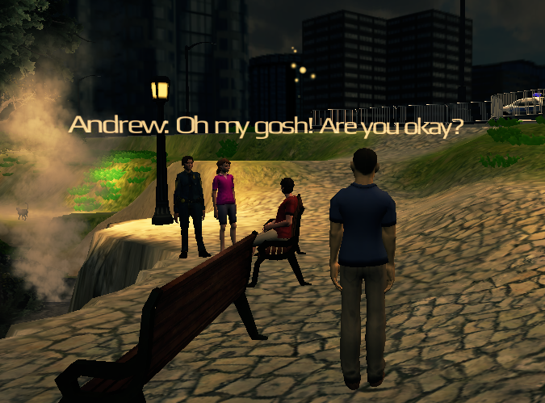
NPCs: Gossiping Onlookers

Slide 12
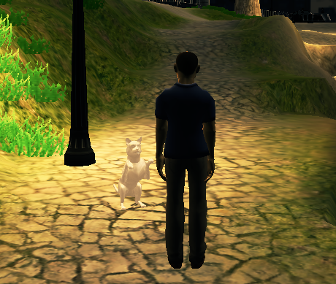
NPCs: Stray Cats :)

Slide 13
Objects
Evidence
Foot print
Hand print
Phone
Knife
Necklace
Wallet
Distractions
Throw a Ball
Other
Trash cans
Boats
Pianos
Cranes

Slide 14
Player Interactions
Destroy the evidence
Plant the evidence
Avoid Detection
Play the piano
Push barrels

Slide 15
Our Differentiator
Interesting moral dilemma as the player!
A twist on the typical crime game.

Slide 16
Future Enhancements
Support console controllers
Better environmental interactions
Things to play with
Ways to distract NPCs
NPC conversations
Player can interact with NPC
Conversation trees between NPCs
More detection and suspicion scenarios!

Slide 17
LAUNCH PARTY
Feel free to join us in the Cleaner Suite for drinks and snacks as we celebrate the successful launch of the Cleaner.

