Slide 1
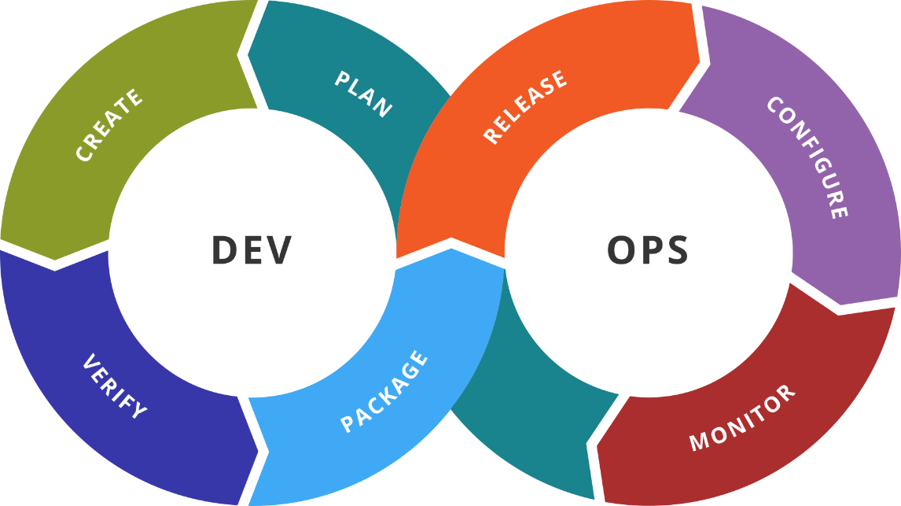
Container Orchestration
Introduction to Kubernetes
SoftUni Team
Technical Trainers
Software University
http://softuni.bg

Slide 2
Table of Contents
Container Orchestration
Kubernetes the Big Picture
Simple Local Installation
Working with Kubernetes
Advanced Local Installation

Slide 3

Previous Week
Quick overview

Slide 4
What We Covered
Infrastructure as Code
Introduction to Terraform
Terraform Basics
Terraform and Docker
Terraform and AWS

Slide 5

Dev
Ops
Container Orchestration
What, Why, and How

Slide 6
Container Orchestration
Containerization brought new demands/requirements:
Workload deployment and distribution
Resource governance
Scalability and availability
Automatization and management
Internal and external communication

Slide 7
Solutions
Docker Swarm
Mesos Marathon
Amazon ECS
HashiCorp Nomad
Kubernetes

Slide 8
Kubernetes Origin
Born out of projects like Borg and Omega at Google
Donated to CNCF in 2014
Open source, licensed under Apache 2.0
Written in Go/Golang
Version 1.0 came into existence in July 2015. Current is 1.13.1
κυβερνήτης in Greek means Helmsman – s.o. who steers the ship
Can be seen often as k8s
8
(Kubernetes)
(Kubernetes)

Slide 9
What Kubernetes Does?
Run a cluster of hosts
Schedule containers to run on different hosts
Facilitate the communication between the containers
Provide and control access to/from outside world
Track and optimize the resource usage

Slide 10
Dev
Ops
The Big Picture
Kubernetes Architecture & Components

Slide 11
Architecture Overview
Kubernetes Cluster
Master Node
Master Node
Node 1
Node 2
Master Node
Pod 1
Pod 1
Proxy
Proxy
Scheduler
Kubelet
Pod n
Kubelet
Pod n
Controller
Node 3
Node 4
API Server
Pod 1
Pod 1
Proxy
Proxy
Key-Value Store
Kubelet
Pod n
Kubelet
Pod n

Slide 12
Masters
Responsible for managing the cluster
Typically more than one is installed
In HA mode one Master node is the Leader
It is work-free
Components running on master are also known as Control Plane
Can be reached via CLI (kubectl), APIs, or Dashboard
Master Node
Scheduler
Controller
API Server
Key-Value Store

Slide 13
Masters – Cluster Store
Based on etcd
Persistent storage
Cluster state and configuration
Distributed and consistent
Provides single source of truth
Can be installed externally
Master Node
Scheduler
Controller
API Server
Key-Value Store

Slide 14
Masters – API Server
Master Node
Front-end to the control plane
Administrative tasks
Exposes the API (REST)
Consumes JSON via Manifest files (YAML)
Scheduler
Controller
API Server
Key-Value Store

Slide 15
Masters – Controller
Executes control loops
Responsible for other controllers
Node controller
Endpoints controller
Namespace controller, and etc.
Watches for changes
Maintains the desired state
Master Node
Scheduler
Controller
API Server
Key-Value Store

Slide 16
Masters – Scheduler
Master Node
Scheduler
Listens API Server for new work
Assigns work to nodes
Controller
API Server
Key-Value Store

Slide 17
(Worker) Nodes
Initially called Minions
Container runtime
containerd, rkt, lxd
Kubelet
Communicates with master
Uses CRI shims
kube-proxy
Network proxy
Node 1
Proxy
Kubelet
Container Runtime
Pod 1
Pod 2

Slide 18
(Worker) Nodes – Kubelet
Main Kubernetes agent
Registers node in the cluster
Listens to API Server
Creates pods
Reports back to the master
Exposes endpoint on :10255
/spec
/healthz
/pods
Node 1
Proxy
Kubelet
Container Runtime
Pod 1
Pod 2

Slide 19
(Worker) Nodes – Container Runtime
Container management:
Pulling images
Starting and stopping
It is pluggable
By default is Docker
Node 1
Proxy
Kubelet
Container Runtime
Pod 1
Pod 2

Slide 20
(Worker) Nodes – Kube Proxy
Provides the networking
Each pod has its own address
All containers in a pod share the same IP address
Offers load balancing across all pods in a service
Node 1
Proxy
Kubelet
Container Runtime
Pod 1
Pod 2

Slide 21
Pods (1)
Smallest unit of scheduling
One or more containers
Containers share the pod environment
Scheduled on nodes
It is atomic – deployed as one and on one node
Created via manifest files
Pod
Environment
net
mount
Main container
Supporting containers

Slide 22
Pods (2)
Pod 1
Pod 2
localhost
localhost
10.10.20.20
10.10.20.21
Pod Network
Each pod has unique IP address
Inter-pod communication is via a pod network
Intra-pod communication is via localhost and port

Slide 23
Replication Controllers
Higher level workload
Looks after pod or set of pods
Scale up/down pods
Sets Desired State
Replication Controller
Pod

Slide 24
Deployments
Even higher level workload
Simplifies updates and rollbacks
Declarative and imperative approach
Self documenting
Suitable for versioning
Deployment
Replication Set
Pod

Slide 25
Services
Provide reliable network endpoint
IP address
DNS name
Port
Expose Pods to the outside world
NodePort (cluster-wide port)
LoadBalancer (cloud-based)
Use End Point object to track Pods
Pod A IP, Pod B IP, …
IP: 10.10.10.1
DNS: demo-svc
Port: 32001
End Point
Service
Node 1
Node 2
Pod A
Pod B
10.10.20.21
10.10.20.22

Slide 26
Services in Action
Services user label selectors to do their magic
Service
app = myapp
version = v01
Pod
Pod
Pod
Pod
app = myapp
app = myapp
app = myapp
app = myapp
version = v01
version = v01
version = v01
version = v01

Slide 27
Services in Action
Services user label selectors to do their magic
Service
app = myapp
version = v01
Pod
Pod
app = myapp
app = myapp
version = v01
version = v01
Initial deployment – two pods with version = v01

Slide 28
Services in Action
Services user label selectors to do their magic
Service
app = myapp
version = v01
Pod
Pod
Pod
Pod
app = myapp
app = myapp
app = myapp
app = myapp
version = v01
version = v02
version = v02
version = v01
Next step – add two more pods with version = v02

Slide 29
Services in Action
Services user label selectors to do their magic
Service
app = myapp
version = v02
Pod
Pod
Pod
Pod
app = myapp
app = myapp
app = myapp
app = myapp
version = v01
version = v02
version = v02
version = v01
Next step – we update the service to look for version = v02

Slide 30
Services in Action
Services user label selectors to do their magic
Service
app = myapp
version = v02
Pod
Pod
app = myapp
app = myapp
version = v02
version = v02
Finally, all pods with version = v01 are destoyed

Slide 31
Dev
Ops
Time for a Break

Slide 32
Dev
Ops
Local Playground with Minikube
Pods, Services, Replica Sets & Deployments

Slide 33
Installation. Configuration. Tools
Installation methods
Localhost (Minikube, Ubuntu on LXD)
On-Premise (VMs, Bare Metal)
Cloud (Hosted Solutions, Turnkey Solutions, Bare Metal)
Configurations
All-in-One Single Node and Different Multi Node Options
Installation tools
kubeadm, KubeSpray, Kops

Slide 34
Minikube
Easiest and recommended way for a local all-in-one cluster
Requirements
kubectl
Hypervisor (VirtualBox, Hyper-V, KVM, xhyve, VMware Fusion)
VT-x/AMD-v enabled
Internet connection on first run
Supports Linux, macOS, and Windows
Provides docker-machine-like experience, but for Kubernetes

Slide 35
Dev
Ops
Practice: See It in Action
Live Demonstration in Class

Slide 36
Dev
Ops
Install a K8s Cluster
Two Methods

Slide 37
Manual Approach
Crate a virtual machine with (2 CPU, 2GB RAM, 10GB HDD)
Install supported distribution (we will use CentOS)
Provide the prerequisites and add repositories
Install and configure the main components
Clone the machine N times
Initialize the Kuberenetes cluster on node 1 (Master)
Install POD network plugin and Dashboard
Join the worker nodes

Slide 38
Good Old Vagrant
Vagrant + VirtualBox is a valid way to go
Few things to consider:
Adjust box CPU and Memory values
Create private network
Mount a common folder
Create custom (known) token on the master
Save the hash value to a file

Slide 39
Dev
Ops
Practice: See It in Action
Live Demonstration in Class

Slide 40

Summary
Kubernetes is a container orchestrator
Standalone or clustered environment
On-premise or in the cloud
Provides automated:
Deployment
Scaling
Management
…
…
…

Slide 41
Resources
Kubernetes Documentation
https://kubernetes.io/docs/home
kubectl overview
https://kubernetes.io/docs/reference/kubectl/overview/
Steps to create a cluster
https://kubernetes.io/docs/setup/independent/create-cluster-kubeadm/
…
…
…

Slide 43



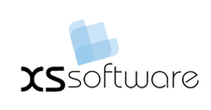


СофтУни диамантени партньори

Slide 44






СофтУни диамантени партньори

Slide 45





Trainings @ Software University (SoftUni)
Software University – High-Quality Education, Profession and Job for Software Developers
softuni.bg
Software University Foundation
http://softuni.foundation/
Software University @ Facebook
facebook.com/SoftwareUniversity
Software University Forums
forum.softuni.bg

