Slide 1
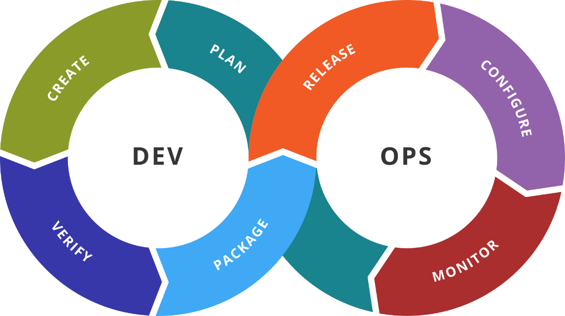
NoSQL Databases
Characteristics, types, examples
SoftUni Team
Technical Trainers
Software University
http://softuni.bg

Slide 2
Table of Contents
NoSQL Databases
Redis
MongoDB
Apache Cassandra

Slide 3

Previous Week
Quick overview

Slide 4
What We Covered
Additional Objects
Health Checks
Resource Quota and Monitoring
Autoscaling
Package Management
Terraform + AWS + Kubernetes

Slide 5

Dev
Ops
NoSQL Databases

Slide 6
What We Had So Far
RDBMS offer structured data and universal language (SQL)
RDBMS follow ACID rules:
Atomicity – transactions are threated as single units
Consistency – transactions bring DB from one valid state to another. Written data must be valid according to all rules
Isolation – concurrent execution of transactions leaves the DB in the same state as if they were executed sequentially
Durability – committed transaction remains committed even in case of system failure
Reasons to move on – hard to scale, the need for unstructured data,…

Slide 7
What is NoSQL?
NoSQL = Not-only-SQL
NoSQL databases store unstructured data
Data is stored in a denormalized form
Key features offered:
Speed – very fast response, usually the data is stored in memory
Scale – easily scalable, following the ever growing demand
Continuous Availability – redundant copies across multiple locations with no downtime
Location Independence – serve data quickly to multiple locations

Slide 8
The CAP Theorem
Consistency
All nodes should see the same data
All clients always have the same view of the data
Availability
Each client can always read and write
The system should remain operational 100% of the time
Partition Tolerance
The system should work despite message loss or partition failure
The system should sustain any amount of network failure that does not result in a failure of the entire network

Slide 9
The Reality
Only two requirements of the CAP theorem can be met at the same time
CA (Consistency and Availability)
Troubles with partitions
Vertica, Greenplum, and etc.
AP (Availability with Partition Tolerance)
Eventual consistency through replication and verification
Cassandra, CouchDB, Dynamo, Voldermort, and etc.
CP (Consistency with Partition Tolerance)
Trouble with availability while keeping data consistent across partitioned nodes
MongoDB, Redis, Berkley DB, Memcached, and etc.

Slide 10
NoSQL Types: Key-Value
Main characteristics
Collection of keys associated with values
Keys are represented with strings
Values are stored as BLOBs
No query language, just simple commands (put, get, delete, …)
Use Cases
Session tracking, shopping carts, …
Examples
Redis, Cassandra, Memcached, Couchbase

Slide 11
NoSQL Types: Document
Main characteristics
Similar to key-value DBs, but values store XML, JSON, or BSON
Offers storage of complex data like trees, collections, dictionaries
Doesn’t support relations and joins
No query language
Examples
MongoDB, CouchDB, OrientDB

Slide 12
NoSQL Types: Column Store
Main characteristics
Store data in column families as rows
Rows have many columns associated with them
Each row can have different set of columns
Offer compression, aggregation queries, and scalability
They are fast to load and query
Examples
Cassandra, DynamoDB, Hbase

Slide 13
NoSQL Types: Graph
Main characteristics
Data is stored in the form of nodes and edges
Nodes are the data entries
Edges are the relationships between the data entries
Edges can have their own properties and direction
Examples
Neo4J, FlockDB, OrientDB

Slide 14
Dev
Ops
Redis
Data Structure NoSQL Database

Slide 15
Introduction
Redis stands for Remote dictionary server
Open source, in-memory data structure store
Offer structures like strings, hashes, lists, sets, and etc.
Other interesting features:
Transactions
Keys with limited time-to-live
Automatic failover
Libraries for many programming languages
Supported on Linux and OS X
Can run on Windows, but not supported

Slide 16
Keys are grouped in key spaces (databases)
Single commands are atomic
Some commands:
Single keys: SET, GET, DEL, GETSET, SETNX
Multiple keys: MSET, MGET, MSETNX
Expiration control: EXPIRE, EXPIREAT, SETEX, TTL, PERSIST
Increment/decrements: INCR, INCRBY, DECR, DECRBY

Slide 17
Dev
Ops
Practice: See It in Action
Live Demonstration in Class

Slide 18
Dev
Ops
MongoDB
Document NoSQL Database

Slide 19
Introduction
Free and open source document oriented database
Documents can contain many different key-value pairs, or key-array pairs, or even nested documents
Offers querying, indexing, and aggregation
Built in high availability, horizontal scaling, and geographic distribution
Libraries for many programming languages
Supported on Windows, Linux, and OS X
Hosted solution is also available by MongoDB Atlas

Slide 20
Dev
Ops
Practice: See It in Action
Live Demonstration in Class

Slide 21
Dev
Ops
Apache Cassandra
Column Store NoSQL Database

Slide 22
Introduction
Free and open-source, distributed, wide column store database
Data is stored in rows and columns
Each column has name (comparator) and value (validator)
Related rows form a column family (resembles the table)
Key space (DB schema) consists of column families
Offers MapReduce support and query language (CQL)
Written in Java and supported on multiple platforms

Slide 23
Dev
Ops
Practice: See It in Action
Live Demonstration in Class

Slide 24

Summary
Multiple ways to classify NoSQL databases
Main classes are:
Key-Value
Document
Column
Graph
Couchbase and OrientDB are multi-model DB
NoSQL DB has their specific field of appliance
It is usually easier to scale NoSQL DB
…
…
…

Slide 25
Resources
General Info About NoSQL Databases
https://en.wikipedia.org/wiki/NoSQL
https://www.xenonstack.com/blog/big-data-engineering/overview-types-nosql-databases/
Redis Documentation
https://redis.io/documentation
Redis University
https://university.redislabs.com/
MongoDB Documentation
https://docs.mongodb.com/
MongoDB University
https://university.mongodb.com/
Apache Cassandra Documentation
http://cassandra.apache.org/doc/latest/
Apache Cassandra CQL Documentation
https://docs.datastax.com/en/dse/6.7/cql/index.html
…
…
…

Slide 27






СофтУни диамантени партньори

Slide 28






СофтУни диамантени партньори

Slide 29





Trainings @ Software University (SoftUni)
Software University – High-Quality Education, Profession and Job for Software Developers
softuni.bg
Software University Foundation
http://softuni.foundation/
Software University @ Facebook
facebook.com/SoftwareUniversity
Software University Forums
forum.softuni.bg

