Slide 1
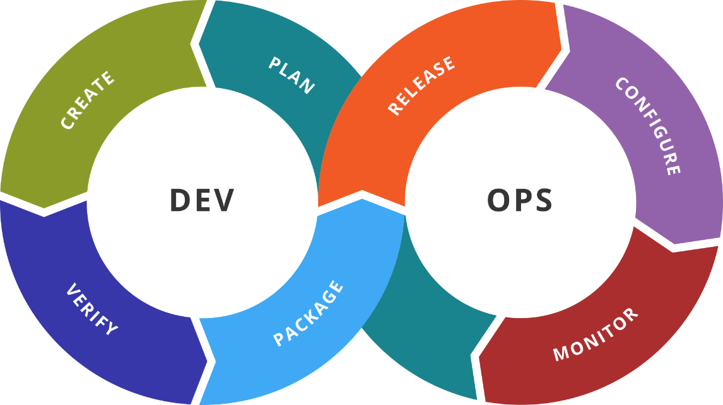
Additional Tools
Complete HashiCorp’s Portfolio
SoftUni Team
Technical Trainers
Software University
http://softuni.bg

Slide 2
Table of Contents
Packer
Vault
Consul
Nomad

Slide 3

Previous Week
Quick overview

Slide 4
What We Covered
NoSQL Databases
Redis
MongoDB
Apache Cassandra

Slide 5

Dev
Ops
Packer
Build Any Image for Any Platform

Slide 6
What is Packer?
Image creation tool
Can produce images for multiple platforms
Can be run on all major operating systems
Installation options – precompiled binaries, source, and others
Not meant to replace configuration management tools
Packer can utilize tools like Ansible, Chef, and Puppet
Advantages – fast deployment, portability, stability, testability
Use cases – CD, Dev/Prod Parity, Appliance/Demo

Slide 7
Packer Terminology
Artifacts are the results of a single build
Builds are a single tasks that eventually produces and image
Builders can create a machine image for a single platform
Commands are part of the packer command-line interface
Post-processors are processing the result of a build or another post-processor to produce a new artifact
Provisioners are responsible for installation and configuration of a machine before turned to static image
Templates are files that define one or more builds

Slide 8
Packer Templates
Building steps are described in JSON configuration files
Templates can have:
builders – required, array
description – optional, string
min_packer_version – optional, string
post-processors – optional, array
provisioners – optional, array
variables – optional, object

Slide 9
Dev
Ops
Vault
Your Secrets are Safe

Slide 10
What is Vault?
Tool for securely accessing secrets (keys, passwords, …)

Slide 11
Key Features
Secure Secret Storage – encrypted storage for key/value secrets
Dynamic Secrets – secrets can be generated on-demand
Data Encryption – encrypt/decrypt of data without storing it
Leasing and Renewal – upon expire secrets are revoked. Clients can renew leases as well
Revocation – built-in support for secrets revocation

Slide 12
Use Cases
General Secret Storage
Vault can be used for the storage of any secrets, plus it offers audit
Employee Credential Storage
Mechanism for storing and tracking employee credentials
API Key Generation
Access key is generated for the duration of a script, then revoked
Data Encryption
Encryption/decryption as a service, no data is stored locally

Slide 13
Vault Glossary
Storage Backend provides durable storage of encrypted data
Barrier is responsible for all data that flows between Vault and the storage backend. It ensures that only encrypted data is written out
Secrets Engine manages the secrets
Audit Device is responsible for managing audit logs

Slide 14
Vault Glossary
Auth Method
Used to authenticate users and applications connecting to Vault
Client Token
Returned when user authenticates and used for future requests
Secret
Artifact returned by Vault that contains confidential or cryptographic material and has associated lease
Server
Long-running instance that provides an API and manages the interaction between the components

Slide 15
Dev
Ops
Practice: See It in Action
Live Demonstration in Class

Slide 16
Dev
Ops
Consul
Service Discovery

Slide 17
What is Consul?
Service mesh solution that offers service discovery, configuration, and segmentation functionality

Slide 18
Key Features
Service Discovery – clients can register a service, or discover providers of a given service
Health Checking – clients provide health checks either on service or node level
KV Store – available for use by the applications for any purpose
Secure Service Communication – services can communicate over secure connections. Intentions can be used to define which services are allowed to communicate
Multi Datacenter – supported out of the box

Slide 19
Consul Glossary
Agent is a daemon running on every member of a Consul cluster. It can run either as client or server
Client is an agent that forwards all RPCs to a server. It is taking part in the LAN gossip
Server is an agent with expanded set of responsibilities. It takes part in the Raft quorum, responds to RPC queries, exchanges WAN gossip, and forwards queries to leaders or remote DCs
Datacenter is private networking environment with low latency and high bandwidth

Slide 20
Consul Glossary
Consensus is the agreement upon the elected leader as well as agreement on the ordering of transactions
Gossip is based on Serf. It provides membership, failure detection, and event broadcast. Involves random node-to-node communication, primarily over UDP
LAN Gossip contains nodes in same datacenter, while WAN Gossip is for servers, located in different datacenters
Remote Procedure Call (RPC) is a request/response mechanism allowing client to make a request of a server

Slide 21
Dev
Ops
Practice: See It in Action
Live Demonstration in Class

Slide 22
Dev
Ops
Nomad
Orchestrate Any Workload

Slide 23
What is Nomad?
Flexible orchestration tool
It can run diverse workload of Docker, non-containerized, microservice, and batch applications
Some benefits:
API-driven Automation – automated workflow management, leads to simplified operations
Self-service Deployments – developers are empowered to service application lifecycle directly
Workload Reliability – failures are handled automatically
Increased Efficiency and Reduced Cost – allows higher application densities

Slide 24
Key Features
Docker Support
Native support for Docker is offered
Operationally Simple
Ships as a single binary both for clients and servers. It builds on the strength of Serf and Consul
Multi-Datacenter/-Region Aware
Infrastructure is represented as groups of datacenters which form region. Scheduling operates on region level
Flexible Workloads
Extensible support for task drivers, allowing it to run containerized, virtualized, and standalone applications
Built for Scale
Designed from the ground up to support global scale infrastructure. It has been proven to scale to cluster sizes that exceed 10k nodes in real-world production environments.

Slide 25
Use Cases
Docker Container Management
Nomad + Consul + Vault offer a complete and flexible solution that scales to thousands of nodes in a single cluster
Legacy Application Deployment
Natively supports running legacy applications, static binaries, JARs, and simple OS commands directly
Microservices
Together with Consul are an ideal solution for managing microservices
Batch Processing Workloads
It can natively run batch jobs, parameterized jobs, and Spark workloads
Multi-region/-cloud Deployments
By design it supports multi-datacenter/-region deployments and is cloud agnostic

Slide 26
Nomad Glossary
Job is a specification of a workload. It is a form of desired state, and Nomad is responsible the match between it and the actual state. Job is made of one or more task groups
Task Group is a set of tasks that must be run together. It is the unit of scheduling – entire group runs on the same client node
Driver is the basic means of executing our tasks
Client is a machine that tasks can be run on
Allocation is a mapping between a task group in a job and a client node

Slide 27
Nomad Glossary
Evaluations are mechanism by which scheduling decisions are made. When desired and actual state differs, new evaluation is created
Servers manage all jobs and clients, run evaluations, and create task allocations. They replicate the data between each other and perform leader election
Regions may contain multiple Datacenters. Servers are assigned to a region. Data is not replicated between regions.
Bin Packing is the process of filling bins (clients) with items (task groups) in a way that maximizes the utilization of bins

Slide 28
Dev
Ops
Practice: See It in Action
Live Demonstration in Class

Slide 29

Resources
Packer Documentation
https://www.packer.io/docs/index.html
Vault Documentation
https://www.vaultproject.io/docs/
Consul Documentation
https://www.consul.io/docs/index.html
Nomad Documentation
https://www.nomadproject.io/docs/index.html
HashiCorp Learn Portal
https://learn.hashicorp.com/
Nomad and Vagrant
https://github.com/hashicorp/nomad/tree/master/demo/vagrant
Nomad Cluster (+ Consul + Vagrant)
https://github.com/oribaldi/nomad-cluster
…
…
…

Slide 31






СофтУни диамантени партньори

Slide 32






СофтУни диамантени партньори

Slide 33





Trainings @ Software University (SoftUni)
Software University – High-Quality Education, Profession and Job for Software Developers
softuni.bg
Software University Foundation
http://softuni.foundation/
Software University @ Facebook
facebook.com/SoftwareUniversity
Software University Forums
forum.softuni.bg

