Slide 1
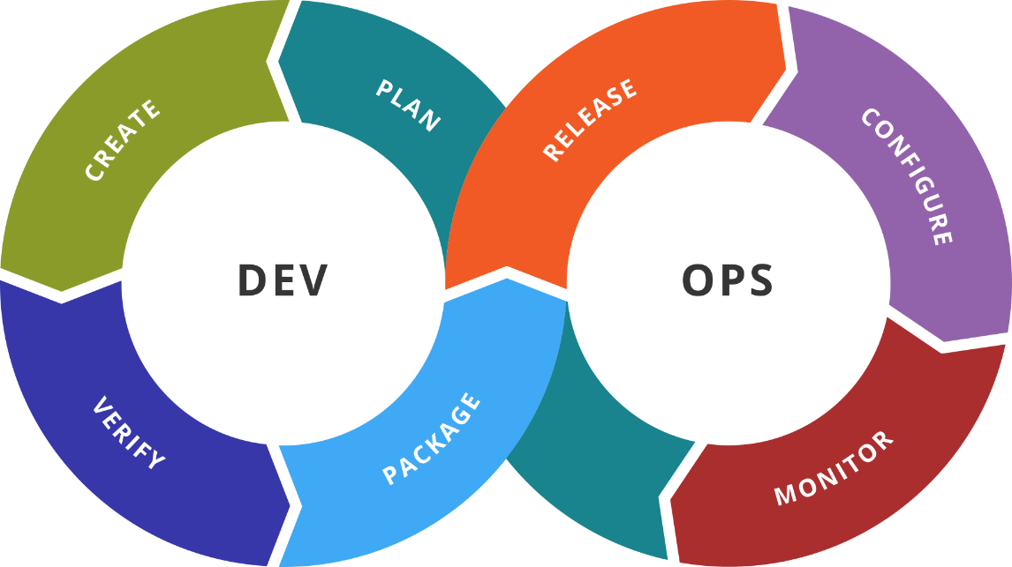
Configuration Management Solutions
Puppet, Chef, and Salt
SoftUni Team
Technical Trainers
Software University
http://softuni.bg

Slide 2
Table of Contents
Puppet by Puppet
Chef by Chef
Salt by SaltStack

Slide 3

Previous Week
Quick overview

Slide 4
What We Covered
Packer
Vault
Consul
Nomad

Slide 5

Dev
Ops
Puppet
By Puppet

Slide 6
Introduction
Solution for automatization of provisioning, configuration, and management of server infrastructure
Configurations are written in Ruby DSL and Embedded Ruby
Based on master-agent model
Masters can run on Linux/Unix systems
Agents support Linux/Unix/Windows
Can be extended with modules – own or 3rd party:
https://forge.puppet.com/

Slide 7
Workflow
An agent node sends facts to the master and requests a catalog
The master compiles and returns the node’s catalog
The agent applies the catalog to the node by checking each resource the catalog describes
If the agent finds resources that are not in their desired state, it makes the changes necessary to correct them
The agent sends a report back to the master

Slide 8
Artifacts
Resources are the fundamental unit for modeling system configurations. Each resource describes some aspect of a system
Manifests are files that contain set of instructions to be executed
Classes are code blocks that can be called in a code elsewhere
Modules are collections of manifests and data (facts, files)
<TYPE> { '<TITLE>':
<ATTRIBUTE> => <VALUE>,
}

Slide 9
Dev
Ops
Practice: See It in Action
Live Demonstration in Class

Slide 10
Dev
Ops
Chef
By Chef

Slide 11
Introduction
Solution for infrastructure and application automation
Instructions are written in Ruby DSL
Master-agent model, pull-based approach
Server portion can be installed only on Linux
Management part can be installed on Linux/macOS/Windows
Client can be installed on Linux/Unix/Windows
You can reuse the expertise of the community:
https://supermarket.chef.io/

Slide 12
Components and Workflow
Chef workstation is the point where users can author and test cookbooks and interact with the Chef server
Chef client nodes are the machines that are managed by Chef
Chef client is installed on each node and is used to configure the node to its desired state
Chef server acts as a hub for cookbooks, policies, and metadata
Nodes use the Chef client to ask the Chef server for configuration details, such as recipes, templates, and file distributions

Slide 13
Artifacts
Resource is a statement of configuration policy that describes the desired state for a configuration item, declares the steps needed, artifact type, and set of properties
Recipes specify the resources to use and the order in which they are to be applied
Cookbooks are the fundamental unit of configuration and policy distribution. They define a scenario and contain everything that is required to support it

Slide 14
Dev
Ops
Practice: See It in Action
Live Demonstration in Class

Slide 15
Dev
Ops
Salt
By SlatStack

Slide 16
Introduction
Infrastructure management solution that can be used for data-driven orchestration, remote execution, and configuration management
Management instructions are written in YAML
Two operation modes – with agents (minions) and agent-less
Linux/Unix/Windows are both supported as minions and masters

Slide 17
Components and Workflow
Salt master is the machine that controls the infrastructure and dictates policies for the servers it manages
Master operates both as a repository for configuration data and as the control center that initiates remote commands and ensures the state of your other machines
Servers that Salt manages are called minions
Minions are responsible for executing the instructions sent by the master, reporting on the success of jobs, and providing data about the underlying host

Slide 18
Artifacts
Execution modules are sets of related functions that perform work on minions
The configuration management portion of Salt is primarily implemented using the state system, which uses state modules
Salt formulas are sets of state module calls, arranged with the aim of producing a certain result
Configuration management is handled by SLS files, written in YAML, that describe how a system should look once the formula has been applied
Salt grains are pieces of information, gathered by and maintained by a minion, primarily concerning its underlying host system

Slide 19
Dev
Ops
Practice: See It in Action
Live Demonstration in Class

Slide 20

Resources
Puppet Documentation
https://puppet.com/docs/puppet/6.1/puppet_index.html
Puppet Self-paced Training
https://learn.puppet.com/category/self-paced-training
Chef Documentation
https://docs.chef.io/
Chef Learn Portal
https://learn.chef.io/
Salt Documentation
https://docs.saltstack.com/en/latest/
Salt Tutorials
https://docs.saltstack.com/en/latest/topics/tutorials/index.html
…
…
…

Slide 22






СофтУни диамантени партньори

Slide 23






СофтУни диамантени партньори

Slide 24





Trainings @ Software University (SoftUni)
Software University – High-Quality Education, Profession and Job for Software Developers
softuni.bg
Software University Foundation
http://softuni.foundation/
Software University @ Facebook
facebook.com/SoftwareUniversity
Software University Forums
forum.softuni.bg

