Slide 1
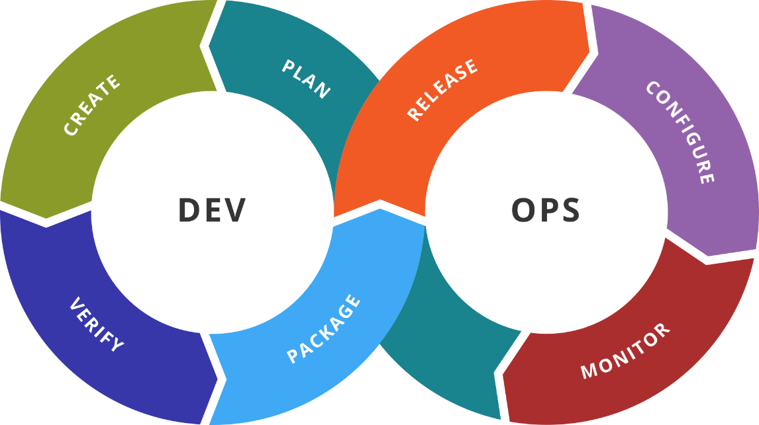
Extract and Analyze System Information
ELK / Elastic Stack
SoftUni Team
Technical Trainers
Software University
http://softuni.bg

Slide 2
Table of Contents
Solutions
ELK / Elastic Stack
Elasticsearch
Logstash
Kibana
Beats
ELK and Docker

Slide 3

Previous Week
Quick overview

Slide 4
What We Covered
Puppet by Puppet
Chef by Chef
Salt by SaltStack

Slide 5

Dev
Ops
Elastic Stack
ex-ELK Stack

Slide 6
ELK (Elastic) Stack
Started as ELK Stack
Elasticsearch
Logstash
Kibana
Then became Elastic Stack
Beats were added
Then other components
ELK become obsolete as name

Slide 7
Elasticsearch
Used for searching, analyzing, and storing of data
The hearth of the Elastic Stack
Distributed, RESTful search and analytics engine
Designed for horizontal scalability, maximum reliability, and easy management
Supported on multiple platforms
Offered through packaging systems and as standalone package

Slide 8
Logstash
Open source, server-side data collection and processing pipeline
Ingests data from a multitude of sources simultaneously, transforms it, and then sends it to your favorite “stash”
Complemented by extensible plugin ecosystem
Strong Elasticsearch synergy
Processing in three stages – input, filter, and output

Slide 9
Kibana
Used for both data visualization and Elastic Stack navigation
Supports multiple visualizations
Visualizations can be used to create Dashboards
Offers interactive experience

Slide 10
Dev
Ops
Practice: See It in Action
Live Demonstration in Class

Slide 11
Dev
Ops
Beats
Feed the data in

Slide 12
Beats
Platform for single-purpose data shippers
Can send data from hundreds or thousands of machines and systems to Logstash or Elasticsearch
Lightweight - they just gather and send data without processing
Plug & Play - use modules to simplify the process
Extensible - we can build our own

Slide 13
Few Beats
Heartbeat
Monitor services for their availability with active probing
Metricbeat
Collect metrics from your systems and services
Filebeat
Offers lightweight way to forward and centralize logs and files
Journalbeat
Analyze journald logs

Slide 14
Dev
Ops
Practice: See It in Action
Live Demonstration in Class

Slide 15
Dev
Ops
Docker and Elastic Stack
…

Slide 16
Docker and Elastic Stack
Docker can be monitored as well as its containers
We will explore both scenarios
Furthermore we will run the whole stack in a Docker

Slide 17
Dev
Ops
Practice: See It in Action
Live Demonstration in Class

Slide 18

Resources
Get Started with Elastic Stack
https://www.elastic.co/start
Get Started with Beats
https://www.elastic.co/guide/en/beats/heartbeat/current/heartbeat-getting-started.html
https://www.elastic.co/guide/en/beats/metricbeat/current/metricbeat-getting-started.html
https://www.elastic.co/guide/en/beats/journalbeat/current/journalbeat-getting-started.html
https://www.elastic.co/guide/en/beats/filebeat/current/filebeat-getting-started.html
…
…
…

Slide 20






СофтУни диамантени партньори

Slide 21






СофтУни диамантени партньори

Slide 22





Trainings @ Software University (SoftUni)
Software University – High-Quality Education, Profession and Job for Software Developers
softuni.bg
Software University Foundation
http://softuni.foundation/
Software University @ Facebook
facebook.com/SoftwareUniversity
Software University Forums
forum.softuni.bg

