Slide 1
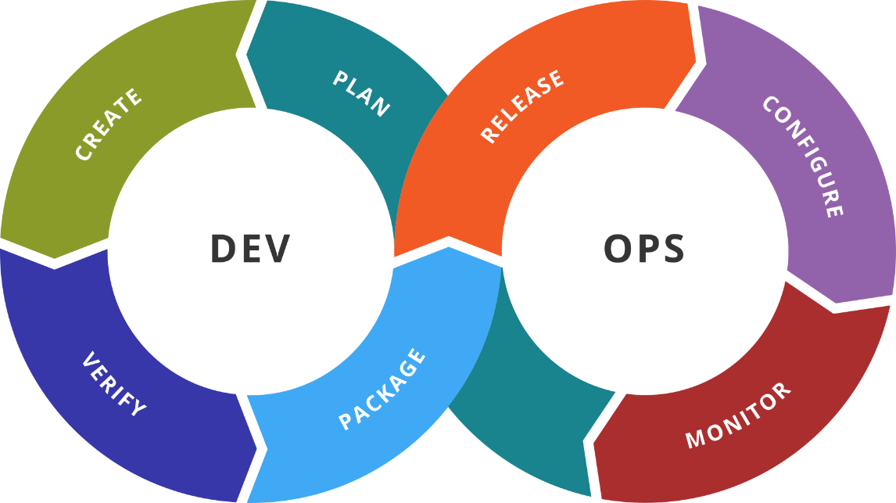
Recap
Recap and Exam Preparation
SoftUni Team
Technical Trainers
Software University
http://softuni.bg

Slide 2
Table of Contents
Recap
Practice or exam simulation
Put (all) the pieces together
Discussion

Slide 3

Dev
Ops
Quick Recap
DOF Module 7

Slide 4
Week 7
Solutions
ELK / Elastic Stack
Elasticsearch
Logstash
Kibana
Beats
ELK and Docker

Slide 5
Dev
Ops
Summary
What We Covered So Far?

Slide 6
Week 1 to 7
The HashiCorp Stack
(Vagrant +) Packer, Terraform, Vault, Consul, Nomad
Kubernetes
Chef, Puppet, and Salt
Some NoSQL Databases
Redis, MongoDB, and Cassandra
Elastic Stack
Elasticsearch, Logstash, Kibana, and Beats

Slide 7
Dev
Ops
The Case
Our Main Task

Slide 8
The Case
We have application based on containers (one or more)
We want to automate the provision and configuration
The same applies to building and deployment of the application
A cluster has to be build to host the application
Automation distribution amongst hosts is not regulated
Application project is hosted on GitHub

Slide 9
Solution Components
Infrastructure
Packer
Terraform
Vagrant
Minikube
KOPS
Monitoring
Elasticsearch
Logstash
Kibana
Beats
AWS / GCP / Azure / On-Prem
Master
Worker
Worker
El
Je
Be
Lo
Ki
Be
Ka
Ap
Ap
Ap
Ap
Ap
Ap
Software
Puppet
Chef
Salt
CI/CD
Jenkins
Kaniko
Ap
Cluster (k8s / nomad)

Slide 10
Dev
Ops
Practice: Now let’s try to solve it
Live Demonstration in Class

Slide 11

Summary
We learnt several new tools
Each one covering one or more areas of DevOps
For sure we know a thing or two about each tool now
Furthermore we can make them work for us
And at the end we managed to combine all or most of the tools together
And saw in a lab environment how a “real” scenario can be handled
… and of course this is just a step of the DevOps journey ☺
…
…
…

Slide 12
Resources
Building Docker Images inside Kubernetes
https://medium.com/hootsuite-engineering/building-docker-images-inside-kubernetes-42c6af855f25
IMG: OCI compatible container builder
https://github.com/genuinetools/img
ELK Stack on Kubernetes
https://crondev.com/elk-stack-kubernetes/
DigitalOcean: CI/CD with Kubernetes Webinar Series
https://go.digitalocean.com/cicd-on-k8s
DigitalOcean: CI/CD with Kubernetes Webinar Series (GitHub)
https://github.com/nkhare/k8s-cicd-webinars
Scaling Docker with Kubernetes
https://www.infoq.com/articles/scaling-docker-with-kubernetes
Jenkins Kubernetes Plugin
https://github.com/jenkinsci/kubernetes-plugin

Slide 14



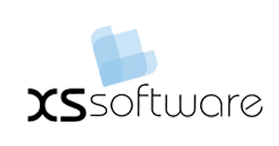


СофтУни диамантени партньори

Slide 15






СофтУни диамантени партньори

Slide 16





Trainings @ Software University (SoftUni)
Software University – High-Quality Education, Profession and Job for Software Developers
softuni.bg
Software University Foundation
http://softuni.foundation/
Software University @ Facebook
facebook.com/SoftwareUniversity
Software University Forums
forum.softuni.bg

