Slide 1
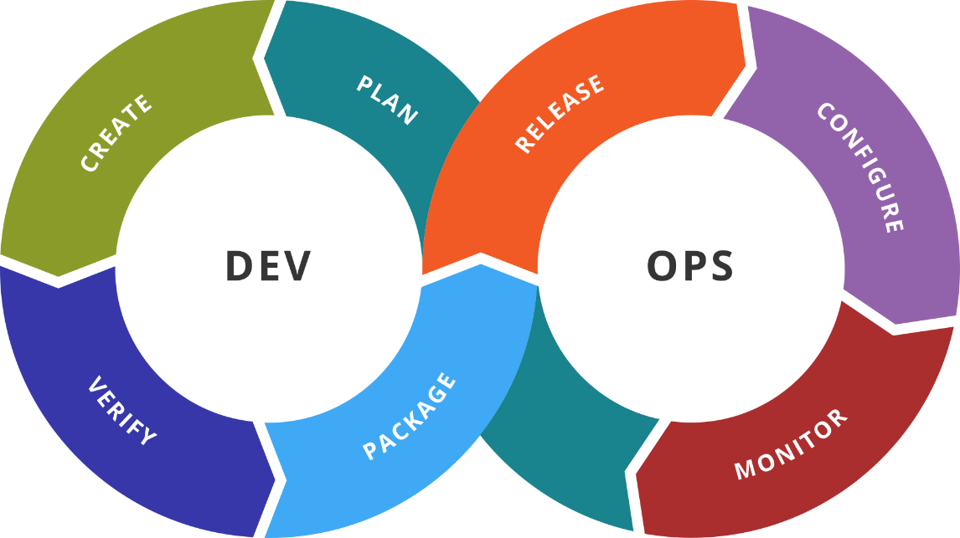
Infrastructure as Code
Reasons. Solutions. Terraform
SoftUni Team
Technical Trainers
Software University
http://softuni.bg

Slide 2
Table of Contents
Infrastructure as Code
Introduction
Terraform Basics
Terraform and Docker
Terraform and AWS

Slide 3

Dev
Ops
Infrastructure as Code
Overview

Slide 4
Introduction
Infrastructure as code (IaC) is the process of managing and provisioning computer data centers through machine-readable definition files, rather than physical hardware configuration or interactive configuration tools.
https://en.wikipedia.org/wiki/Infrastructure_as_code

Slide 5
Dev
Ops
Terraform by HashiCorp
Overview

Slide 6
Introduction
Terraform is a tool for
Building
Changing
Versioning
And it is doing it
Safely
Efficiently
It can manage both cloud providers and on-premise solutions
Infrastructure

Slide 7
Features
Infrastructure as Code
Described using a high-level configuration syntax
Execution Plans
Created during planning phase. It shows what would be done
Resource Graph
Dependency is tracked and if possible, execution is parallelized
Change Automation
Changes can be applied with minimal human interaction

Slide 8
Comparison
Provides flexible abstraction of resources and providers
It covers physical hardware, virtual machines, containers, etc.
Configuration management tools expect that the target exists
Terraform enables and cooperates with CM tools

Slide 9
HashiCorp Configuration Language (HCL)
# An AMI
variable "ami" {
description = "the AMI to use"
}
/* A multi
line comment. */
resource "aws_instance" "web" {
ami = "${var.ami}"
count = 2
source_dest_check = false
connection {
user = "root"
}
}
https://www.terraform.io/docs/configuration/syntax.html

Slide 10
Interpolation Syntax
Interpolations are wrapped in ${}, such as ${var.foo}
It allows you to reference variables, attributes of resources, call functions, etc.
Simple math is possible - ${count.index + 1}
Conditionals are supported (CONDITION ? TRUEVAL : FALSEVAL)
Interpolation can be escaped with $${foo}
More information here:
https://www.terraform.io/docs/configuration/interpolation.html

Slide 11
Building Blocks (1)
Configuration files
Must end with .tf or .tf.json
Are loaded in alphabetical order
Content is appended not merged
Override files
Name should be override or end with _override
Loaded after the non-override files in alphabetical order
Content is merged
* Terraform files are declarative
* Order of variables, resources, etc. doesn’t matter

Slide 12
Building Blocks (2)
Resources
Play central part in our infrastructure
Combination of type and name must be unique
Have also meta-parameters, timeouts, dependencies
There are also connection blocks and provisioners
resource "aws_instance" "web" {
ami = "ami-408c7f28"
instance_type = "t1.micro"
}

Slide 13
Building Blocks (3)
Data Sources
Used to fetch or calculate external information
Can be used to drive the infrastructure creation process
Providers
Responsible for the lifecycle of the resources
Multiple providers are allowed
External components (incl. 3rd party) with separate lifecycle

Slide 14
Building Blocks (4)
Variables
Input variables serve as parameters for modules
When used in root module
Can be set from CLI
Or with environment variables
Outputs
Define values that will be highlighted to the end user
Provide a way to easily extract and query resources information

Slide 15
Building Blocks (5)
Local Values
Assign name to an expression that can be used multiple times
Modules
Used for modularization and encapsulation of resources
Terraform
Used to configure Terraform itself

Slide 16
Installation
All major operating systems are supported
Just go to https://www.terraform.io/downloads.html
Older versions are also available
When upgrading, check the Upgrade Guide for possible issues
For extensions (modules) check here:
https://registry.terraform.io/
Additionally, Install at least syntax highlighting plugin
VS Code is a good option with lots of extensions

Slide 17
Dev
Ops
Practice: Install. Setup. Basic Tasks
Live Demonstration in Class

Slide 18
Dev
Ops
Terraform and Docker
Explore Basic Concepts

Slide 19
Introduction
Dedicated Docker provider
Used to interact with Docker containers and images
Uses Docker API, it can work with Docker and Docker Swarm
Docker Resources
docker_container, docker_image, docker_network, docker_volume
Swarm Resources
docker_config, docker_secret, docker_service

Slide 20
Dev
Ops
Practice: Interacting with Docker
Live Demonstration in Class

Slide 21
Dev
Ops
Terraform and AWS
From 0 to 100 in 1 Hour ;)

Slide 22
Introduction
Dedicated Amazon Web Services provider
Provides support for many resources for AWS
Should be configured with the proper credentials
The following methods are supported, in this order:
Static credentials
Environment variables
Shared credentials file
EC2 Role

Slide 23
Dev
Ops
Practice: Terraform and AWS
Live Demonstration in Class

Slide 24

Summary
Terraform is
Tool for infrastructure provisioning
Support many platforms
Declarative approach
Solutions can be modularized
Extensible with 3rd party modules
Terraform is not
Competitor of Ansible, Chef, Puppet, or Salt
Instead they can be used in combination
…
…
…

Slide 25
Resources
Terraform site
https://www.terraform.io
Terraform Module Registry
https://registry.terraform.io/
Terraform documentation
https://www.terraform.io/docs/index.html
Visual Studio Code
https://code.visualstudio.com/
VIM Terraform syntax highlighting
https://github.com/hashivim/vim-terraform
…
…
…

Slide 27



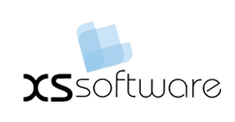


СофтУни диамантени партньори

Slide 28






СофтУни диамантени партньори

Slide 29





Trainings @ Software University (SoftUni)
Software University – High-Quality Education, Profession and Job for Software Developers
softuni.bg
Software University Foundation
http://softuni.foundation/
Software University @ Facebook
facebook.com/SoftwareUniversity
Software University Forums
forum.softuni.bg

