Slide 1

The Global Diffusion of Low Carbon Technologies
Presented by
Deyu Kong ,Rehapriadarsini ManiKandasamy
Graduate student, Data Science,
Columbian College of Arts and Sciences,George Washington University
Supervised by
Dr. Edwin Lo Katherine Stapleton
George Washington University World Bank Group

Slide 2
Motivation:
A wide agreement that achieving net-zero emissions will require an increase in the pace and scale of adoption of low-carbon technologies (LCTs)
Now : Limited evidence on the diffusion of LCTs, focusing on their invention and indicators of innovation
Invention
Innovation
Diffusion
Notes:
There is wide agreement that achieving net-zero emissions will require an increase in the pace and scale of adoption of low-carbon technologies (LCTs). The IEA (2021) estimates that existing technologies should already be able to achieve over 70 percent of the cut in global emissions required to reach net-zero by mid-century, if deployed at scale. Despite the central importance of LCT adoption, however, to date the academic literature has provided limited evidence on the diffusion of LCTs, focusing instead primarily on their invention and indicators of innovation. A wide economics literature has studied low carbon patenting activity (e.g. Popp 2002, Acemoglu et al., 2012, Aghion et al., 2016., Dechezlepretre et al., 2013, Popp et al., 2022) and a growing engineering literature focuses on LCT costs (e.g. Way et al., 2022, Grubb et al., 2022). Research that does extend to deployment or diffusion to date has typically studied the adoption of a specific LCT in a specific industry or country (e.g. using data on eco-innovation in the EU’s Community Innovation Survey, or studying the efficiency of vehicles (Knittel et al. (2011)) or residential energy efficiency (Constantini et al. (2017)).
This paper aims to fill this gap on LCT diffusion by shedding light on the extent to which low carbon technologies have started to impact labor markets and board room discussions. We first follow a growing literature that infers the spread of new technologies through their footprint in the demand for new tasks or skills in the text of job adverts (e.g. Rock 2021, Acemoglu et al., 2022, Goldfarb et al., 2022). We then also measure the mentions of LCTs in the quarterly earnings calls of the world’s largest firms, in a similar vain to Bloom et al., (2022).

Slide 3

Why?
Critical policy question: how to bring about rapid enough progress in deployment of LCTs?
Understanding diffusion is key to answering this question
Low-carbon patenting growth has not accelerated
sufficiently over the past decade
Slide source: World Bank presentation

Slide 4
Dataset:
Job adverts data : Data on scraped online job adverts from Burning Glass Technologies (BGT) for 35 countries
Data size : online job postings on a daily basis, sourced from >40,000 online job boards and company websites
Earnings calls transcripts data : Data from Refinitiv Eikon on the transcripts from quarterly shareholder earnings calls meetings of publicly listed firms from 2002-present (covers 10,554 firms in 82 countries)

Slide 5
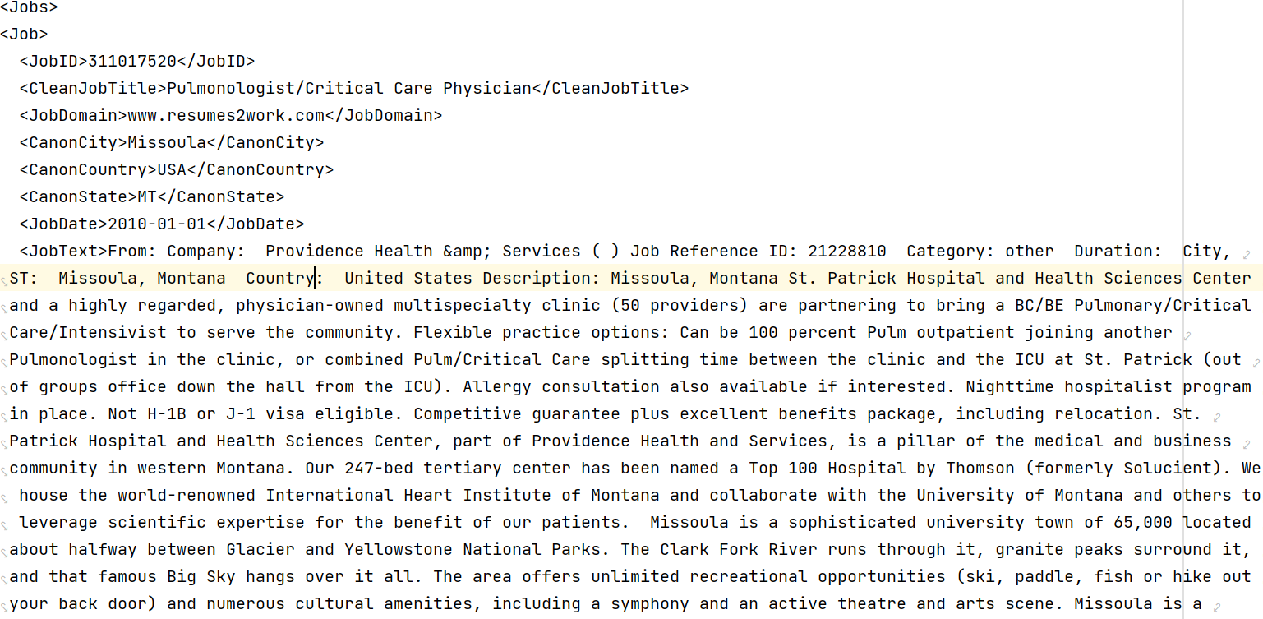
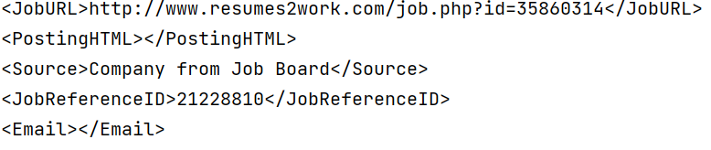
Dataset:

Slide 6
Previous work by World Bank:
Hand extract the key words from the job titles by Disruptive tech group
Expand list using synonyms, hypernyms and hyponyms for these words from WordNet, Dictionary.com and google trends and keep only ’bigrams’, following Bloom et al. (2021)
Results in 250 bigrams which we classify into 51 technologies
Slide source: World Bank presentation

Slide 7
Problem Statement
Use Natural Language Processing techniques to discover synonymous phrases and word combinations that have missed

Slide 8
Proposed Methodology
Zero Shot Classification
Bigram Counter

Slide 9
Zero shot classification:
Zero-shot classification is a technique that allows us to associate an appropriate label with a piece of text.
This association is irrespective of the text domain and the aspect. For example, it can be a topic, emotion, or event described by the label.
Slide source: World Bank presentation

Slide 10
Zero shot classification:
The output is a dictionary with three main keys:
Labels | Scores | Sequence
The list of all the candidate labels used for prediction | The list of the probability scores corresponding to the labels. | The original sequences/text used for the prediction
Slide source: World Bank presentation

Slide 11
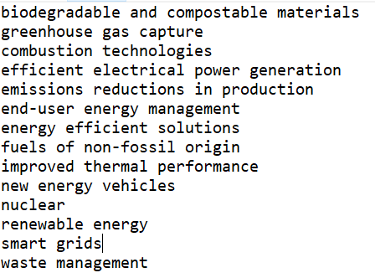
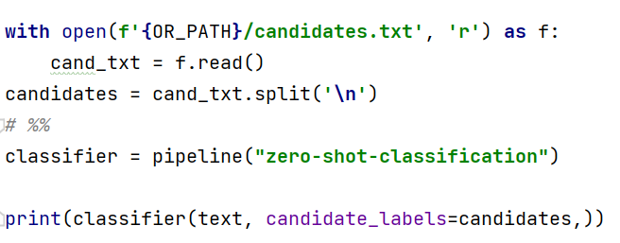
Zero shot classification:

Slide 12
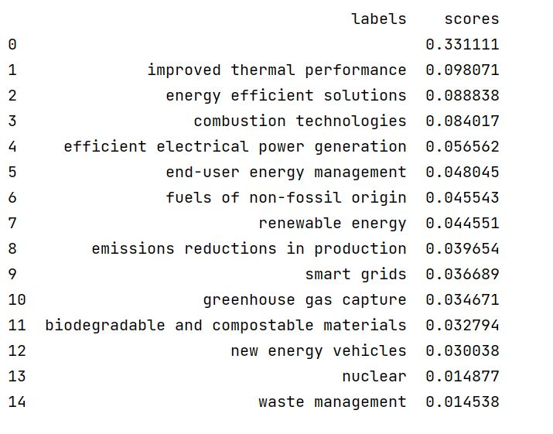

Zero shot classification:
Gives you some idea of the topic
Score is probability of hitting label topic
Empty means none of the provided
Takes too long to inference
35 seconds for one job ads over 14 candidates on a Nvidia V100 GPU
Unacceptable for longer candidate list and millions of text entries

Slide 13
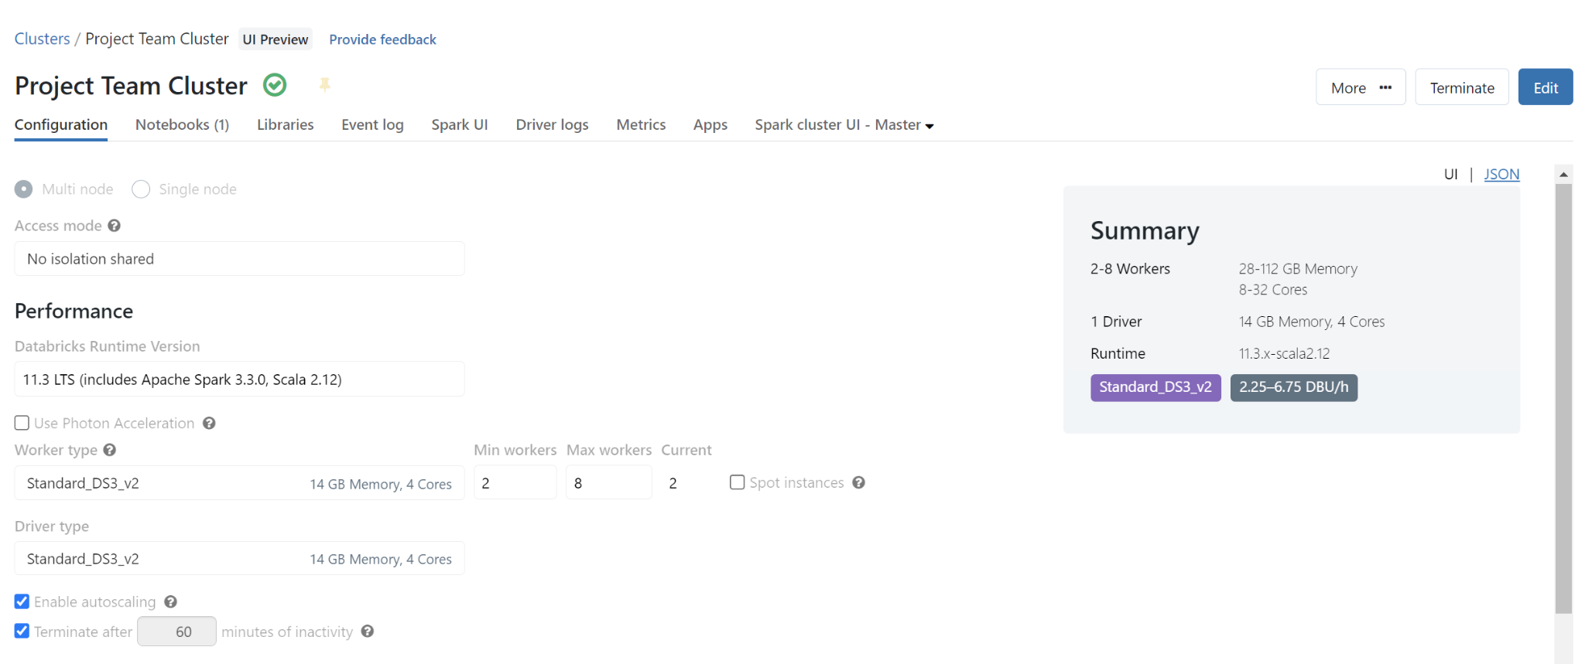
PySpark on Azure Databricks
Libraries used: spark-nlp(4.2.1) & spark-xml(0.15.0)

Slide 14
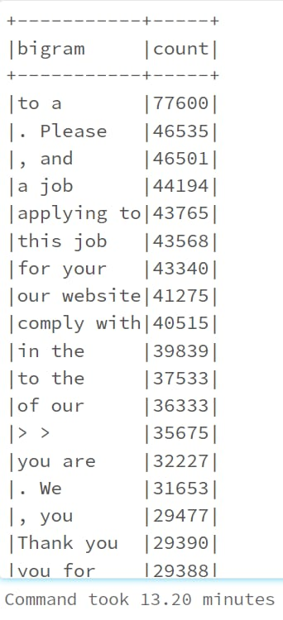
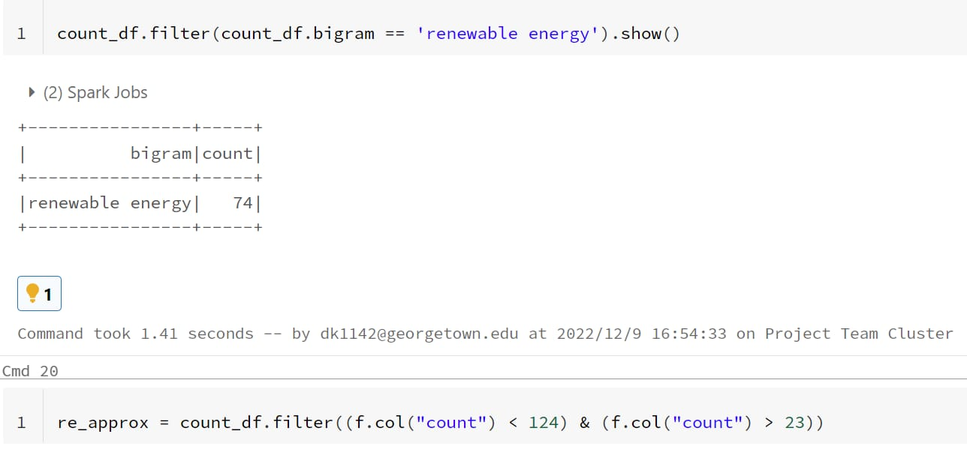
Bigram Counter:
Multiple .xml files
Spark rdd Dataframe
Spark-nlp Pipeline
Bigram Counts
Finding Synonymous Bigram for "renewable energy"
Filtered Results
Bigram Count Dictionary

Slide 15
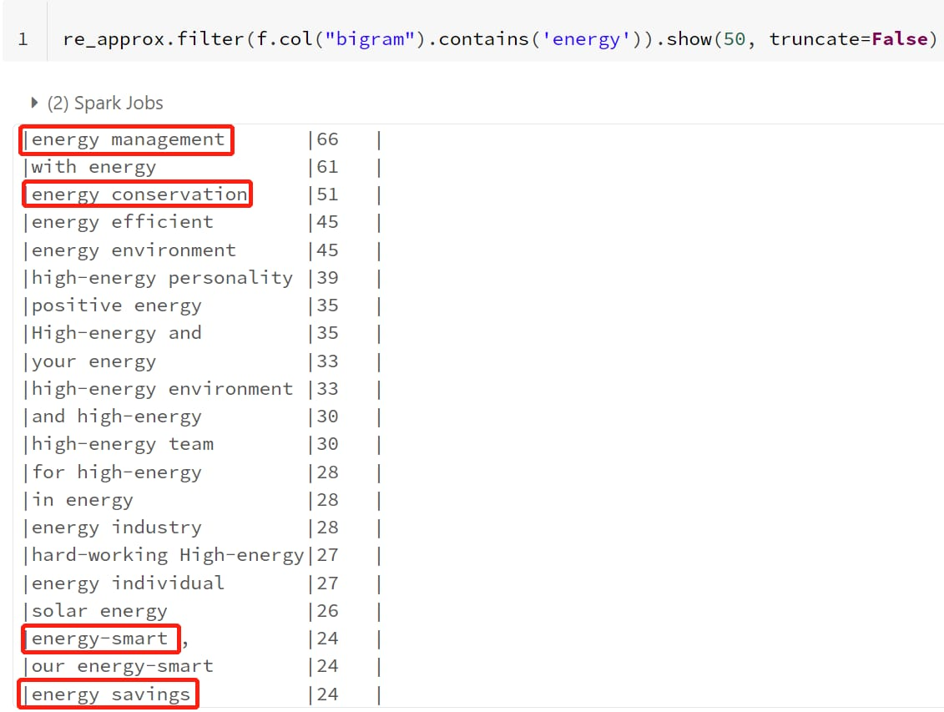


Bigram Counter:
“energy efficiency”: 112
+51%
“renewable energy”: 74
-31%
“energy conservation”: 51
Threshold: 60%
Core Keyword: energy
-68%
“energy-smart”: 24
-65%
“solar energy ”: 26
Notes:
The bigram model approximates the probability of a word given all the previous words by using only the conditional probability of one preceding word.

Slide 16
Limitations:
Future Improvements:
Processing Power: 24 mins for 2 .xml files
Hyperparameters: threshold & “core” keyword
Punctuation removal / Lower-case
Manual Screening: Selecting meaningful ones form filtered results
Loop through existing bigrams and append new ones automatically
Cosine/Vector Similarity between tokens/bigrams
Implement Zero-shot classification pipeline in spark-nlp
Beefier GPU
More Budget!

Slide 17

Conclusion:
Big Data Conundrum: Simple task for small data becomes difficult for Big Data.
Think about tools and resource availability
Trial and Error: Learn from failures and obstacles and keep trying

Slide 18
References:
Popp, David. 2002. “Induced Innovation and Energy Prices.” THE AMERICAN ECONOMIC REVIEW,92(1): 60.
https://www.section.io/engineering-education/how-to-implement-zero-shot-classification-using-python/
Gary King, Patrick Lam, and Margaret Roberts. 2017. “Computer-Assisted Keyword and Document Set Discovery from Unstructured Text.” American Journal of Political Science, 61, 4, Pp. 971-988.

Slide 19


