Slide 1

The Global Diffusion of Low Carbon Technologies
Presented by
Deyu Kong
Rehapriadarsini Manikandasamy
Supervised by
Katherine Stapleton
World Bank Group

Slide 2
Motivation:
A wide agreement that achieving net-zero emissions will require an increase in the pace and scale of adoption of low-carbon technologies (LCTs)
Now : Limited evidence on the diffusion of LCTs, focusing on their invention and indicators of innovation
Invention
Innovation
Diffusion

Slide 3

Why?
Critical policy question: how to bring about rapid enough progress in deployment of LCTs?
Understanding diffusion is key to answering this question
Low-carbon patenting growth has not accelerated
sufficiently over the past decade
Slide source: World Bank presentation

Slide 4
Dataset:
Job adverts data : Data on scraped online job adverts from Burning Glass Technologies (BGT) for 35 countries
Data size : online job postings on a daily basis, sourced from >40,000 online job boards and company websites
Earnings calls transcripts data : Data from Refinitiv Eikon on the transcripts from quarterly shareholder earnings calls meetings of publicly listed firms from 2002-present (covers 10,554 firms in 82 countries)

Slide 5
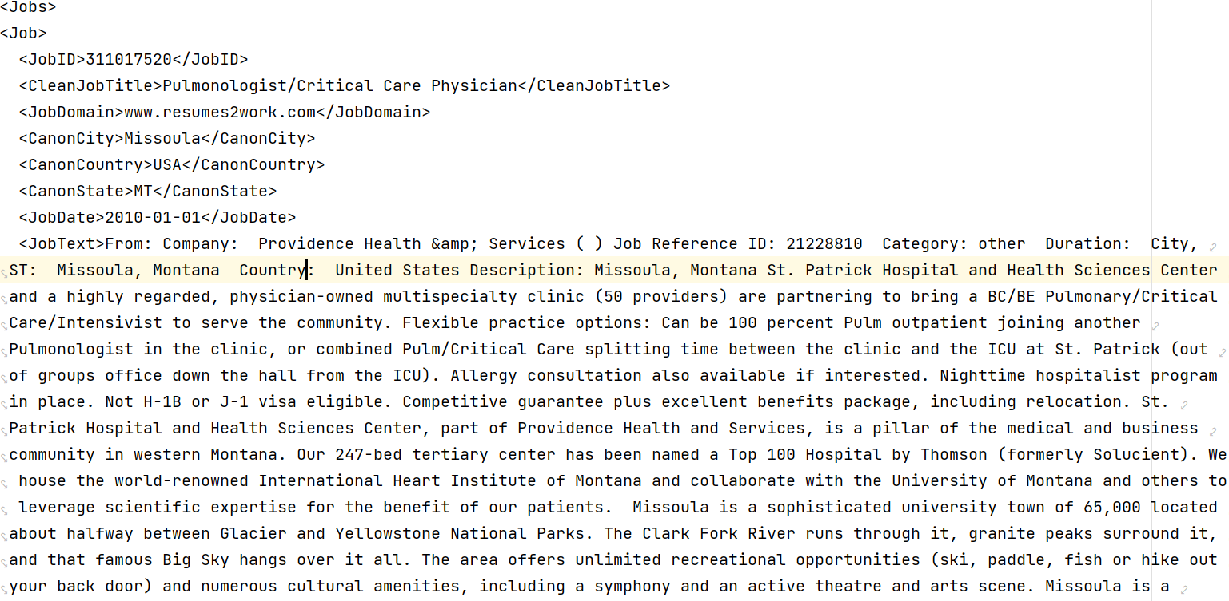
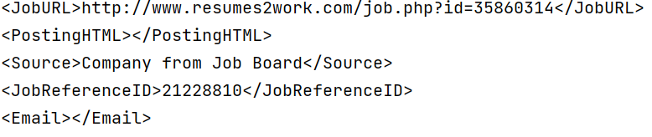
Dataset:
Limitations:
Text heavy
No human annotated labels

Slide 6
What World Bank has achieved so far?
Hand extract the key words from the job titles
Expand list using synonyms, hypernyms and hyponyms for these words from WordNet, Dictionary.com and google trends and keep only ’bigrams’, following Bloom et al. (2021)
Results in 250 bigrams which we classify into 51 technologies
Slide source: World Bank presentation

Slide 7
Next Step:
Use a Masked Sequence to Sequence (MASS) language model to discover synonymous phrases and word combinations that have missed
Separate into technology ’producers’ and ’consumers’ (adopters/deployers) and adopt a classification algorithm to categorize the industries
Slide source: World Bank presentation

Slide 8
Initial Considerations
Zero Shot Classification
Bigram Counter

Slide 9
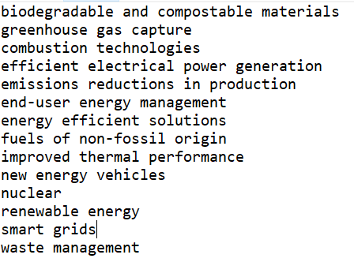
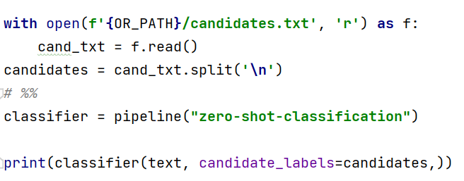
Zero shot classification:

Slide 10
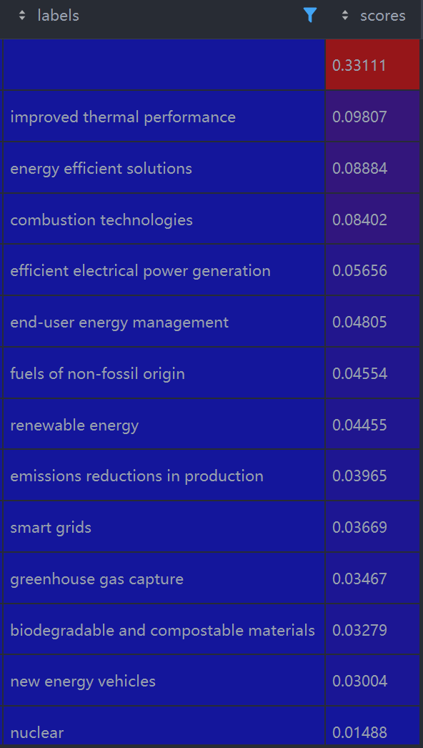

Zero shot classification:
Gives you some idea of the topic
Score is probability of hitting label topic
Empty means none of the provided
Takes too long to inference
35 seconds for one job ads over 14 candidates on a Nvidia V100 GPU
Unacceptable for longer candidate list and millions of text entries

Slide 11


Moving on: Bigram Counter
Return to traditional NLP: Counter of Bigrams:
Find bigrams of similar counts/frequency with existing keywords
“Electric Propulsion”: 120
+20%
“Electric Vehicle”: 100
-20%
“Hybrid Vehicle”: 80
Threshold: 20%
-30%
“Electric Engineering”: 70
-40%
“EV”: 60

Slide 12
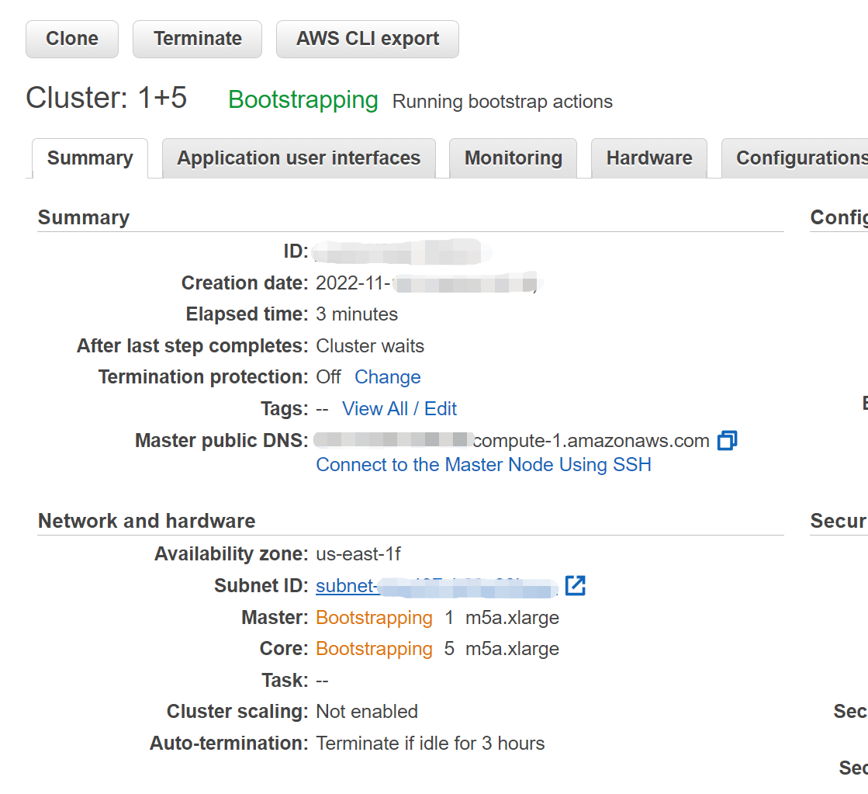
Further down: Scale-Up
Build Counter for Big Data: Gigabytes of corpus
Pyspark rdd dataframe & Amazon EMR Cluster
May or maynot work, but worth to give it a shot

Slide 13

Lessons Well Learnt !
Real data aren’t always served on a silver plate
Data engineering is also part of the process
Adjust expectations and communicate
Start from something small & easy, then go big
Keep an open mind and learn from failures

