Slide 1

Your Data Isn't
Unclear.
It's Just Scattered.
Business Operating System
Knowledge Core
Foundation — spans all cores
Sales Core
Estimates & contracts
CRM in one tab. Spreadsheets in another. Reports living in someone's head. When your systems don't talk, "how's the business doing?" becomes a 20-minute Where's Waldo hunt.
Start Performance brings it all together — one dashboard, everything you need, nothing you don't.
Service Core
Jobs & customer portal
Operations Core
Team management & workflows
Intelligence
AI insights & daily digest
AI Chat
Website bot, grounded in your data
Notes:
Opening hook. "Where's Waldo" scattered-data metaphor. Knowledge Core leads the left panel.

Slide 2
THE CHALLENGE
Sound Familiar?
📋
Quotes emailed, never tracked
📞
Customers call for status updates
Jobs live on whiteboards or paper
Your team answers the same question all day
🗂️
Training locked in people's heads
📊
Reporting takes hours to pull
New hires take weeks to get up to speed
By the time you see it, it's already old
🔗
Systems that don't talk to each other
👁️
No visibility until it's too late
Data entry happens twice, mistakes happen once
You find out about problems after they blow up
💸
Admin work eats your day
🤷
No single source of truth
Chasing paperwork instead of growing the business
Everyone's working from a different version of reality
Other tools store your data. Start Performance connects it and puts it to work.
Notes:
Pain points slide. 8 specific challenges organized in a 2-column grid. The contrast line at the bottom sets up the solution.

Slide 3
One Platform. Everything Connected.
Start Performance replaces the patchwork of tools with a single system your whole team actually uses.
💼
🔧
SPANS ALL CORES
Sales Core
Service Core
📚
Leads · Estimates
Proposals · Contracts
Job tracking
Customer portal
Knowledge Core
📊
🤖
Intelligence
AI Chat
Articles · SOPs · Training
Quizzes · Resources
The institutional memory
that powers every module
Activity feed
AI insights & digest
Website chatbot
Grounded in your data
⚙️
Operations Core
Team management
& workflows
Notes:
Knowledge Core is the foundation powering all other modules. AI Chat is grounded in KB content. Intelligence references KB articles.

Slide 4
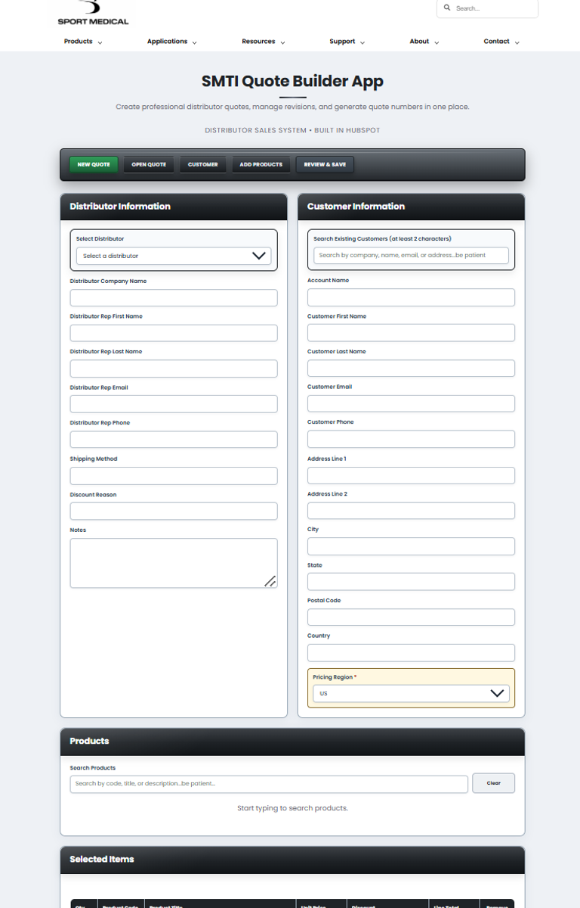
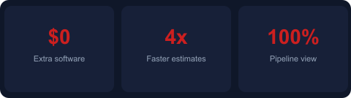
SALES CORE
Close More Deals With Less Paperwork
Track every lead from first contact through close
Build and send estimates with a single click
Convert estimate → proposal → contract instantly
Full pipeline visibility — nothing falls through
Automated follow-up reminders for the team
Notes:
Sales Core. Screenshot: SMTI quote builder.

Slide 5
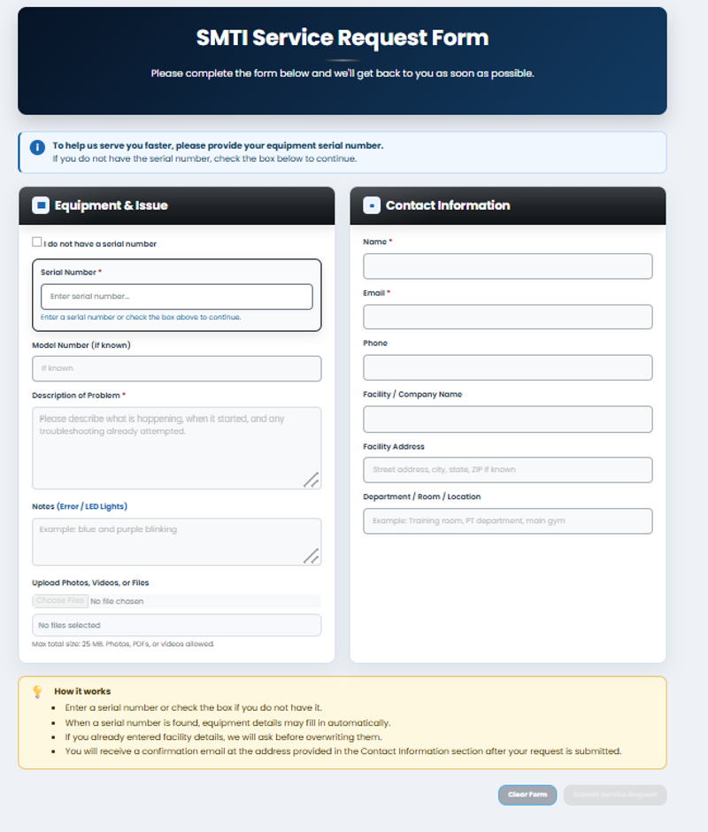
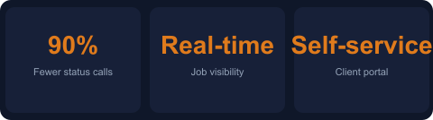
SERVICE CORE
Run Your Jobs — Not Your Inbox
Job queue with full status tracking end-to-end
Scheduled → In Progress → Waiting Parts → Done
Customer portal: clients check status 24/7
Search, filter, and export any job history
Eliminates "where's my order?" calls completely
Notes:
Service Core. Screenshot: SMTI service request form.

Slide 6
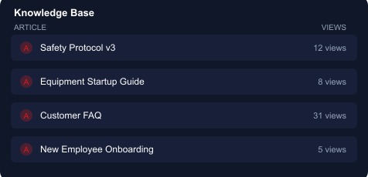
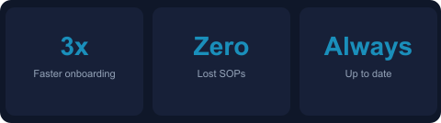
KNOWLEDGE CORE
Stop Losing Knowledge When People Leave
Internal wiki: policies, SOPs, and how-to guides
Upload articles with a built-in HTML editor
Resource library with file tracking and view counts
Training modules with quizzes for new hires
New employees productive in days, not weeks
"Training used to take 3 weeks. Now new hires are handling calls in 4 days."
Notes:
Knowledge Core detail slide.

Slide 7
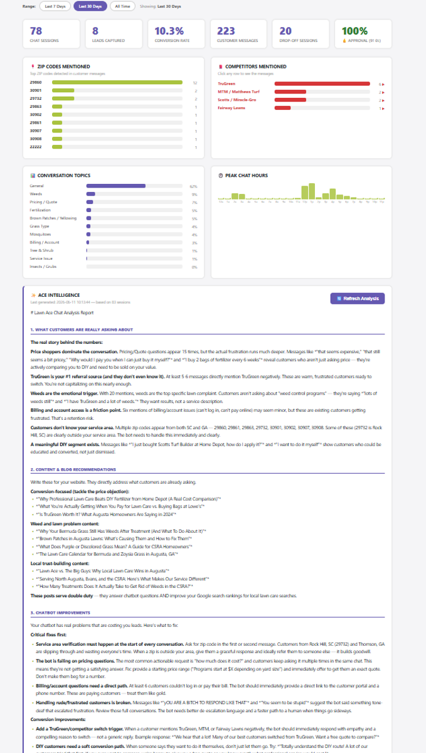
INTELLIGENCE + AI
See What's Happening Before You Have to Ask
📬
Daily Digest Email
Every morning: what needs your attention today — automatically.
🤖
AI Pipeline Insights
Flags stale deals, overdue follow-ups, and gaps you're missing.
💬
AI Website Chat Bot
Branded chatbot grounded in your Knowledge Base. Handles support 24/7.
📈
Full Activity Log
Every action, every team member — searchable and exportable.
Notes:
Intelligence. Real screenshot: SP analytics dashboard.

Slide 8
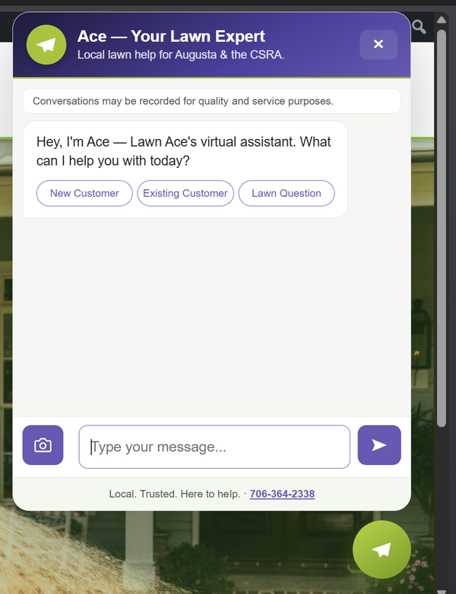
AI CHAT
Your Website Works for
You Around the Clock
Branded chatbot lives on your public website
Grounded in your own Knowledge Base content
Guides visitors: new customer, support, FAQ
Captures leads and routes service requests
You control the tone, guardrails, and content
Shown: a client deployment — your bot carries your brand and content.
Notes:
AI Chat. Real screenshot: client chatbot. Each deployment is custom branded.

Slide 9
BUSINESS OUTCOMES
What Our Clients Experience
60%
90%
3×
100%
Less time on
admin work
Fewer customer
status calls
Faster employee
onboarding
Pipeline visibility
from day one
* Outcomes vary by business size and starting point.
✅ Quotes out the door same day — not next week
✅ Customers stop calling for status updates
✅ New hires are productive within days, not weeks
✅ Every job, every lead, every interaction — in one place
✅ AI flags overdue follow-ups before deals go cold
✅ Leadership sees the whole business in real time
Notes:
Outcomes slide. Lead with the numbers, back them with specific behaviors. Inspired by Skynaros "Value Delivered" format.

Slide 10
Investment
Custom-configured for your business. Add cores as you grow.
Start Performance Platform
As low as $249
per month + one-time setup & configuration fee
EVERYTHING INCLUDED:
💼 Sales Core
🔧 Service Core
📚 Knowledge Core
⚙️ Operations Core
📊 Intelligence
🤖 AI Chat
Notes:
Pricing: starts at $249/month + one-time setup fee. All 6 cores included. Update the price and setup fee before presenting.

Slide 11
Ready to Replace the Chaos?
Most teams are fully live in under a week.
No IT department. No 6-month rollout.
1
2
3
→
→
Schedule a 30-min demo
We configure the platform
Your team goes live
Book Your Free Demo →
Notes:
Closing CTA. Add your contact info, website, or calendar booking link before sharing.

