Slide 1
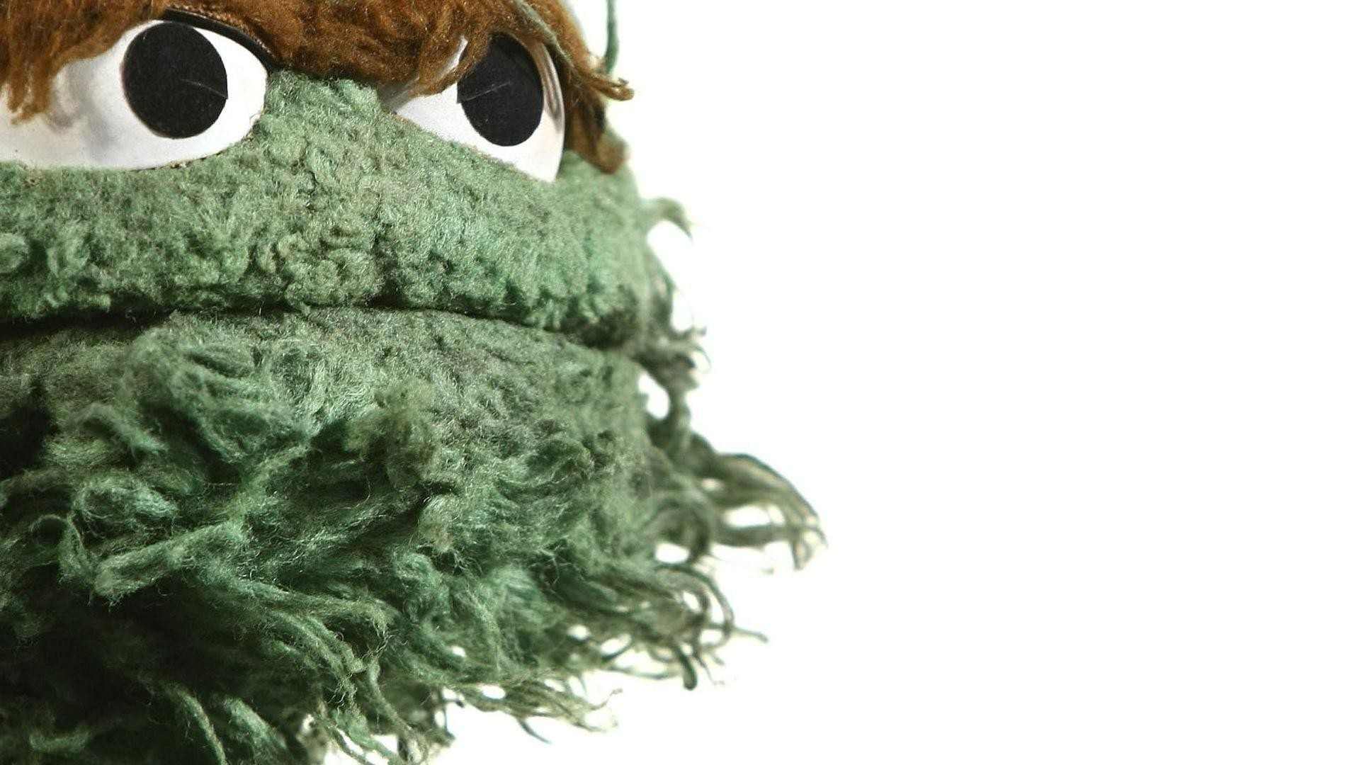
Productionizing
Trash Can-alytics
A proposal by Herschel Pecker

Slide 2
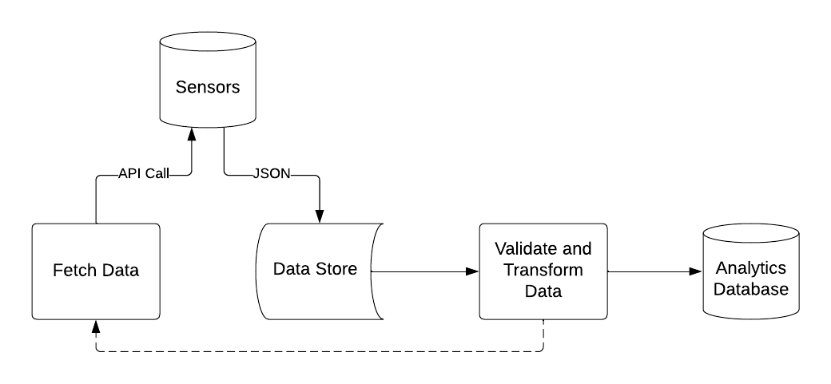
The ETL Process
Orchestration needs
Easy: Airflow / Prefect
Unified: Kubernetes

Slide 3
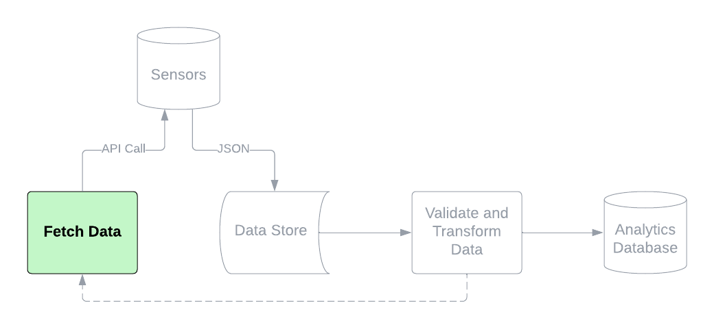
Fetching the Data
Scheduled vs. streaming
Easy: AWS Lambda / Azure Functions
Unified: App in Docker

Slide 4
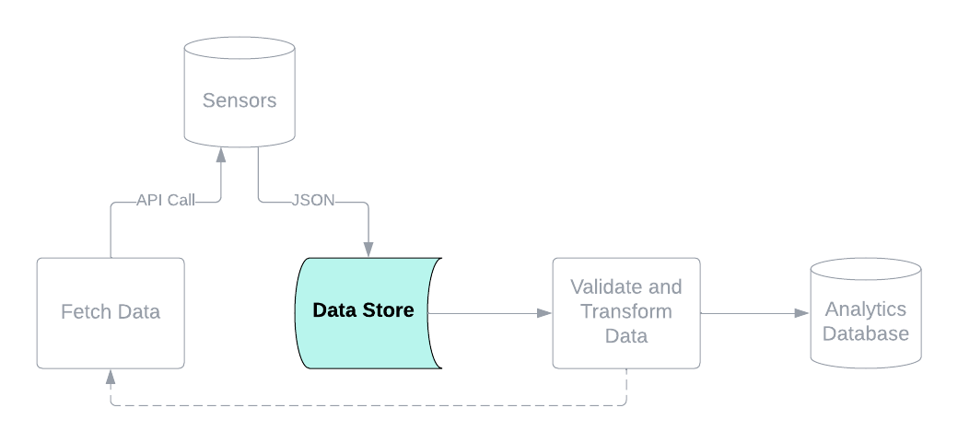
Storing the Raw Data
Idempotent
Retention rules
Easy: s3 bucket / Blob storage
Unified: Kafka

Slide 5
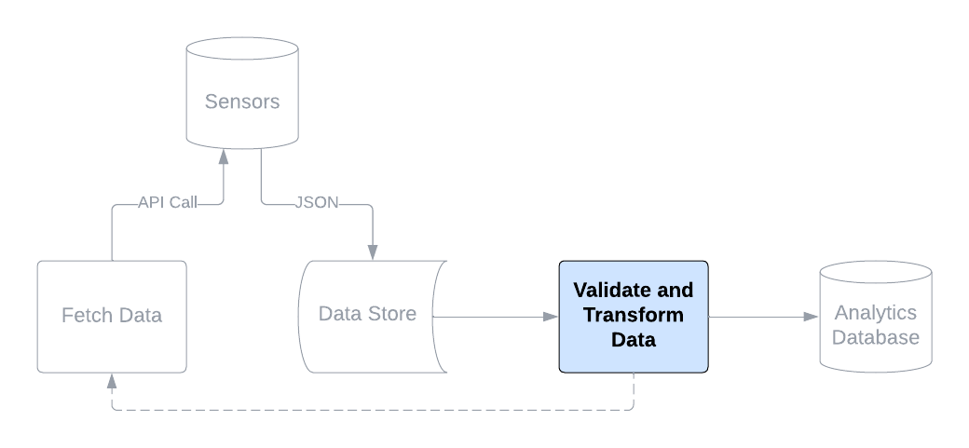
Validating and Transforming
Invalid data – rerun fetch job
Missing data – availability vs. consistency
Recommended: Snowflake, dbt

Slide 6
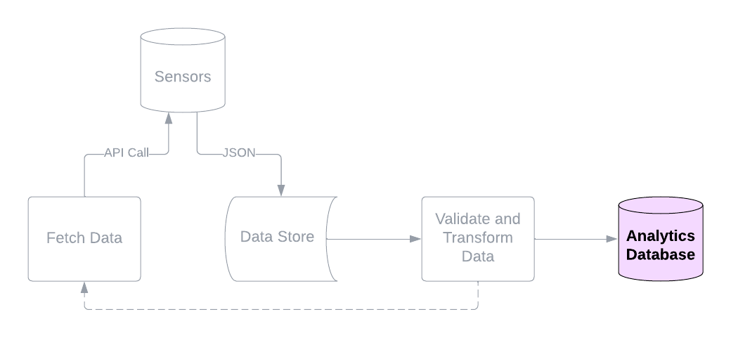
Ready for Analysis
Views over tables
Performance monitoring

Slide 7
Questions and Discussion

