Slide 1


Slide 2


“InTime”
(Student Teacher Attendance System)
Second Year Project Synopsis
Submitted by
ROLL | NAME
2301010438 | Manasvi Raghav
2301010457 | Herscheeta Khurana
2301010449 | Raunak Tiwari
2301010443 | Niti Dagar
Industry Mentor: Mr. Vishwanil Suman
Faculty Mentor: Ms. Megha Sharma

Slide 3
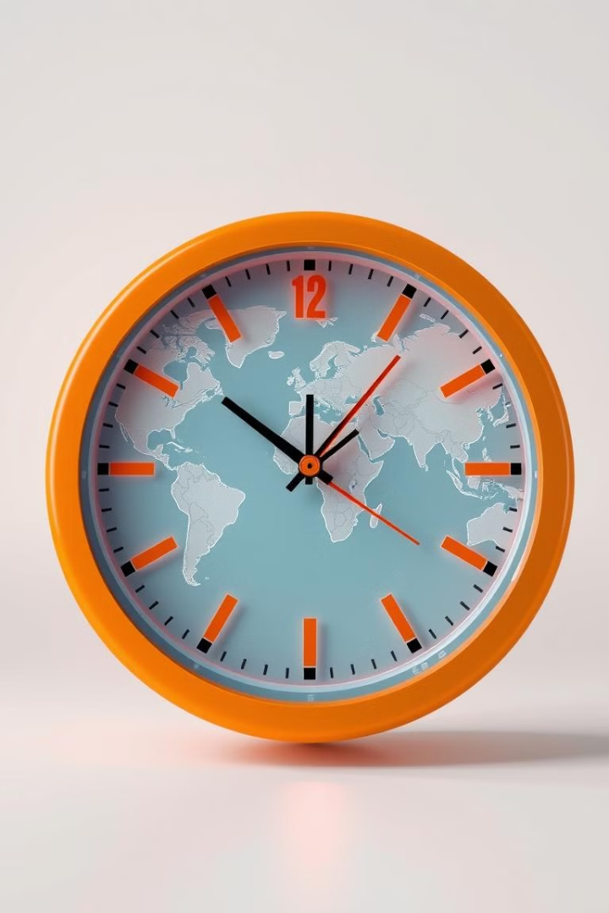
InTime
Student Teacher Attendance System

Slide 4
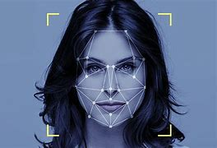

Overview
Our project, "Face Recognition Attendance System," leverages computer vision and artificial intelligence to automate attendance tracking using facial recognition. This system replaces traditional manual or biometric systems with a more seamless, contactless solution. By using a live webcam stream, it identifies faces in real time, matches them against a pre-trained database, and marks attendance accordingly. This project not only improves accuracy and security but also reduces administrative workload and human error. The system is built using Python, Flask, OpenCV, and the face_recognition library.

Slide 5
About the Problem
Manual attendance systems
Teachers Face
A reliable, automated system
Traditional biometric and manual attendance
Manual attendance systems cause delays, errors, and inefficiencies, leading to unnecessary stress for teachers.
Teachers face long queues, biometric failures, and administrative constraints, resulting in inaccurate attendance records and time loss.
A reliable, automated system is required to ensure accurate attendance tracking, reduce manual work, and enhance efficiency.
Traditional biometric and manual attendance systems are error-prone, time-consuming, and require maintenance. "InTime" offers a geolocation-based alternative, ensuring effortless, real-time, and accurate attendance management while reducing administrative burdens.
Notes:
New Courses replaced with New Programmes

Slide 6
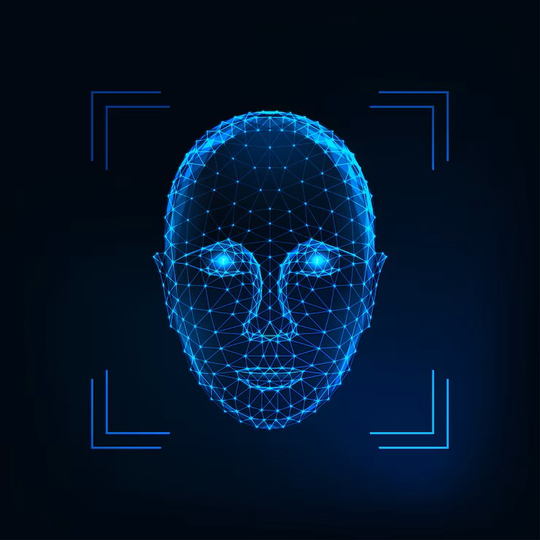
Objectives
The primary objective of this project is to create an automated attendance marking system using facial recognition. Key goals include:
Eliminate manual entry of attendance.
Minimize the possibility of impersonation or proxies.
Use computer vision to identify faces in real-time via webcam.
Log attendance with timestamps securely.
Ensure ease of use through a clean web interface.
Store records systematically for future reference. Overall, the system aims to be accurate, efficient, and scalable for both academic and professional environments.

Slide 7
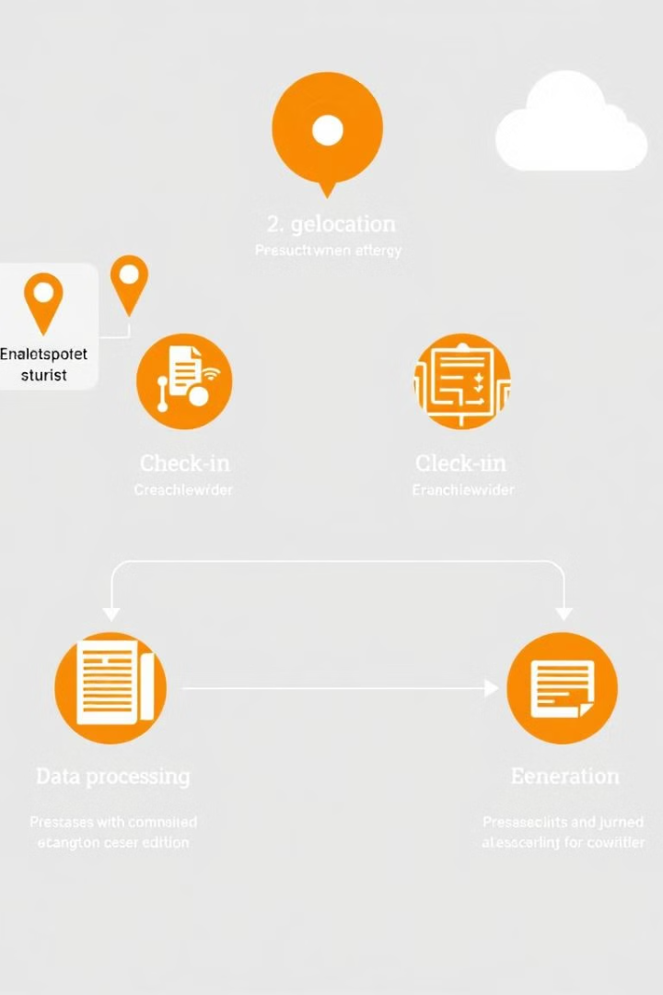




How does it work?
Geolocation Check-in
Attendance Recording
Teachers check in and out using their phone's GPS location, ensuring accurate time and location.
The system automatically records attendance data based on geolocation check-ins and check-outs.
Real-Time Dashboard
Attendance using biometrics
View attendance data in real-time through an intuitive dashboard, providing instant insights.
Prevent Fraud

Slide 8
System Architecture
User accesses a web interface with an active webcam feed.
On clicking “Mark Attendance,” the current webcam frame is captured.
The captured image is sent to the Flask backend using a POST request.
Flask server decodes the image and converts it to RGB format.
The system compares the image with known face encodings stored in a folder named “images.”
If a match is found, attendance is recorded in a CSV file named with the current date

Slide 9
Working Mechanism
The system flow is as follows:
User opens the app and allows webcam access.
System continuously displays live video.
On button click, the image is captured and converted into base64.
Image is decoded and processed by OpenCV on the server.
Face encodings are generated using face_recognition.
These encodings are compared against known faces.
If a match is found, attendance is marked with the current time.
Status message is returned to the frontend.
This real-time flow ensures accuracy and efficiency with minimal delay.

Slide 10
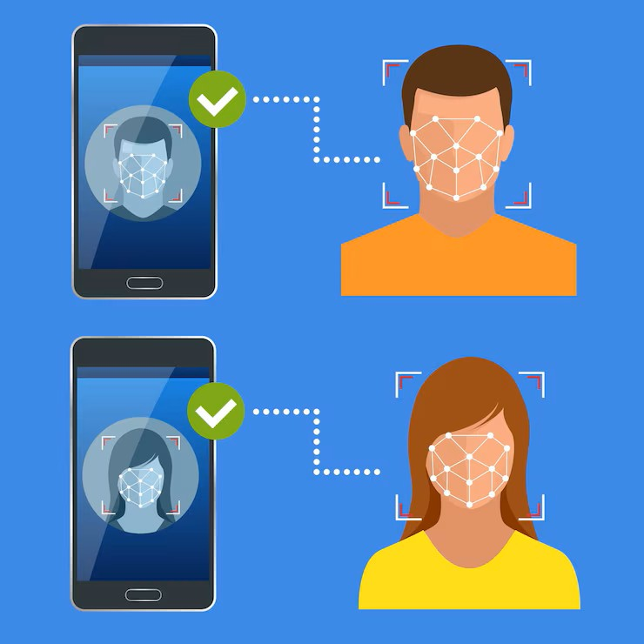
Features
Our system provides the following features:
Real-time face detection and recognition.
Secure and contactless attendance.
Attendance is marked only once per user per day.
Easy-to-use web interface with one-click operation.
Alert messages indicating success or failure.
Automatically creates daily CSV logs.
Scalable to large numbers of users by simply adding more images.
Debug-friendly with logs for loading and processing images.
These features ensure both usability and reliability.

Slide 11
Advantages
This system brings significant benefits over traditional attendance methods. It provides a contactless and hygienic solution suitable for post-COVID environments. It reduces the need for expensive biometric devices. The system can be used anywhere with just a webcam and browser, making it cost-effective and portable. It eliminates human errors and prevents proxies. Also, storing data in CSV format ensures that records are well-organized and ready for analysis. It can easily be extended to include features like face training, analytics, or integration with databases and cloud platforms.

Slide 12
Limitations and Future Scope
While functional, our system does have limitations. It currently supports only one face at a time, and recognition accuracy depends on lighting and image quality. It doesn't yet support database integration or user management. In the future, we plan to:
Add support for multiple face recognition simultaneously.
Integrate a proper login system and cloud database.
Improve accuracy with deep learning models.
Create a dashboard for administrators to view attendance trends.
Allow dynamic face registration through the web interface.

Slide 13
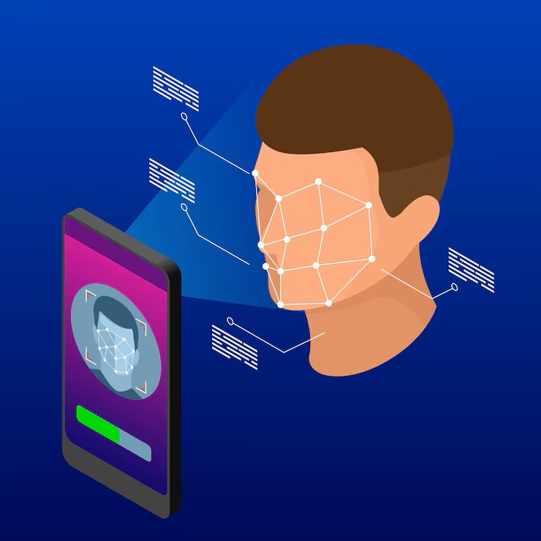
Conclusion
The Face Recognition Attendance System is an innovative approach to solving the challenges of manual and biometric attendance systems. It demonstrates how machine learning and web technologies can come together to offer smart, practical solutions. Our system is easy to deploy, requires minimal resources, and can be scaled as needed. While there is room for improvement, we believe it serves as a solid foundation for more advanced attendance management systems in both educational and corporate sectors. This project enhanced our technical, analytical, and problem-solving skills.

Slide 14
Tools and Technologies Used
We built this project using a combination of modern web development and machine learning tools. The backend is developed using Flask, a lightweight Python web framework. For facial detection and recognition, we utilized the face_recognition library built on top of dlib and OpenCV. Frontend technologies include HTML5, Bootstrap 5, and JavaScript. Webcam access is handled via getUserMedia API. Attendance records are stored in CSV format using the pandas library, ensuring easy export and analysis. Image processing and base64

Slide 15

Thank You

