Slide 1
M1 Presentation
Harshit Gupta
Rafid Hasan

Slide 2
Approach
We used Pytorch because we had a better understanding and experience with it from HW 3. In our experience, Pytorch gave higher accuracies with less memory usage
We were debating to use tensorflow because it is more code friendly
Used a for loop to test each pruning threshold and then graphed the data in terms of accuracy
Chose the model where we are able to have the highest threshold while maintaining a stable accuracy

Slide 3
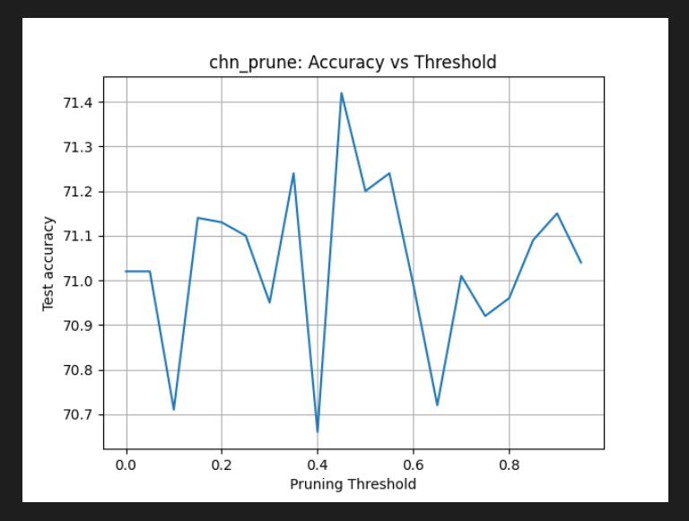
Experimental Data

Slide 4
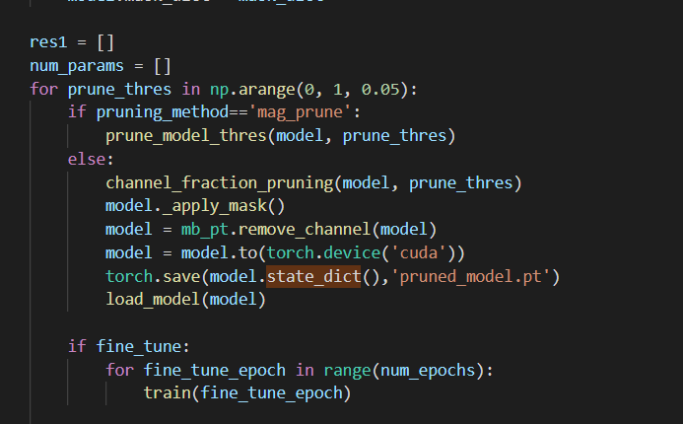
Experimental Data

Slide 5
Experimental Data
Pruning Fraction | #Fine-tune epochs | Max Memory Usage (MB) | Average latency for one image (ms) | Maximum power consumption (W) | Average energy consumption per image (mJ)
.9 | 5 | 32 | 5.103 | 9.057 | 40.04

Slide 6
Conclusion
We still need to keep working on our models as there are inconsistencies that needs to addressed.

