Slide 1
M2 Presentation
Harshit and Rafid

Slide 2
Approach for M2
Complete Pruning
Quantize Models
Analyze Data
Epochs = 10
Used Dynamic_Quantize function with unsigned 8 bit integer
Collect data for all thresholds
Graph quantized data on top of pruning to see differences

Slide 3
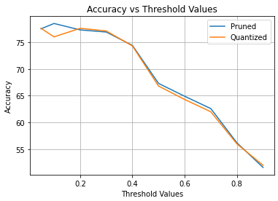
Accuracy Plot

Slide 4
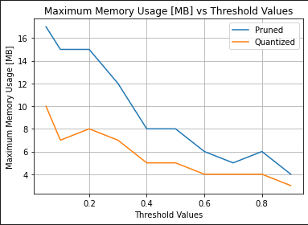
Max Memory Plot

Slide 5
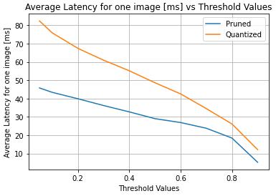
Average Latency For One Image Plot

Slide 6
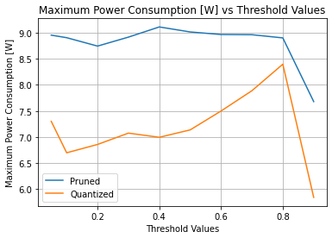
Max Power Consumption Plot

Slide 7
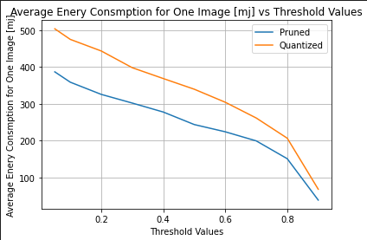
Average Energy Consumption for One Image Plot

Slide 8
Pruned Data
0.00 | 10 | 19 | 77.8 | 47.653 | 9.013 | 414.078
0.05 | 10 | 17 | 77.5 | 45.790 | 8.954 | 386.98702
0.10 | 10 | 15 | 78.5 | 43.377 | 8.905 | 358.889565
0.20 | 10 | 15 | 77.3 | 39.890 | 8.744 | 325.767329
0.30 | 10 | 12 | 76.9 | 36.189 | 8.916 | 302.219427
0.40 | 10 | 8 | 74.4 | 32.720 | 9.111 | 277.892279
0.50 | 10 | 8 | 67.3 | 29.024 | 9.015 | 243.90789
0.60 | 10 | 6 | 64.9 | 26.908 | 8.966 | 224.263548
0.70 | 10 | 5 | 62.6 | 23.789 | 8.962 | 199.548724
0.80 | 10 | 6 | 56.2 | 18.440 | 8.901 | 151.197552
0.90 | 10 | 4 | 51.6 | 5.190 | 7.68 | 38.873215

Slide 9
Quantized Data
0.00 | 10 | 11 | 77.8 | 87.200 | 7.8 | 540.649
0.05 | 10 | 10 | 77.6 | 82.380 | 7.302 | 503.82878
0.10 | 10 | 7 | 76 | 75.830 | 6.699 | 475.108036
0.20 | 10 | 8 | 77.6 | 67.394 | 6.859 | 443.603046
0.30 | 10 | 7 | 77.1 | 60.933 | 7.076 | 398.215293
0.40 | 10 | 5 | 74.3 | 55.160 | 6.996 | 368.828982
0.50 | 10 | 5 | 66.8 | 48.630 | 7.138 | 339.841448
0.60 | 10 | 4 | 64.3 | 42.540 | 7.5 | 304.460859
0.70 | 10 | 4 | 62 | 34.507 | 7.889 | 261.680378
0.80 | 10 | 4 | 56 | 26.129 | 8.397 | 206.887277
0.90 | 10 | 3 | 52 | 12.089 | 5.844 | 68.393505

Slide 10
Conclusion
What Data Shows
Quantized models accuracy stayed the same
Quantized models decreased in memory
Quantized models took more time to predict
Quantized models consumed more energy
Things to Look Into
We need to look into the max wattage since there are some discrepancies

Slide 11
Moving Forward for M3
Test Pruning
Test Quantization
Competition
Try different variations of pruning
Try different types of quantization with different data types
Figure out what performance metric to compete in

