Slide 1

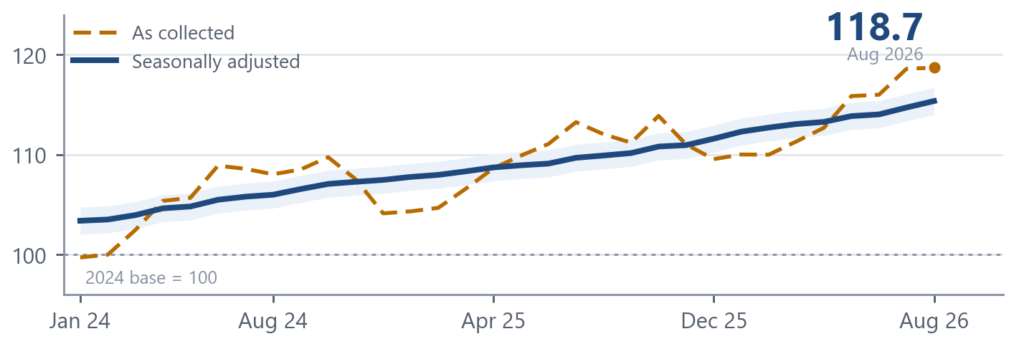
SMART INDIA HACKATHON 2026
• Problem Statement ID – SIH26056
• Problem Statement Title – Development of a Real-time Airfare Price Index for India through Automated Web Scraping of Airline and Online Travel Aggregator Portals for Augmentation of the Consumer Price Index (CPI)
• Theme – Travel & Tourism
• PS Category – Software
• Team Name – Bharat Bytes
VIMAAN Validated Index of Market Airfares
for Augmenting National-statistics
Skyscanner tells you what a ticket costs. VIMAAN tells the RBI whether to raise rates.
517
ROUTES, 3× A DAY
78 → 517
VS DGCA TODAY
SDMX
Source: Modelled on the VIMAAN sampling design. Base 2024 = 100, as in CPI 2024.
FEED INTO CPI 2024
WALKTHROUGH Prototype video and screens on Google Drive
LIVE vimaan-console.vercel.app SOURCE github.com/hersheysss3/vimaan-airfare-index

Slide 2
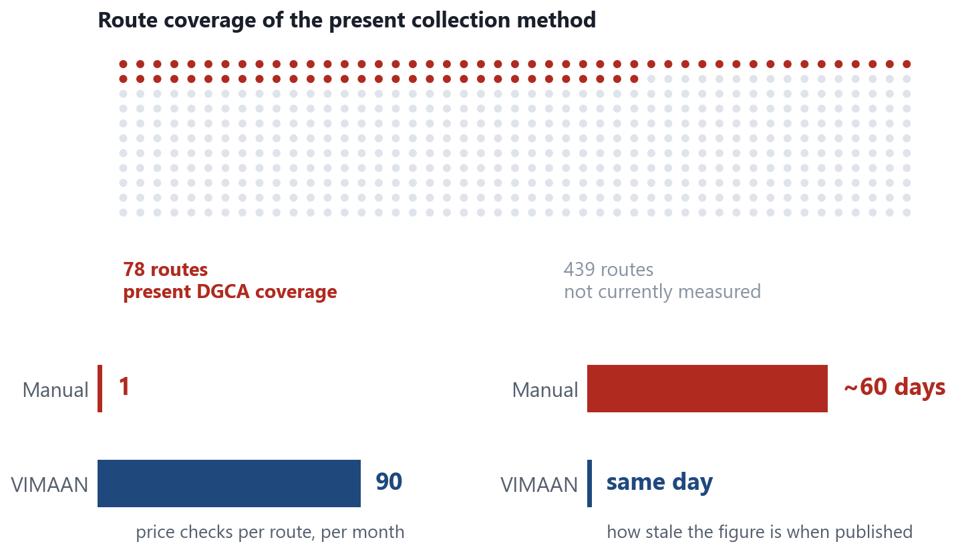
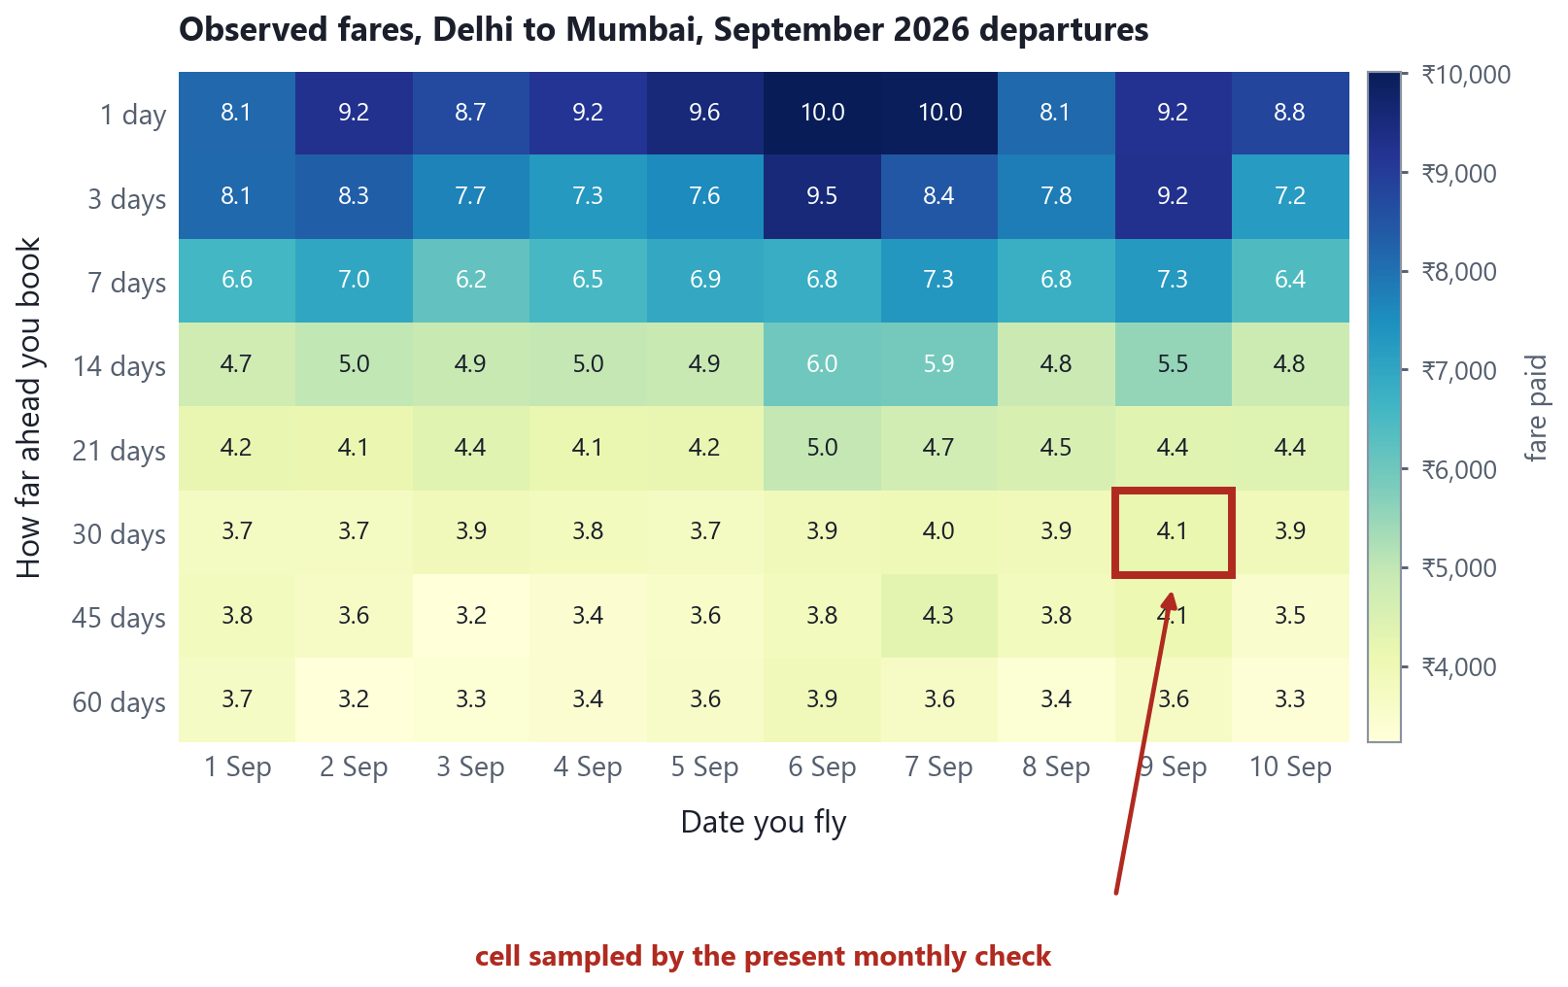
PROPOSED SOLUTION
Bharat Bytes
VIMAAN Validated Index of Market Airfares for Augmenting National-statistics. An automated replacement for the manual airfare price collection that currently supplies the CPI transport group.
EXHIBIT 2 DETAILED EXPLANATION OF THE PROPOSED SOLUTION
EXHIBIT 3 HOW IT ADDRESSES THE PROBLEM
Source: Route count from DGCA Monthly Domestic Traffic Statistics. Present coverage per PIB PRID 1810467.
INNOVATION AND UNIQUENESS OF THE SOLUTION
Source: Fare grid modelled on the VIMAAN sampling design, Delhi–Mumbai, September 2026 departures.
01 Full price surface sampled
02 Multilateral index estimators
03 Statutory collection basis
04 Reproducible output
Eight advance-purchase windows across every departure date in a 60-day horizon, each fare attributed to its month of departure.
Jevons elementary aggregates, then GEKS-Jevons on a 25-month rolling window, which removes chain drift.
Rule 135(2) tariff pages and licensed APIs supply two of three lanes. robots.txt observed; no personal data.
Hashed raw snapshots, a methodology endpoint for each value, and SDMX-JSON for direct ingestion by MoSPI.

Slide 3
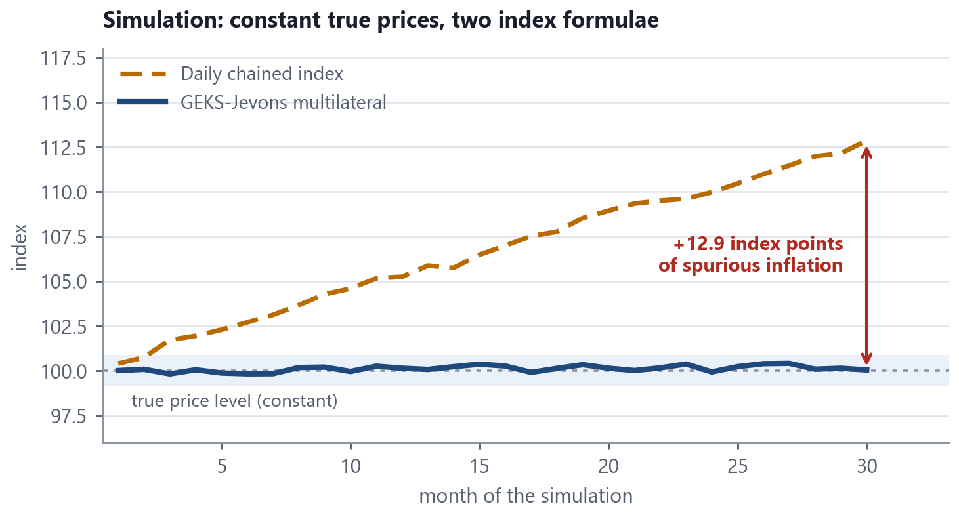
TECHNICAL APPROACH
Bharat Bytes
METHODOLOGY AND PROCESS FOR IMPLEMENTATION
TECHNOLOGIES TO BE USED
1 COLLECT
2 CLEAN
3 ADJUST
4 INDEX
5 PUBLISH
COLLECT Python 3.11 · Playwright · httpx · Redis + RQ
statutory tariff pages, licensed APIs, public portals
IATA codes, one currency, all-in fares, outliers out
hedonic model strips stops, duration, cabin, baggage
Jevons → GEKS–Jevons → DGCA passenger weights
REST + SDMX-JSON, dashboard, surge alerts to DGCA
STORE PostgreSQL 16 + TimescaleDB · Parquet / DuckDB
PROCESS Polars · NumPy / SciPy · Great Expectations
The pipeline runs without manual intervention. Sampling parameters are given in the specification, right.
STATISTICS statsmodels · X-13ARIMA-SEATS · index library
EXHIBIT 4 EFFECT OF THE INDEX FORMULA ON THE PUBLISHED FIGURE
SERVE FastAPI · Pydantic v2 · SDMX-JSON · Swagger
INTERFACE React 18 + Vite · visx · MapLibre + deck.gl
OPERATE Docker Compose · Prometheus + Grafana · CI
INDEX SPECIFICATION
Collection
3 times daily, 02:00 / 11:00 / 19:00 IST
Lead buckets
L1, L3, L7, L14, L21, L30, L45, L60
Horizon
60 days forward, every departure date
Attribution
month of departure (acquisition basis in parallel)
Elementary
Jevons geometric mean, per route and bucket
Multilateral
GEKS-Jevons, cross-checked with Time-Product-Dummy
Window
25 months, rolling, extended by mean splicing
Weights
DGCA base-period route passengers
Seasonal
X-13ARIMA-SEATS, Indian moving-holiday regressors
Output
REST, SDMX-JSON, monthly bulletin
Source: Simulation with constant true prices. Estimators per ONS Methodology Working Paper 12 and the ILO/IMF CPI Manual 2020.
OUT OF SCOPE BY DESIGN
P_J(0,t) = Πⱼ ( pⱼᵗ / pⱼ⁰ )^(1/n) Index(t) = Σᵢ wᵢ Iᵢ(t) / Σᵢ wᵢ × 100, wᵢ = DGCA base-period passengers
No CAPTCHA solving, no login or paywall circumvention, no fingerprint spoofing, and no personal data at any stage. Two of the three intake lanes do not scrape.

Slide 4
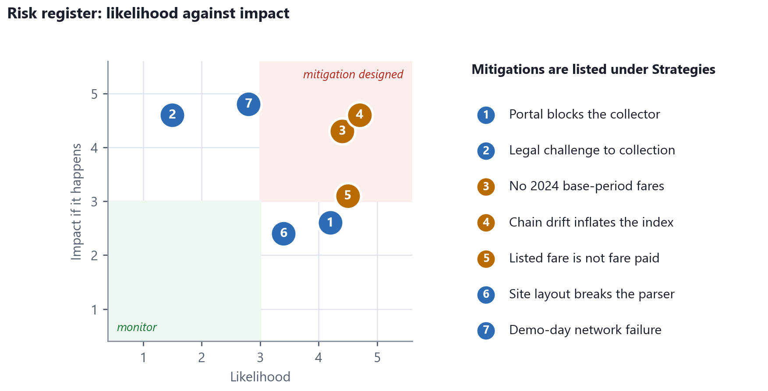
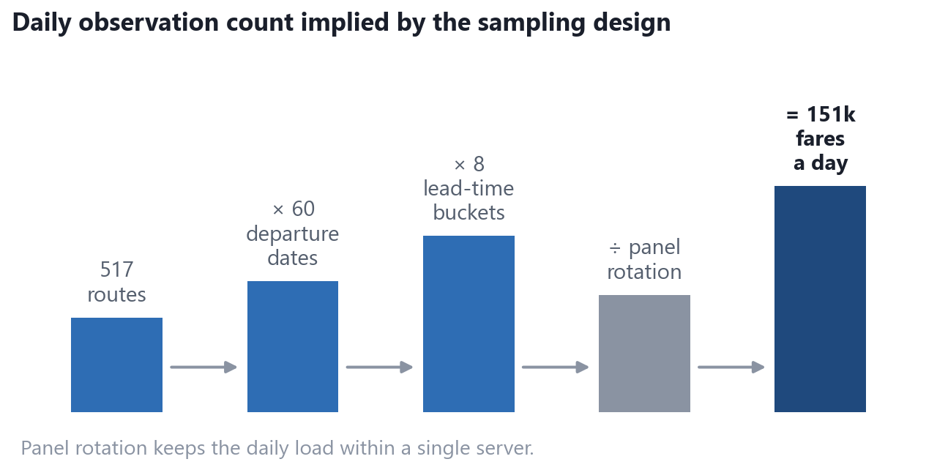
FEASIBILITY AND VIABILITY
Bharat Bytes
ANALYSIS OF THE FEASIBILITY OF THE IDEA
EXHIBIT 6 POTENTIAL CHALLENGES AND RISKS
COLLECTION BASIS IS STATUTORY
Rule 135(2), Aircraft Rules 1937 obliges every airline to publish its tariff. Two of our three intake lanes therefore need no scraping at all.
COMPONENTS ARE STANDARD AND UNLICENSED
Python, Playwright, PostgreSQL, statsmodels, FastAPI, React, Docker. Nothing exotic, nothing licensed, nothing to procure.
EXHIBIT 5 IMPLIED DATA VOLUME
Source: Team assessment. Each entry is answered in the strategies below.
STRATEGIES FOR OVERCOMING THESE CHALLENGES
1 Portal blocks us
three independent lanes; A and B are statutory and contractual
2 Legal challenge
Rule 135(2) mandate + Collection of Statistics Act 2008; zero PII
3 No 2024 base fares
backcast from DGCA yields; published provisional with a band
4 Chain drift
GEKS–Jevons and TPD on a 25-month rolling window, mean spliced
5 Listed ≠ paid
yield calibration from DGCA route revenue, published with uncertainty
Source: Derived from the sampling design set out in the specification on slide 3.
6 Parser breaks
config-driven selectors, schema-drift detector, per-lane SLO alarms
7 Demo network dies
seeded 21-day dataset, fully offline Docker Compose, backup video

Slide 5
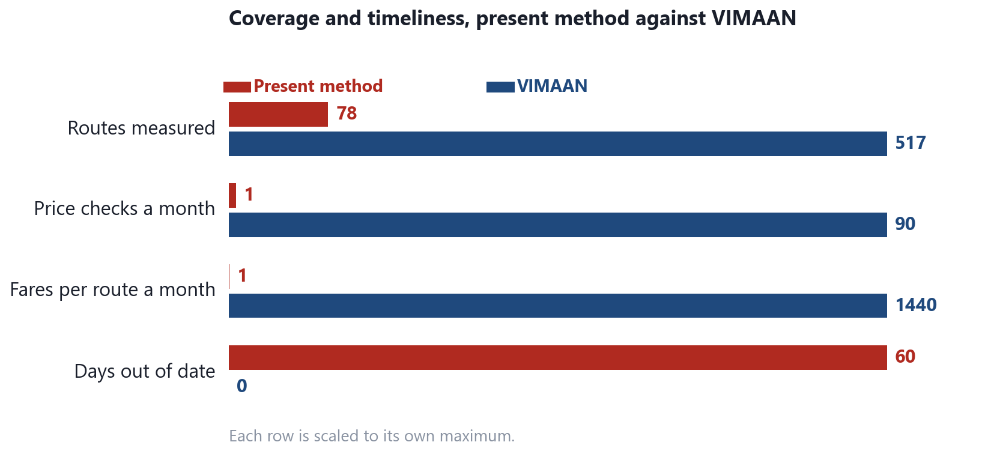
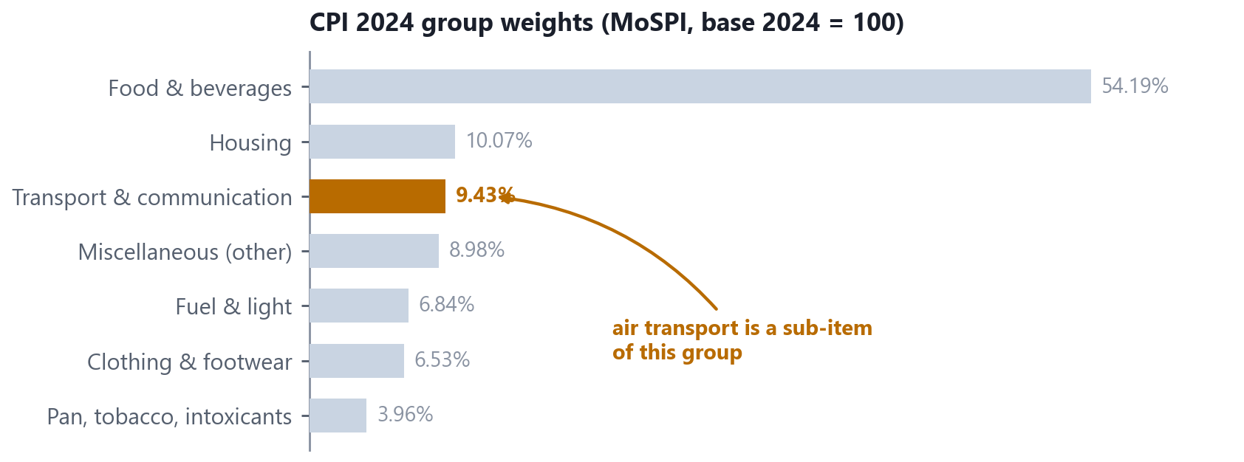
IMPACT AND BENEFITS
Bharat Bytes
EXHIBIT 7 POTENTIAL IMPACT ON THE TARGET AUDIENCE
TRANSMISSION OF THE INDEX INTO POLICY
Millions of fares
VIMAAN index
CPI 2024
Repo rate
517 routes, 3× daily
quality-adjusted
transport, 9.43%
EMIs for 140 crore
Source: CPI group weight from MoSPI. Repo transmission is the standard monetary policy channel, not a claim specific to this project.
BENEFITS OF THE SOLUTION (SOCIAL, ECONOMIC, ENVIRONMENTAL)
ECONOMIC — MOSPI AND THE RBI
An unbiased, quality-adjusted airfare component feeds headline CPI, which sets the repo rate. Better input, better monetary policy.
ADMINISTRATIVE — DGCA
Source: Present method per PIB PRID 1810467. VIMAAN figures are design parameters.
Tariff monitoring goes from 78 hand-checked routes a month to 517 routes three times a day, with automatic fare-surge alerts.
EXHIBIT 8 POSITION WITHIN THE CPI 2024 BASKET
SOCIAL — CITIZENS AND TRAVELLERS
Public route and lead-time indices expose the true advance-purchase penalty and festival-season surges. No such statistic exists for India today.
ENVIRONMENTAL — MOCA
Field price collection is replaced by an automated feed, removing enumerator travel. The ATF pass-through model shows how much of a fare rise is fuel.
STATISTICAL — MOSPI, RBI AND THE IMF
Source: MoSPI, Consumer Price Index base 2024 = 100. First release, PIB PRID 2227012.
SDMX-JSON is ingested without manual handling. Hashed provenance makes every published value defensible under statistical audit and under RTI.

Slide 6
RESEARCH AND REFERENCES
Bharat Bytes
DETAILS / LINKS OF THE REFERENCE AND RESEARCH WORK · EACH SOURCE, AND WHAT IT SETTLES
A INDIAN STATUTORY BASIS
B INTERNATIONAL METHOD
C OUR OWN VALIDATION
Establishes that the data is public and that MoSPI may collect it
Establishes that our estimators are the ones NSOs already use
Establishes how anyone can check the number we publish
1. MoSPI — FAQs on the CPI 2024 Series, Annexure V
airfare prices are collected through online platforms mospi.gov.in
8. ONS — aggregate index of air fares (FOI-2023-1164)
fixed advance-purchase windows; month-of-departure basis ons.gov.uk
DATASETS ASSEMBLED BEFORE HOUR ZERO
routes_top500.csv (DGCA), dgca_pax_weights.csv, base_2024_fares.csv (backcast), airports.geojson, atf_prices.csv (IOCL), festival_calendar.csv
2. PIB — first CPI release on base 2024 = 100, 12 Feb 2026
358 items · COICOP 2018 · Transport weight 9.43% PRID 2227012
9. ONS — Methodology Working Paper 12
index-number methods on web-scraped price data ons.gov.uk
3. Aircraft Rules, 1937 — Rule 135(2)
every airline shall publish its established tariff civilaviation.gov.in
10. ONS — multilateral methods in consumer price statistics
GEKS–Jevons, TPD, rolling windows, splicing ons.gov.uk
HOW THE INDEX WILL BE VALIDATED
Benchmarked against MoSPI's own manually collected airfare series over overlapping months. Cross-lane divergence tests with a flag threshold. Leave-one-route-out sensitivity on the DGCA weights. A published revision policy.
4. Collection of Statistics Act, 2008
statutory mandate for official price collection indiacode.nic.in
11. ILO / IMF / OECD / Eurostat — CPI Manual 2020
why Jevons, not Carli or Dutot, for elementary aggregates imf.org
5. PIB / MoCA — DGCA Tariff Monitoring Unit
78 routes, monthly, read by hand from airline sites PRID 1810467
12. Statistics Canada — Air Transportation Index, 2020
dynamic airline pricing inside an official index statcan.gc.ca
DISTINCTION FROM A FARE-SEARCH PRODUCT
Unit of observation
a price surface, not a single price
6. DGCA — Monthly Domestic Traffic Statistics
route-wise passengers — our index weights dgca.gov.in
13. Statistics Netherlands / Eurostat — web scraping
25-month window guidance and chain-drift evidence unece.org
Elementary aggregate
Jevons geometric mean, not an arithmetic average
Multilateral stage
GEKS-Jevons on a rolling window
Attribution
month of departure, DGCA passenger weights
7. MoSPI — Expert Group Report on updation of the CPI
weight derivation and item-basket methodology mospi.gov.in
14. IOCL — Aviation Turbine Fuel price circulars
input to the fuel pass-through model iocl.com
Delivery
an SDMX statistical feed, not only a dashboard
STANDING OF THE METHOD
Auditability
a reproducibility hash on every published value
The collection basis is statutory and the estimators are those already in use by the UK Office for National Statistics, Statistics Canada and Statistics Netherlands on web-collected prices. The contribution here is their application to Indian route data, with the supporting evidence published alongside every figure.
Collection basis
two of three lanes statutory, not scraped
SEE IT RUN walkthrough · vimaan-console.vercel.app

