Slide 1
Associative proof of the Diamond Operator & Associative characteristics of MS Boolean
functions
Tomer Hershkovitz, I.D: 308261163
Supervisor: Doc. Moti Medina

Slide 2
Outline
Review my initial project goals.
Meta Stable class – a Meta Stable pythonic environment.
Theoretical presentation of the project.

Slide 3
Meta Stable Python Class
It has a variety of abilities such as:
  Extracting an MS truth table from a Boolean function.
  Testing associativity for MS functions or regular by definition or through my theoretical achievements.
  MS operators (F_Closer, star, res).
  Generate inputs (MS or Boolean).
  Create a RG
  Convert RG2Bin or Bin2RG

Slide 4
Initial project goals
Goal 1: Introduce an analytic based solution that shows the associative of the MS-closer diamond operator.
Goal 2: Deduce a more general approach of proving (analytically) the associative characteristics of MS-closer operators & provide an automated method to determine the associative characteristics of an operator.

Slide 5
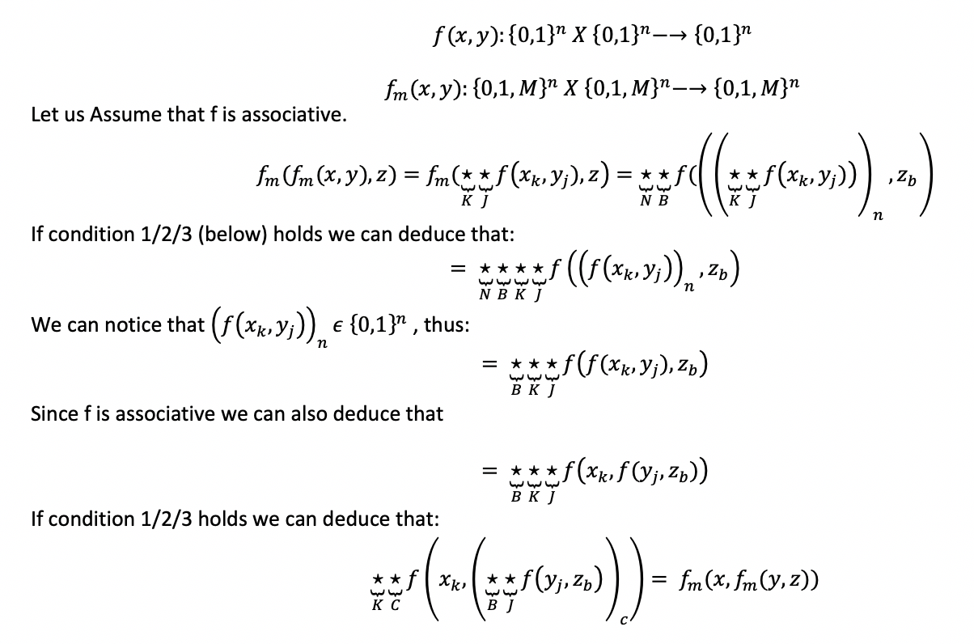
Theoretical Part – General proof of MS Associative

Slide 6
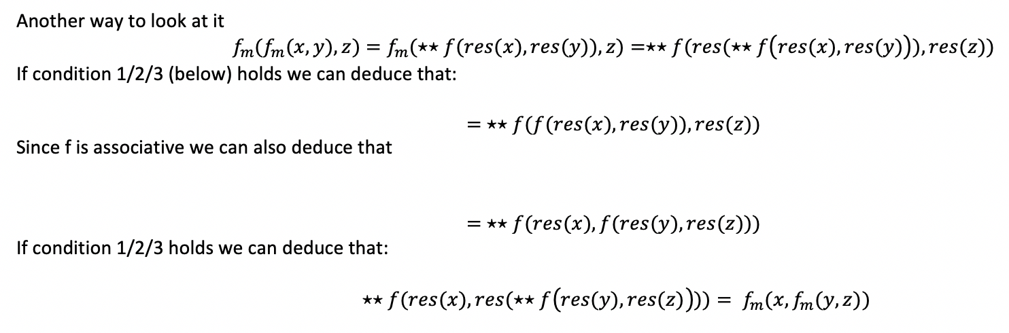
Theoretical Part – General proof of MS Associative

Slide 7
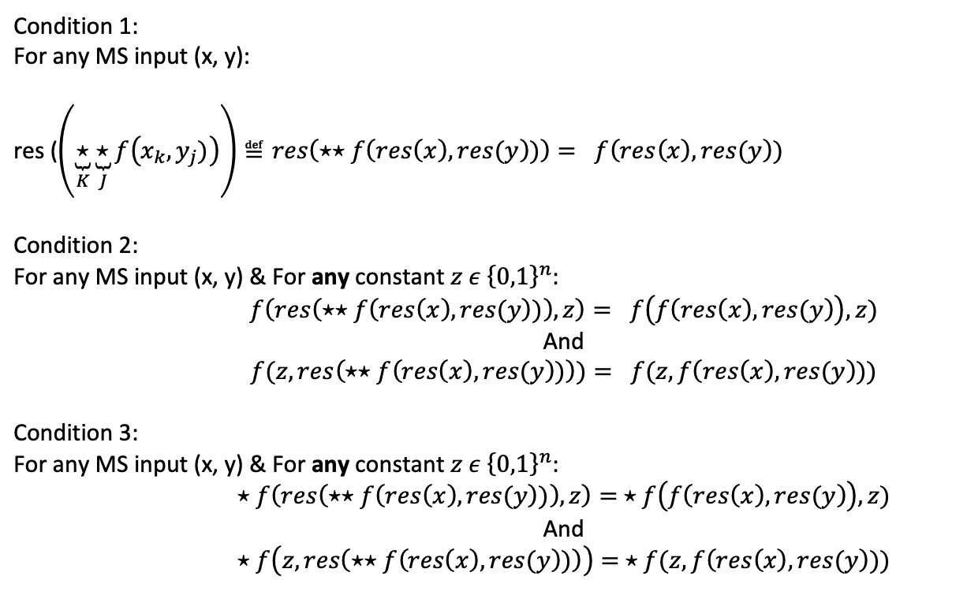
Theoretical Part – The Conditions

Slide 8
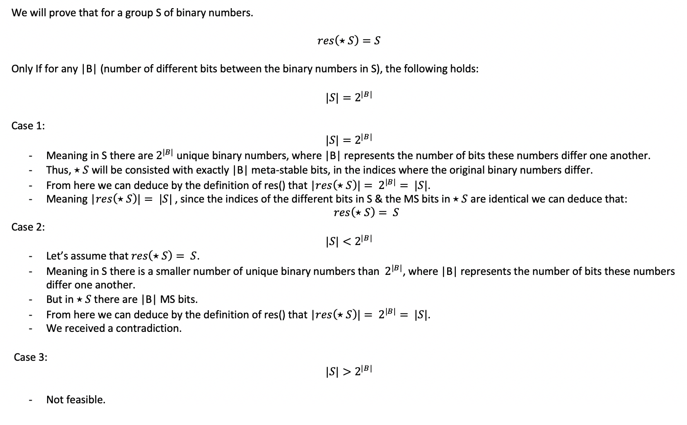
Theoretical Part – Proof of conjecture 1

Slide 9
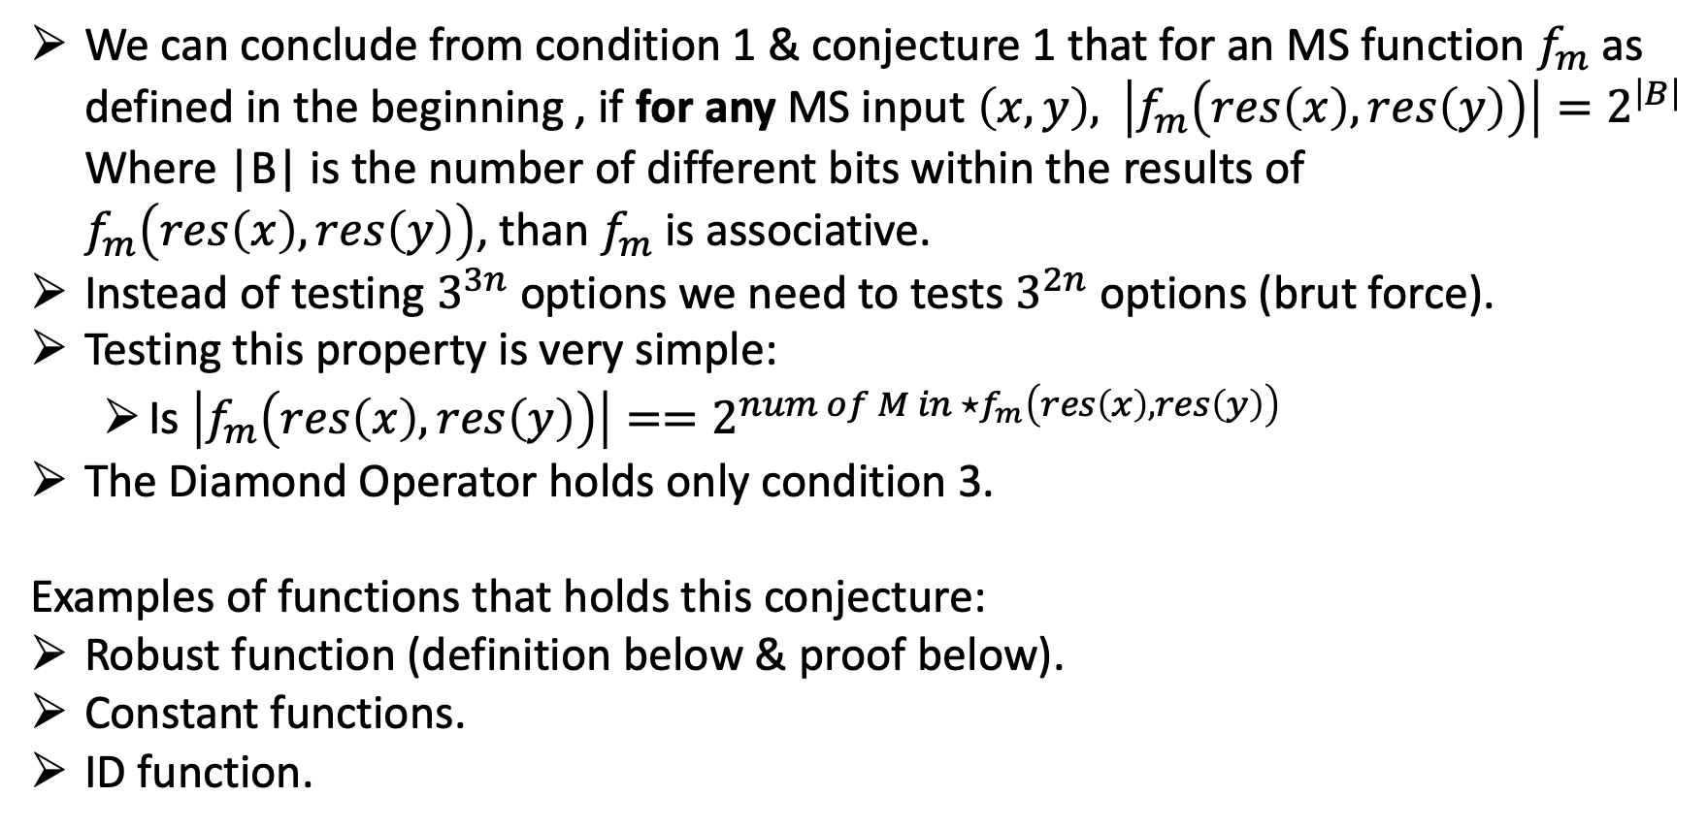
Theoretical Part – Meanwhile conclusions

Slide 10
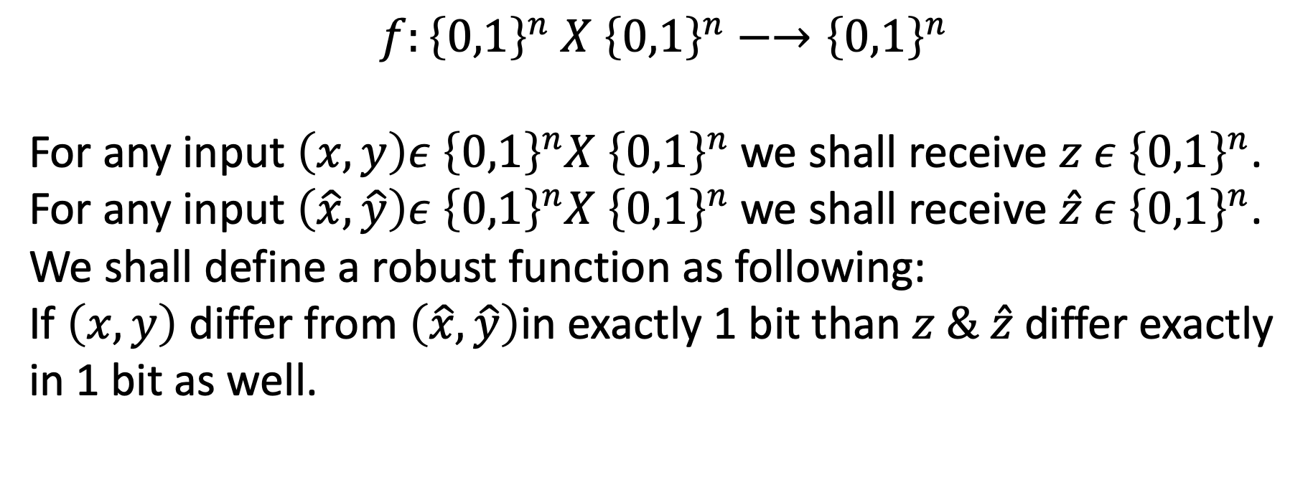
Theoretical Part – Robust Function

Slide 11
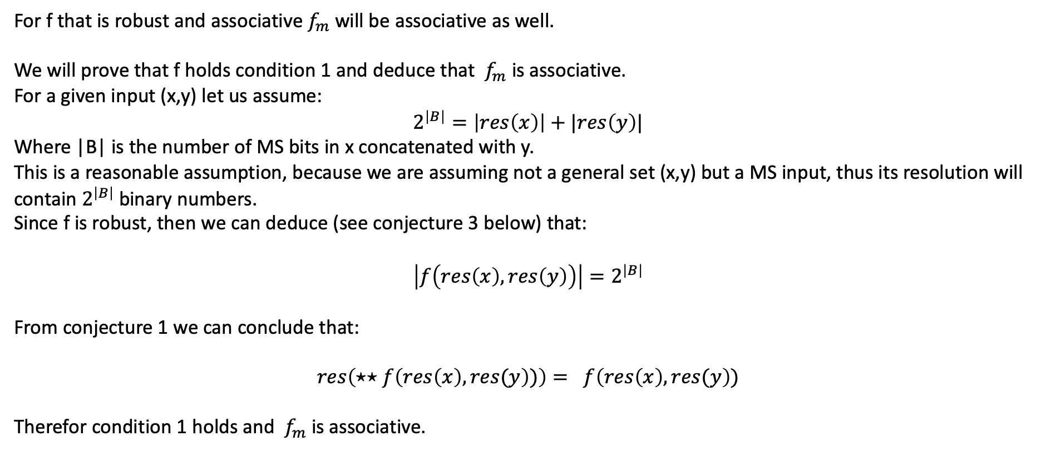
Theoretical Part – Proof of Conjecture 2

Slide 12
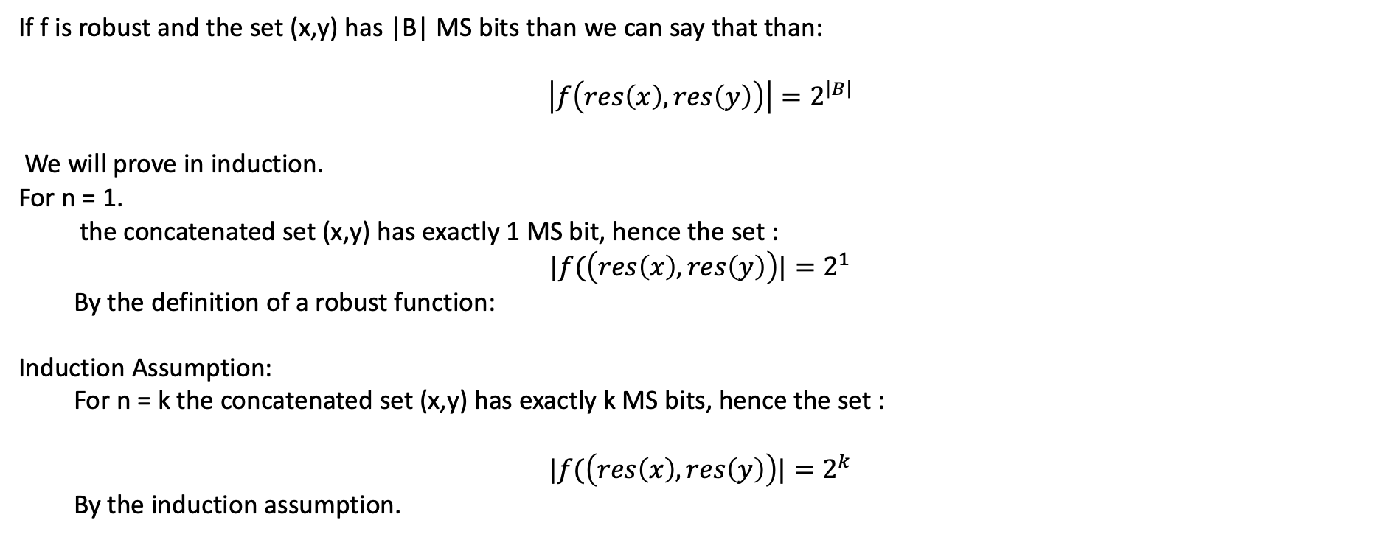
Theoretical Part – Proof of Conjecture 3

Slide 13
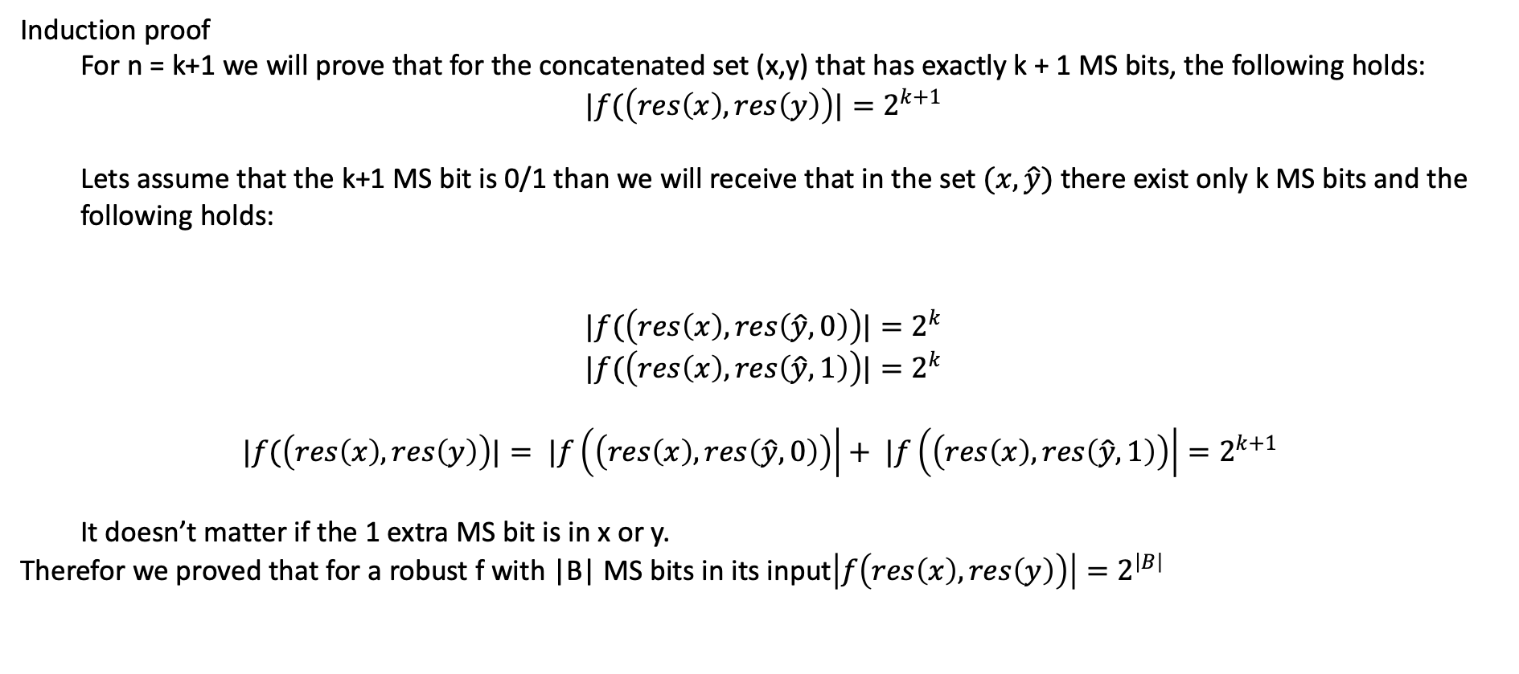
Theoretical Part – Proof of Conjecture 3

Slide 14
Theoretical Part – Conclusions
I’ve offered 3 new conditions on how to determine if a MS function is associative
I’ve suggested and proven that for a family of operators we can deduce immediate associativity.
I’ve proved 3 different conjectures.
I’ve implemented a python MS environment.

Slide 15
Lets call it day
Or
Lets call it a first degree in electrical engineering

