Slide 1
Survey Package in R
design = svydesign( ids = ~SDMVPSU , strata = ~SDMVSTRA ,
nest=TRUE , weights =~WTMEC_1, data = NHANES)
Notes:
The complex survey design used to obtain a representative sample of the United states is taken into account each time we run a regression test, a chi-squared test, create a scatterplot, or for example, build a table of totals. Our dataset only has 14000 observed cases of CKD in 2014, but using the survey package, i can determine that 38 million people in the U.S. have CKD. And this is really helpful and powerful.

Slide 2
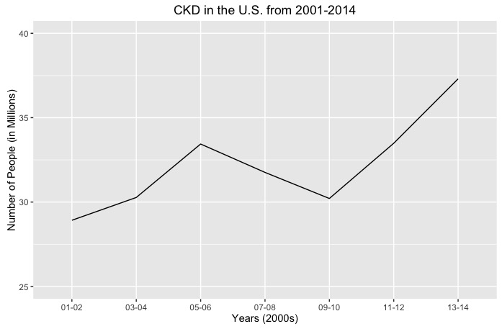
CKD in the U.S.
Clear and
immediate idea
Notes:
Of what has been and is happening among roughly 300 million people…which is perfect because….

Slide 3
Broad Public Health Survey
Where have we been?
Where are we now?
Who and what do we need to look at?
Notes:
for a broad public health survey we are looking at these types of question…. The third especially in our case

Slide 4
Logistic Regression Model
Y=LDL+Hypertension+Sex+Diabetes+….
Notes:
Talk about narrowing down variables
Visualizations, Forward and backward selection and cross validation to determine associations and potential risk factors for CKD

Slide 5
Importance of Research
This model helps identify what we should focus on in future studies
CKD is becoming more prevalent
Dialysis is difficult and expensive
Notes:
What CAUSES CKD? This type of model helps with more specific future studies to determine the causes of CKD
How can we prevent it? Because it is serious, growing, and expensive. When using something like NHANES, it is all about getting a sense. In order to improve the health of a country, you need to get a strong general sense of its health landscape before you can dive in to all the specifics.

