Slide 1
SGP-TOD: Building Task Bots Effortlessly via Schema-Guided Prompting
Presentation Overview by Group 3 2025/03/13

Slide 2
Outlines
Introduction
Key Contributions
SGP-TOD Architecture
DST Prompter (Dialogue State Tracking)
Policy Prompter
Experimental Setup
Results & Analysis
Limitations & Future Work
Conclusion

Slide 3
Introduction
What is Task-Oriented Dialogue (TOD)?
Used in virtual assistants, customer service, and automated support.
Traditional methods require extensive fine-tuning and large labeled datasets.
SGP-TOD Solution:
Leverages Large Language Models (LLMs) with schema-guided prompting.
Enables zero-shot generalization, reducing the need for labeled data.

Slide 4
Key Contributions
SGP-TOD enables efficient end-to-end task bot creation.
Uses task schema to guide LLMs in generating responses.
Achieves state-of-the-art (SOTA) zero-shot performance across multiple datasets.
Reduces reliance on task-specific training and fine-tuning.

Slide 5
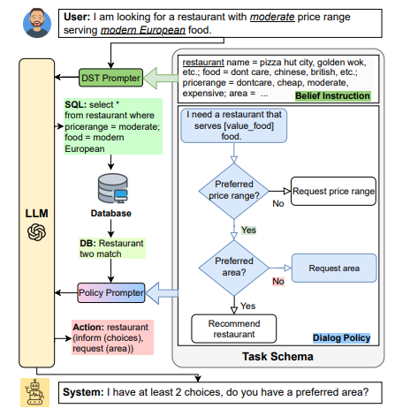
SGP-TOD Architecture
Three main components:
LLM: Generates responses based on structured instructions.
DST Prompter: Tracks dialogue state using belief instructions.
Policy Prompter: Guides system actions using predefined policy skeletons.

Slide 6
DST Prompter (Dialogue State Tracking)1/3
Extracts user intent and required slots.
Uses Belief Instructions (BI) to help LLM interpret and track dialogue states.
Uses SQL-based belief state representation to interact with databases.
Example:
User asks for a restaurant.
DST Prompter tracks parameters like " food", “area", and "price range".
Generates structured queries to retrieve relevant information.

Slide 7
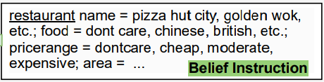
DST Prompter (Dialogue State Tracking)2/3
Extracts user intent and required slots.
Uses Belief Instructions (BI) to help LLM interpret and track dialogue states.
Uses SQL-based belief state representation to interact with databases.
Example:
User asks for a restaurant.
DST Prompter tracks parameters like " food", “area", and "price range".
Generates structured queries to retrieve relevant information.

Slide 8
DST Prompter (Dialogue State Tracking)3/3
Extracts user intent and required slots.
Uses Belief Instructions (BI) to help LLM interpret and track dialogue states.
Uses SQL-based belief state representation to interact with databases.
Example:
User asks for a restaurant.
DST Prompter tracks parameters like " food", “area", and "price range".
Generates structured queries to retrieve relevant information.

Slide 9
Policy Prompter
Defines system behavior based on user intent and database results.
Uses policy skeletons to ensure consistency in responses.
Example:
If no restaurant matches, system asks for alternative preferences.
If multiple restaurants match, system provides ranked recommendations.

Slide 10
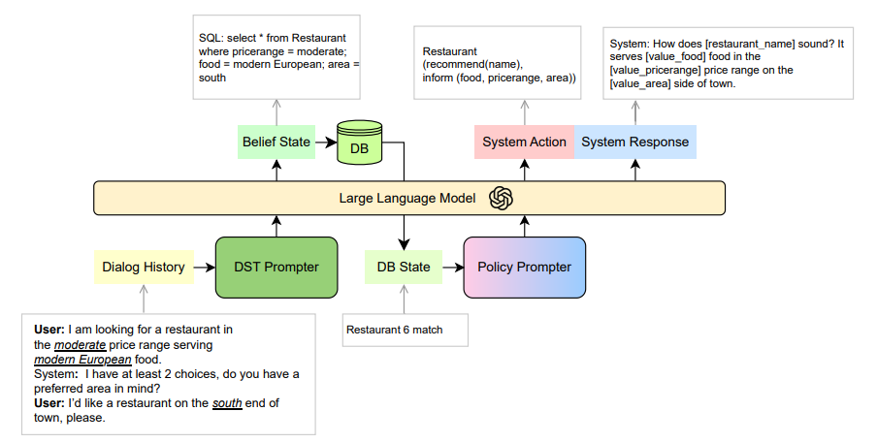
Dialog Example 1

Slide 11
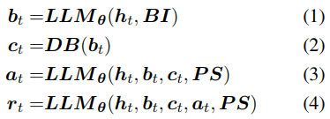
Dialog Example 2

Slide 12
Dialog Example 3
ht
ht

Slide 13
Dialog Example 4
bt
ht
Belief Instructions (BI)
bt
ht

Slide 14
Dialog Example 5
bt
ht
ct
bt
ht
ct

Slide 15
Dialog Example 6
bt
at
ht
ct
bt
ht
ct
Policy Skeletons (PS)
at

Slide 16
Dialog Example 7
bt
at
rt
ht
ct
bt
ht
ct
at
rt

Slide 17
Experimental Setup
Datasets: Evaluated on MultiWOZ, RADDLE, STAR datasets.
Comparison Methods:
Fine-tuned models: BERT+S, SAM.
Few-shot methods: ChatGPT using 15-shot prompting.
Evaluation Metrics:
Task Transfer: Performance on unseen tasks within the same domain.
Domain Transfer: Performance on tasks in completely new domains.

Slide 18
Results & Analysis
SGP-TOD achieves top zero-shot performance.
Outperforms or matches SOTA zero-shot transfer methods.
Impact of different LLMs:
Codex > GPT-3.5 in action label interpretation.
GPT-3.5-E2E benefits from structured response formatting.
Effect of different task schemas:
SGP-TOD performs well across different manually-crafted schemas.

Slide 19
Limitations & Future Work
Potential Data Contamination(數據汙染:預看到測試資料):
LLM pre-training data is undisclosed, making contamination verification difficult.
Future work should include systematic data filtering.
Dependence on Schema Quality:
Variations in schema design can lead to performance discrepancies.
Need for automatic schema generation for better generalization.
Future Directions:
Personalized chatbots with dynamic task schemas.
Enhanced LLM moderation to filter inappropriate content.

Slide 20
Conclusion
SGP-TOD provides a scalable, schema-driven prompting strategy for task bots.
Enables zero-shot adaptability without fine-tuning, reducing development time.
Future research can focus on:
Improved schema optimization techniques.
More robust transfer learning strategies for new domains.

Slide 21
Q&A

Slide 22
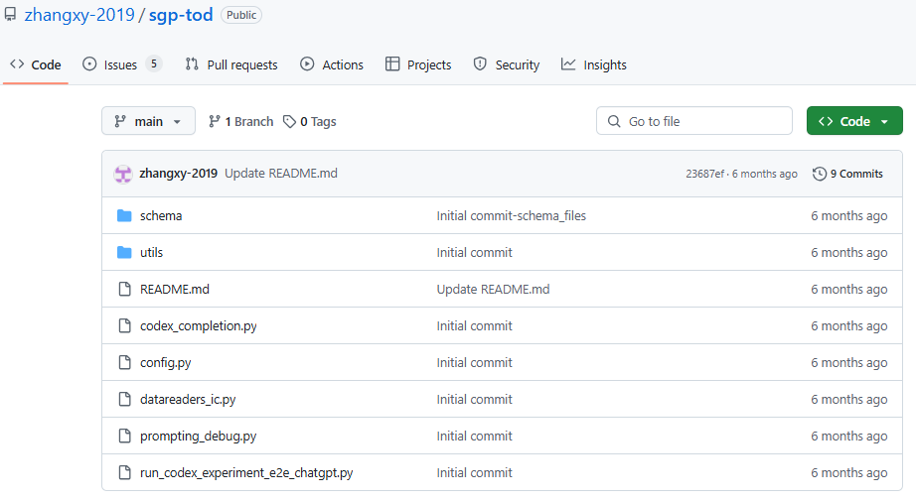
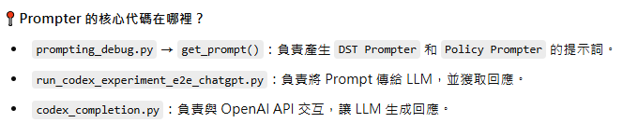
https://github.com/zhangxy-2019/sgp-tod/tree/main

Slide 23
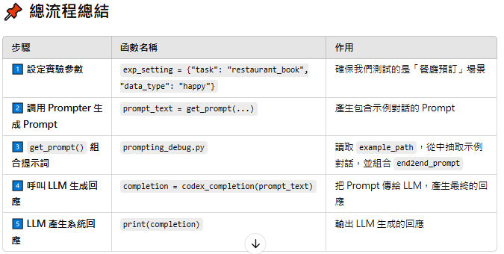

Slide 24
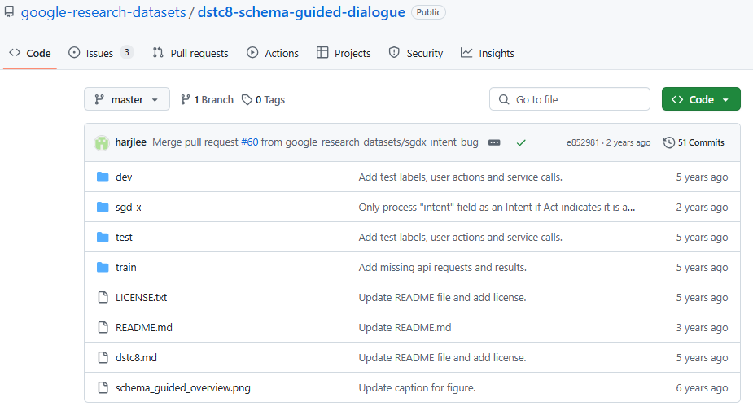
https://github.com/google-research-datasets/dstc8-schema-guided-dialogue/tree/master

Slide 25
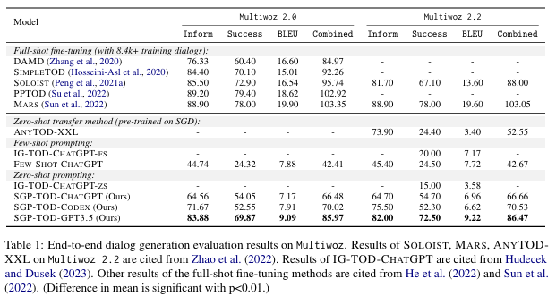

Slide 26
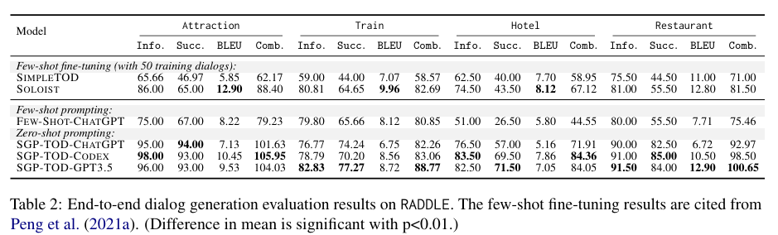

Slide 27
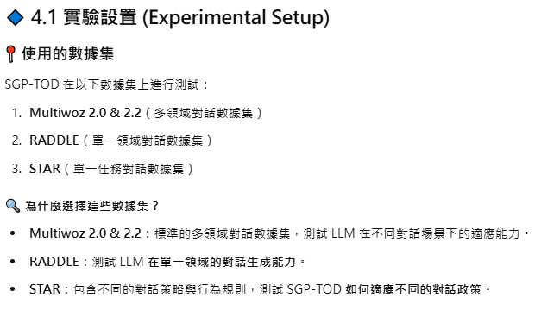

Slide 28
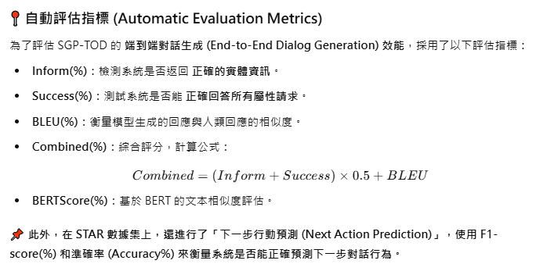

Slide 29
