Slide 1

Basic Terrain Following (BTF)

Slide 2

Smooth Level Vertical (SLEVE)

Slide 3

Cut cell

Slide 4
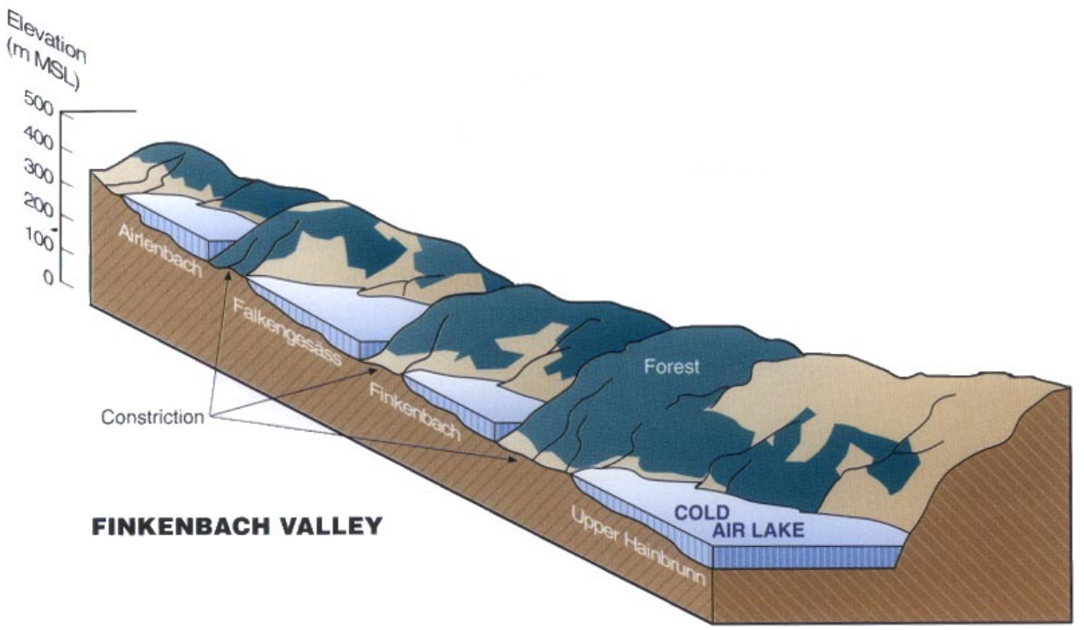
Cold air pools
Mountain Meteorology, C. David Whiteman

Slide 5
How do cold air pools affect the weather?

Slide 6
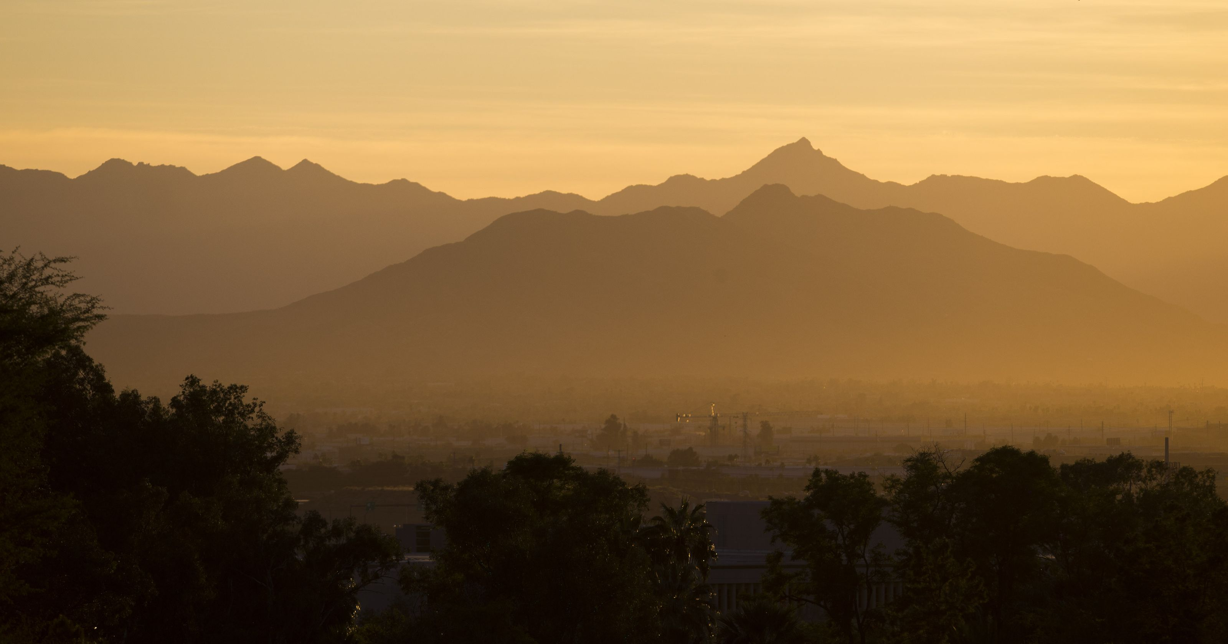
Air pollution
Michael Chow/The Republic

Slide 7
How do cold air pools affect the weather?
Fog
Low stratus cloud
Frost
Freezing rain
Delay ice melt affects hydrology

Slide 8
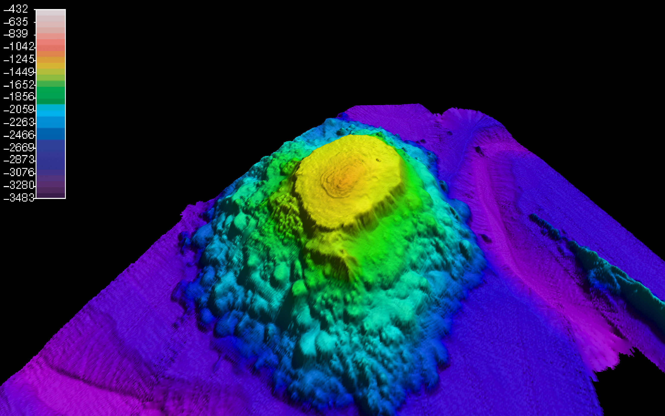
Ocean seamounts
NOAA

Slide 9
Model results
Nonhydrostatic model
Dry dynamical core (no parametrisations)
Inviscid
Free-sleep lower boundary

Slide 10
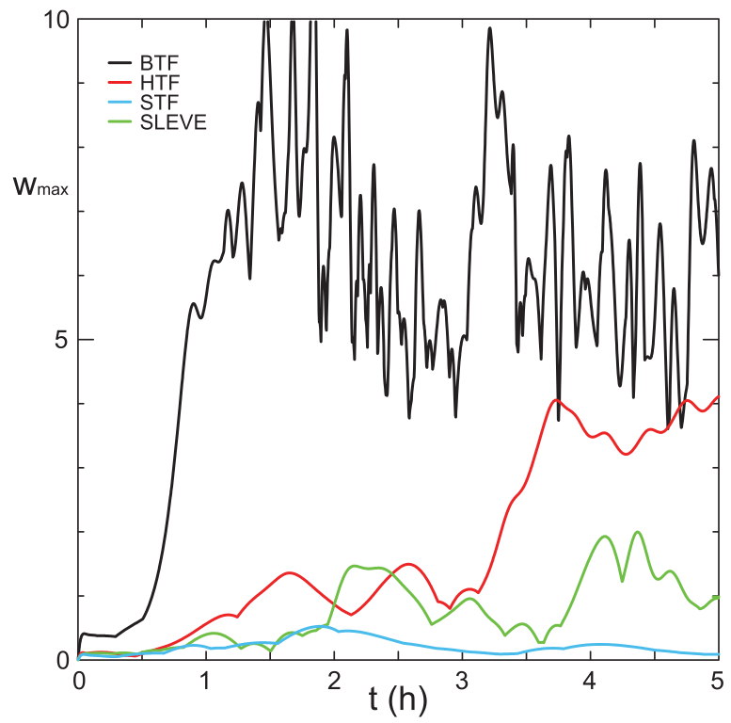
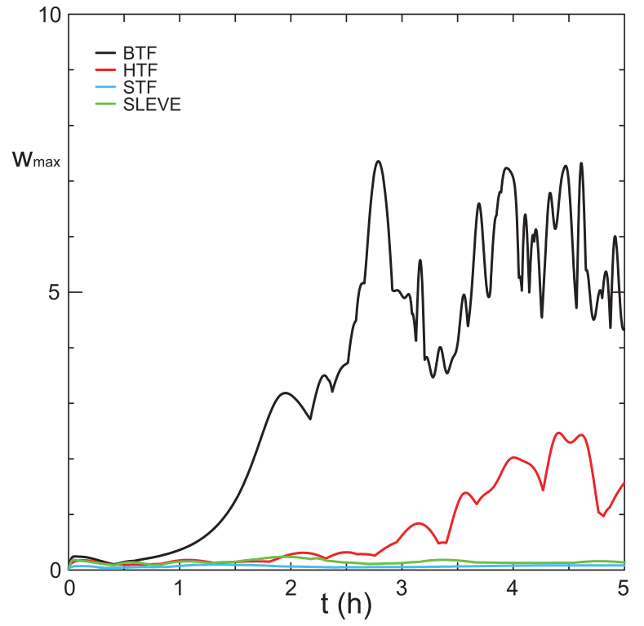
Spurious vertical velocities
∇p calculated in transformed coordinates
∇p calculated in Cartesian coordinates
Klemp, J. B., 2011: A terrain-following coordinate with smoothed coordinate surfaces. Mon. Wea. Rev., 139, 2163–2169

Slide 11
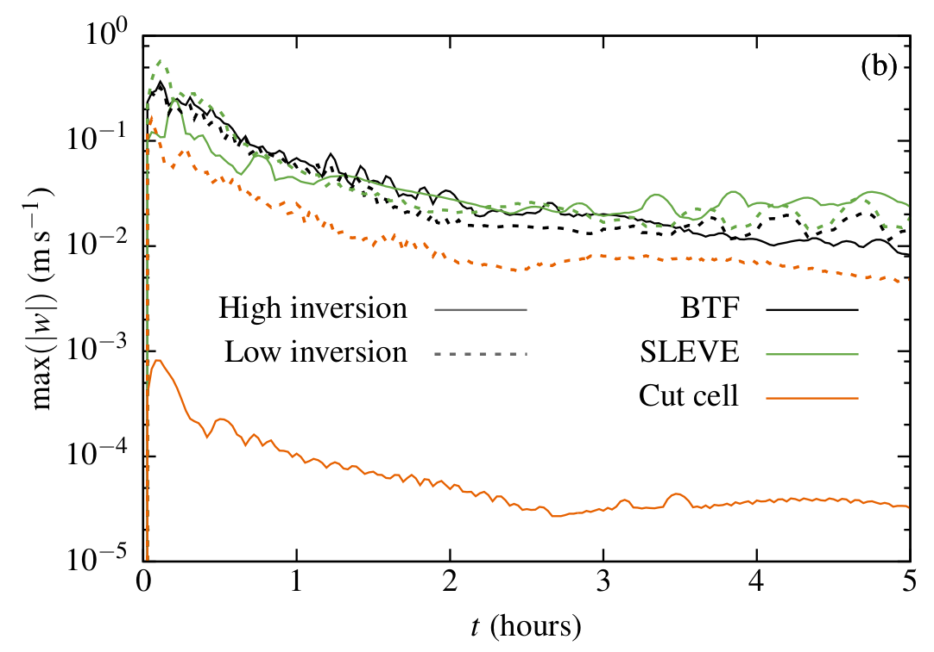
Spurious vertical velocities
∇p calculated in Cartesian coordinates
Curl-free pressure gradient formulation

Slide 12
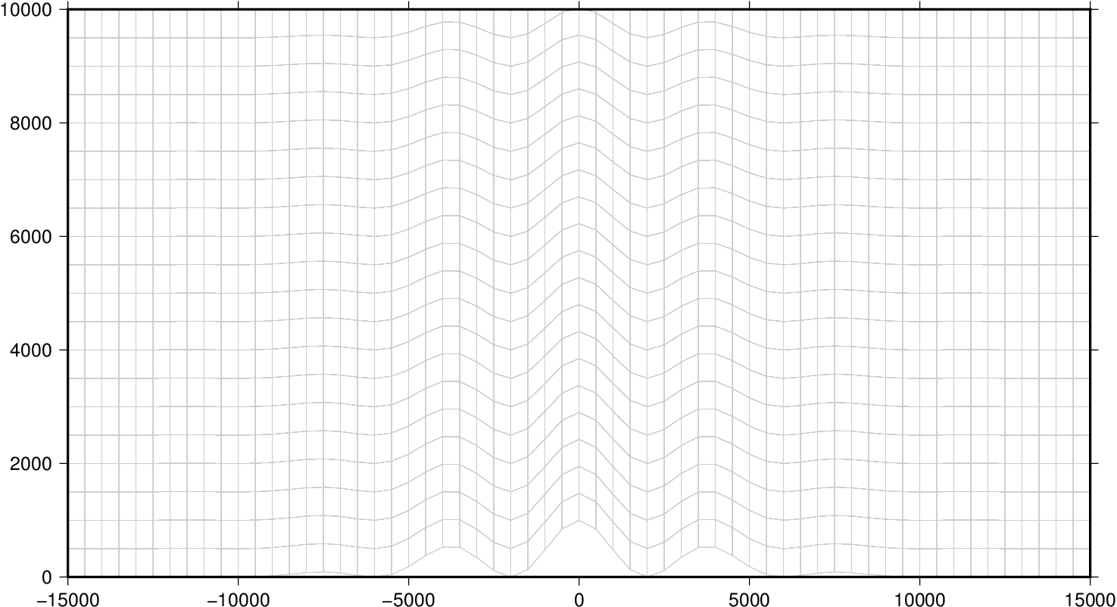
Spurious circulation (BTF)

Slide 13
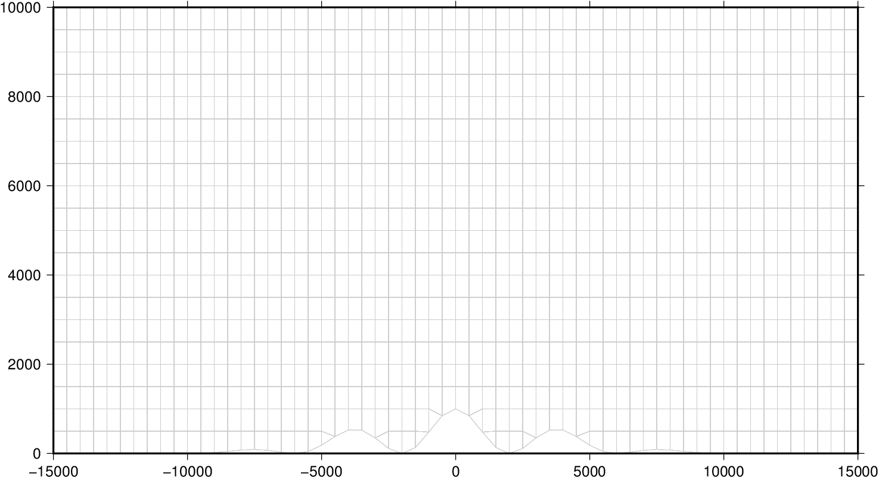
Spurious circulation (cut cell)

Slide 14
Conclusions
Curl-free pressure gradient formulation
  Accurate
  Mostly insensitive to distortions
Cut cells may have slight advantages
More work required on multidimensional advection scheme
  find out more at PhD Group, 17th February

