Slide 1

CST HE RUANXIAO
INTRODUCTION

Slide 2

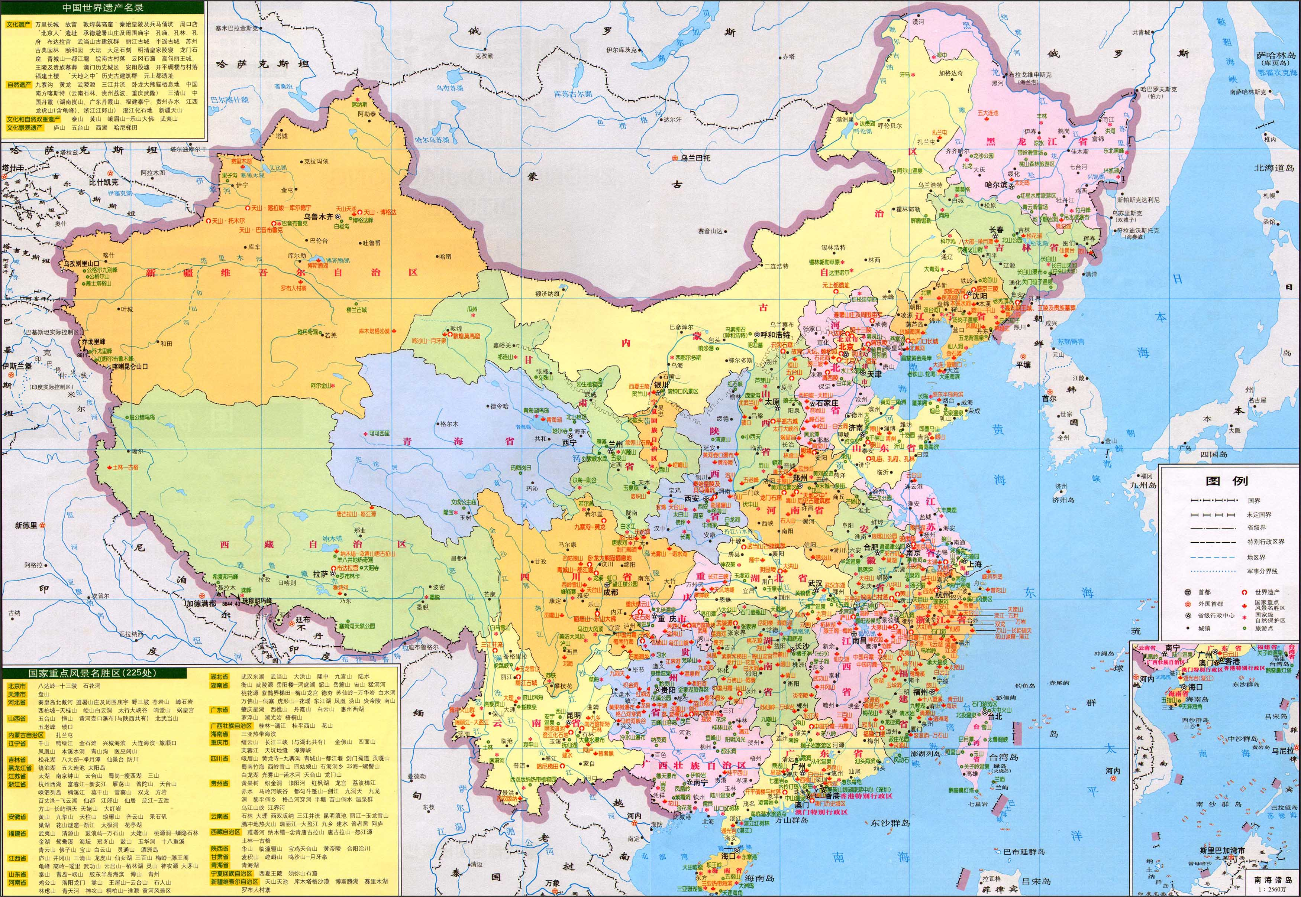
MY HOMETOWN
I’m from China.
Eastern.
Near the sea.(a lot of seafood, disco on the sea)tread on the beach,and then you will get the clam.
Mild weather

Slide 3
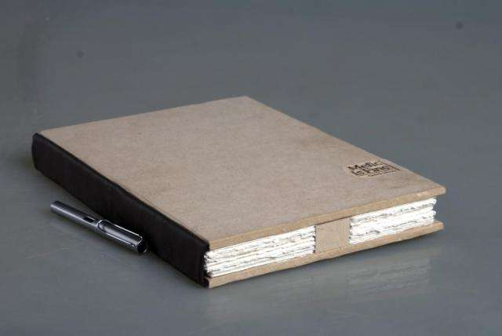

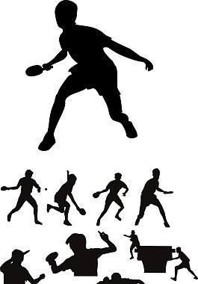
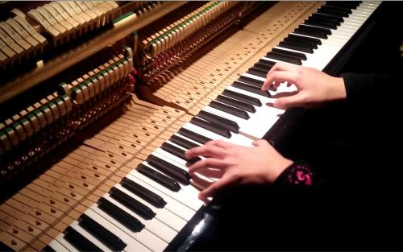
HOBBIES
Hobbies
Table tennis(from the beginning ,I play it to improve my eyesite,but later I found it’s so interesting. It requires strength and techniques.)
Reading
Piano(just a little : for entertainment)
Watching the films: I find it a good way to relax )

Slide 4
WHY I CHOOSE CST
My sister’s major is software engineering.
I am interested in her career , so I want to explore this fresh new world.

