Slide 1
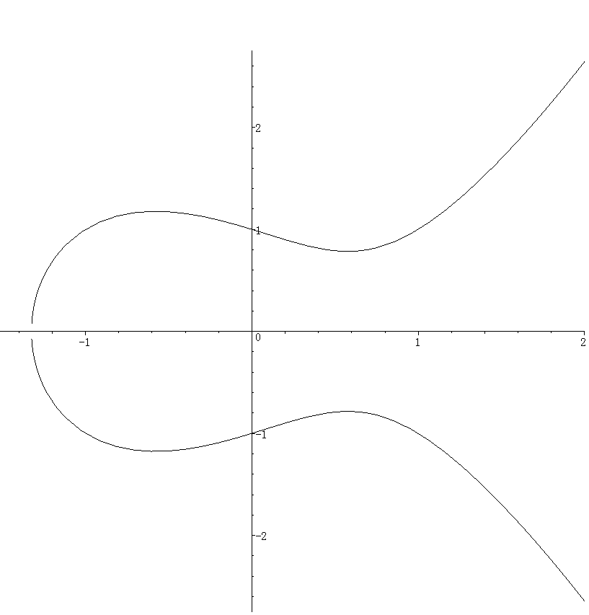















$$l_{2}$$
$$l_{4}$$
$$S_{1}=−(P+Q)$$
$$l_{6}$$
$$l_{5}$$
$$Q$$
$$P$$
$$O$$
$$l_{1}$$
$$R$$
$$S_{2}=P+Q$$
$$l_{3}$$
$$S_{3}=−\left(\left(P+Q\right)+R\right) \\ S_{6}=−(P+\left(Q+R\right))$$
$$S_{3}=−(Q+R)$$
$$S_{5}=Q+R$$

