Slide 1


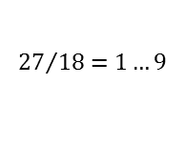

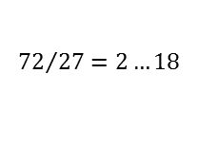



$$72$$
$${27}/{18=1…9}$$
$$9$$
$$9$$
$$27$$
$$18$$
$$27$$
$$27$$
$$18$$
$${72}/{27=2…18}$$

