Slide 1
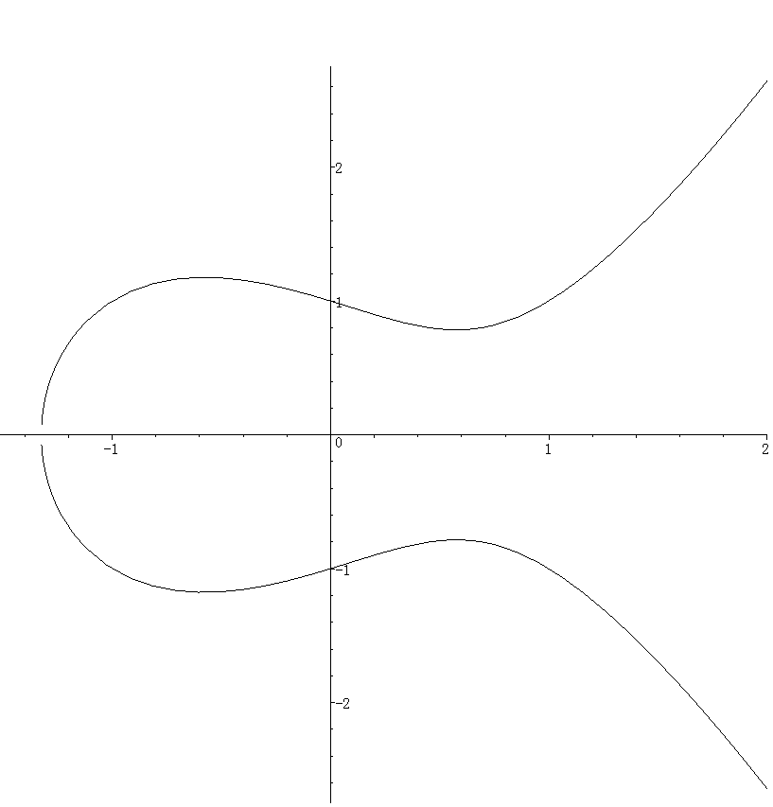






$$−(P+Q)$$
$$Q$$
$$v_{P+Q}$$
$$P$$
$$l_{P,Q}$$
$$P+Q$$

