Slide 1
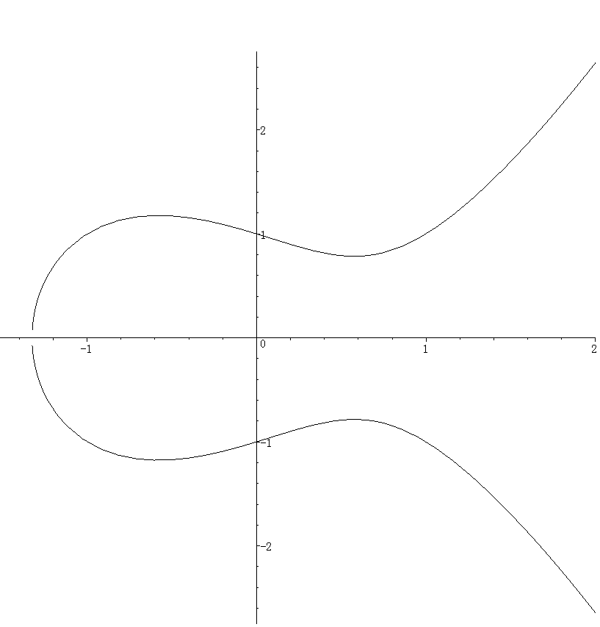

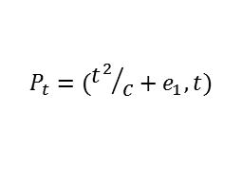

$P_{t}$が$P_{1}\left(e_{1},0\right)$に近づく
.
$$P_{t}=({t^{2}}/c+e_{1},t)$$
.
$$t$$

