Slide 1
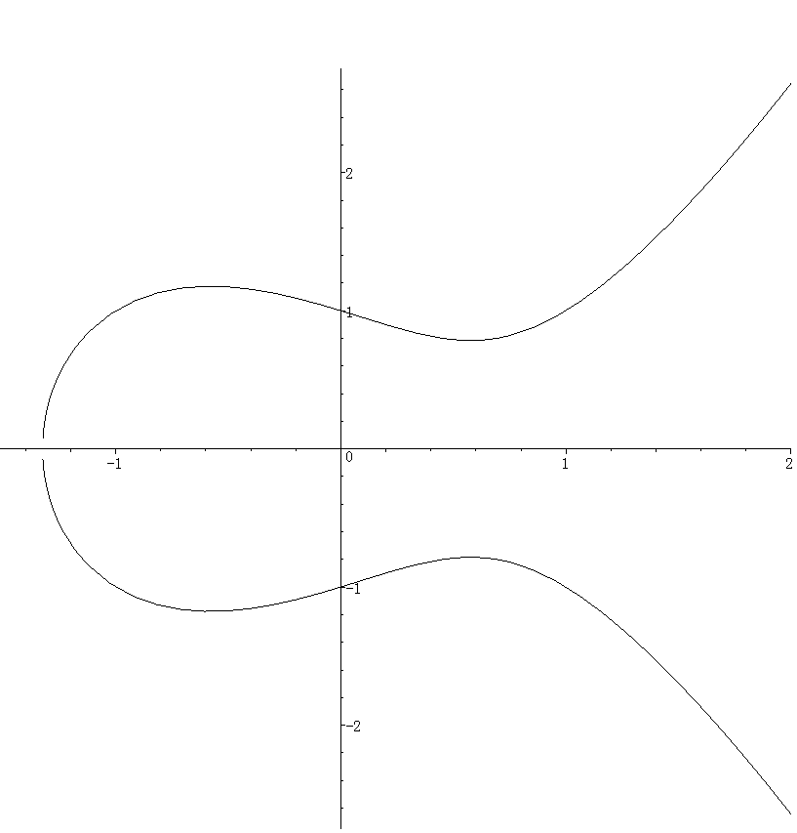



$P_{t}$が$P_{1}\left(e_{1},0\right)$に近づく
.
$$P_{t}=(\frac{t^{2}}{c}+e_{1},t)$$
.
$$t$$

