Slide 1
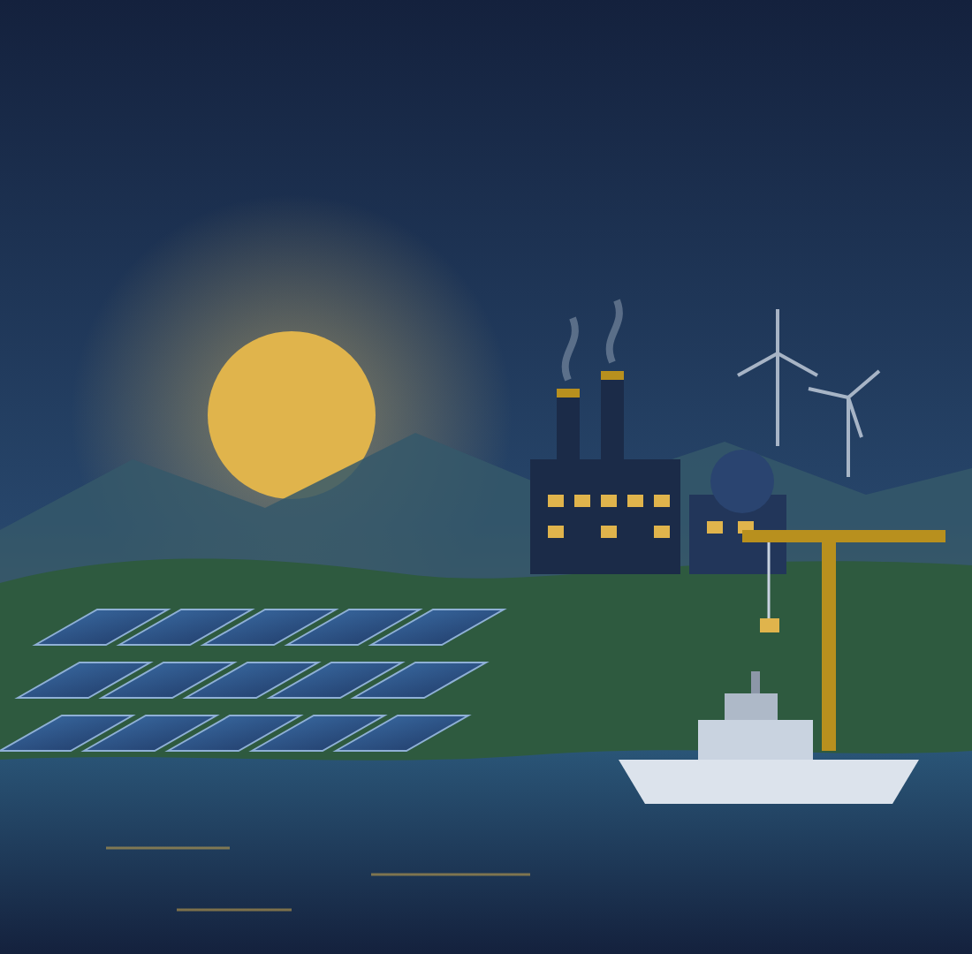
RESOURCE GOVERNANCE · INTEGRATED BRIEFING
Stabilise, Save, Invest and Grow
Indonesia's resource wealth, Danantara's pipeline and the road to 8% growth
Stabilise
Save
Invest
Grow
What we have, how we deal with current conditions, how we prepare the future, how we make it sustainable, and how we reach high growth
Briefing · 16 October 2026 · October 2026 data update · Draft
RESTRICTED · contains data from the DDMF RKAP 2026 (Private & Confidential)
Notes:
This briefing summarises the integrated paper. It follows five steps: what Indonesia has, how to deal with current conditions by stabilising, how to prepare the future by saving, how to make it sustainable by investing part of the savings through DDMF, and how to reach high growth towards 8% through careful design, execution, monitoring and risk mitigation. It contains confidential DDMF data; restrict circulation.
SOURCES FOR THIS SLIDE
1. Uploaded file: RKAP_2026_DDMF_pptver.pdf — DDMF (Danantara Development Mandate Fund), Rencana Kerja dan Anggaran Perusahaan (RKAP) 2026, presentation version, marked Private & Confidential
2. Policy Paper 1 — Stabilise and Save: Managing Indonesia's Natural-Resource Wealth (Resource Revenue Governance Series, Sept 2026, EN/ID docx): framework, export analysis and two-window fund
3. Policy Note 2 — Stabilise, Save and Invest (29 Sept 2026, EN/ID docx): full text, tables and figures summarised in this deck
4. Cover illustration: original artwork drawn by the author for this series
5. Integrated Paper — Stabilise, Save, Invest and Grow (8 Oct 2026, EN/ID docx): full text, tables and figures summarised in this briefing
Page numbers refer to the page numbers printed on the RKAP DDMF 2026 slides. The RKAP is confidential: restrict circulation of this deck accordingly.

Slide 2
AGENDA
RESTRICTED
Five steps from resource wealth to high growth
1
What we have
4
Making it sustainable: invest
Resource wealth; the Rp 5,396 T pipeline in Industry, Technology and Finance
Gate, defence, funding from resources, effects, jobs, screening
2
Current conditions: stabilise
5
Reaching high growth
Precedents, the 2026 windfall, import substitution, one fund
The 8% bridge, three scenarios, roadmap, dashboard, risks
3
Preparing the future: save
Appendix
Saving at home, three windows and their rules
Projects by cluster, points to clarify and references
2
Notes:
The briefing follows the flow of the integrated paper: what we have, current conditions, the future, sustainability, and high growth.
SOURCES FOR THIS SLIDE
1. Policy Note 2 — Stabilise, Save and Invest (29 Sept 2026, EN/ID docx): structure of Sections 1–7 and appendix

Slide 3
KEY MESSAGES
RESTRICTED
Spend from savings where it multiplies, and aim it at growth
Rp 5,396 T
54% · 74%
+2.2% GDP
pipeline after the October 2026 update: Industry 91%, Technology 9%; defence 39% and the Giant Sea Wall 22%
of the 2027–34 need funded by natural resources, and anchored on them with partners (save 40%, 80% to development)
at the 2031 peak, +0.9% for good; about +0.6 pp growth a year in 2027–30; US$124 bn of imports, 58% for defence
4.0 m jobs
6.9%
ICOR 4.3
at the 2029 peak (25.5 m job-years); open unemployment 4.7% → about 3.7% in 2028–30
growth in 2029 with all resource levers, the updated pipeline and better efficiency; gap to 8% about 1.1 pp
needed for 8%: investment (32.5% of GDP) is no longer the constraint, efficiency is
Figures from DDMF RKAP 2026, the October 2026 update and the author's illustrative models (Parts 4 and 5). Rp T = Rp trillion.
3
Notes:
Six numbers carry the argument. With the October 2026 figures the pipeline is 5,396 trillion rupiah, dominated by defence and the Giant Sea Wall. Natural resources can fund about half of it under a maximised, time-limited rule. At its peak it supports about 4 million jobs and lifts GDP by 2.2 percent. Growth reaches about 6.9 percent; 8 percent needs an ICOR of about 4.3, so efficiency, not money, is now the binding constraint.
SOURCES FOR THIS SLIDE
1. Priority list revised on 2 Oct 2026 at the user's request: shipyard & ship components (investment Rp5.24 T, equity Rp1.10 T) and alutsista (Rp16.12 T, Rp3.39 T) added to the RKAP's 13 priority projects, from RKAP p. 111, giving 15 projects: investment Rp799.0 T, equity Rp147.7 T
2. Author's calculation: maritime & defence projects (EV Power Pack, shipyard & ship components, Athens, alutsista) = investment Rp191.6 T, DDMF equity Rp20.2 T (≈9.5× leverage); sovereignty tier (shipyard, alutsista, Athens equity) Rp19.5 T ≈ 7% of the Rp270 T development window 2027–32; Athens availability payment ≈ Rp15.8 T/yr = illustrative 20-year annuity at 7% on Rp167.2 T, ≈8% of the Rp187.1 T Kemhan 2026 budget
3. RKAP DDMF 2026 (uploaded file), p. 10: 40 projects, total investment Rp2,091.5 T, DDMF equity Rp419.1 T, 2027–2032
4. RKAP DDMF 2026 (uploaded file), p. 15: additional paid-in capital Rp10 T (initial capital Rp0.1 T)
5. Kementerian Keuangan, Media Keuangan (2025), 'PNBP 2024 terealisasi 117% dari target APBN': natural-resource PNBP 2024 Rp229.2 T (oil & gas 110.9; non-oil & gas 118.3); 2023 Rp254.2 T (116.2; 138.0) (https://mediakeuangan.kemenkeu.go.id/article/show/pnbp-2024-terealisasi-117-dari-target-apbn)
6. DDTC News (Sept 2026), 'Setoran PNBP tembus Rp435,1 triliun, sudah 94,8% dari target APBN 2026', citing the Ministry of Finance: Jan–Aug 2026 PNBP Rp435.1 T (+41.7%); natural-resource PNBP Rp194.6 T (oil & gas 80.1; non-oil & gas 114.4) (https://news.ddtc.co.id/berita/nasional/1822596/setoran-pnbp-tembus-rp4351-triliun-sudah-948-dari-target-apbn-2026)
7. Author's classification of the 35 costed RKAP projects into six groups by link to resource wealth (resource conversion; energy transition & FX; non-resource industry; digital & frontier tech; public goods; defence PPP). CPE is not described in the RKAP and is assumed to be petrochemical
8. Author's calculation of leverage from the RKAP financing assumption (p. 10): DDMF share of capex = 30% equity × 70% held = 21%, so Rp 1 of DDMF equity ≈ Rp 4.76 of total investment
9. Author's illustrative model (Python), documented in Policy Note 2, Section 4: resource PNBP Rp250 T/yr in constant 2026 prices, −2%/yr after 2030; future window 4% real return, 3% annual budget draw; development equity 4.5% real cash yield from year 5, exited evenly over years 10–15; aggressive case 30% contribution, 60/30/0 split, loan ≤5% of future-window balance a year to 2034
10. Author's growth model (growth8.py, scen8.py): growth = investment ratio ÷ ICOR, calibrated to 2025 (PMTB 28.77% of GDP, growth 5.11%, implied ICOR 5.63); natural-resource levers and scenario parameters as documented in Appendix E of the integrated paper
11. Integrated Paper — Stabilise, Save, Invest and Grow (8 Oct 2026, EN/ID docx): Chapters 11–12
12. Author's employment model (jobs.py, workbook DDMF_Employment_Model): 35 costed projects in seven work types; construction job-years per Rp 1 T from ERIA (2023) PSN input-output results rebased to 2025 prices (×1.30); induced jobs +35%; permanent jobs per project anchored on IMIP (≈129 per Rp 1 T) and Danantara downstream projects (≈168); 40% of extra jobs assumed to reduce open unemployment
Page numbers refer to the page numbers printed on the RKAP DDMF 2026 slides. The RKAP is confidential: restrict circulation of this deck accordingly.

Slide 4
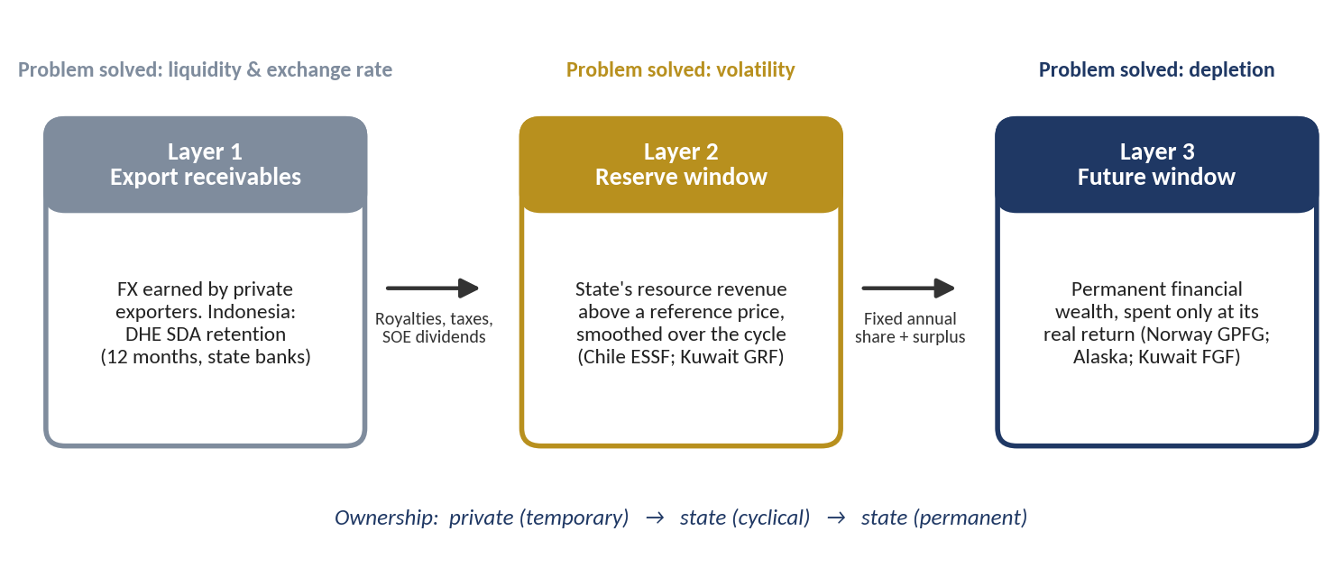
PART 1 · RESOURCE WEALTH
RESTRICTED
Resource wealth is large, volatile and depleting
US$122 bn
8.4%
8 phases
r = 0.63
resource exports in 2025 (record US$150 bn in 2022)
of GDP in 2025
of boom and bust in 25 years
with dollar GDP; 0.17 with real growth
Source: Policy Paper 1 (Stabilise and Save), export analysis 2000–2025.
4
Notes:
Policy Paper 1 showed that resource exports are large and unstable and that the cycle moves the rupiah and revenue more than real growth. It proposed three layers of policy. Indonesia has only the first, DHE SDA.
SOURCES FOR THIS SLIDE
1. Policy Paper 1 — Stabilise and Save: Managing Indonesia's Natural-Resource Wealth (Resource Revenue Governance Series, Sept 2026, EN/ID docx): Chapter 1 statistics (2025 exports US$122 bn, 8.4% of GDP; eight phases, Table 2; correlation r = 0.63 with dollar GDP growth and 0.17 with real growth, Figure 4) and Figure 6 (three layers)
2. UN Comtrade Database, Indonesia as reporter, exports by HS 4-digit heading, 2000–2025 (https://comtradeplus.un.org)
3. CEPII BACI, HS92 version, for 2001–03, 2005–09 and 2011–13, scaled to Comtrade levels (https://www.cepii.fr/CEPII/en/bdd_modele/bdd_modele_item.asp?id=37 (accessed via https://oec.world))
4. World Bank, World Development Indicators: GDP (current US$), GDP growth (annual %), Indonesia (https://databank.worldbank.org/source/world-development-indicators)
5. Coordinating Ministry for Economic Affairs (2025), socialisation of PP 8/2025 on DHE SDA; Ministry of Finance press release SP-39/KLI/2026 on PP 21/2026

Slide 5
PART 1 · OCTOBER 2026 UPDATE
RESTRICTED
Six programmes updated: the pipeline grows to Rp 5,396 T
Programme | RKAP 2026 (Rp T) | Updated (Rp T) | Timeline assumed
Giant Sea Wall | 97.0 | 1,200 | 2027–2040
Defence modernisation ‡ (replaces Athens + alutsista) | 183.4 | 2,125 | 2027–2034
National Data Centre | 4.1 | 50 | 2027–2031
Quantum technology | 0.5 | 20 | 2027–2031
Semiconductors | 7.1 | 15 | 2027–2030
AI and IT programme (replaces sovereign AI) | 13.8 | 200 | 2027–2032
Total of the six | 305.9 | 3,610
Rp 5,396 T
pipeline, from Rp 2,091 T in the RKAP (2.6×); equity ≈ Rp 1,133 T
39%
defence modernisation: Rp 2,125 T, ≈ Rp 266 T a year to 2034
22%
Giant Sea Wall: Rp 1,200 T, ≈ Rp 86 T a year to 2040
‡ New submarines, unmanned surface vessels (USV), fast attack craft, carrier Sriwijaya refurbishment, fighter squadrons and MRO. Timelines and 21% equity are assumptions.
Sources: DDMF RKAP 2026 p. 110–112; figures provided in October 2026; author's assumptions for timelines (integrated paper, Section 2.3).
5
Notes:
New figures for six programmes replace the RKAP values. The Giant Sea Wall rises from 97 trillion to 1,200 trillion rupiah. Defence modernisation, covering new submarines, unmanned surface vessels, fast attack craft, the refurbishment of the carrier Sriwijaya, fighter squadrons and MRO, replaces Athens and alutsista and totals 2,125 trillion. The National Data Centre is 50 trillion, quantum technology 20, semiconductors 15, and other AI and IT 200. The pipeline grows from 2,091 to 5,396 trillion rupiah; defence and the sea wall are now almost two-thirds of it.
SOURCES FOR THIS SLIDE
1. RKAP DDMF 2026 (uploaded file), p. 110–112: RKAP values replaced
2. Figures provided by the user in October 2026: Giant Sea Wall Rp 1,200 T; defence modernisation Rp 2,125 T (new submarines, USV, fast attack craft, carrier Sriwijaya refurbishment, fighter squadrons, MRO); National Data Centre Rp 50 T; quantum technology Rp 20 T; semiconductors Rp 15 T; other AI and IT Rp 200 T. Timelines and 21% equity are the author's assumptions.
3. Integrated paper (v3, 16 October 2026), Section 2.3 and Table 2.4
Page numbers refer to the page numbers printed on the RKAP DDMF 2026 slides. The RKAP is confidential: restrict circulation of this deck accordingly.

Slide 6
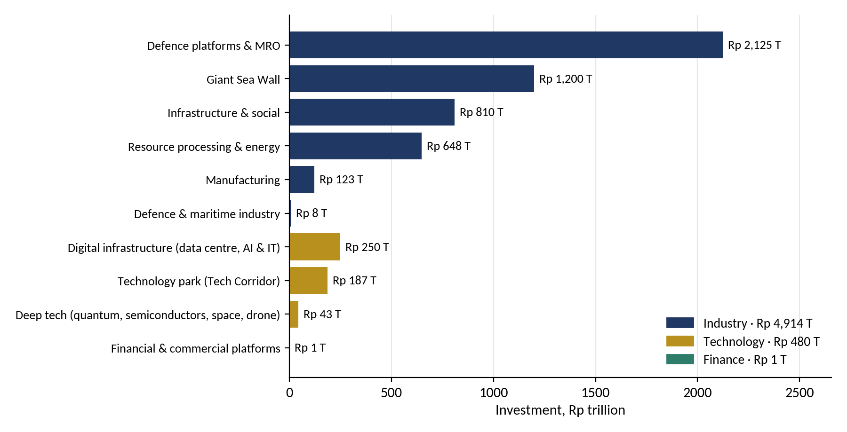
PART 1 · THREE CLUSTERS
RESTRICTED
Industry, Technology, Finance: what the pipeline builds
Industry
Rp 4,914 T · 91% · 26 projects
Resource processing & energy 648 · Infrastructure & social 810 · Giant Sea Wall 1,200 · Defence platforms & MRO 2,125 · Defence industry 8 · Manufacturing 123
Technology
Rp 480 T · 9% · 7 projects + IMX
AI and IT 200 · Data Centre 50 · Tech Corridor 187 · Quantum 20 · Semiconductors 15 · Space and drone 8
Finance
Rp 1 T + the fund
B2G/B2B MSME platform; ERP Merah Putih (uncosted); the resource fund and its funding instruments (Part 4)
Why re-cluster: with the new figures, defence alone would be larger than the rest of the old clusters, and AI and data centres do not belong with roads and schools. Segments keep the economic differences the model needs.
Source: author's classification of the RKAP DDMF 2026 list and the October 2026 update (integrated paper, Section 2.4 and Appendix A).
6
Notes:
All projects are re-clustered by what they build. Industry, 4,914 trillion rupiah or 91 percent, is physical capacity: resource processing and energy, infrastructure, the sea wall, defence and manufacturing. Technology, 480 trillion, covers digital infrastructure, deep tech and the Tech Corridor; IMX is placed here with its purpose to be confirmed. Finance is small in capital spending, 1 trillion for a B2G and B2B platform plus ERP Merah Putih, but holds the fund and the instruments that pay for the other two.
SOURCES FOR THIS SLIDE
1. RKAP DDMF 2026 (uploaded file), p. 110–112: project list
2. Figures provided by the user in October 2026: Giant Sea Wall Rp 1,200 T; defence modernisation Rp 2,125 T (new submarines, USV, fast attack craft, carrier Sriwijaya refurbishment, fighter squadrons, MRO); National Data Centre Rp 50 T; quantum technology Rp 20 T; semiconductors Rp 15 T; other AI and IT Rp 200 T. Timelines and 21% equity are the author's assumptions.
3. Integrated paper (v3, 16 October 2026), Section 2.4, Table 2.5–2.6, Figure 2.2 and Appendix A
Page numbers refer to the page numbers printed on the RKAP DDMF 2026 slides. The RKAP is confidential: restrict circulation of this deck accordingly.

Slide 7
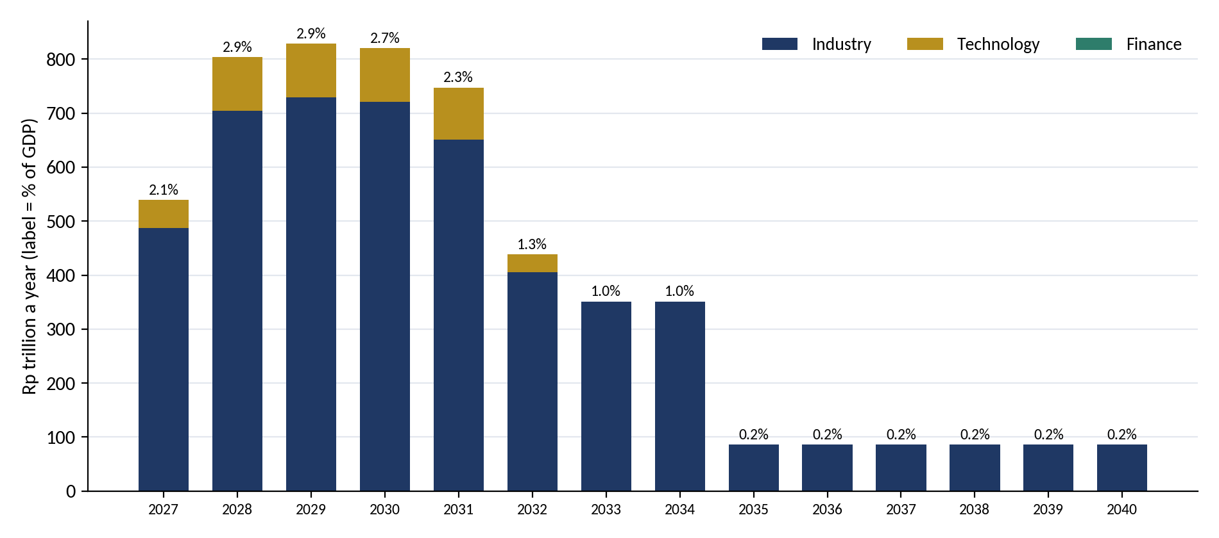
PART 1 · TIMING
RESTRICTED
Investment nears 3% of GDP in 2028–2030, then falls in three steps
≈ Rp 820 T
a year in 2028–30, 2.7–2.9% of GDP (RKAP peak 1.7%)
2032 · 2035
step-downs: RKAP projects end (→ Rp 438 T), defence ends (→ Rp 86 T)
to 2040
the sea wall alone, ≈ Rp 86 T a year
Reading: the October timelines spread spending further than the RKAP (2027–2032), which softens the 2032 drop but does not remove it; the sea wall keeps a floor of activity to 2040.
Source: author's calculation; GDP from BPS 2025 projected at 5% a year (integrated paper, Figure 2.3).
7
Notes:
Spreading each project evenly over its timeline, investment rises from about 540 trillion rupiah in 2027 to about 820 trillion a year in 2028 to 2030, close to 3 percent of GDP, almost twice the RKAP peak. It falls in three steps: in 2032 when the RKAP projects end, in 2035 when the defence programme ends, and in 2041 when the sea wall is finished. Each step is a drag on growth and jobs, so a successor pipeline is needed from 2030.
SOURCES FOR THIS SLIDE
1. Author's cluster model v3 (clusters_v3.py): ten segments in three clusters; IMF (2026) multipliers 0.5→1.2 scaled by domestic content ÷ 0.70; capacity effect = productive share × cumulative capital ÷ ICOR 6.5; larger of the two each year.
2. BPS (2025): GDP 2025 Rp23,821.1 T; employed persons 146.54 m (Sakernas Aug 2025); tax ratio and ICOR from MoF/Bappenas publications as cited in the integrated paper
3. Integrated paper (v3, 16 October 2026), Figure 2.3

Slide 8
PART 2 · TIMING
RESTRICTED
A windfall is under way in 2026: capture it now
Rp 435.1 T
total PNBP, Jan–Aug 2026: +41.7% year on year, already 94.8% of the full-year target
Rp 194.6 T
natural-resource PNBP in eight months, vs Rp 229.2 T in all of 2024
Recommendation
Park the excess over the budget assumption in a transitional account that becomes the fund's opening capital, and seed the development window in 2027.
Sources: Media Keuangan (2025) for 2023–2024; DDTC News (2026) citing the Ministry of Finance for Jan–Aug 2026.
8
Notes:
Resource non-tax revenue was 254 trillion rupiah in 2023 and 229 trillion in 2024. In the first eight months of 2026 alone it reached 195 trillion, and total PNBP was up 41.7 percent year on year. This is exactly the windfall the reserve window is designed to capture. Without a fund it will be spent as it arrives.
SOURCES FOR THIS SLIDE
1. Kementerian Keuangan, Media Keuangan (2025), 'PNBP 2024 terealisasi 117% dari target APBN': natural-resource PNBP 2024 Rp229.2 T (oil & gas 110.9; non-oil & gas 118.3); 2023 Rp254.2 T (116.2; 138.0) (https://mediakeuangan.kemenkeu.go.id/article/show/pnbp-2024-terealisasi-117-dari-target-apbn)
2. DDTC News (Sept 2026), 'Setoran PNBP tembus Rp435,1 triliun, sudah 94,8% dari target APBN 2026', citing the Ministry of Finance: Jan–Aug 2026 PNBP Rp435.1 T (+41.7%); natural-resource PNBP Rp194.6 T (oil & gas 80.1; non-oil & gas 114.4) (https://news.ddtc.co.id/berita/nasional/1822596/setoran-pnbp-tembus-rp4351-triliun-sudah-948-dari-target-apbn-2026)
3. Policy Note 2 — Stabilise, Save and Invest (29 Sept 2026, EN/ID docx): Section 2.4

Slide 9
PART 2 · STRUCTURAL STABILISATION
RESTRICTED
Import substitution steadies the rupiah, with a catch
The benefit: CDME as an example
The catch: correlated risk
US$0.9 bn
US$4.5 bn
Coal or nickel price falls
LPG imports saved a year at 20% substitution
a year at full substitution
State resource revenue falls; reserve window pays out
US$2.88 bn
≈ 3 years
Resource-conversion projects earn less; dividends fall
capex for 1.4 MTPA
for FX savings to equal capex at 20% substitution
Fund, budget and projects weaken at the same time
Refinery, biodiesel and ship components work the same way: each dollar of imports replaced makes the rupiah less dependent on export prices.
Answer: a 35% cap per commodity chain and a share of assets with contracted, price-independent returns (e.g. solar PPAs, labour-intensive manufacturing).
Source: DDMF RKAP 2026, CDME project overview; author's calculation (capex ÷ annual FX saving).
9
Notes:
Projects that replace imports reduce the current account's dependence on commodity prices. CDME alone would save about 0.9 billion dollars a year at 20 percent LPG substitution. But these projects earn revenue that moves with the same commodity prices as state revenue, so a portfolio of only resource-conversion assets would concentrate risk. Caps by commodity and uncorrelated assets such as contracted solar power are the answer.
SOURCES FOR THIS SLIDE
1. RKAP DDMF 2026 (uploaded file), p. 119: project overview — CDME: LPG import saving ≈US$0.9 bn/yr at 20% substitution, up to ≈US$4.5 bn/yr at 100%; capex ≈US$2.88 bn for 1.4 MTPA; risk that DME is less competitive than LPG
2. RKAP DDMF 2026 (uploaded file), p. 124: project overview — EV Power Pack: substitution of imported vessels and components
3. Author's calculation: US$2.88 bn ÷ US$0.9 bn per year ≈ 3.2 years for FX savings to equal capex (not a financial payback)
4. Policy Note 2 — Stabilise, Save and Invest (29 Sept 2026, EN/ID docx): Section 2.3 (correlated-risk argument and 35% commodity cap)
Page numbers refer to the page numbers printed on the RKAP DDMF 2026 slides. The RKAP is confidential: restrict circulation of this deck accordingly.

Slide 10
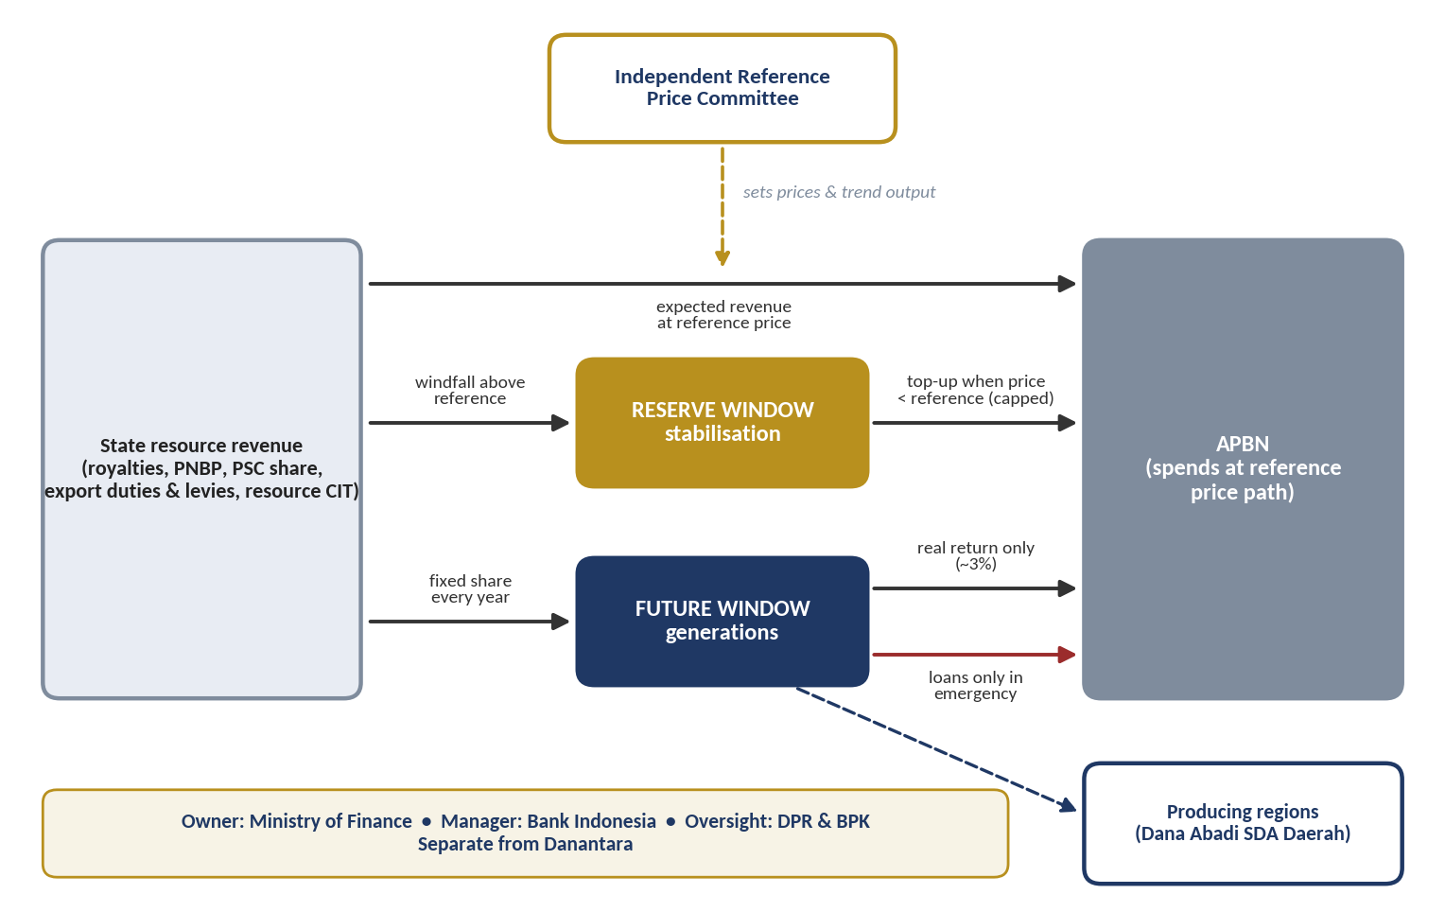
PART 2 · THE PROPOSAL
RESTRICTED
The proposal: one fund with two windows
Reserve window · stabilise
Saves revenue above an independent reference price; tops up the budget when prices fall. Liquid foreign assets.
Future window · save
Fixed share every year; releases only the real return (~3%). Borrowing only in emergencies.
The new question
If domestic returns are high, should part of the savings be invested at home, through DDMF, for larger multiplier effects?
Source: Policy Paper 1, Figure 10 and Table 9.
10
Notes:
The fund saves windfalls above an independent reference price in a reserve window, and a fixed share every year in a future window that spends only its real return. This note asks what happens if part of the long-term saving is invested at home instead.
SOURCES FOR THIS SLIDE
1. Policy Paper 1 — Stabilise and Save: Managing Indonesia's Natural-Resource Wealth (Resource Revenue Governance Series, Sept 2026, EN/ID docx): Figure 10 (fund architecture) and Table 9 (window rules)
2. Hacienda Chile (n.d.), Economic and Social Stabilization Fund; UNU-WIDER, Copper, the fiscal rule and stabilisation funds in Chile
3. Norwegian Ministry of Finance (2025). Meld. St. 1 (2025–2026), National Budget 2026; Norwegianpetroleum.no (2026), Management of revenues.
4. Alaska Permanent Fund Corporation (2025). 2025 Annual Report.
5. Kuwait Decree-Law No. 81 of 2026 on borrowing from the Future Generations Fund (loans ≤10% of FGF net assets); reported in AGBI (Sept 2026) and Times Kuwait (Sept 2026); IMF (2026) Kuwait Article IV, Country Report 26/052
6. Timor-Leste: EITI (2023) country profile; IMF (2025) Timor-Leste Article IV Consultation (withdrawals above the Estimated Sustainable Income in most years since 2009)

Slide 11
PART 3 · SAVING AT HOME OR ABROAD
RESTRICTED
Saving means converting rent into lasting assets
Foreign financial assets
Depleting natural capital
Norway, Alaska, Kuwait: best when the economy is already capital-rich
Future window
Coal, oil and gas, nickel, tin, copper
Domestic productive capital
rent
Capital-scarce economies: higher returns at home if invested well
Development window
Consumption
Spent as it arrives: the wealth is gone when the resource is
What happens today
Hartwick (1977)
Invest at home
≈ 30% lost
reinvest resource rent to keep total wealth constant
when capital is scarce (Collier et al., 2010; van der Ploeg & Venables, 2011)
average efficiency loss in public investment (IMF, 2015): rules matter
11
Notes:
The Hartwick rule says a country stays as wealthy as before only if it reinvests resource rent in other assets. Norway chose foreign financial assets because it was capital-rich. For capital-scarce economies, Collier and co-authors and van der Ploeg and Venables argue for investing more at home, parking money abroad only while investment capacity is built. Indonesia sits in between: large gaps but uneven investment efficiency.
SOURCES FOR THIS SLIDE
1. Policy Note 2 — Stabilise, Save and Invest (29 Sept 2026, EN/ID docx): Section 2.1
2. Hartwick, J. M. (1977). Intergenerational equity and the investing of rents from exhaustible resources. American Economic Review, 67(5), 972–974.
3. Collier, P., van der Ploeg, F., Spence, M. & Venables, A. J. (2010). Managing resource revenues in developing economies. IMF Staff Papers, 57(1), 84–118.
4. van der Ploeg, F. & Venables, A. J. (2011). Harnessing windfall revenues: optimal policies for resource-rich developing economies. The Economic Journal, 121(551), 1–30.
5. Berg, A., Portillo, R., Yang, S.-C. S. & Zanna, L.-F. (2013). Public investment in resource-abundant developing countries. IMF Economic Review, 61(1), 92–129.
6. Gelb, A., Tordo, S. & Halland, H. (2014). Sovereign wealth funds and long-term development finance: risks and opportunities. World Bank Policy Research Working Paper 6776.
7. IMF (2015), Making Public Investment More Efficient, IMF Staff Report (on average about 30% of potential gains from public investment are lost to inefficiency)
8. Norwegian Ministry of Finance (2025). Meld. St. 1 (2025–2026), National Budget 2026; Norwegianpetroleum.no (2026), Management of revenues.

Slide 12
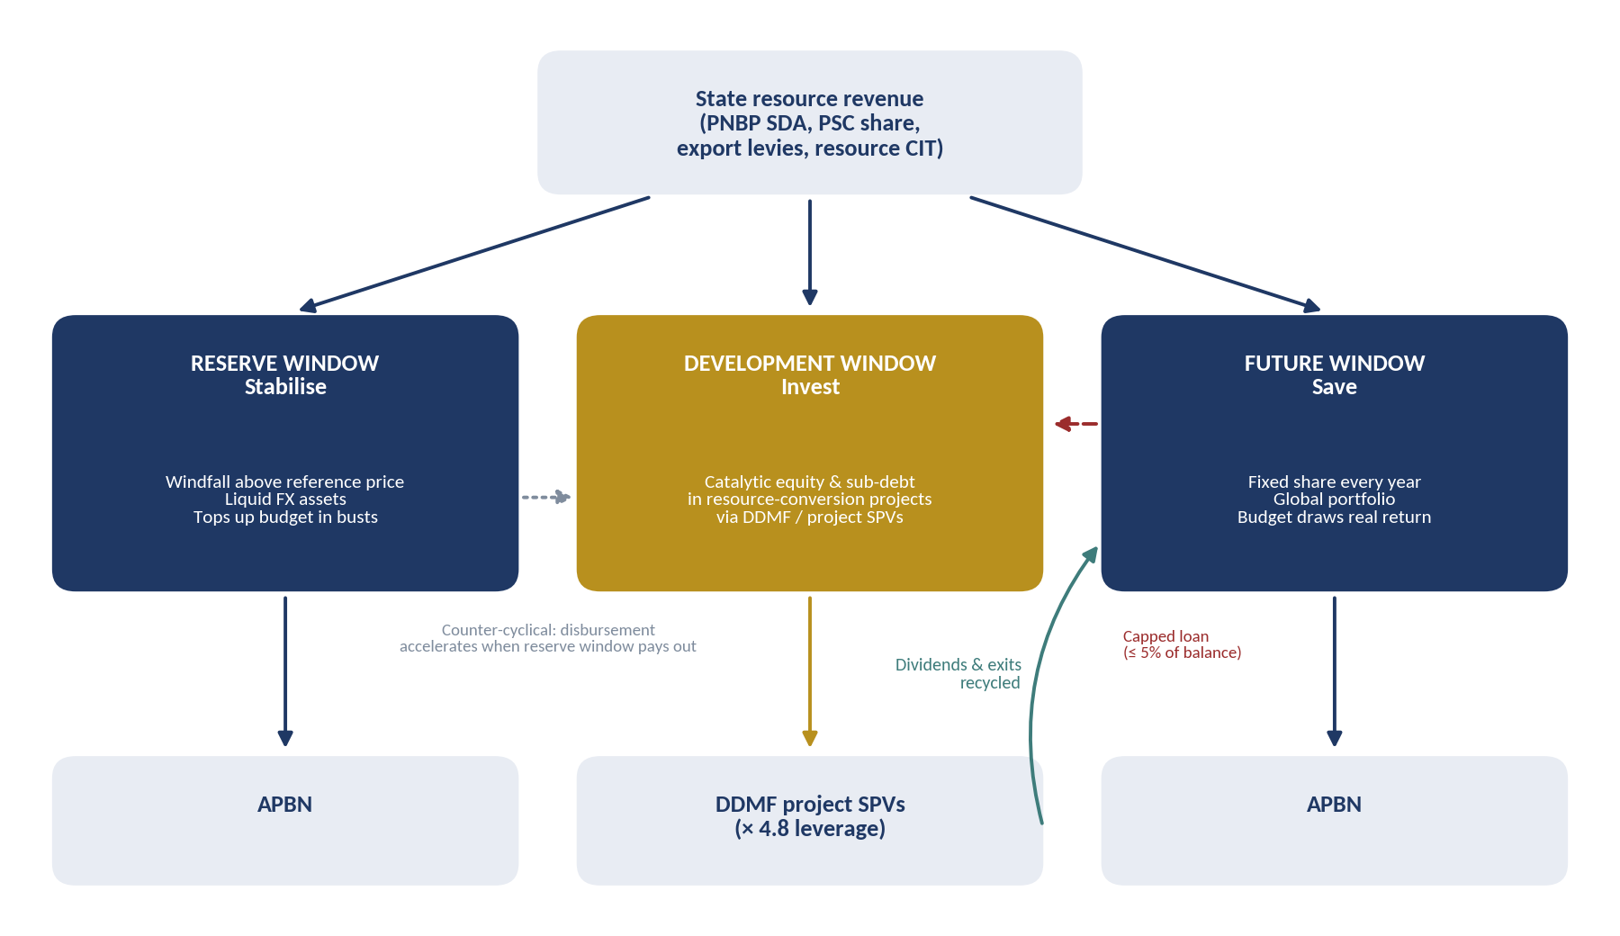
PART 3 · DESIGN
RESTRICTED
Three windows: stabilise, invest, save
Reserve window
Unchanged. Windfall above the reference price; tops up the budget in busts.
Development window
Early-years share of long-term savings + capped loan; catalytic equity via DDMF; counter-cyclical.
Future window
Fixed share every year; global portfolio; receives recycled dividends and exits.
Source: author's proposal, extending Figure 10 of Policy Paper 1.
12
Notes:
The reserve window is unchanged. The future window still saves a fixed share and releases only its real return. The new development window takes part of the long-term savings in the early years, may borrow a capped amount from the future window, and invests as catalytic equity or subordinated debt through DDMF. Dividends and exits flow back to the future window.
SOURCES FOR THIS SLIDE
1. Policy Note 2 — Stabilise, Save and Invest (29 Sept 2026, EN/ID docx): Figure 2 (three-window architecture), extending Figure 10 of Policy Paper 1
2. Kuwait Decree-Law No. 81 of 2026 on borrowing from the Future Generations Fund (loans ≤10% of FGF net assets); reported in AGBI (Sept 2026) and Times Kuwait (Sept 2026); IMF (2026) Kuwait Article IV, Country Report 26/052

Slide 13
PART 3 · RULES (1/2)
RESTRICTED
How much, from where, and for which projects
Element | Rule | Why
Inflow | Long-term savings raised from 25% to 30% of resource PNBP. Development window gets 60% of this flow in 2027–32, 30% in 2033–38, nothing after 2038 unless renewed by Law | Front-loads investment while domestic returns are highest; sunset keeps the future window as the long-run destination
Spending from savings | Borrow up to 5% of the future window's balance a year until 2034, total capped; repaid first from exits; no write-off without a Law | The 'spend from savings' element, bounded on Kuwait's 2026 model
Eligible projects | ≥ 70% resource conversion and energy transition; ≤ 30% other, of which the sovereignty tier ≤ 20%; public goods and social infrastructure excluded | A resource fund should convert resource wealth; social assets have no cash flow to recycle
Return floor | Expected portfolio return ≥ 10-year government bond yield in real terms (DDMF 'sovereign floor', score 1) | Keeps principal recyclable; below the floor the subsidy belongs in the APBN
Multiplier hurdle | Economic IRR ≥ 10% real, counting FX savings, taxes, jobs and TKDN, verified independently | Captures benefits a financial return misses
Crowding in | ≥ Rp 3.5 of other capital per Rp 1 of fund money (RKAP structure implies 3.8) | Makes the multiplier explicit and measurable
Percentages are reference points for discussion, not calibrated recommendations.
13
Notes:
The first six rules set the money and the tests. The saving rate rises to 30 percent, with a front-loaded development share that sunsets. The window may borrow a capped amount from the future window. Projects must convert resource wealth, clear a return floor and an economic-return hurdle, and crowd in at least 3.5 rupiah of other capital.
SOURCES FOR THIS SLIDE
1. Policy Note 2 — Stabilise, Save and Invest (29 Sept 2026, EN/ID docx): Table 3 (rules 1–6) and Table 3a (sovereignty tier)
2. Kuwait Decree-Law No. 81 of 2026 on borrowing from the Future Generations Fund (loans ≤10% of FGF net assets); reported in AGBI (Sept 2026) and Times Kuwait (Sept 2026); IMF (2026) Kuwait Article IV, Country Report 26/052
3. RKAP DDMF 2026 (uploaded file), p. 108: 'sovereign floor' score 1 used as the return floor
4. Author's calculation of leverage from the RKAP financing assumption (p. 10): DDMF share of capex = 30% equity × 70% held = 21%, so Rp 1 of DDMF equity ≈ Rp 4.76 of total investment
5. Rates and shares are the author's proposals for discussion, not calibrated values
Page numbers refer to the page numbers printed on the RKAP DDMF 2026 slides. The RKAP is confidential: restrict circulation of this deck accordingly.

Slide 14
PART 3 · RULES (2/2)
RESTRICTED
Caps, instruments, timing and governance
Element | Rule | Why
Concentration | ≤ 15% of the window in one project; ≤ 35% in one commodity chain | Limits correlated commodity risk
Instruments | Equity, subordinated debt, capped first-loss only; no guarantees or comfort letters | The RKAP flags contingent liabilities as a key risk
Disbursement | Stage-gated tranches at feasibility study, financial close and construction milestones | Money follows readiness, not announcements
Counter-cyclical timing | When the reserve window pays out, approved projects may draw up to 1.5× the annual allocation | Fiscal multipliers are larger in downturns (Auerbach & Gorodnichenko, 2012)
Governance | MoF owns the money; independent Development Window Investment Committee decides; DDMF executes under a mandate agreement; BPK audit; project-level reporting | Keeps the separation principle and adds a contractual channel
Percentages are reference points for discussion, not calibrated recommendations.
14
Notes:
The remaining rules control risk: concentration caps, no guarantees, stage-gated disbursement, counter-cyclical timing and governance that keeps the money with the Ministry of Finance while DDMF executes under a mandate.
SOURCES FOR THIS SLIDE
1. Policy Note 2 — Stabilise, Save and Invest (29 Sept 2026, EN/ID docx): Table 3 (rules 7–11)
2. RKAP DDMF 2026 (uploaded file), p. 22, 75: contingent-liability risk (guarantees, comfort letters, bailout pressure)
3. Auerbach, A. J. & Gorodnichenko, Y. (2012). Measuring the output responses to fiscal policy. American Economic Journal: Economic Policy, 4(2), 1–27.
4. IFSWF (2008). Generally Accepted Principles and Practices for Sovereign Wealth Funds (Santiago Principles).
Page numbers refer to the page numbers printed on the RKAP DDMF 2026 slides. The RKAP is confidential: restrict circulation of this deck accordingly.

Slide 15
PART 4 · PRECEDENTS
RESTRICTED
Others invest savings at home, and some got it wrong
Models to follow
Nigeria · NSIA (2011)
Ireland · ISIF (2014)
Malaysia · Khazanah Dana Impak
Three funds: stabilisation, future generations and a domestic infrastructure fund
A pension reserve (savings) fund redirected to domestic investment with a 'double bottom line': return plus economic impact
Ring-fenced impact capital; return floor = 10-year government bond yield (~3.5%)
Warnings to heed
Timor-Leste · Greater Sunrise (2019)
Malaysia · 1MDB
US$650 million from the Petroleum Fund for a concentrated domestic bet, outside the ESI discipline
A state investment vehicle that escaped oversight: the case for independent committees, audit and disclosure
Sources: NSIA Act 2011; ISIF (National Treasury Management Agency (Amendment) Act 2014); DDMF RKAP 2026; EITI; US Department of Justice (1MDB).
15
Notes:
Nigeria's NSIA runs stabilisation, future-generations and domestic infrastructure funds side by side. Ireland converted a pension reserve fund into a domestic strategic investment fund with a double bottom line. Khazanah Dana Impak ring-fences impact capital with a sovereign-yield floor. The warnings are Timor-Leste's concentrated Greater Sunrise purchase outside its withdrawal rule, and 1MDB's governance failure.
SOURCES FOR THIS SLIDE
1. Nigeria Sovereign Investment Authority (Establishment etc.) Act 2011: Stabilisation Fund, Future Generations Fund and Nigeria Infrastructure Fund
2. Ireland: National Treasury Management Agency (Amendment) Act 2014, establishing the Ireland Strategic Investment Fund from the National Pensions Reserve Fund ('double bottom line' mandate)
3. RKAP DDMF 2026 (uploaded file), p. 109: Khazanah Dana Impak: return floor = 10-year Malaysian Government Securities yield (≈3.5%)
4. Timor-Leste: 2019 purchase of the ConocoPhillips and Shell interests in Greater Sunrise (≈US$650 million) financed through the Petroleum Fund, per Government of Timor-Leste / Timor GAP announcements and IMF Article IV reports
5. 1MDB: US Department of Justice civil forfeiture actions relating to 1Malaysia Development Berhad (from 2016)
6. Gelb, A., Tordo, S. & Halland, H. (2014). Sovereign wealth funds and long-term development finance: risks and opportunities. World Bank Policy Research Working Paper 6776.
Page numbers refer to the page numbers printed on the RKAP DDMF 2026 slides. The RKAP is confidential: restrict circulation of this deck accordingly.

Slide 16
PART 4 · THE PROJECT GATE
RESTRICTED
Six tests every project must pass before any money moves
1
Resource or sovereignty link
2
Return floor
3
Multiplier
Converts resource wealth or replaces imports (≥ 70%), or builds the defence-industrial base (≤ 20%)
Real financial return ≥ 10-year SBN yield at portfolio level
Economic IRR ≥ 10% real, independently verified
4
Crowding in
5
Concentration
6
Measured impact
≥ Rp 3.5 of other capital for every Rp 1 from the fund
≤ 15% per project, ≤ 35% per commodity chain; no guarantees
Quantified baseline and targets for jobs, TKDN, FX and emissions
Test 6 responds to the RKAP 2026, where every development-impact KPI target is currently zero.
16
Notes:
In practice the rules become six tests at the investment committee. A project that fails any one is routed elsewhere: to the budget, to KPBU or to DDMF's own capital.
SOURCES FOR THIS SLIDE
1. Policy Note 2 — Stabilise, Save and Invest (29 Sept 2026, EN/ID docx): Table 3a (sovereignty tier, test 1)
2. Policy Note 2 — Stabilise, Save and Invest (29 Sept 2026, EN/ID docx): Table 3, restated as six tests
3. RKAP DDMF 2026 (uploaded file), p. 62–64: impact KPIs with zero 2026 targets (basis for test 6)
Page numbers refer to the page numbers printed on the RKAP DDMF 2026 slides. The RKAP is confidential: restrict circulation of this deck accordingly.

Slide 17
PART 4 · DEFENCE AND SOVEREIGNTY
RESTRICTED
Rp 2,125 T for defence: build at home, use resource dollars
Rp 2,125 T
≈ Rp 266 T / yr
Rules for the defence programme
Fund holds only the domestic industrial share (yards, components, MRO) within the 20% sovereignty tier; platforms, crews and operations stay on the APBN
Imported share financed by loans funded by retained resource export proceeds (DHE SDA), not foreign loans
Domestic-content target 60%: submarines and fast attack craft at domestic yards; MRO at home; offsets under Law 16/2012; KKIP endorsement
SME suppliers brought in through Develop–Off-taker–Certification–Upgrading programmes
Confirm additionality against the existing alutsista budget; phase deliveries to keep defence imports ≤ US$ 7 bn a year
Equity only, no guarantees; classified details to DPR Commission I and BPK in closed session
2027–34: submarines, USV, fast attack craft, carrier Sriwijaya refit, fighter squadrons, MRO
≈ 1% of GDP, vs Kemhan 2026 budget Rp 187 T (alutsista Rp 84.5 T)
US$ 72 bn
7.0 m
imported at 40% domestic content; US$ 48 bn at 60%
job-years; +1.7 m for every 10 points of domestic content
Sources: October 2026 figures; CNBC Indonesia (2026) and ASPI (2026) on the Kemhan budget; Law 16/2012; Triantama (2026); author's model (integrated paper, Sections 2.5, 7.3, 8.5, 10.3).
17
Notes:
Indonesia's resource wealth lies largely at sea, so protecting it is part of saving it. The defence modernisation programme of 2,125 trillion rupiah over 2027 to 2034, about 266 trillion a year, is larger than the whole 2026 defence budget of 187 trillion; whether it is additional is the first open point. At 40 percent domestic content about 72 billion dollars is imported. Today 55 percent of alutsista modernisation is funded by foreign loans. The proposal: the fund holds only the domestic industrial share within the 20 percent sovereignty tier, platforms stay on the budget, the imported share is financed with loans funded by retained resource export proceeds, and domestic content rises to 60 percent.
SOURCES FOR THIS SLIDE
1. Figures provided by the user in October 2026: Giant Sea Wall Rp 1,200 T; defence modernisation Rp 2,125 T (new submarines, USV, fast attack craft, carrier Sriwijaya refurbishment, fighter squadrons, MRO); National Data Centre Rp 50 T; quantum technology Rp 20 T; semiconductors Rp 15 T; other AI and IT Rp 200 T. Timelines and 21% equity are the author's assumptions.
2. CNBC Indonesia (30 Jan 2026), 'Kementerian Pertahanan dapat Rp187 triliun, berapa buat alutsista?': Kemhan 2026 budget Rp187.1 T; alutsista modernisation Rp84.48 T (45.1%), funded by foreign loans Rp46.5 T, domestic rupiah Rp33.44 T, domestic loans Rp3.69 T, SBSN Rp0.8 T, PNBP Rp0.06 T (https://www.cnbcindonesia.com/research/20260130133929-128-706742/kementerian-pertahanan-dapat-rp187-triliun-berapa-buat-alutsista); Tempo (2026), 'Anggaran Kemhan 2026 sebesar Rp187,1 triliun'
3. ASPI (2026). More money, same problems: how Indonesia can make the most of its defence budget. The Strategist.
4. Law No. 16 of 2012 on the Defence Industry (local content and offset obligations; role of the Defence Industry Policy Committee, KKIP)
5. Triantama, F. (2026). A milestone, not a finish line: Indonesia's defence industry in SIPRI's Top 100. Australian Outlook, AIIA, 22 January.
6. Author's cluster model v3 (clusters_v3.py): ten segments in three clusters; IMF (2026) multipliers 0.5→1.2 scaled by domestic content ÷ 0.70; capacity effect = productive share × cumulative capital ÷ ICOR 6.5; larger of the two each year.
7. Integrated paper (v3, 16 October 2026), Sections 2.5, 7.3, 8.5 and 10.3

Slide 18
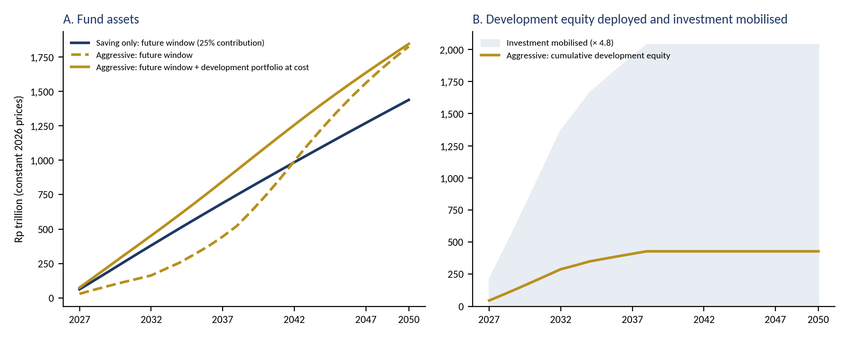
PART 4 · ILLUSTRATIVE SIMULATION
RESTRICTED
Saving only versus aggressive, 2027–2050
Assumptions
Resource PNBP Rp 250 T a year, falling 2% a year after 2030
Future window earns 4% real; 3% of balance to the budget each year
Development equity yields 4.5% real from year 5; exited over years 10–15
Constant 2026 prices; taxes and GDP effects excluded
Reading: the aggressive path gives up about Rp 36 T of budget draws to 2035, deploys Rp 428 T of equity and mobilises about Rp 2,039 T of investment; total fund assets in 2050 are higher (Rp 1,845 T against Rp 1,438 T).
Source: author's illustrative model. Parameters are assumptions to show trade-offs, not forecasts.
18
Notes:
The simulation compares a saving-only fund with the aggressive design. The future window's balance dips in the early years because money goes to projects, but total assets, including the development portfolio at cost, stay above the saving-only path as equity is recycled. Panel B shows the equity deployed and the investment mobilised.
SOURCES FOR THIS SLIDE
1. Policy Note 2 — Stabilise, Save and Invest (29 Sept 2026, EN/ID docx): Figure 4 and Section 4.2
2. Author's illustrative model (Python), documented in Policy Note 2, Section 4: resource PNBP Rp250 T/yr in constant 2026 prices, −2%/yr after 2030; future window 4% real return, 3% annual budget draw; development equity 4.5% real cash yield from year 5, exited evenly over years 10–15; aggressive case 30% contribution, 60/30/0 split, loan ≤5% of future-window balance a year to 2034
3. Norwegian Ministry of Finance (2025). Meld. St. 1 (2025–2026), National Budget 2026; Norwegianpetroleum.no (2026), Management of revenues.

Slide 19
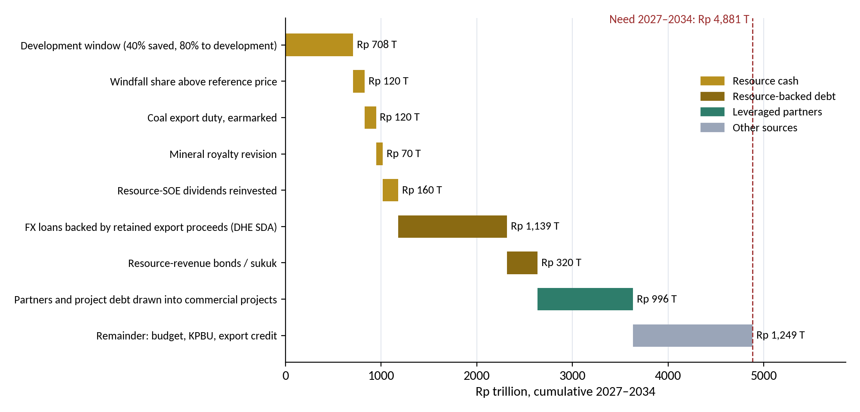
PART 4 · FUNDING
RESTRICTED
Natural resources can fund about half of the pipeline
54%
funded by natural resources: Rp 1,178 T cash + Rp 1,459 T resource-backed debt
74%
resource-anchored, with partners drawn into commercial projects (Rp 996 T)
26%
remainder from APBN, KPBU and export credit (Rp 1,249 T)
Basis: resource PNBP Rp 283.4 T in the RAPBN 2027; coal duty simulations Rp 11.7–19 T a year; SOE dividends Rp 142.3 T in 2025; DHE SDA retained US$ 22.9 bn in Mar–Apr 2025. All flows illustrative and to be confirmed with MoF, BI and Danantara.
Source: author's funding model (integrated paper, Section 10.3, Figure 10.3 and Table 10.2).
19
Notes:
The pipeline needs about 4,881 trillion rupiah in 2027 to 2034. Under a maximised, time-limited rule, saving 40 percent of resource revenue and directing 80 percent of it to development, natural resources provide about 1,178 trillion of cash: the development window 708, windfall 120, coal export duty 120, royalty revision 70 and resource-SOE dividends 160. Resource-backed debt adds 1,459 trillion: loans funded by retained export proceeds of 8 billion dollars a year, and resource-revenue bonds. That is 54 percent of the need. Partners drawn into commercial projects take the resource-anchored share to 74 percent; about a quarter remains for the budget, KPBU and export credit.
SOURCES FOR THIS SLIDE
1. Author's funding model (funding_v3.py): RAPBN 2027 resource PNBP Rp 283.4 T (oil and gas 129.9, non-oil-and-gas 153.5); coal export duty simulation Rp 11.7–19 T a year (Kontan); SOE dividends Rp 142.3 T in 2025; DHE SDA retained US$22.9 bn in March–April 2025; royalty increase postponed May 2026.
2. Integrated paper (v3, 16 October 2026), Section 10.3, Figure 10.3 and Table 10.2

Slide 20
PART 4 · FUNDING RULES
RESTRICTED
Commercial equity first, public goods next, defence last
 | Current rule | Maximised rule
Save / to development | 30% / 60% | 40% / 80%
Development window 2027–34 (Rp T) | 398 | 708
Resource cash (Rp T) | 868 | 1,178
Resource money incl. backed debt | 2,327 (48%) | 2,637 (54%)
Resource-anchored with partners | 68% | 74%
Budget gives up a year (Rp T) | 83 | 111
Future window share of PNBP | 12% | 8%
1 · Commercial equity
Rp 265 T
21% equity in resource processing, manufacturing, defence industry and technology; recycled on exit
2 · Public goods
Rp 449 T
30% of infrastructure and sea-wall cost; the rest from resource-revenue bonds, KPBU and APBN
3 · Defence domestic share
Rp 464 T
≤ Rp 142 T from the window (20% tier); rest from earmarked windfall, coal duty and royalty via the defence budget
Safeguards: maximised rule for 2027–2034 only, then back to 30% and 60/30; same caps, gate and sunset as the development window; resource-backed debt serviced from future PNBP or project cash, with a published debt ceiling.
Source: author's funding model (integrated paper, Section 10.3).
20
Notes:
Resource cash is used in order of priority. First the 21 percent equity in commercial projects, about 265 trillion rupiah, which is recycled. Next 30 percent of the cost of public goods, about 449 trillion, for infrastructure and the sea wall. Last the domestic share of defence, about 464 trillion, of which at most about 142 trillion can come from the development window under the sovereignty-tier cap. The maximised rule costs the budget about 111 trillion a year instead of 83, and slows saving for future generations until 2034, so it should be time-limited and written into the Law.
SOURCES FOR THIS SLIDE
1. Author's funding model (funding_v3.py): RAPBN 2027 resource PNBP Rp 283.4 T (oil and gas 129.9, non-oil-and-gas 153.5); coal export duty simulation Rp 11.7–19 T a year (Kontan); SOE dividends Rp 142.3 T in 2025; DHE SDA retained US$22.9 bn in March–April 2025; royalty increase postponed May 2026.
2. Integrated paper (v3, 16 October 2026), Section 10.3

Slide 21
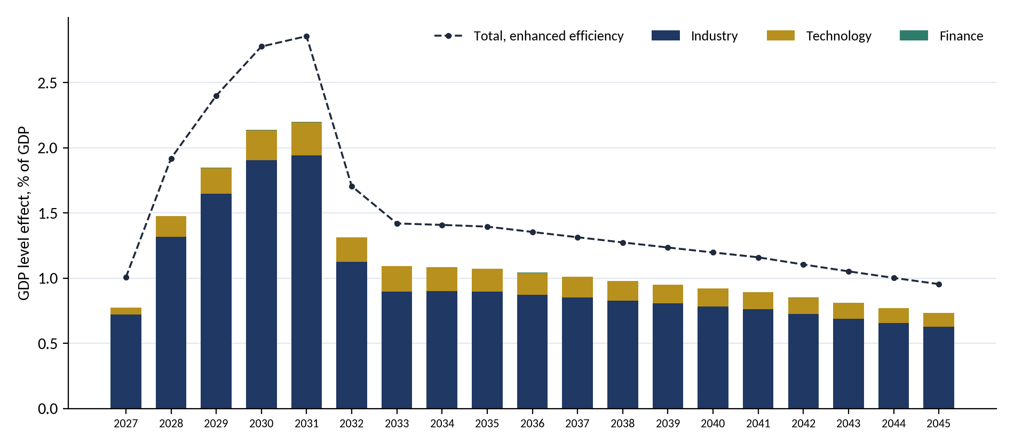
PART 4 · ECONOMIC EFFECTS
RESTRICTED
The pipeline lifts GDP by about 2.2% at its peak and 0.9% for good
+2.2%
GDP at the 2031 peak (2.9% with IMF-level efficiency)
+0.61 pp
growth a year on average in 2027–30 (+0.46 in 2029)
+0.9%
GDP for good: Rp 464 T a year
 | Industry | Technology | Total
Investment (Rp T) | 4,914 | 480 | 5,396
Peak GDP effect (%) | 1.94 | 0.25 | 2.20
Permanent (Rp T a year) | 396 | 68 | 464
Imports (US$ bn) | 110.9 | 13.2 | 124.1
−0.82 pp
growth in 2032 as RKAP projects end
Source: author's cluster model (integrated paper, Chapter 8 and Appendix B); IMF (2026) public-investment multipliers for Indonesia. Illustrative.
21
Notes:
Using IMF multipliers for Indonesia scaled by domestic content, and an ICOR of 6.5 for the lasting capacity effect, the updated pipeline raises GDP by about 2.2 percent at its 2031 peak, or 2.9 percent with better efficiency, and by about 0.9 percent permanently. It adds about 0.8 points to growth in 2027 and 2028, 0.46 in 2029 and 0.6 on average in 2027 to 2030. Industry provides almost nine-tenths of the effect. The pipeline is 2.6 times the RKAP's, but its effect only about 1.5 times, because defence is import-heavy and the sea wall adds little new capacity. Growth falls by about 0.8 points in 2032.
SOURCES FOR THIS SLIDE
1. IMF (2026). Batsuuri, T., Huidrom, R. & Wingender, P. Golden Vision 2045: Making the Most out of Public Investment – Indonesia. Selected Issues Paper SIP/2026/006.
2. Author's cluster model v3 (clusters_v3.py): ten segments in three clusters; IMF (2026) multipliers 0.5→1.2 scaled by domestic content ÷ 0.70; capacity effect = productive share × cumulative capital ÷ ICOR 6.5; larger of the two each year.
3. BPS (2025): GDP 2025 Rp23,821.1 T; employed persons 146.54 m (Sakernas Aug 2025); tax ratio and ICOR from MoF/Bappenas publications as cited in the integrated paper
4. Integrated paper (v3, 16 October 2026), Sections 8.1–8.3, Figure 8.1, Tables 8.2–8.3

Slide 22
PART 4 · PER RUPIAH AND SENSITIVITY
RESTRICTED
Defence domestic content is the largest single lever
Per Rp 1 T | GDP yr 1 | GDP yr 5 | Lasting a yr | Imports US$ m | Job-years
Resource processing & energy | 0.39 | 0.94 | 0.15 | 25 | 4,649
Infrastructure & social | 0.57 | 1.37 | 0.12 | 11 | 6,439
Giant Sea Wall | 0.61 | 1.46 | 0.09 | 8 | 5,925
Defence platforms & MRO | 0.29 | 0.69 | 0.03 | 34 | 3,291
Manufacturing | 0.36 | 0.86 | 0.15 | 28 | 5,759
Digital infrastructure | 0.25 | 0.60 | 0.15 | 37 | 4,470
Tech Corridor | 0.54 | 1.29 | 0.12 | 14 | 5,925
Sensitivity: added growth and imports
Variant | 2029 pp | Peak % | US$ bn
Base case | 0.46 | 2.20 | 124
Defence content 60% | 0.51 | 2.48 | 100
Sea wall by 2034 | 0.51 | 2.49 | 124
Both | 0.56 | 2.78 | 100
IMF efficiency | 0.60 | 2.86 | 124
Three levers that cost nothing extra: raise defence domestic content to 60% (submarines and fast attack craft at domestic yards, MRO at home); close the efficiency gap (+30% on the effect); and phase the sea wall so it does not compete with the 2028–30 peak for the budget.
Source: author's calculation (integrated paper, Tables 8.4–8.5; job-years from Appendix F).
22
Notes:
Per trillion rupiah, the sea wall and infrastructure give the largest short-run boost and the most jobs; resource processing and technology give the most permanent capacity; defence platforms give the least, about 0.03 trillion of lasting GDP a year and 34 million dollars of imports. Because defence is 39 percent of the pipeline, its domestic content matters more than any other parameter: raising it from 40 to 60 percent adds about 0.3 points to the peak GDP effect and saves about 24 billion dollars of imports.
SOURCES FOR THIS SLIDE
1. Author's cluster model v3 (clusters_v3.py): ten segments in three clusters; IMF (2026) multipliers 0.5→1.2 scaled by domestic content ÷ 0.70; capacity effect = productive share × cumulative capital ÷ ICOR 6.5; larger of the two each year.
2. Triantama, F. (2026). A milestone, not a finish line: Indonesia's defence industry in SIPRI's Top 100. Australian Outlook, AIIA, 22 January.
3. Author's employment model (jobs.py, workbook DDMF_Employment_Model): 35 costed projects in seven work types; construction job-years per Rp 1 T from ERIA (2023) PSN input-output results rebased to 2025 prices (×1.30); induced jobs +35%; permanent jobs per project anchored on IMIP (≈129 per Rp 1 T) and Danantara downstream projects (≈168); 40% of extra jobs assumed to reduce open unemployment
4. Integrated paper (v3, 16 October 2026), Sections 8.4–8.5, Tables 8.4–8.5

Slide 23
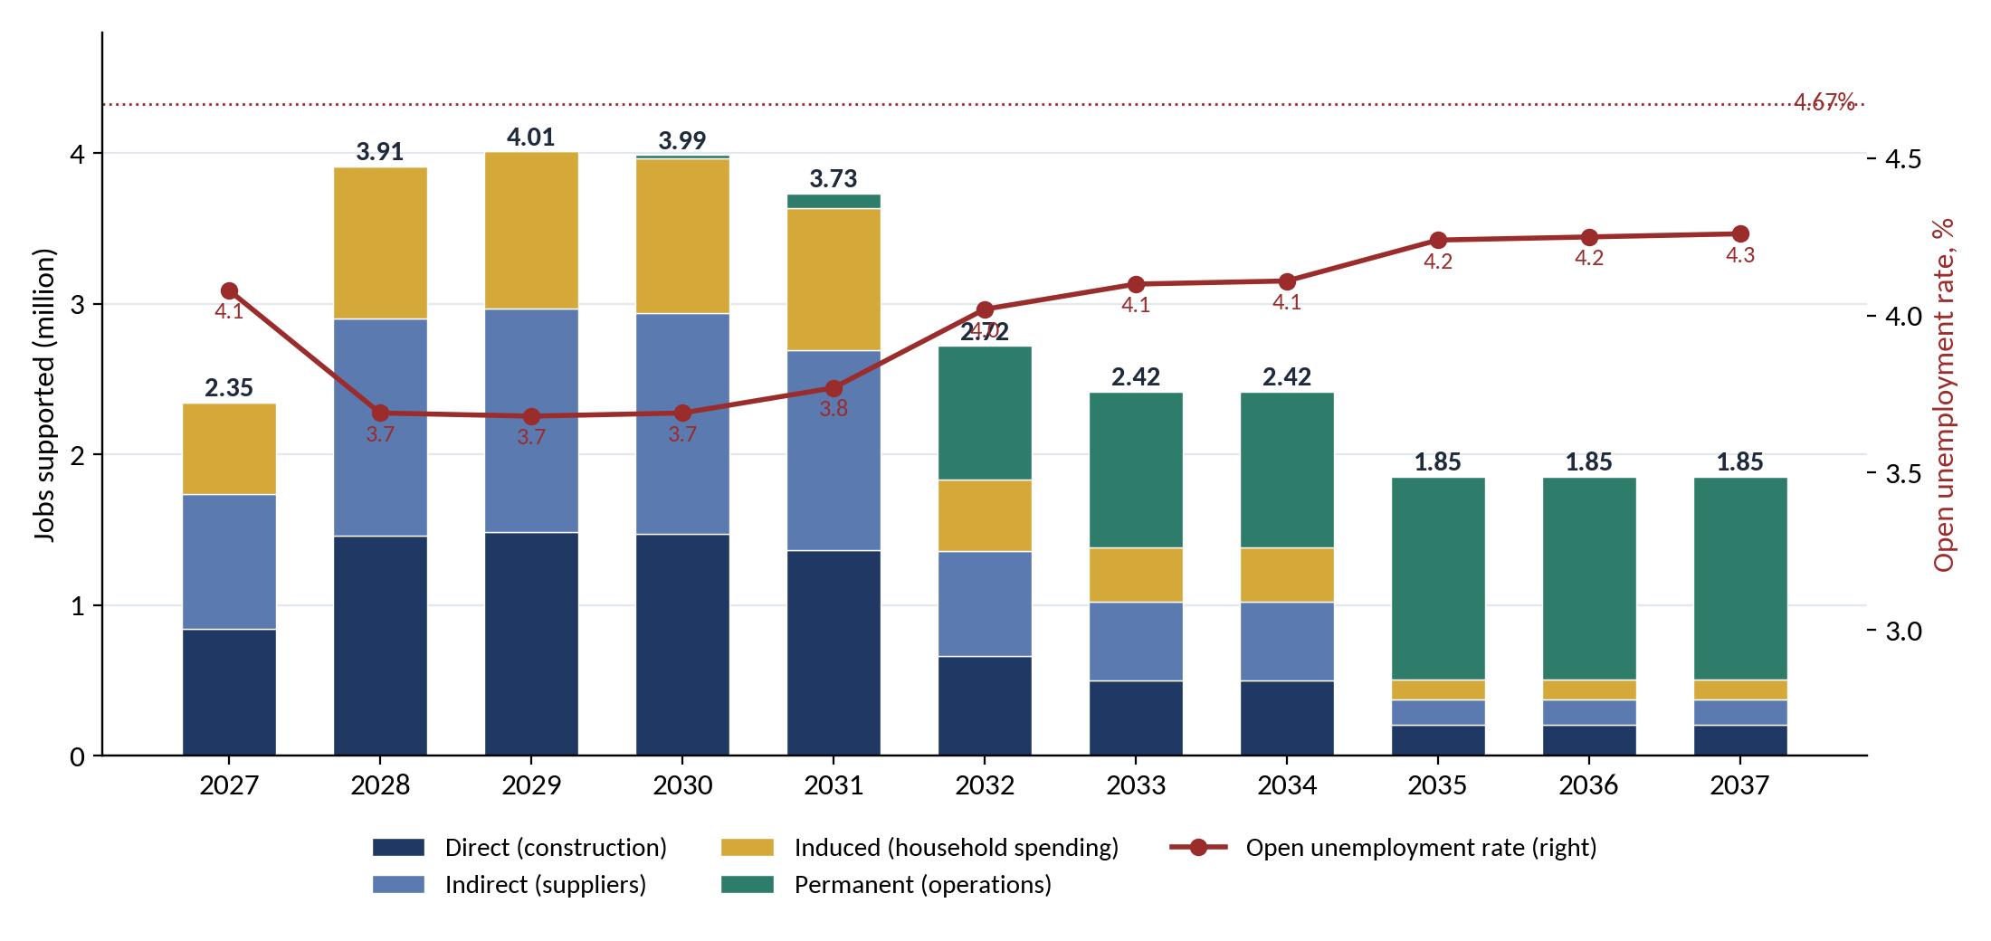
PART 4 · JOBS
RESTRICTED
4.0 million jobs at the peak; unemployment down to about 3.7%
25.5 m
job-years in construction (direct, suppliers, induced)
4.0 m
jobs at the 2029 peak
4.7% → 3.7%
unemployment 2028–30 (range 3.3–4.1%)
1.4 m
lasting jobs after construction
Reading: jobs supported, not all new jobs. About 1 m jobs end in 2032 with the RKAP projects and 0.6 m in 2035 with the defence programme; the successor pipeline protects jobs as well as growth.
Source: author's employment model (integrated paper, Section 8.7 and Appendix F); ERIA (2023) PSN input-output coefficients; BPS Sakernas Feb 2026.
23
Notes:
Counted project by project, the 34 costed projects support about 25.5 million job-years: 9.5 million on site, 9.4 million at suppliers and 6.6 million from household spending. At the 2029 peak that is about 4.0 million jobs. Assuming 40 percent of the extra jobs reduce open unemployment, the rate falls from 4.7 percent to about 3.7 percent in 2028 to 2030. It rises to about 4.0 percent in 2032 when the RKAP projects end and about 4.2 percent in 2035 when the defence programme ends; the sea wall and 1.4 million lasting jobs keep it about 0.4 points lower to 2040.
SOURCES FOR THIS SLIDE
1. Author's employment model (jobs.py, workbook DDMF_Employment_Model): 35 costed projects in seven work types; construction job-years per Rp 1 T from ERIA (2023) PSN input-output results rebased to 2025 prices (×1.30); induced jobs +35%; permanent jobs per project anchored on IMIP (≈129 per Rp 1 T) and Danantara downstream projects (≈168); 40% of extra jobs assumed to reduce open unemployment
2. ERIA (2023). Impact analysis of Indonesia's national strategic projects (PSN), Volume 1, Chapter 5: economic and employment effects using input-output analysis. Economic Research Institute for ASEAN and East Asia.
3. BPS (2026). Keadaan Ketenagakerjaan Indonesia Februari 2026 (open unemployment 4.68%, 7.24 million unemployed, 147.67 million employed), as reported by Bisnis.com and CNN Indonesia, 5–6 May.
4. IMIP (2026). Investasi IMIP capai Rp696,9 triliun, serap 89.849 tenaga kerja. PT Indonesia Morowali Industrial Park.
5. Kontan (2026). Danantara garap 26 proyek hilirisasi senilai Rp 225 triliun, serap 37.833 pekerja; Bisnis.com (2026), Daftar lengkap 6 proyek hilirisasi Danantara (6 February).
6. Integrated Paper — Stabilise, Save, Invest and Grow (8 Oct 2026, EN/ID docx): Section 8.7, Tables 8.6–8.8, Figure 8.3 and Appendix F

Slide 24
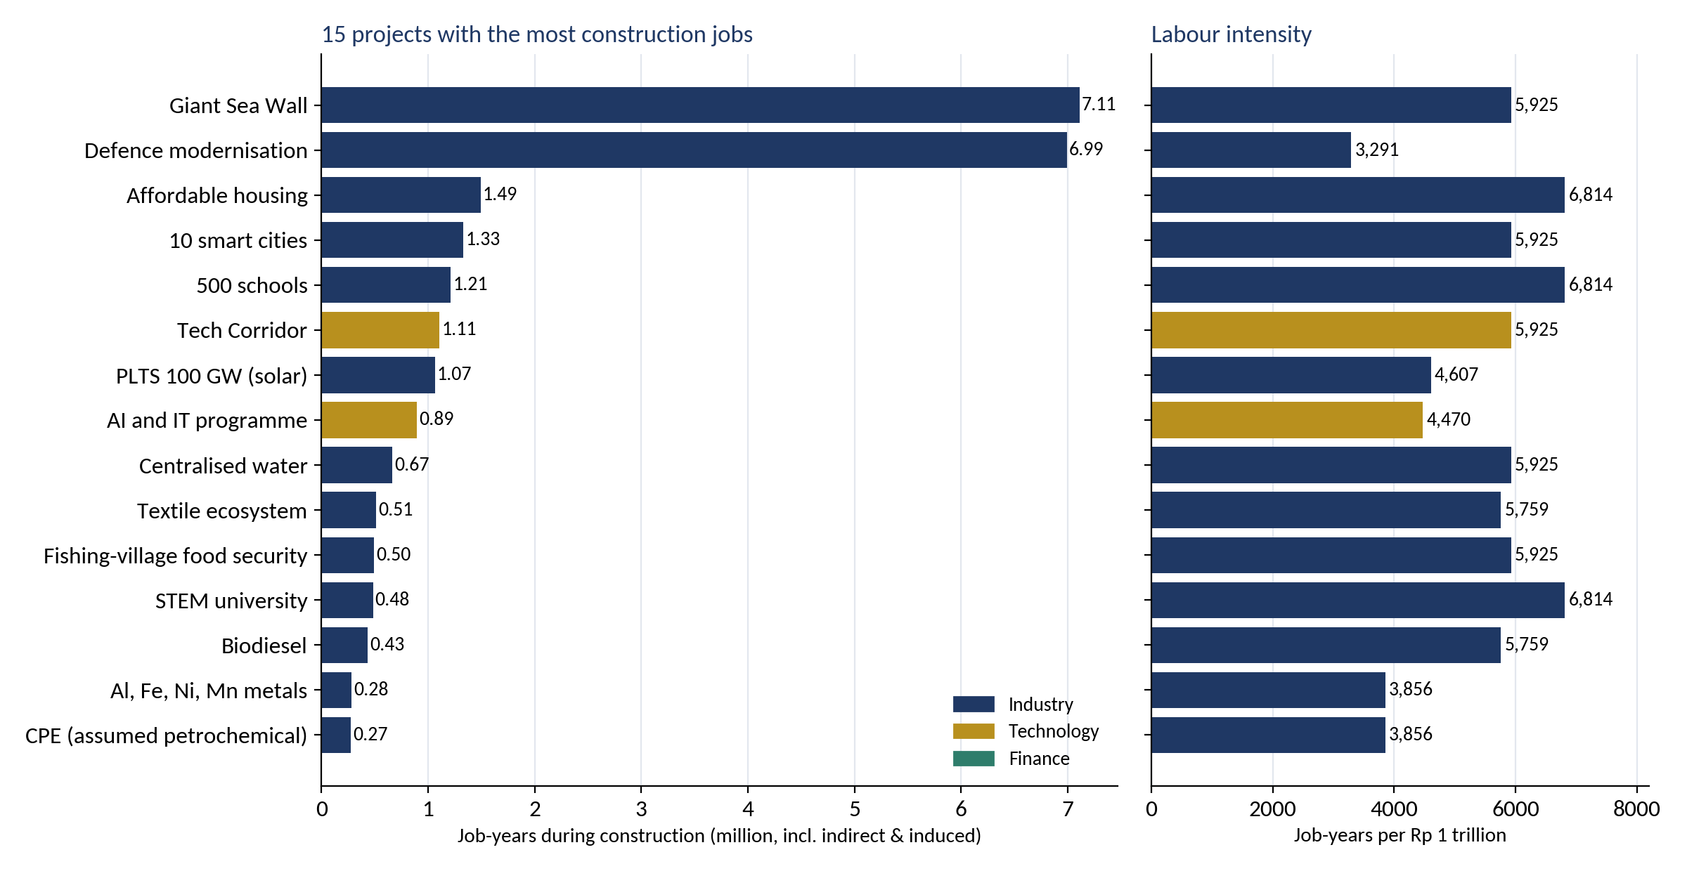
PART 4 · JOBS AND CONSUMPTION
RESTRICTED
The sea wall and defence employ the most; wages feed consumption
The consumption loop, 2029 peak
≈ 3.0 m
on-site and supplier jobs
≈ Rp 119 T
wages a year (Rp 3.33 m a month)
Rp 59–95 T
genuinely new household income
Rp 45–81 T
extra consumption
+0.3–0.6%
GDP after further rounds
Already inside the IMF multipliers: it explains them, not extra growth.
Defence: 7.0 m job-years but only 3,291 per Rp 1 T, because most of the money buys imports. Build submarines and fast attack craft at domestic yards and keep MRO at home; hire locally so wages become Indonesian consumption.
Source: integrated paper, Sections 8.7–8.8; BPS average wage Aug 2025.
24
Notes:
The Giant Sea Wall supports about 7.1 million job-years over 14 years, about half a million jobs a year, and defence modernisation about 7.0 million over 2027 to 2034. Labour intensity differs widely: about 5,900 to 6,800 job-years per trillion rupiah for civil works and buildings, about 3,300 for defence with 40 percent domestic content. Each 10 points of extra defence domestic content adds about 1.7 million job-years. Wages spent raise household consumption; this loop is already in the IMF multipliers.
SOURCES FOR THIS SLIDE
1. Author's employment model (jobs.py, workbook DDMF_Employment_Model): 35 costed projects in seven work types; construction job-years per Rp 1 T from ERIA (2023) PSN input-output results rebased to 2025 prices (×1.30); induced jobs +35%; permanent jobs per project anchored on IMIP (≈129 per Rp 1 T) and Danantara downstream projects (≈168); 40% of extra jobs assumed to reduce open unemployment
2. BPS (2025). Rata-rata upah buruh Rp3,33 juta per Agustus 2025 (as reported by Bisnis.com, 5 November).
3. Kontan (2025). Prabowo bidik ekonomi tumbuh 8% di 2029, konsumsi rumah tangga naik 7,27%.
4. Indonesia Business Post (2025). Danantara considers direct investment in coal gasification to DME (7 November); Indonesia seeks global investors for US$80 billion Giant Sea Wall (9 September).
5. Integrated Paper — Stabilise, Save, Invest and Grow (8 Oct 2026, EN/ID docx): Sections 8.7–8.8, Table 8.7, Figure 8.2 and Table 8.9

Slide 25
PART 4 · PROJECT SCREEN (1/2)
RESTRICTED
The resource-conversion core goes first
Project | Equity (Rp T) | Verdict | Conditions or reason
PLTS 100 GW | 48.6 | Anchor | Main coal-transition asset. 10 GW tranches after the hybrid-tariff regulation; link to domestic PV and silica; demand risk (Trina's unused 3 GW)
CDME (coal to DME) | 9.7 | Conditional | US$0.9 bn/yr FX saving at 20%. Needs take-or-pay offtake, a DME price rule vs subsidised LPG, a carbon-cost test and a time-limited mandate
Tarsius Ph.1 and Anoa (rare earths) | 0.6 | Eligible, pull forward | Small tickets; pilot built; MIND ID, PT Timah and Perminas cooperating; start of a mine-to-magnet chain
Al, Fe, Ni, Mn metals; Copper; Silica | 17.7 | Eligible | Deepens nickel and copper chains; subject to the 35% commodity cap and a feasibility study
Refinery; CPE; Biodiesel | 39.4 | Conditional | Import substitution. Biodiesel only alongside BPDP levy reform, to avoid a second subsidy
EV Power Pack (maritime) | 0.6 | Eligible, priority | Nickel link and ship-import substitution; near PT PAL's shipyard; needs captive demand from SOEs and ministries
Textile ecosystem | 18.7 | Conditional (≤ 30% tier) | No resource link but a high employment multiplier; machine modernisation through co-financing
Source: author's first screen based on DDMF RKAP 2026 project overviews; not an investment appraisal.
25
Notes:
Solar is the anchor. Rare earths, metals, copper and silica are eligible and should be pulled forward. Coal-to-DME, the refinery, CPE and biodiesel are conditional. The EV Power Pack qualifies with captive demand. Textiles qualify within the non-resource cap.
SOURCES FOR THIS SLIDE
1. Policy Note 2 — Stabilise, Save and Invest (29 Sept 2026, EN/ID docx): Table 5 (rows 1–7)
2. RKAP DDMF 2026 (uploaded file), p. 110–112: DDMF equity estimates
3. RKAP DDMF 2026 (uploaded file), p. 120: project overview — PLTS 100 GW
4. RKAP DDMF 2026 (uploaded file), p. 119: project overview — CDME
5. RKAP DDMF 2026 (uploaded file), p. 127: project overview — Tarsius
6. RKAP DDMF 2026 (uploaded file), p. 124: project overview — EV Power Pack
7. RKAP DDMF 2026 (uploaded file), p. 126: project overview — textile ecosystem
8. Policy Paper 1 — Stabilise and Save: Managing Indonesia's Natural-Resource Wealth (Resource Revenue Governance Series, Sept 2026, EN/ID docx): Section 4.7 (BPDP levy reform)
Page numbers refer to the page numbers printed on the RKAP DDMF 2026 slides. The RKAP is confidential: restrict circulation of this deck accordingly.

Slide 26
PART 4 · PROJECT SCREEN (2/2)
RESTRICTED
Defence splits, technology is staged, public goods stay on budget
Project | Equity (Rp T) | Verdict | Conditions or reason
Shipyard & ship components | 1.1 | Eligible, priority (sovereignty) | Localises yard capacity and components; tranches tied to the vessel backlog, TKDN milestones and SME supplier development
Defence modernisation (Rp 2,125 T) * | 446.2 | Split: industry share only | Domestic yards, components and MRO within the 20% tier; platforms on the APBN; imports financed by DHE SDA loans, not foreign loans; 60% domestic-content target
MOBNAS & MOLINAS | 5.3 | High risk, capped | Behind schedule, land not secured, partner not appointed; strict stage-gating
Tech Corridor | 39.2 | Not yet | Scope, milestones and support still to be determined
Data Centre; AI and IT programme * | 52.5 | Conditional | Commercial tranches only (shared compute, sovereign cloud) with anchor public demand; public systems and skills on budget; renewable power
Quantum; semiconductors * | 7.3 | Conditional / redesign | Quantum as staged research partnerships; back-end semiconductors and power devices with an anchor offtaker
Biosimilar & pharma; E-commerce | 2.1 | Outside the fund | On hold or commercial: DDMF's own capital or private investors
Waste, landfill mining, RDF | 3.5 | Outside the fund | Regional public services: regional endowment or budget; RDF may qualify later as a coal substitute
Housing, schools, STEM university, smart cities, water, fishing villages | 207.2 | Budget route | No cash flow to recycle: APBN, SBSN or KPBU, supported by the future window's annual return
Giant Sea Wall (Rp 1,200 T) * | 252.0 | Budget route, resource-backed | APBN, KPBU availability payments and resource-revenue bonds; up to 30% from resource cash; stage by segment
Equity figures are DDMF equity estimates in the RKAP 2026; * October 2026 figures with 21% equity assumed.
26
Notes:
Shipyards and components are eligible. Defence modernisation splits: the fund holds only the domestic industrial share within the sovereignty tier, platforms stay on the budget and imports are financed with DHE SDA loans. The data centre and AI programme qualify only for commercial tranches; quantum and semiconductors are staged. MOBNAS is high risk; the Tech Corridor is not ready. Public goods, including the sea wall, have no cash flow to recycle and belong on the budget, supported by resource-revenue bonds.
SOURCES FOR THIS SLIDE
1. Remark added at the user's request (2 Oct 2026): Project Athens is an unknown / black programme — classified, with scope and details not disclosed; the figures shown are the RKAP's indicative values (RKAP p. 11, 111, 129)
2. Policy Note 2 — Stabilise, Save and Invest (29 Sept 2026, EN/ID docx): Table 5 (sovereignty-tier rows and rows 8–13)
3. Policy Note 2 — Stabilise, Save and Invest (29 Sept 2026, EN/ID docx): Table 3a
4. Law No. 16 of 2012 on the Defence Industry (local content and offset obligations; role of the Defence Industry Policy Committee, KKIP)
5. RKAP DDMF 2026 (uploaded file), p. 111: shipyard & ship components; alutsista
6. RKAP DDMF 2026 (uploaded file), p. 110–112: DDMF equity estimates
7. RKAP DDMF 2026 (uploaded file), p. 128: project overview — MOBNAS & MOLINAS
8. RKAP DDMF 2026 (uploaded file), p. 130: project overview — Tech Corridor
9. RKAP DDMF 2026 (uploaded file), p. 125: project overview — biosimilar & pharma
10. RKAP DDMF 2026 (uploaded file), p. 131: project overview — e-commerce (Borobudur)
11. RKAP DDMF 2026 (uploaded file), p. 121–123: project overview — waste projects
12. RKAP DDMF 2026 (uploaded file), p. 129: project overview — Athens
Page numbers refer to the page numbers printed on the RKAP DDMF 2026 slides. The RKAP is confidential: restrict circulation of this deck accordingly.

Slide 27
PART 4 · DUE DILIGENCE
RESTRICTED
Four high-risk projects need redesign
Project | Rp T (equity) | Key finding | Verdict | Redesign
Textile ecosystem | 89.0 (18.7) | Cotton ~100% imported; mills at 30–50% utilisation; Sritex bankrupt, 60 firms closed | Restructure, don't build | Buy and modernise distressed mills; viscose-based fabric; tranches tied to utilisation and trade enforcement
Biosimilar & pharma | 8.9 (1.9) | 70–90% of APIs imported; 3 EPO producers already; 66 trials in 2024 | Conditional | mAbs and insulin with a tech partner; priority APIs; trial capacity via INA-CRC
Semiconductors | 15.0 (3.1) | Imports ~US$4.9 bn, fragmented; a fab costs US$35–43 bn vs ~US$0.8 bn available | Redesign | OSAT and power devices with an anchor offtaker; silica materials; chip-design talent
E-commerce | 1.0 (0.2) | Shopee 54% + TikTok-Tokopedia 38%; Bukalapak and Blanja exited | High death-on-arrival risk | B2G/B2B MSME platform: consolidate PaDi UMKM and e-Katalog; supply-chain finance
Sources: USDA/Databoks; APSyFI; BenarNews; GPFI; WHO (2026); BPOM Reg. 8/2024; Kemenperin (2026); WSTS; BCG; Momentum Works; e-Conomy SEA 2025; Telkom; LKPP.
27
Notes:
Due diligence on four high-risk projects. Textile: the constraint is demand and import competition, not capacity; restructure distressed assets. Pharma: most APIs are imported and three firms already make EPO; refocus on antibodies and insulin with a partner. Semiconductors: no captive market for a fab; invest in assembly and test and power devices with an anchor offtaker. E-commerce: two platforms hold about 92 percent; build a B2G and B2B platform for MSMEs instead.
SOURCES FOR THIS SLIDE
1. USDA via Databoks (2025). Indonesia enters the list of top global cotton importers 2024/2025; API / Kontan (2017), cotton supply almost 100% imported.
2. BenarNews (2025). Bankruptcy of Sritex and layoffs. 7 March.
3. GPFI / CNBC Indonesia (2025). Tanaman obat berserakan di RI, tapi impor 90% bahan baku obat. 18 July; Bisnis.com (2026), Menkes klaim impor bahan baku obat berhasil diturunkan 20%. 24 June.
4. WHO (2026). Driving clinical trials in Indonesia through collaborative action. 7 January.
5. WSTS (2026). Semiconductor market forecast, spring 2026. World Semiconductor Trade Statistics.
6. BCG (2023). Navigating the costly economics of chip making. Boston Consulting Group.
7. Kemenperin / Investortrust (2026). Semiconductor imports hit Rp81.64 trillion; roadmap for semiconductors. January.
8. Infineon / eeNews (2024). Infineon doubles packaging capacity in Indonesia.
9. Momentum Works (2026). Indonesia e-commerce market share 2025 (via Bisnis.com, May 2026). Google, Temasek & Bain (2025). e-Conomy SEA 2025.
10. Telkom (2023). PaDi UMKM consistently expands MSMEs' market network; LKPP / Kontan, e-Katalog MSME products.
11. Integrated Paper — Stabilise, Save and Invest (Oct 2026, EN/ID docx): Chapter 8 (due diligence on the Others group)

Slide 28
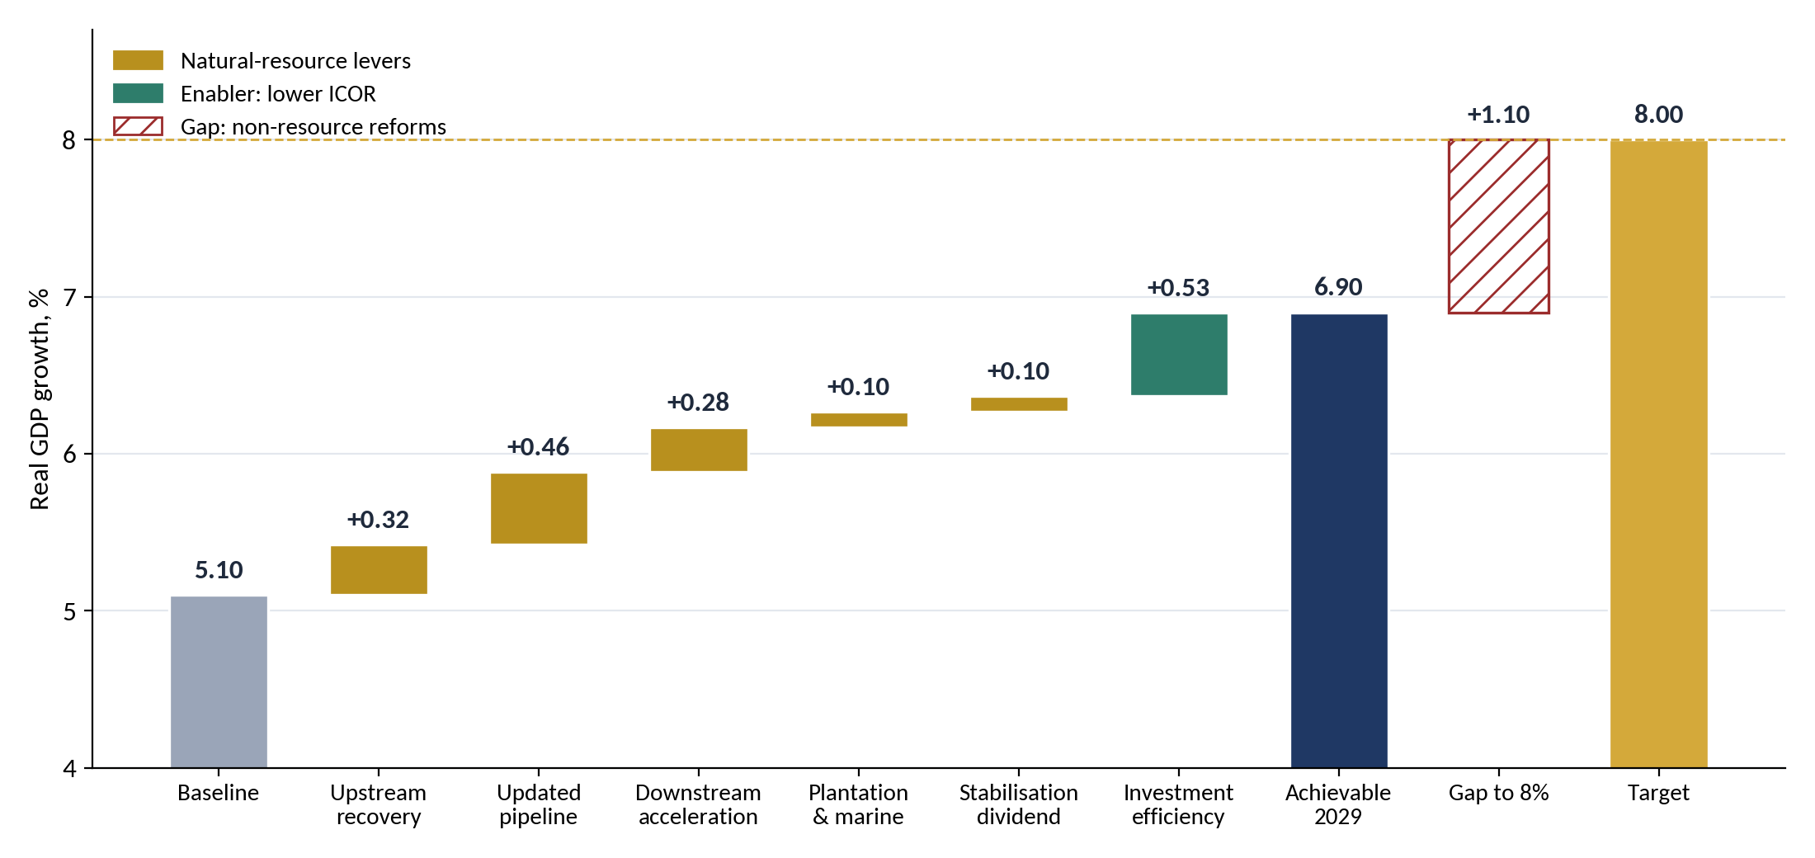
PART 5 · GROWTH BRIDGE
RESTRICTED
Resources and the pipeline lift growth to about 6.9%, not 8%
6.37%
growth in 2029 from resource levers and the pipeline (+0.46 pp)
6.90%
with better investment efficiency (ICOR 5.6 → 5.1)
1.10 pp
gap to 8%: needs an ICOR of about 4.3
Reading: the pipeline is 2.6× the RKAP's, but adds only +0.46 pp in 2029 (RKAP +0.34): defence equipment is imported and the sea wall adds little capacity. Investment reaches 32.5% of GDP, so efficiency, not money, is what is missing.
Source: author's calculation (integrated paper, Chapter 11 and Appendix E); BPS 2025–2026; BKPM 2026. Illustrative.
28
Notes:
The bridge starts from 5.1% growth. Upstream recovery, the updated pipeline, faster downstreaming, plantation and marine productivity and a stabilisation dividend add about 1.27 points in 2029, taking growth to about 6.4%. Better investment efficiency adds about 0.53 points, to 6.9%. The remaining 1.1 points must come from non-resource reforms, mainly a lower ICOR. The downstreaming roadmap is often credited with 2 points; our estimate for all processing levers is 0.6 to 0.9 points, because much equipment is imported and mining is currently contracting.
SOURCES FOR THIS SLIDE
1. Author's growth model (growth8.py, scen8.py): growth = investment ratio ÷ ICOR, calibrated to 2025 (PMTB 28.77% of GDP, growth 5.11%, implied ICOR 5.63); natural-resource levers and scenario parameters as documented in Appendix E of the integrated paper
2. BPS (2026). Ekonomi Indonesia 2025 tumbuh 5,11 persen; Ekonomi Indonesia triwulan II-2026 (as reported by Jawapos, KabarBursa and IDN Financials).
3. Bisnis.com (2026). Hilirisasi sumbang 30,2% total investasi, realisasi Rp584,1 triliun. 15 January.
4. Fortune Indonesia (2024). Bahlil uraikan peta jalan hilirisasi buat capai pertumbuhan ekonomi 8%; Bappenas targetkan investasi RI 2025–2029 capai Rp47,59 kuadriliun.
5. IMF (2026). World Economic Outlook Update, January 2026 (Indonesia growth projection 5.0% for 2026, as reported by IDN Financials).
6. Ramey, G. & Ramey, V. A. (1995). Cross-country evidence on the link between volatility and growth. American Economic Review, 85(5), 1138–1151.
7. van der Ploeg, F. & Poelhekke, S. (2009). Volatility and the natural resource curse. Oxford Economic Papers, 61(4), 727–760.
8. Integrated Paper — Stabilise, Save, Invest and Grow (8 Oct 2026, EN/ID docx): Chapter 11, Table 11.2 and Figures 11.1–11.2

Slide 29
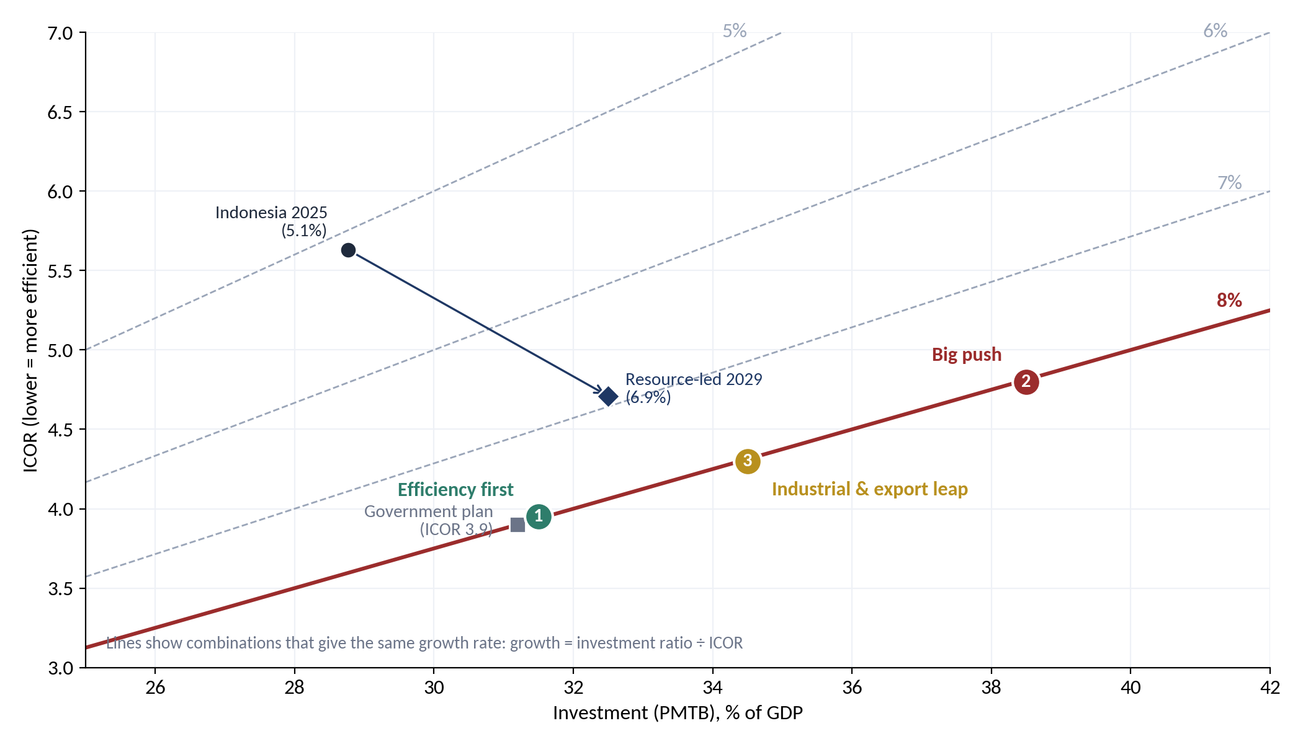
PART 5 · THREE ROUTES TO 8%
RESTRICTED
Three ways to reach 8% by 2029, each with one very hard assumption
 | S1 Efficiency | S2 Big push | S3 Industry
Investment, % GDP | 31.5 | 38.5 | 34.5
ICOR (2029) | 3.95 | 4.8 | 4.3
Growth 26/27/28/29 | 5.3/5.8/6.6/8.0 | 6.3/6.9/7.5/8.0 | 5.5/6.1/6.9/8.0
Extra investment 2029 | Rp 834 T | Rp 3,058 T | Rp 1,765 T
Investment growth | 8.9% | 15.3% | 11.6%
Manufacturing growth | 8.5% | 9.0% | 11.5%
Current account 2029 | −1.3% | −3.8% | −1.8%
Resource contribution | ≈ +1.3 pp | ≈ +2.0 pp | ≈ +1.5 pp
Source: author's calculation (integrated paper, Chapter 12). Illustrative scenarios, not forecasts. Current account assumes extra saving of 1.5, 6.0 and 4.0 pp of GDP.
29
Notes:
Growth is roughly the investment ratio divided by the ICOR. Efficiency first keeps investment near 31.5% of GDP but needs an ICOR of 3.95. The big push needs investment of 38.5% of GDP and leaves a current-account deficit near 3.8%. The industrial and export leap needs investment of 34.5% and manufacturing growth of 11.5% a year.
SOURCES FOR THIS SLIDE
1. Author's growth model (growth8.py, scen8.py): growth = investment ratio ÷ ICOR, calibrated to 2025 (PMTB 28.77% of GDP, growth 5.11%, implied ICOR 5.63); natural-resource levers and scenario parameters as documented in Appendix E of the integrated paper
2. Bisnis.com (2025). AHY: Perbaikan konektivitas dan digitalisasi bantu tekan ICOR ke level 4. 23 September.
3. DDTC News (2025). Masuk RPJMN 2025–2029, pertumbuhan ekonomi 2029 ditarget tembus 8%.
4. New Straits Times (2026). Indonesia Q4 current account deficit at 0.7pct of GDP (full-year 2025 deficit US$1.5 billion, about 0.1% of GDP). February.
5. Integrated Paper — Stabilise, Save, Invest and Grow (8 Oct 2026, EN/ID docx): Chapter 12, Table 12.1 and Figure 12.1

Slide 30
PART 5 · WHAT EACH ROUTE DEMANDS
RESTRICTED
Efficiency, money or manufacturing: the choice is which risk to carry
S1 · Efficiency first
S2 · Big push
S3 · Industrial & export leap
HARDEST ASSUMPTION
HARDEST ASSUMPTION
HARDEST ASSUMPTION
ICOR 3.95 in four years (Singapore level)
Investment +15% a year to 38.5% of GDP
Manufacturing +11.5% a year (share → 22%)
WHAT IT TAKES
WHAT IT TAKES
WHAT IT TAKES
Logistics cost 14.3% → 8–9% of GDP
Licences in days, not months
SOEs run for returns under Danantara
Every project through the six-test gate
Pipeline held at its peak to 2035
Downstreaming at twice the roadmap pace
Fund 80/20 split; loans up to 10%
Saving +6 pp; FDI +2 pp of GDP
Nickel → battery materials, cells, EVs
Aluminium, copper cable, oleochemicals
Shipbuilding and defence as exports
SME suppliers through DOCK-UP
MAIN RISK
MAIN RISK
MAIN RISK
Reform politics: if reforms stall, growth stays near 6%
Current account near −3.8% of GDP; inflation, credit, waste
Global demand, trade frictions, nickel prices, skills
Source: integrated paper, Sections 12.2–12.4; Katadata (2025) for the logistics target; Bisnis (2025) for the ICOR path.
30
Notes:
Each scenario rests on a hard assumption and carries a different risk. Efficiency first depends on the politics of reform. The big push depends on the balance of payments. The industrial leap depends on global markets and skills.
SOURCES FOR THIS SLIDE
1. Katadata (2025). Menko Airlangga minta biaya logistik turun jadi 8% pada 2030.
2. Bisnis.com (2025). AHY: Perbaikan konektivitas dan digitalisasi bantu tekan ICOR ke level 4. 23 September.
3. Fortune Indonesia (2024). Bahlil uraikan peta jalan hilirisasi buat capai pertumbuhan ekonomi 8%; Bappenas targetkan investasi RI 2025–2029 capai Rp47,59 kuadriliun.
4. DDTC News (2025). Masuk RPJMN 2025–2029, pertumbuhan ekonomi 2029 ditarget tembus 8%.
5. Kuwait Decree-Law No. 81 of 2026 on borrowing from the Future Generations Fund (loans ≤10% of FGF net assets); reported in AGBI (Sept 2026) and Times Kuwait (Sept 2026); IMF (2026) Kuwait Article IV, Country Report 26/052
6. Integrated Paper — Stabilise, Save, Invest and Grow (8 Oct 2026, EN/ID docx): Sections 12.2–12.4

Slide 31
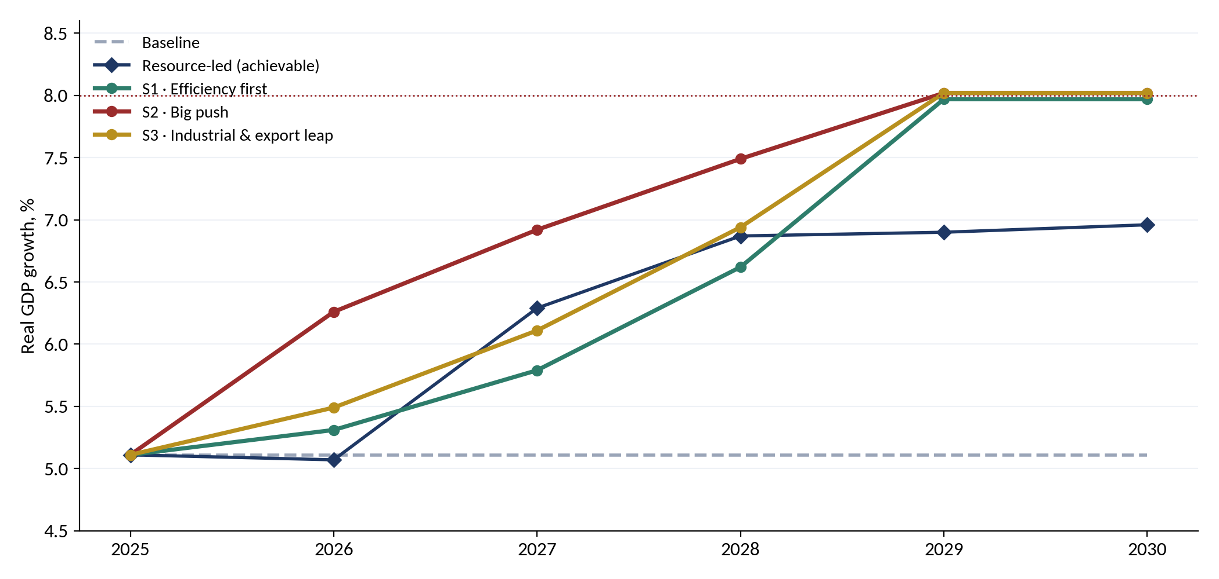
PART 5 · RECOMMENDED PATH
RESTRICTED
Recommended: industrial leap, 33.5% investment, ICOR 4.2–4.3
2026–27 · Fix and prepare
Restore mining output; pass the fund Law; start logistics, licensing and SOE reforms; prepare bankable industrial projects
2027–29 · Build
Run the pipeline through the gate, funded resources-first; downstream towards Rp 1,000 T a year; defence content to 60%; deficit below 2.5% of GDP
2029–32 · Sustain
33.5 ÷ 4.2 ≈ 8.0. With the updated pipeline, investment already reaches about 32.5% of GDP in 2029; the missing piece is efficiency. Indonesia grew 7–8% a year in the mid-1990s with investment of roughly 30% of GDP.
Launch the successor pipeline before the 2032 drop; export from the new capacity; review and taper the development window
Source: integrated paper, Section 12.6; World Bank WDI for the 1990s. Illustrative.
31
Notes:
The recommended path combines the industrial and export leap with the reforms of efficiency first. Better efficiency means investment of about 33.5% of GDP is enough for 8%, instead of 38.5%. Indonesia grew 7 to 8% a year in the mid-1990s with investment of roughly 30% of GDP. Holding 8% after 2029 needs a successor pipeline and a low ICOR.
SOURCES FOR THIS SLIDE
1. Author's growth model (growth8.py, scen8.py): growth = investment ratio ÷ ICOR, calibrated to 2025 (PMTB 28.77% of GDP, growth 5.11%, implied ICOR 5.63); natural-resource levers and scenario parameters as documented in Appendix E of the integrated paper
2. World Bank, World Development Indicators: GDP (current US$), GDP growth (annual %), Indonesia (https://databank.worldbank.org/source/world-development-indicators)
3. Integrated Paper — Stabilise, Save, Invest and Grow (8 Oct 2026, EN/ID docx): Section 12.6 and Figure 12.2

Slide 32
PART 5 · ROADMAP
RESTRICTED
From windfall capture in 2026 to sunset review in 2038
2026
2028
2030
2032
2034
2036
2038
2040
Transitional account (2026 windfall)
Recalibration, draft Law, DDMF mandate
Law enacted; committee set up
Development window: 60% share
Development window: 30% share
Loan facility (≤ 5% of future window)
Exits recycled to future window
First deposits
First full review
Sunset review
Indicative; depends on the legislative calendar. Builds on the working plan in Policy Paper 1.
32
Notes:
The roadmap starts now: capture the 2026 windfall, sign a DDMF mandate and recalibrate in 2027, enact the Law in 2028 and make first deposits in 2029. The development share is 60 percent to 2032 and 30 percent to 2038. Exits start recycling from about 2037. The window sunsets in 2038 unless renewed by Law.
SOURCES FOR THIS SLIDE
1. Policy Note 2 — Stabilise, Save and Invest (29 Sept 2026, EN/ID docx): Section 7 and Table 3 (dates and shares)
2. Policy Paper 1 — Stabilise and Save: Managing Indonesia's Natural-Resource Wealth (Resource Revenue Governance Series, Sept 2026, EN/ID docx): Chapter 5 working plan and timeline (Table 10)
3. All dates are indicative and depend on the legislative calendar

Slide 33
PART 5 · MONITOR
RESTRICTED
A public dashboard with triggers agreed in advance
Indicator | 2025 | 2029 target | Red flag | Owner
Real GDP growth (%) | 5.1 | 8.0 | Below 6% for four quarters after 2027 | Bappenas, BPS
Investment, PMTB (% of GDP) | 28.8 | 33–34 | Below 30% in 2027 | Bappenas, BKPM
Open unemployment (%) | 4.7 | 3.7–4.0 | Above 4.5% in 2028 | Manpower, BPS
ICOR | 5.6 | ≤ 4.3 | Above 5.0 in 2028 | Bappenas
Manufacturing growth (%) | 5.3 | ≥ 10 | Below 7% in 2028 | Ministry of Industry
Downstream investment (Rp T) | 584 | ≥ 1,000 | Below 700 in 2027 | BKPM
Logistics cost (% of GDP) | 14.3 | ≤ 9 | Above 12% in 2028 | Coordinating Ministry
Current account (% of GDP) | −0.1 | ≥ −2.5 | Below −2.5% | Bank Indonesia
Pipeline funded by resources | — | ≥ 50% | Below 40% | MoF, Danantara
Defence domestic content (%) | 43 | ≥ 60 | Below 45% in 2028 | Kemhan, KKIP
Pre-agreed responses: deficit above 2.5% of GDP → slow drawdowns and re-phase import-heavy projects; ICOR above 5.0 in 2028 → freeze projects not through the gate; inflation above 3.5% → re-phase construction; growth below 6% → reassess, don't add spending.
Source: integrated paper, Chapter 14 (Table 14.1 and Section 14.2); 2025 values from BPS, BKPM, Bank Indonesia and the Coordinating Ministry.
33
Notes:
A programme of this size will go off course somewhere. The dashboard is published every quarter. Each indicator has a 2029 target and a red flag, and the responses to each red flag are agreed before money moves, so that the reaction is automatic rather than political.
SOURCES FOR THIS SLIDE
1. BPS (2026). Ekonomi Indonesia 2025 tumbuh 5,11 persen; Ekonomi Indonesia triwulan II-2026 (as reported by Jawapos, KabarBursa and IDN Financials).
2. Bisnis.com (2026). Hilirisasi sumbang 30,2% total investasi, realisasi Rp584,1 triliun. 15 January.
3. Katadata (2025). Menko Airlangga minta biaya logistik turun jadi 8% pada 2030.
4. New Straits Times (2026). Indonesia Q4 current account deficit at 0.7pct of GDP (full-year 2025 deficit US$1.5 billion, about 0.1% of GDP). February.
5. CNBC Indonesia (30 Jan 2026), 'Kementerian Pertahanan dapat Rp187 triliun, berapa buat alutsista?': Kemhan 2026 budget Rp187.1 T; alutsista modernisation Rp84.48 T (45.1%), funded by foreign loans Rp46.5 T, domestic rupiah Rp33.44 T, domestic loans Rp3.69 T, SBSN Rp0.8 T, PNBP Rp0.06 T (https://www.cnbcindonesia.com/research/20260130133929-128-706742/kementerian-pertahanan-dapat-rp187-triliun-berapa-buat-alutsista); Tempo (2026), 'Anggaran Kemhan 2026 sebesar Rp187,1 triliun'
6. Integrated Paper — Stabilise, Save, Invest and Grow (8 Oct 2026, EN/ID docx): Chapter 14, Table 14.1 and Section 14.2

Slide 34
PART 5 · RISKS AND SAFEGUARDS
RESTRICTED
Every major risk has a rule written against it
Risk | Evidence | Safeguard
Correlated commodity exposure | Project and state revenue both fall when coal or nickel prices fall | 35% commodity cap; assets with contracted returns
Stranded coal assets | DME may be uncompetitive against LPG; coal demand declining | Time-limited CDME mandate; carbon-cost test; solar as anchor
Contingent liabilities | RKAP lists guarantees, comfort letters, bailout pressure; Athens AP | No guarantees; defence via equity only, availability payments on APBN
Defence-specific risks | Single buyer; export controls; limits on technology transfer; classified information | Multi-year contracts; offsets; 20% tier cap; closed-session reporting to DPR Commission I and BPK
Exceptions become the rule | Timor-Leste: withdrawals above the ESI almost every year since 2009 | Caps in the Law; 2038 sunset; extension only by Law
Capture and misuse | 1MDB; costly subsidised lending elsewhere | Independent committee; BPK audit; project disclosure; Santiago Principles
Absorptive capacity, Dutch disease | ≈ 30% efficiency loss (IMF, 2015); rupiah pressure | Stage-gating; readiness-based disbursement; counter-cyclical timing
Unmeasured impact | All RKAP 2026 impact KPIs have zero targets | No disbursement without quantified baselines
Source: author's assessment.
34
Notes:
The main risks are correlated commodity exposure, stranded coal assets, contingent liabilities, defence-specific risks such as a single buyer and export controls, exceptions becoming the rule, capture and misuse, absorptive capacity, and unmeasured impact. Each maps to a specific rule in the design.
SOURCES FOR THIS SLIDE
1. Policy Note 2 — Stabilise, Save and Invest (29 Sept 2026, EN/ID docx): Table 6, incl. defence-specific risks
2. Law No. 16 of 2012 on the Defence Industry (local content and offset obligations; role of the Defence Industry Policy Committee, KKIP)
3. RKAP DDMF 2026 (uploaded file), p. 21–22, 74–75: DDMF risk register: project, financial, fiscal, legal, strategic, sustainability, reputation and contingent risks
4. RKAP DDMF 2026 (uploaded file), p. 119: project overview — CDME commercial risk vs LPG
5. RKAP DDMF 2026 (uploaded file), p. 62–64: zero impact-KPI targets
6. IMF (2015), Making Public Investment More Efficient, IMF Staff Report (on average about 30% of potential gains from public investment are lost to inefficiency)
7. Timor-Leste: EITI (2023) country profile; IMF (2025) Timor-Leste Article IV Consultation (withdrawals above the Estimated Sustainable Income in most years since 2009)
8. IFSWF (2008). Generally Accepted Principles and Practices for Sovereign Wealth Funds (Santiago Principles).
Page numbers refer to the page numbers printed on the RKAP DDMF 2026 slides. The RKAP is confidential: restrict circulation of this deck accordingly.

Slide 35
PART 5 · RECOMMENDATIONS
RESTRICTED
Eight decisions to take
1
One Law, three windows
5
Public goods on the budget
Reserve stabilises, development invests, future saves; development window sunsets in 2038
Housing, schools, sea walls, water via APBN, SBSN or KPBU; platform purchases and availability payments too
2
Capture the 2026 windfall
6
Require measurable impact
Park the excess over the budget assumption in a transitional account; seed the window in 2027
Quantified baselines and targets for jobs, value added, TKDN, imports and emissions, reported publicly
3
A mandate, not the money
7
Recalibrate in 2027
DDMF originates and executes; the fund's committee approves each disbursement
Test the 30% rate, 60/30/0 split, loan cap and return floor against scenarios, incl. a coal price collapse
4
Start with the core
8
Create a sovereignty tier
PLTS in tranches, rare earths, metals, copper, silica; CDME, refinery, CPE, biodiesel when conditions are met
Shipyards and alutsista join the priority list (15 projects); defence-industrial base ≤ 20% of the window, via domestic yards and SMEs
35
Notes:
Eight recommendations, including a sovereignty tier for maritime and defence: one Law for three windows; capture the 2026 windfall; give DDMF a mandate rather than the money; start with the resource-conversion core; route public goods through the budget; require measurable impact; and recalibrate the parameters in 2027.
SOURCES FOR THIS SLIDE
1. Policy Note 2 — Stabilise, Save and Invest (29 Sept 2026, EN/ID docx): Section 7 (recommendations, incl. the sovereignty tier)
2. DDTC News (Sept 2026), 'Setoran PNBP tembus Rp435,1 triliun, sudah 94,8% dari target APBN 2026', citing the Ministry of Finance: Jan–Aug 2026 PNBP Rp435.1 T (+41.7%); natural-resource PNBP Rp194.6 T (oil & gas 80.1; non-oil & gas 114.4) (https://news.ddtc.co.id/berita/nasional/1822596/setoran-pnbp-tembus-rp4351-triliun-sudah-948-dari-target-apbn-2026)
3. Priority list revised on 2 Oct 2026 at the user's request: shipyard & ship components (investment Rp5.24 T, equity Rp1.10 T) and alutsista (Rp16.12 T, Rp3.39 T) added to the RKAP's 13 priority projects, from RKAP p. 111, giving 15 projects: investment Rp799.0 T, equity Rp147.7 T
Page numbers refer to the page numbers printed on the RKAP DDMF 2026 slides. The RKAP is confidential: restrict circulation of this deck accordingly.

Slide 36
THE RECOMMENDATION IN ONE PARAGRAPH
Stabilise, save, invest and grow
Stabilise with the reserve window, save with the future window, and invest a time-limited, rule-bound share of the savings through a development window. Organise the Rp 5,396 T pipeline in Industry, Technology and Finance; fund it natural-resources first, for about half its cost; build defence at home. Use it as one engine of an industrial leap with efficiency discipline: investment of about a third of GDP and an ICOR near 4.2–4.3. Run it on a public dashboard with responses agreed in advance.
Stabilise
Save
Invest
Grow
36
Notes:
Close with the one-paragraph recommendation. Savings are spent on assets, not consumption; the rules keep the future window whole; and the growth ambition is pursued through efficiency and industry, monitored in public.
SOURCES FOR THIS SLIDE
1. Policy Note 2 — Stabilise, Save and Invest (29 Sept 2026, EN/ID docx): closing summary ('The option in one paragraph')

Slide 37
APPENDIX · PROJECTS (1/2)
RESTRICTED
Industry cluster: 26 projects, Rp 4,914 T
Project | Segment | Rp T | Years
PLTS 100 GW (solar) | Resources & energy | 231.4 | 2027–30
Fishing-village food security | Resources & energy | 83.8 | 2028–31
Biodiesel | Resources & energy | 75.4 | 2028–31
Al, Fe, Ni, Mn metals | Resources & energy | 73.3 | 2029–31
CPE (assumed petrochemical) | Resources & energy | 71.2 | 2028–31
CDME (coal to DME) | Resources & energy | 46.3 | 2027–30
Refinery | Resources & energy | 40.9 | 2027–32
Silica | Resources & energy | 8.9 | 2028–31
Legacy waste – landfill mining | Resources & energy | 6.0 | 2028–31
Legacy waste – RDF | Resources & energy | 6.0 | 2028–31
Project Tarsius Ph.1 (rare earths) | Resources & energy | 2.3 | 2029–32
Copper | Resources & energy | 2.0 | 2028–31
Project Anoa (rare earths) | Resources & energy | 0.4 | 2027–31
Project | Segment | Rp T | Years
10 smart cities | Infrastructure & social | 225.0 | 2028–32
Affordable housing | Infrastructure & social | 219.4 | 2028–31
500 schools | Infrastructure & social | 178.0 | 2027–31
Centralised water | Infrastructure & social | 112.2 | 2028–31
STEM university | Infrastructure & social | 71.0 | 2027–31
Decentralised waste | Infrastructure & social | 4.6 | 2027–31
Giant Sea Wall * | Giant Sea Wall | 1200.0 | 2027–40
Defence modernisation ‡ * | Defence platforms & MRO | 2125.0 | 2027–34
Shipyard & ship components | Defence & maritime industry | 5.2 | 2028–32
EV Power Pack (maritime) | Defence & maritime industry | 3.0 | 2028–31
Textile ecosystem | Manufacturing | 89.0 | 2028–31
MOBNAS & MOLINAS | Manufacturing | 25.0 | 2027–29
Biosimilar & pharma | Manufacturing | 8.9 | 2028–31
Source: DDMF RKAP 2026 p. 110–112; * October 2026 update; ‡ submarines, USV, fast attack craft, carrier refit, fighters, MRO. Uncosted: electric stoves, high-speed rail, Trans-Sumatra toll road.
37
Notes:
Projects in the Industry cluster by segment, with investment, equity and timeline. Asterisked programmes are the October 2026 figures; the rest are from the RKAP.
SOURCES FOR THIS SLIDE
1. RKAP DDMF 2026 (uploaded file), p. 110–112: project list
2. Figures provided by the user in October 2026: Giant Sea Wall Rp 1,200 T; defence modernisation Rp 2,125 T (new submarines, USV, fast attack craft, carrier Sriwijaya refurbishment, fighter squadrons, MRO); National Data Centre Rp 50 T; quantum technology Rp 20 T; semiconductors Rp 15 T; other AI and IT Rp 200 T. Timelines and 21% equity are the author's assumptions.
3. Integrated paper (v3, 16 October 2026), Appendix A
Page numbers refer to the page numbers printed on the RKAP DDMF 2026 slides. The RKAP is confidential: restrict circulation of this deck accordingly.

Slide 38
APPENDIX · PROJECTS (2/2)
RESTRICTED
Technology and Finance clusters, and the totals
Project | Cluster | Rp T | Equity | Years
National Data Centre * | Technology | 50.0 | 10.5 | 2027–31
AI and IT programme * | Technology | 200.0 | 42.0 | 2027–32
Quantum technology development * | Technology | 20.0 | 4.2 | 2027–31
Semiconductors * | Technology | 15.0 | 3.1 | 2027–30
National space programme | Technology | 5.4 | 1.1 | 2027–31
Drone | Technology | 3.0 | 0.6 | 2028–31
Tech Corridor | Technology | 186.9 | 39.2 | 2028–31
E-commerce (B2G/B2B MSME platform) | Finance | 1.0 | 0.2 | 2028–31
IMX (purpose to be confirmed) (TBC) | Technology | n.a. | n.a. | n.a.
ERP Merah Putih (TBC) | Finance | n.a. | n.a. | n.a.
Electric stoves (kompor listrik) (TBC) | Industry | n.a. | n.a. | n.a.
High-speed rail (kereta cepat) (TBC) | Industry | n.a. | n.a. | n.a.
Trans-Sumatra toll road (TBC) | Industry | n.a. | n.a. | n.a.
Cluster | Projects | Rp T | Equity
Industry | 26 (+3 TBC) | 4,914 | 1,032
Technology | 7 (+1 TBC) | 480 | 101
Finance | 1 (+1 TBC) | 1 | 0.2
Total | 34 (+5 TBC) | 5,396 | 1,133
Source: DDMF RKAP 2026 p. 110–112; * October 2026 update; TBC = no cost estimate yet. IMX placed in Technology, purpose to be confirmed.
38
Notes:
Projects in the Technology and Finance clusters, the uncosted projects to be confirmed, and the totals by cluster.
SOURCES FOR THIS SLIDE
1. RKAP DDMF 2026 (uploaded file), p. 110–112: project list
2. Figures provided by the user in October 2026: Giant Sea Wall Rp 1,200 T; defence modernisation Rp 2,125 T (new submarines, USV, fast attack craft, carrier Sriwijaya refurbishment, fighter squadrons, MRO); National Data Centre Rp 50 T; quantum technology Rp 20 T; semiconductors Rp 15 T; other AI and IT Rp 200 T. Timelines and 21% equity are the author's assumptions.
3. Integrated paper (v3, 16 October 2026), Appendix A
Page numbers refer to the page numbers printed on the RKAP DDMF 2026 slides. The RKAP is confidential: restrict circulation of this deck accordingly.

Slide 39
APPENDIX · POINTS TO CLARIFY
RESTRICTED
Twelve points to settle before decisions
# | Point | Why it matters
1 | Is the Rp 2,125 T defence programme additional? | ≈ Rp 266 T a year vs Kemhan 2026 Rp 187 T (alutsista Rp 84.5 T)
2 | Defence domestic content and financing | Largest lever in the model; foreign loans vs DHE SDA loans
3 | Timelines of the October figures | Defence 2027–34 and sea wall 2027–40 are assumptions
4 | IMX | Purpose, cost and owner; provisionally in Technology
5 | AI and IT programme (Rp 200 T) | Hardware, software, skills, public systems; operator and users
6 | Funding assumptions | Windfall, coal duty, royalty (postponed May 2026), dividends, DHE loans need MoF, BI, Danantara confirmation
7 | RKAP total and equity | Text Rp 1,994.5 T vs tables Rp 2,091.5 T (earlier sea-wall figure)
8 | Coal-to-DME scope | RKAP Rp 46.3 T vs press reports of Rp 164 T
9 | PLTS 100 GW | Far above RUPTL 2025–34 (17.1 GW of new solar)
10 | CPE (Rp 71.2 T) | Not described; assumed petrochemical
11 | Other uncosted projects | ERP Merah Putih, electric stoves, high-speed rail, Trans-Sumatra toll
12 | Domestic-content parameters | Pending the BPS Input-Output Table 2020 import matrix
Source: integrated paper, Appendix C.
39
Notes:
The most important open point is whether the 2,125 trillion rupiah defence programme is additional to the existing alutsista budget. Others concern domestic content and financing of defence, the assumed timelines, IMX, the composition of the AI and IT programme, the funding assumptions, and remaining RKAP inconsistencies.
SOURCES FOR THIS SLIDE
1. RKAP DDMF 2026 (uploaded file), p. 10, 110–112: totals and financing
2. Figures provided by the user in October 2026: Giant Sea Wall Rp 1,200 T; defence modernisation Rp 2,125 T (new submarines, USV, fast attack craft, carrier Sriwijaya refurbishment, fighter squadrons, MRO); National Data Centre Rp 50 T; quantum technology Rp 20 T; semiconductors Rp 15 T; other AI and IT Rp 200 T. Timelines and 21% equity are the author's assumptions.
3. Integrated paper (v3, 16 October 2026), Appendix C
Page numbers refer to the page numbers printed on the RKAP DDMF 2026 slides. The RKAP is confidential: restrict circulation of this deck accordingly.

Slide 40
APPENDIX B · REFERENCES
RESTRICTED
Sources
Auerbach, A. J. & Gorodnichenko, Y. (2012). Measuring the output responses to fiscal policy. AEJ: Economic Policy, 4(2), 1–27.
Berg, A., Portillo, R., Yang, S.-C. S. & Zanna, L.-F. (2013). Public investment in resource-abundant developing countries. IMF Economic Review, 61(1).
Collier, P., van der Ploeg, F., Spence, M. & Venables, A. J. (2010). Managing resource revenues in developing economies. IMF Staff Papers, 57(1).
DDMF (2026). Rencana Kerja dan Anggaran Perusahaan (RKAP) 2026, presentation version. Private & Confidential.
DDTC News (2026). Setoran PNBP tembus Rp435,1 triliun, sudah 94,8% dari target APBN 2026.
Gelb, A., Tordo, S. & Halland, H. (2014). Sovereign wealth funds and long-term development finance. World Bank PRWP 6776.
Hartwick, J. M. (1977). Intergenerational equity and the investing of rents from exhaustible resources. AER, 67(5).
IMF (2014). Is it time for an infrastructure push? World Economic Outlook, October, Ch. 3. IMF (2015). Making Public Investment More Efficient.
Kementerian Keuangan (2025). PNBP 2024 terealisasi 117% dari target APBN. Media Keuangan.
van der Ploeg, F. & Venables, A. J. (2011). Harnessing windfall revenues. The Economic Journal, 121(551), 1–30.
CSIS (2025). Gray, R. & Nguyen, D. M. N. Indonesian industrialization: downstreaming up the value chain.
Dunne, J. P. & Tian, N. (2013). Military expenditure and economic growth: a survey. Economics of Peace and Security Journal, 8(1).
IMF (2026). Batsuuri, T., Huidrom, R. & Wingender, P. Golden Vision 2045: Making the Most out of Public Investment – Indonesia. SIP/2026/006.
Kee, H. L. & Xie, E. (2025). Nickel, steel and cars: export ban and domestic value-added in Indonesia. World Bank PRWP.
Triantama, F. (2026). A milestone, not a finish line: Indonesia's defence industry in SIPRI's Top 100. Australian Outlook, AIIA.
Resource Revenue Governance Series (2026). Stabilise and Save (Paper 1); Stabilise, Save and Invest (Note 2); Integrated Paper with three-cluster analysis (Oct 2026).
40
Notes:
Key sources used in this briefing.
SOURCES FOR THIS SLIDE
1. CNBC Indonesia (30 Jan 2026), 'Kementerian Pertahanan dapat Rp187 triliun, berapa buat alutsista?': Kemhan 2026 budget Rp187.1 T; alutsista modernisation Rp84.48 T (45.1%), funded by foreign loans Rp46.5 T, domestic rupiah Rp33.44 T, domestic loans Rp3.69 T, SBSN Rp0.8 T, PNBP Rp0.06 T (https://www.cnbcindonesia.com/research/20260130133929-128-706742/kementerian-pertahanan-dapat-rp187-triliun-berapa-buat-alutsista); Tempo (2026), 'Anggaran Kemhan 2026 sebesar Rp187,1 triliun'
2. Law No. 16 of 2012 on the Defence Industry (local content and offset obligations; role of the Defence Industry Policy Committee, KKIP)
3. Dunne, J. P. & Tian, N. (2013). Military expenditure and economic growth: A survey. The Economics of Peace and Security Journal, 8(1), 5–11.
4. Uploaded file: RKAP_2026_DDMF_pptver.pdf — DDMF (Danantara Development Mandate Fund), Rencana Kerja dan Anggaran Perusahaan (RKAP) 2026, presentation version, marked Private & Confidential
5. Policy Paper 1 — Stabilise and Save: Managing Indonesia's Natural-Resource Wealth (Resource Revenue Governance Series, Sept 2026, EN/ID docx): full reference list
6. Policy Note 2 — Stabilise, Save and Invest (29 Sept 2026, EN/ID docx): full reference list
7. UN Comtrade Database, Indonesia as reporter, exports by HS 4-digit heading, 2000–2025 (https://comtradeplus.un.org)
8. CEPII BACI, HS92 version, for 2001–03, 2005–09 and 2011–13, scaled to Comtrade levels (https://www.cepii.fr/CEPII/en/bdd_modele/bdd_modele_item.asp?id=37 (accessed via https://oec.world))
9. World Bank, World Development Indicators: GDP (current US$), GDP growth (annual %), Indonesia (https://databank.worldbank.org/source/world-development-indicators)
10. Kementerian Keuangan, Media Keuangan (2025), 'PNBP 2024 terealisasi 117% dari target APBN': natural-resource PNBP 2024 Rp229.2 T (oil & gas 110.9; non-oil & gas 118.3); 2023 Rp254.2 T (116.2; 138.0) (https://mediakeuangan.kemenkeu.go.id/article/show/pnbp-2024-terealisasi-117-dari-target-apbn)
11. DDTC News (Sept 2026), 'Setoran PNBP tembus Rp435,1 triliun, sudah 94,8% dari target APBN 2026', citing the Ministry of Finance: Jan–Aug 2026 PNBP Rp435.1 T (+41.7%); natural-resource PNBP Rp194.6 T (oil & gas 80.1; non-oil & gas 114.4) (https://news.ddtc.co.id/berita/nasional/1822596/setoran-pnbp-tembus-rp4351-triliun-sudah-948-dari-target-apbn-2026)
Page numbers refer to the page numbers printed on the RKAP DDMF 2026 slides. The RKAP is confidential: restrict circulation of this deck accordingly.

