Slide 1
Handwriting to LaTeX Equations via Neural Nets
Zachary Hervieux-Moore
ORF 525 Final Project

Slide 2
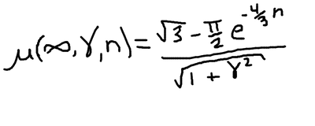
Problem
\mu ( \infty , \gamma , n ) = \frac { \sqrt { 3 } - \frac { \pi } { 2 } e ^ { - \frac { 4 } { 3 } n } } { \sqrt { 1 + \gamma ^ { 2 } } } \ .

Slide 3

Problem Formulation
Setup:
x is an image from space X
y is a sequence of tokens from space Y
Goal:
minimize the 0/1 loss
Contraint:
f belongs to our neural network function class

Slide 4
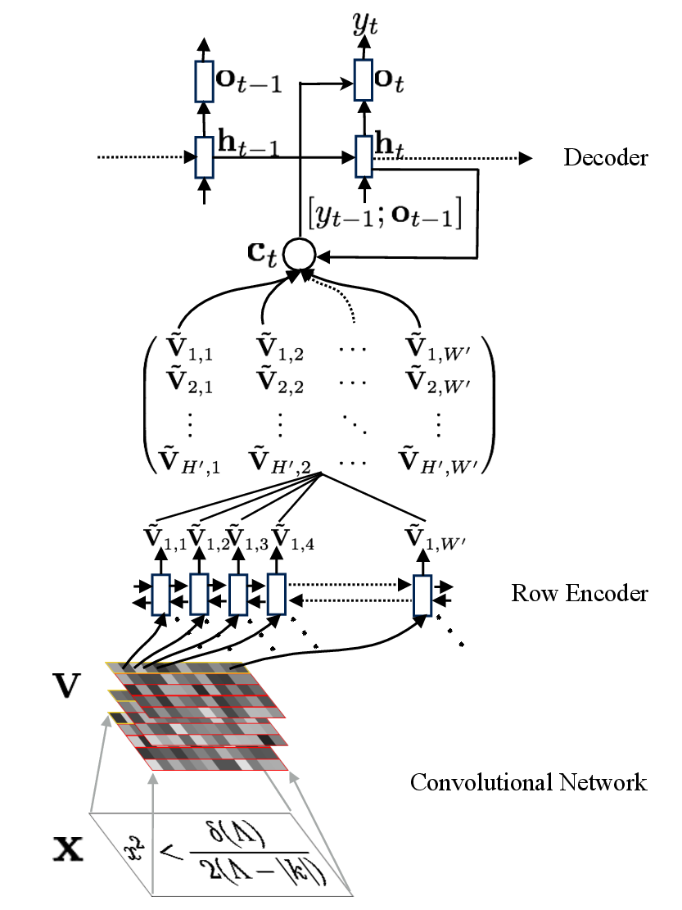
Model

Slide 5
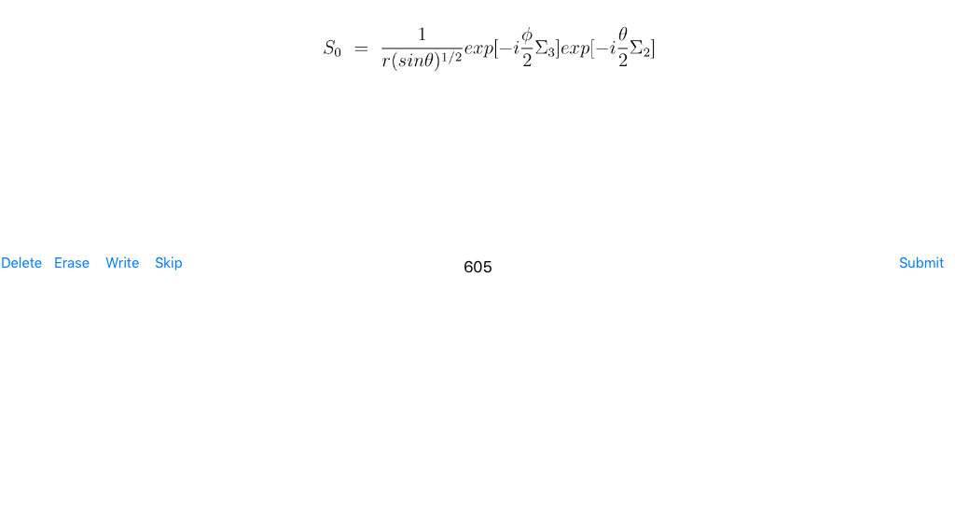
Data
Im2latex dataset
Created iPad app to gather own data

Slide 6
Preprocessing
Truncating images
Batching images together by size
Normalizing LaTeX labels
E.g. x^2_i -> x_i^2
Finding all the tokens for the “LaTeX alphabet” and removing the very rare ones

Slide 7
Results
20+ hours of training on AWS EC2 instance
Approximately 25% accuracy rate
Small sample size
OCR methods get 95%
im2latex gets 75%
Peculiar behaviour of predicting the same thing repeatedly

Slide 8
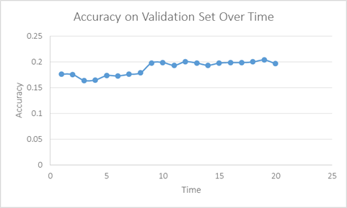
Conclusion
Need more data
Alter the loss function
Train for longer

