Slide 1
IMPROVING CROSS-SECTIONAL MOMENTUM: Residual Momentum and Volatility Targeting
FINANCIAL MARKETS ANALYTICS - A.Y. 2025-2026
Can plain cross-sectional momentum be improved by reducing:
systematic factor exposure;
momentum crash risk?

Slide 2

Motivations: Why Plain Momentum Needs Improvement
PLAIN MOMENTUM IS SIMPLE AND WELL-KNOWN:
buy recent winners
short recent losers
exploit return continuation
BUT IT HAS TWO MAIN WEAKNESSES:
exposure to common risk factors
severe loss during momentum crashes
GOAL OF THE PROJECT:
Test wheter refined momentum strategies improve the risk profile of plain momentum

Slide 3

DATASET AND DATA AUDIT
DATASET
S&P 500 Securities
Monthly price data
Sample period: December 1990 - November 2018
Price matrix: 336 monthly observations and 1355 securities
Average active securities: approximately 501.
Important choice
The investable universe is defined using historical S&P 500 weights, not only price availability.

Slide 4

Cleaning Issues: Stale Prices and Duplicate Securities
Main data issues identified
663 stocks show suspected post-exit stale prices
Stale price rule: at least 6 consecutive months of zero log-returns after index exit
170 normalized company names are linked to more than one ticker historically
10 companies have simultaneous duplicate active securities
Backtest decision
Use historical weights to identify active constituents
Keep the analysis at security level
Report duplicates as a limitation

Slide 5

PLAIN 12-1 Cross-Sectional Momentum Baseline
Momentum signal: M(i,t) = P(i,t−1) / P(i,t−12) − 1
Skip the most recent month.
Rank all eligible stocks cross-sectionally.
Long top 10% winners.
Short bottom 10% losers.
Equal-weighted long-short portfolio.
Role in the project
plain momentum is the benchmark strategy to improve.

Slide 6

FF5 RESIDUAL MOMENTUM
Objective
Reduce exposure to systematic risk factors.
Method
Estimate rolling Fama-French 5-factor regressions.
Rolling window: 36 months.
Minimum observations: 24.
Extract residual returns.
Compute residual momentum signal:
Residual momentum signal: M_RES(i,t) = mean residuals / residual volatility
Interpretation
Momentum is computed on stock-specific residual performance, not on raw returns.

Slide 7
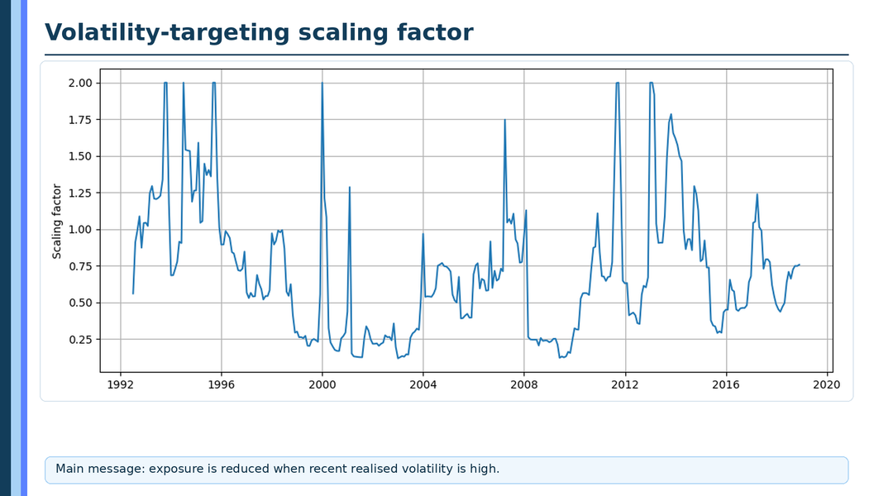

VOLATILITY-TARGETED MOMENTUM
OBJECTIVE
Reduce momentum crash risk.
Method
Keep the plain momentum signal unchanged.
Estimate trailing 6-month realized volatility.
Scale exposure toward a 10% annual volatility target.
Two versions tested
Standard volatility targeting with maximum leverage of 2.0.
No-leverage volatility targeting with exposure capped at 1.0.
Preferred version
The no-leverage version is more consistent with crash protection.

Slide 8

Combined Strategy
Combined refinement
FF5 residual momentum + no-leverage volatility targeting.
Why combine them?
Residual momentum addresses factor exposure.
Volatility targeting addresses crash risk.
No-leverage cap avoids increasing exposure before sudden crashes.
Final comparison sample
June 1994 – November 2018.
294 monthly observations.

Slide 9
PERFORMANCE COMPARISON
Final strategy comparison
Strategy | Ann. Return | CAGR | Ann. Volatility
Plain MOM | 2.59% | -2.47% | 29.82%
FF5 Residual MOM | -1.34% | -2.54% | 15.56%
Plain MOM VT No-Lev | 2.04% | 0.54% | 16.21%
Combined Residual + VT | 0.17% | -0.37% | 10.44%
Main message
The refined strategies do not clearly dominate in terms of return, but they substantially reduce risk.

Slide 10
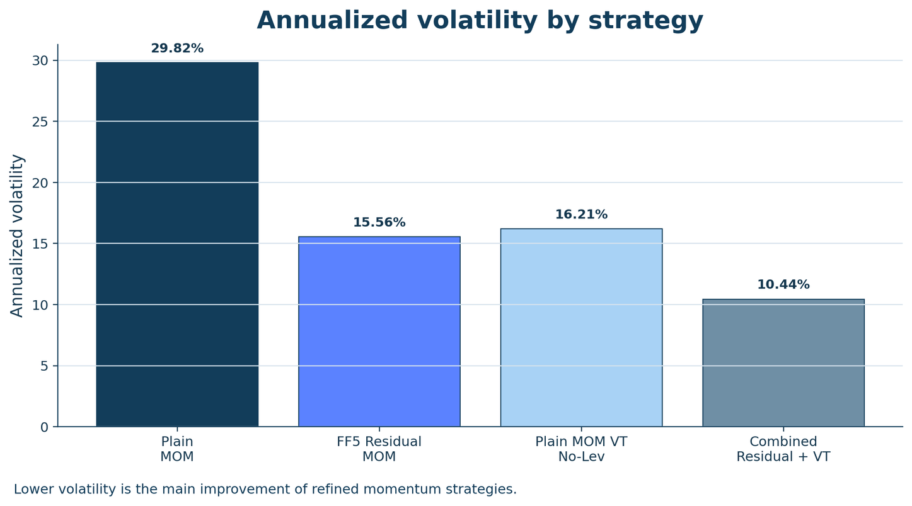
PERFORMANCE COMPARISON
Volatility bar chart
The refined strategies do not clearly dominate in terms of return, but they substantially reduce risk.

Slide 11

Crash - Risk Comparison
Final strategy comparison
Strategy | Max Drawdown | Worst 1M | Worst 3M
Plain MOM | -82.47% | -47.30% | -66.33%
FF5 Residual MOM | -67.76% | -19.83% | -31.60%
Plain MOM VT No-Lev | -54.36% | -45.56% | -45.32%
Combined Residual + VT | -42.79% | -9.48% | -13.14%
Main message:
The combined strategy has the most defensive crash-risk profile.

Slide 12
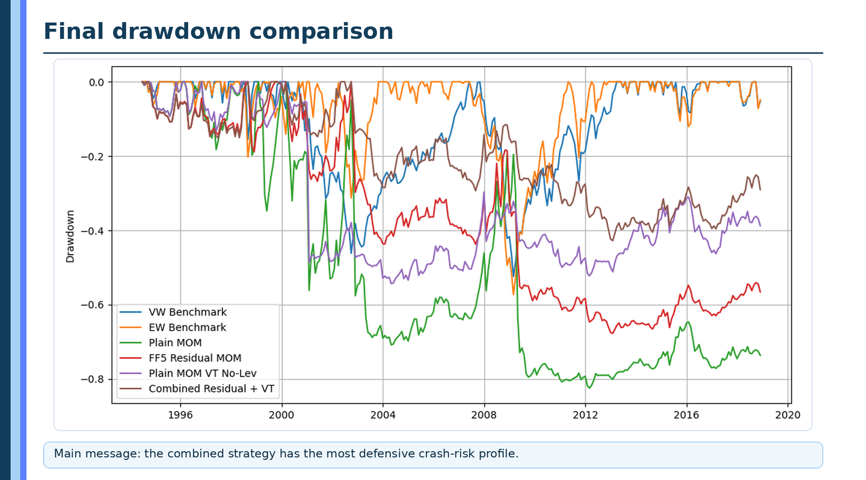
Crash - Risk Comparison
Final strategy comparison
Main message:
The combined strategy has the most defensive crash-risk profile.

Slide 13
Factor Exposure Analysis
FF5 regression result
Strategy | Market Beta | FF5 R²
Plain MOM | -0.649 | 0.211
FF5 Residual MOM | -0.338 | 0.130
Combined Residual + VT | -0.185 | 0.110
Interpretation
Residualisation reduces factor exposure: from -0.649 to -0.338
The combined strategy has the lowest absolute market beta: - 0.185.
FF5 R² decreases after residualisation.
Alpha evidence is not statistically strong.
Main message
The improvement is mainly risk-based, not alpha-based.

Slide 14
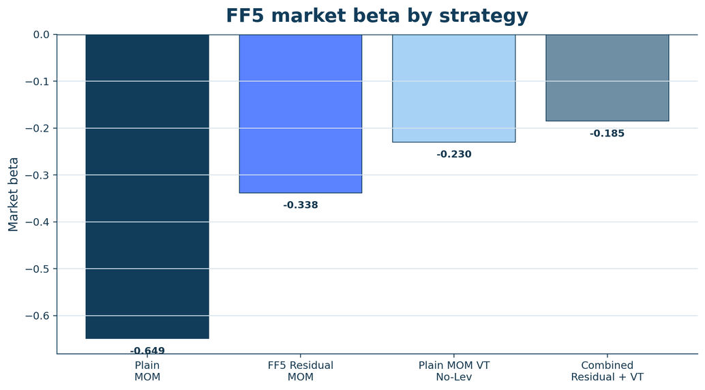
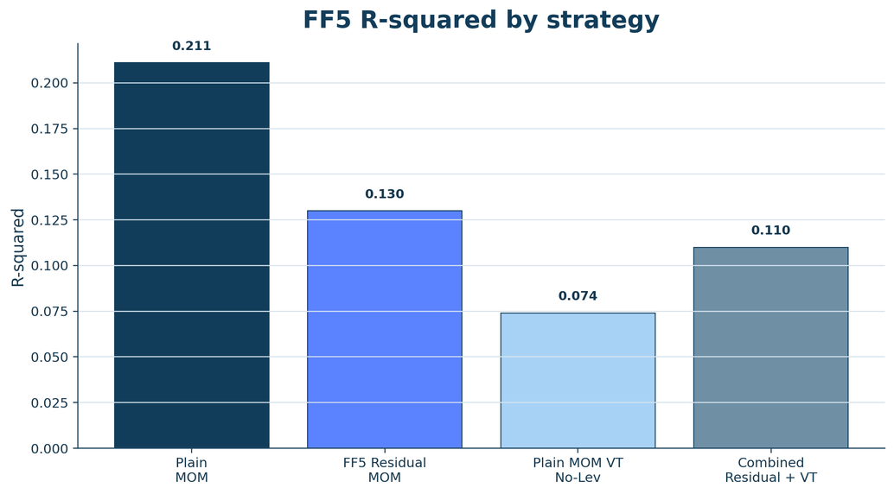
Factor Exposure Analysis
Main message
Residualisation reduces factor exposure, while alpha evidence is not statistically strong.

Slide 15
Main Findings, Limitations and Conclusion
Main findings
Plain momentum shows severe crash risk.
FF5 residual momentum reduces factor exposure.
No-leverage volatility targeting reduces volatility and drawdowns.
The combined strategy has the most defensive risk profile.
Limitations
Results are sample-specific.
Monthly S&P 500 data only.
Duplicate securities are reported but not manually consolidated.
Transaction costs are not explicitly modelled.
Conclusion
Residualisation and volatility targeting are more effective at improving the risk profile of momentum than at generating clearly superior abnormal returns.

Slide 16

Thank You!

