Slide 1
BYO-ASM
Building an Attack Surface Management
Platform
Using Open Source to identify what an attacker is likely to exploit

Slide 2
Disclaimer, whoami, repo
ALL OPINIONS ARE MY OWN AND DO NOT REPRESENT ANY ORGANIZATION I’M RELATED
@heryxpc - everywhere (no OSINT needed)
Demo and slides:
https://github.com/heryxpc/byo-asm-recon

Slide 3

Agenda
What is Attack Surface Management?
How to implement Attack Surface Management?
Demo: EASM tools
Cloud Recon on ASM
Demo: CloudQuery
Demo: Cartography and NeoDash
Mixing ASM and Vulnerability Management
Demo: Visualize your attack surface
Automation and next steps

Slide 4
What is Attack Surface Management
Attack Surface Management (ASM) is the process to identify and manage the sum of all places an attacker can...ATTACK.
This can be a network, a system, a web app or any other IT infra (or humans behind it...).
Google-it: https://letmegooglethat.com/?q=attack+surface+management
YouTube-it: https://www.youtube.com/results?search_query=attack+surface+management

Slide 5


Why doing so?
Because someone else will do it...
  Threat Actors, Bounty Hunters, etc.
To know what is (NOT) protected
  Do you know what you don't know?
To prioritize security efforts
  You can't tackle everything, focus on the highest impact/likelihood = risk

Slide 6
How to implement Attack Surface Management
Discovery/Recon: Find all the assets you own
Inventory: Keep an updated asset DB
Prioritize: Define what is critical and what is not
Protect: Apply security controls
Monitor: Repeat all over again
The magic recipe or silver bullet
Spoiler: doesn’t exists

Slide 7
The choosing your vendor problem
Each focus/strength is on different places
  Specific Cloud Provider/Technology Stack
  Asset Discovery (e.g. Shadow IT)
  Threat Intelligence
  Vulnerability Management
  Data Enrichment
  Monitoring
Might be expensive
  By Organization Size
  By Business Model
  Due to Infrastructure Requirements
LOTS OF VENDORS: https://github.com/someengineering/cloud-security-list?tab=readme-ov-file

Slide 8
DIY, YOU LAZY HACKER!
THIS TALK IS NOT ABOUT PROMOTING VENDORS
IT’S ABOUT USING OPEN SOURCE TO PERFORM ATTACK SURFACE MANAGEMENT

Slide 9
The right tool for the right job
The tools landscape is huge as well:
Web Recon: subfinder, amass, etc.
Cloud Recon: CloudQuery, Cartography, etc.
Network Recon: nmap, masscan, etc.
Vulnerability Scanning: OpenVAS, Nessus, etc.
Container Scanning: Clair, Trivy, etc.
Git scanning: trufflehog, gitrob, etc.
How to do it right then?
* Choose your initial focus (Web, Cloud, Network)
* Set a minimal scope (e.g. one AWS accounts, one root domain)
* Automate as much as possible
* Iterate all over again

Slide 10
[DEMO] External Attack Surface Management
Notes:
Show small demo of Shodan API script
Local script filtering by keyword
Local script filtering by SSL certs based on org
Show CSV file at Google Sheets
Present https://github.com/g0ldencybersec/EasyEASM
Docker image running EasyEASM
Present quickly the config used for pasive enumeration
Present quickly the config used for complete enumeration
Show notifications integration with Slack

Slide 11

Cloud Recon for ASM
Cloud Infra ~= Network + Data + Access
What discovering infra can help you with?
Find misconfigurations
Detect open ports
Identify publicly exposed data (S3, etc.)
Perform Drift Detection
Correlate infrastructure
Multiple providers: AWS, Azure, GCP
Services: EC2, S3, RDS, etc.
Configuration: IAM, VPC, etc.

Slide 12
[DEMO] CloudQuery + Grafana
Notes:
Present CloudQuery project
Show the GitHub repo: https://github.com/cloudquery/cloudquery
Run the CloudQuery, Postgress and Grafana Docker images
Run the sync command
Show sample grafana dashboards: AWS Asset Inventory, EC2 instances, Security policies, Open Ports
Show sample queries in Grafana
Show sample queries for security aspects from https://github.com/cloudquery/cloudquery/tree/main/plugins/source/aws/policies_v1/foundational_security

Slide 13
[DEMO] Cartography + NeoDash
Notes:
Present Cartography project
Show the GitHub repo:https://github.com/lyft/cartography
Run the Neo4j, Cartography and NeoDash Docker images
Run AWS sync intel module
Spin up previously saved Neo4j and NeoDash Graph DB
Show table with EC2 instances and AMIs
Show table with IAM access
Show table with S3 buckets and permissions
Show graph of Github repositories

Slide 14
Mixing ASM and Vulnerability Management
You mapped all your assets: now what?
Generate alerts based on configuration changes (Drift Detection)
Find the path an attacker would take
Identify highests risk assets (e.g. public facing, PII access, etc.)
Identify Vulnerabilities in your assets

Slide 15
[DEMO] Visualize Your Attack Surface with risks
Notes:
Demo Visualize your attack surface
Load previously prepared Neo4j and NeoDash Graphs with obfuscated data
Show the GitHub to Semgrep finding dashboard
Show the domain to Service and ECR image dashboard
Show the EC2 to vulnerabilities dashboard

Slide 16

Next steps - Automation
External attackers are running automated recon
  BUT, only external surface.
Red/Purple/Blue Teams can automate recon
  AND, access internal information.
Perform continuous recon
  Automate discovery
Perform vulnerability scanning
  Automate scanning
Create alerts for critical assets/vulnerabilities (Monitoring)
Automate remediation process
Automate reporting process

Slide 17
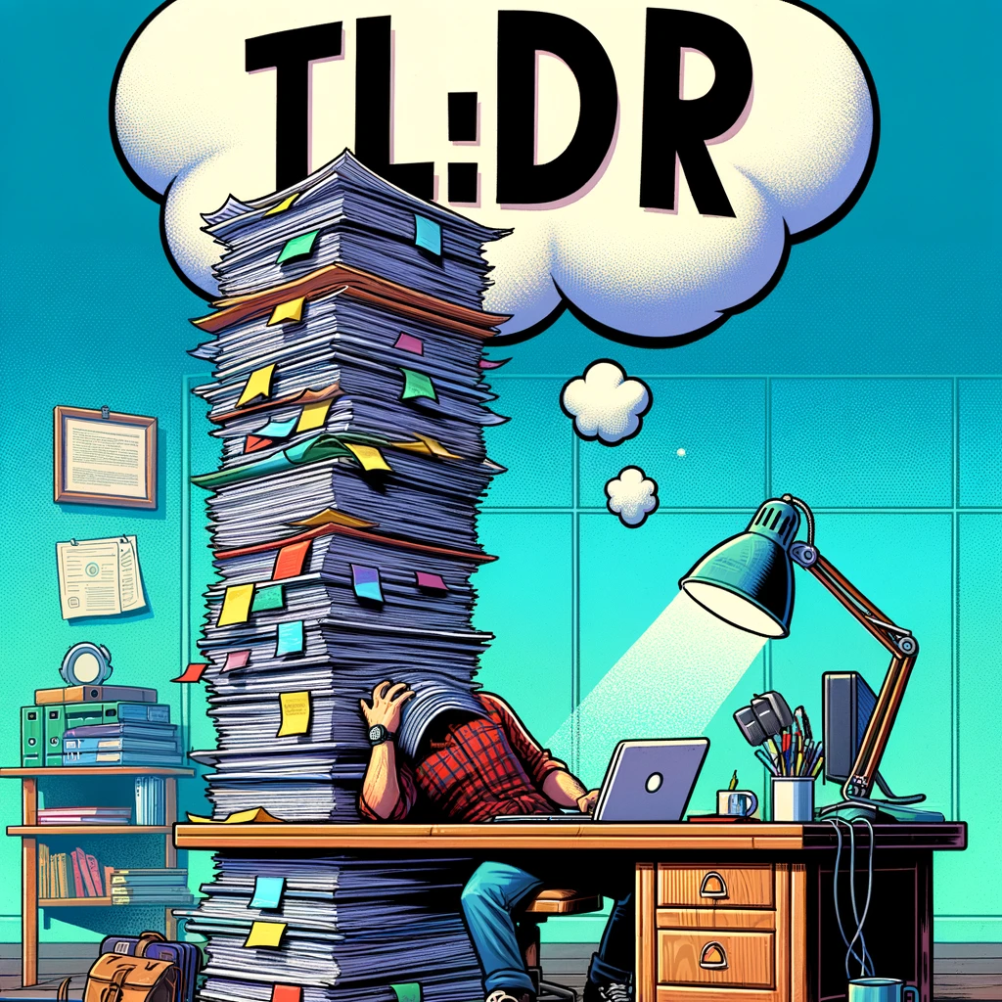
ASM reduces the unknowns
  Updated Asset Inventory
Enables regular Vulnerability Reporting
Helpful during Incident Response
There is no silver bullet
If you can pay for it:
  Understand what you are paying for
  Consider the limitations
  You still need to build a pipeline
If you can build it:
  Build first a capable team
  Understand the tools you are using
  Balance the building vs buying cost

