Slide 1
PERFORMANCE
Entity Framework vs Dapper vs ADO.NET
By Valerii Nahaienko

Slide 2
Factors that affect performance
Object to SQL execution time
How long will be generating from object model to SQL query
SQL to object execution time
How long will be mapping from table data to object model
Generated query
What SQL will be generated (time executing in database, result data size…)

Slide 3
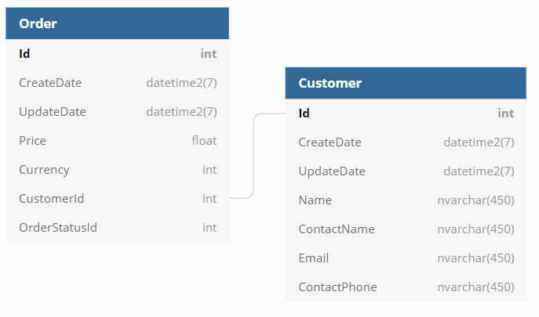
Scheme of tables

Slide 4
SELECT

Slide 5
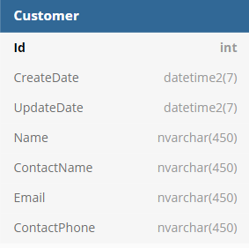
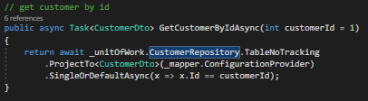
Select customer
Select customer by id

Slide 6
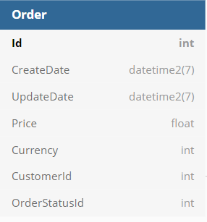
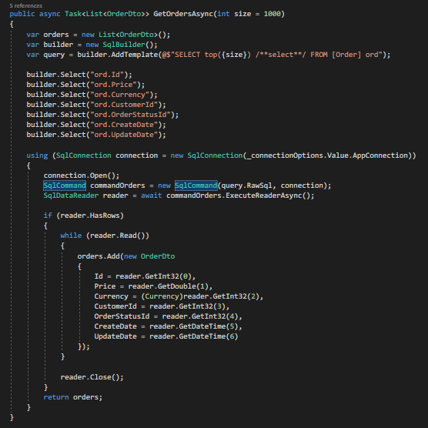
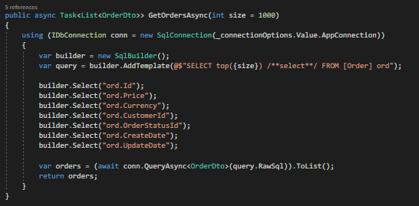
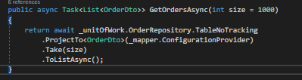
Select orders
Select 10000 orders

Slide 7
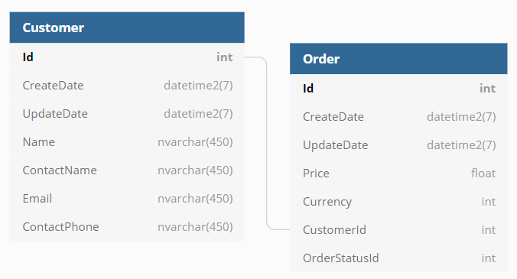
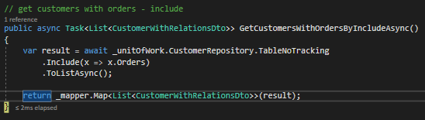
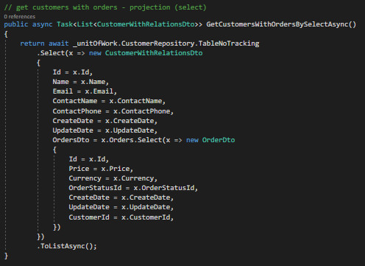
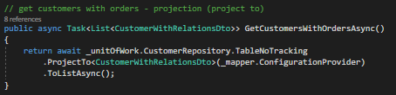

Select customers with orders
Select 100 customers join 100 orders per customer (10 000 rows)

Slide 8
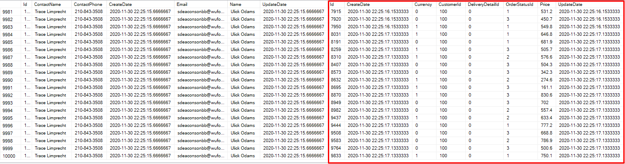
Query result
Select 100 customers join 100 orders per customer (10 000 rows) query result

Slide 9
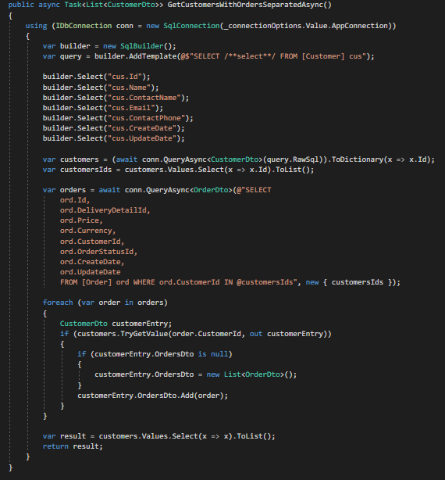
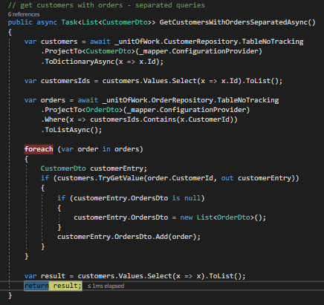
Select customers with orders
Select 100 customers with 100 orders per customer (10 000 rows) by separated queries

Slide 10

CUD

Slide 11
CUD operations with customer

Slide 12
Conslution
In average EF is 2 times slower in select, 6 times slower in insert and 4 times slower in the update than Dapper
In most cases, there is no significant difference in efficiency between dapper and ado
There is no best tool, the choice always depends on the situation

Slide 13
Thank You

